Slide 1

CDBG Grant Administration
Wednesday, October 18, 2023

Slide 2
CDBG Grant Administration
Award to Grant Agreement
Wendy Bell

Slide 3
Grant Accountability & Transparency Act
The post-award process is driven by the Grant Accountability and Transparency Act (GATA)
  Formulated in 2010
  Based on 2 CFR 200 (same as CDBG/all federal funds)
  The purpose of GATA is to provide for the development of a coordinated, non-redundant process for the provision of effective and efficient oversight of the selection and monitoring of grant recipients, ensuring quality programs, limiting fraud, waste and abuse, and defining the purpose, scope, applicability and responsibilities in the life cycle of a grant.
Formulated in 2010
Based on 2 CFR 200
The purpose of

Slide 4
Video Training & Resources
Video Training & Resources (illinois.gov)
https://dceo.illinois.gov/aboutdceo/grantopportunities/learning-library.html

Slide 5
Notice of State Award Finalist (NOSAF)
  PRA Programmatic Risk Assessment
    Review by Program Manager of Grantee’s financial and program performance requirements
  Environmental Review Requirements
  Confirmation of Competitive Procurement for Activity Delivery
  Copy of Executed Contract for Activity Delivery
  Letter to U.S. Representatives & Senators
  Other Special Grant Conditions
Formulated in 2010
Based on 2 CFR 200
The purpose of

Slide 6
Notice of State Award Finalist (NOSA)
Issued AFTER all conditions of the NOSAF are met.
  Created by grant manager and approved by Deputy Director
  The Grantee will receive a system-generated email that the NOSA is ready for acceptance
  The Administrator should be listed in the Grantee’s record as a contact
  The Grantee must accept the NOSA
Formulated in 2010
Based on 2 CFR 200
The purpose of

Slide 7
Indirect Cost Selection
After acceptance of the NOSA
  New Grantees will receive an email invitation to select an indirect cost rate.
  Previous system, known as CARS, has been updated to the GATA Centralized Indirect Cost Rate System
  Selection made once, not annually
  Video for the process:
  https://illinois2.webex.com/recordingservice/sites/illinois2/recording/6ded53d0292b4a5cac585a00f0042353/playback

Slide 8
Grant Agreement
  After NOSA accepted
  After CARS submission
  Review the Grant Agreement
    Exhibits
    Budget Certification
  Signed by Authorized Official and designee, if applicable
  Return entire signed agreement and budget to grant manager

Slide 9
CDBG Grant Administration
Post Grant Agreement – Housing Rehabilitation
Kara Cozadd

Slide 10
Housing Rehabilitation Specific
After Executed Grant Agreement
  Potential applicant and contractor solicitation
    An invitation to apply must be distributed. A notice in the local paper and letters to households in the project area must state the place and times staff will be available to assist with the application process.
    Administrative staff should have a local presence and provide adequate time for all households in the project area to apply for assistance.
    The contractor ad should specify pre-qualified requirements and contact information to obtain contract application

Slide 11
Housing Rehabilitation Specific
Eligibility Requirements for Housing Rehab Recipients
  Single-Family, Owner-Occupied-proof of ownership, homeowner insurance. Must be reverified prior to rehab construction.
  Income Eligible-verification of all persons in the household the age of 18 and older. Must be re-verified prior to rehab construction.
    Use form (update income chart annually)
    https://www.hudexchange.info/incomecalculator
    https://www.hudexchange.info/incomecalculator/

Slide 12
Housing Rehabilitation Specific
  Prioritization of Housing Applicants
Once all households in the project area have had the opportunity to apply, prioritization must be given to:
- Very Low income
- Elderly and Handicapped Households
- 51% of points must be given to the above criteria
As soon as an applicant is eligible to participate in the program, take photos of home and send information to DNR/IHPA for clearance and start of Tier 2 process.

Slide 13
CDBG Grant Administration
Environmental Record Review Brief Refresher & Updates
Kirk Kumerow

Slide 14
DCEO OCD Environmental Materials Website
https://dceo.illinois.gov/communitydevelopment/environmentalmaterials.html
Your primary source for CDBG Environmental Record Review (ERR) guidance; forms; samples
Is updated when HUD or DCEO changes ERR forms

Slide 15
24 CFR Part 58
Entities Assuming HUD’s Environmental Review Responsibilities
DCEO’s ERR Mission:
To not return CDBG funds to HUD for lack of proper environmental review.

Slide 16
NEPA Assumption Authority under Part 58 [§58.4]
Responsible Entities (REs) assume HUD’s NEPA responsibilities
  Unit of General Local Government (UGLG)
Serve as the Federal Agency on behalf of HUD
RE assumes responsibility for:
  Environmental Review
  Environmental Decision-making
  Environmental Action that would apply to HUD under NEPA and related laws

Slide 17
NEPA Assumption Authority under Part 58 [§58.4]
Assumed by execution of grant agreement (as HUD subrecipient) and/or by certification of the RROF
Responsibility cannot be delegated
Responsibility to ensure mitigation is incorporated into project plans and contracts, and implemented

Slide 18
Certifying Officer
Responsible Federal Official under Section 102 of NEPA and related statutes
Chief Elected Official of CDBG Grantee Community
Authorized to execute the RROF
Accepts jurisdiction of Federal Courts for RE
Has the authority to enter into binding commitment in response to court judgements

Slide 19
58.22 Limitation of Action
Prior to environmental approval/clearance, the RE may not:
  Commit HUD funds
  Begin bid process, or
  Commit non-HUD funds where the activity would
    Have an adverse environmental impact or
    Limit the choice of reasonable alternatives
    Do not take action before environmental clearance!!

Slide 20
Levels of Environmental Record Review

Slide 21
EXEMPT
CATEGORICALLY EXCLUDED NOT SUBJECT TO §58.5 (CENST)
CATEGORICALLY EXCLUDED SUBJECT TO §58.5 (CEST)
ENVIRONMENTAL ASSESSMENT (EA)
ENVIRONMENTAL IMPACT STATEMENT (Rare for IL CDBG)

Slide 22
Typical ERR Preparation and Approval Timelines
EIS – one to two years
EA – 45 to 100 days to complete depending on consultations required
CEST – 30 to 75 days depending on consultations required
CENST – less than an hour
Exempt & CoC – less than an hour

Slide 23
Cat Ex SUBJECT to 58.5 [§58.35(a)]
Most Common For DCEO CDBG:
Acquisition, repair, improvement, reconstruction or rehabilitation of public facilities and improvements when the facilities and improvements are:
  Already in place
  Retained for the same use
  3. Without change in size or capacity by more than 20%
(e.g., HR; Replacement of water or sewer lines or lift or pump stations in place; Sewer re-lining)

Slide 24
CEST converts to EXEMPT
Complete Statutory Worksheet with all supporting documentation
  “All No’s” for 16 bodies of law
  No circumstances requiring formal compliance/mitigation
Document the file and proceed with project once DCEO approves

Slide 25
CEST cannot convert to EXEMPT
Complete Statutory Worksheet with all supporting documentation
  Requires one or more formal mitigation(s) or further compliance action(s)
Proceed with approval process
  NOI/RROF publication/posting
  RROF (HUD Form 7015.15)
  DCEO Env. Release Letter

Slide 26
Environmental Assessment [§58.36]
Any project not Exempt or Categorically Excluded, and does not meet EIS thresholds. Some IL CDBG examples:
Extension of water or sewer lines to an unserved area
Water tower – additional or replacement

Slide 27
Environmental Assessment [§58.36]
The purpose is to evaluate the project as a whole
Determine existing conditions and trends
Identify all impacts (direct, indirect, cumulative)
Examine and recommend feasible ways to eliminate or minimize adverse environmental impacts
Examine alternatives to project itself, if applicable

Slide 28
Environmental Assessment [§58.36]
Use Environmental Assessment (EA) format provided on DCEO OCD Environmental Materials Website that follows §58.40
  Includes 16 Compliance Factors, 20 Environmental Assessment Factors and all supporting documentation indicating a Finding of No Significant Impact (FONSI)
  Sign and date (by preparer and CEO)

Slide 29
Environmental Assessment [§58.36]
  FONSI and NOI/RROF publication/posting (& dissemination)
  RROF (HUD Form 7015.15)
  DCEO Env. Release Letter

Slide 30
New Environmental Assessment (EA-ER) Form
Starting with Environmental Assessments (EA-ER) submitted on or after February 1st, 2023, formatting must use new version from HUD containing 20 (up from 18) Environmental Assessment Factors (EAF’s),
New Environmental Assessment Factors (EAF’s) are:
Climate Change Impacts
Energy Efficiency
Required by Presidential Executive Order (E.O.) 14008 –
“Tackling the Climate Crisis at Home and Abroad”

Slide 31
Environmental Assessment (EA-ER) Form
The HUD Exchange Website for guidance in documenting Environmental Assessment Factors and their Categories is:
https://www.hudexchange.info/programs/environmental-review/environmental-assessment/

Slide 32
CDBG PI & ED-PI Highlights to Avoid ERR Cancellation
US EPA EJScreen (https://www.epa.gov/ejscreen) to document “Environmental Justice” must not be researched and printed until all 15 other bodies of environmental law have been documented – That is a HUD OEE Mandate!!!!
Chief Elected Official of CDBG Grantee Community is the RE signatory

Slide 33
CDBG PI & ED-PI Highlights to Avoid ERR Cancellation
Always allow at least one full calendar day between ERR prep activities (i.e., between FP &/or WL 8-Step publications; between last of 15 bodies of law & EJScreen; between EJScreen & CEST or EA signature; between CEST or EA signature & FONSI/NOI/RROF or NOI/RROF publication; between end of publication comment period &
HUD 7015.15 RROF signature

Slide 34
CDBG PI & ED-PI Highlights to Avoid ERR Cancellation
The “On or about” date at the start of an NOI/RROF or FONSI/NOI/RROF publication must be dated at least one day later than the “comments received by” date stated in the publication.
Don’t count either publication date or “comments received by” date for days of local public comment period.

Slide 35
CDBG PI & ED-PI Highlights to Avoid ERR Cancellation
8-Step Flood Plain and/or Wetlands “Early” and “Final” public comment periods must have at least one full day between end of “Early” comment period and publication date of “Final” FP/WL Notice.
If 8-step is last supporting docs, wait one full day after “Final” comment period to research US EPA
EJScreen for Environmental Justice.

Slide 36
Example: 15-day Comment Period
S | M | T | W | T | F | S
 |  |  | 1 - Pub | 2 | 3 | 4
5 | 6 | 7 | 8 | 9 | 10 | 11
12 | 13 | 14 | 15 | 16 | 17 - RROF | 18
19 | 20 | 21 | 22 | 23 | 24 | 25
26 | 27 | 28 | 29 | 30 | 31
36
Notes:
36

Slide 37
Key Take-Aways
ERR prep errors, most commonly “dating” or “timing” related. Of the 27 ERR’s received for 30 PY’2021 CDBG PI Grant awards to date, 7 were cancelled and returned for correction and re-publication (25.9%). Remaining 3 are SHPO/THPO delayed.
Of the 34 PY’2020 CDBG PI ERR’s received, 4 were cancelled and returned for correction and re-publication (11.7%).

Slide 38
Key Take-Aways
Some of that 45% cancellation increase was granting more HUD OEE “teachable moments” to new ERR preparers in PY’2020 than PY’2021.
Most CDBG PI ERR Preparers now experienced
No HUD OEE “teachable moments” for PY’2022
CDBG PI ERR’s/ED-PI ERR’s.

Slide 39
Environmental Review
Housing Rehabilitation Specific
An Early Start is Important! Kara Cozadd submits packet to DNR/HP for Tier One SHPO clearance letter!
Avoids project delays and heads off potential conflicts
Procedural reasons:
  Grantee may not commit HUD funds on an activity prior to RROF approval and Grantee may not commit non-HUD funds prior to RROF approval if the activity or project would have an adverse enviro. impact or limit choice
  ERR must be submitted to DCEO ERO within 90 days of date of NOSAF, like any other Special Grant Condition specified in NOSAF
  Remember DNR/HP Tier One blanket clearance letter will only be found on their website! You must print and attach it to your Tier One packet that you send to Kara! She no longer receives a copy from DNR/HP!!
Re

Slide 40
State Historic Preservation Office Delays
When SHPO/IDNR is taking over 30 days to process Section 106 clearance requests for our projects, we consulted several years ago with HUD, our General Counsel and the IDNR Agency Director and instituted our new policy:
If it has been 45 days since you have sent proper Section 106 information to the SHPO for their initial review and have not received a response, please notify Kirk, Kara or Dave.
Once DCEO is notified, we will provide a waiver from SHPO clearance.
This DCEO waiver letter will be utilized in the ERR in place of the SHPO’s Section 106 clearance letter.
If the SHPO re-enters the review after DCEO’s waiver letter, the community has no obligation to comply.
This policy does not eliminate the need for HUD Tribal consultation.

Slide 41
State Historic Preservation Office (SHPO)
State Historic Preservation Office (SHPO)/IDNR
1 Old State Capitol Plaza, Springfield, IL 62702-1271
217-782-4836
https://www2.Illinois.gov/dnrhistoric/pages/default.aspx
https://www2.illinois.gov/dnrhistoric/Pages/default.aspx

Slide 42
Housing Rehabilitation Specific
Costs of Performing the Review [§58.23]
  If Activity Delivery (AD) is budgeted, Grantee may reimburse ERR prep costs from AD
  If a formal mitigation cost is incurred during ERR prep (e.g., an IDNR Incidental Take Authorization for Illinois Chorus Frog or Franklin’s Ground Squirrel, or a Phase I ASTM for ED project), Grantee may reimburse from Construction or Housing Rehab funds (as applicable)

Slide 43
Housing Rehabilitation Specific
Who Does What
  Must use an experienced Environmental specialist (Guidebook, Section II)
  Specialist may prepare supporting documentation
  RE’s must independently evaluate their work and prepare the environmental review itself (i.e., CEO signature on HUD/DCEO ERR forms)
  Correspondence to interested tribes and public Notices must be sent under the RE’s signature and on its letterhead
  Specialist should never address Tribes directly (i.e., Grantee letterhead/CEO signature)
  Specialist should not sign or address public Notices

Slide 44
Housing Rehabilitation Specific
Tiered Review [§58.15] CDBG HR
Begin CDBG HR review when NOSAF issued
Project area identified, but specific addresses unknown
TWO STEP PROCESS
  Tier 1: CEST project area-wide review
  Tier 2: CEST home-specific review
Best suited for CEST projects such as scattered site single family
HR Tiered CEST projects CANNOT convert to exempt!
  There will always be NOI/RROF publication/posting for Tier 1

Slide 45
Housing Rehabilitation Specific
Tiered Review
Tier 1
Area-wide (addresses unknown)
  A reasonable geographic area (i.e., the application’s project area)
Answers as many factors in the environmental review as feasible (for CDBG HR, 12 of 16 bodies of Federal environmental law)
Tier 2
Site-specific (now know home address)
This is separate ERR. Each home must have its own Tier 2 review complementing the Tier 1 review
Will cite the Tier 1 for all previously answered factors (12 of 16)
Will answer factors unanswered in Tier 1 requiring specific address (4 of 16)

Slide 46
Housing Rehabilitation Specific
Tier 1 12 Bodies of Law
Airport Hazards; Coastal Barriers, Flood Insurance; Clean Air; Coastal Zone; Endangered Species; Explosive & Flammable Hazards; Farmland Protection; Floodplain Management; Sole Source Aquifers; Wetlands Protection; & Wild and Scenic Rivers
Tier 2 4 Bodies of Law
Contamination & Toxic Substances
Historic Preservation
Noise Abatement & Control
Environmental Justice

Slide 47
Housing Rehabilitation Specific
HR Tiered Review: Do I Submit a RROF?
No! You cannot convert ANY tiered reviews to Exempt at the target area Tier 1 level!
This means you must:
  Publish/post NOI/RROF as appropriate, stating it is a tiered review and identifying what aspects of the review will be evaluated at each level (12 Tier 1 vs. 4 Tier 2)
  Submit Tier 1 CEST ERR with RROF to DCEO HR ERO for review
  Receive DCEO Tier 1 environmental release letter that will be contingent on complete Tier 2 reviews for each home being completed/DCEO-approved prior to award of a home’s housing rehab contract.

Slide 48
Housing Rehabilitation Draws
HR Tiered Review: When Do I Draw Funds?
For Activity Delivery and/or Rehabilitation Administration, you may draw AFTER DCEO approval of the target area Tier 1 CEST review and Grant Agreement is executed!
For an individual home’s Housing Rehabilitation, you may draw AFTER DCEO approval of that home’s individual Tier 2 CEST review, without having to publish/post, submit a new RROF, or receive a new environmental release letter (only email approval from DCEO HR ERO)

Slide 49
CDBG Environmental Review Officers (EROs)
For PI, ED-PI & ED:
Kirk Kumerow
217-558-4106
CEO.ERO@illinois.gov
For HR:
Kara Cozadd
217-558-2833
Kara.Cozadd@illinois.gov

Slide 50
CDBG Grant Administration
2 CFR 200 Procurement Standards
Covers Current CDBG-Eligible Activities (as of October 2023)
Kirk Kumerow

Slide 51
2 Code of Federal Regulations (CFR) 200
  Subtitle A, “Office of Management and Budget Guidance for Grants and Agreements” became effective as uniform Federal guidance on 12/26/2014;
  Originally Called OMB “Super Circular” in 2011;
  Launched by Obama administration to streamline guidance for federal awards to ease the administrative burden and costs
  across Federal agencies’ funding programs.

Slide 52
2 CFR 200.317-.326 Procurement Standards
§200.317 Procurements by states
§200.318 General procurement standards
§200.319 Competition
§200.320 Methods of procurement to be followed
§200.321 Contracting with MBE, et. al.
§200.322 Procurement of recovered materials
§200.323 Contract cost and price
§200.324 Federal agency or pass-through entity review
§200.325 Bonding requirements
§200.326 Contract provisions

Slide 53
2 CFR 200.318 General Procurement Standards
Use local procedures if conform with federal law
Maintain contractor oversight
Maintain written standards of conduct for all employees
Use most economical approach
Use intergovernmental or inter-entity agreements
Use federal excess/surplus property
Use value engineering
Use responsible contractors
Maintain procurement records
Use T&M contracts only if necessary
Local grantee responsible for all aspects of contract

Slide 54
2 CFR 200.319 Competition
Full, open and competitive procurement process
  No unreasonable requirements
  No unnecessary experience or bonding requirement
  No noncompetitive pricing among firms
  No noncompetitive retainer contracts
  No conflicts of interest
  No “brand name” requirement
  No arbitrary actions
No geographic preference
Must have written procedures
  Include technical description of work or product
  Include criteria for proposal evaluation
If pre-qualified lists are used, they must be current

Slide 55
2 CFR 200.320 Methods of Competition - CDBG
Procurement by micro-purchases – Rare for State CDBG
Procurement by small purchase procedures – CDBG AD/HR Admin/Rehab Inspection/ED A/E
Procurement by sealed bids (formal advertising) – All CDBG Construction
Procurement by competitive proposals – Only for ED A/E
(intentionally left blank)
Procurement by noncompetitive proposals – Generally not for State CDBG

Slide 56
Micro-Purchases & Small Purchase Procedures
Procurement by micro-purchase ($10,000 or less; $2,000 or less for Construction)
Procurement by small purchase procedures (Less than $250,000 anticipated cost)
May be used for activity delivery, rehabilitation administration or inspection, or ED A/E services
Phone, mail or e-mail solicitation acceptable (document efforts)
Solicit at least three potential qualified bidders
Make bid packet available for pick up, mailing or e-mailing
No less than two bidders (if one bidder; document reason)
vi. A/E services may include price as a factor,
but not the sole factor

Slide 57
Small Purchase Procedures (Cont.)
2 CFR 200 encourages use of shared resources:
State CDBG Activity Delivery/HR Administration/Rehab Inspection may be obtained from an Intergovernmental Agreement Agency or Inter-Entity Agreement Agency without SPP bidding process.

Slide 58
Procurement by Sealed Bids (Formal Advertising)
Procurement of CDBG or “other-funded” construction above $2000 listed in a Grant Agreement must be by sealed bids (formal advertising)

Slide 59
Procurement by Sealed Bids (Formal Advertising)
Procurement by sealed bids (formal advertising)
  Proposals must have:
    Detailed description
    Two or more responsible bidders
    Require a firm, fixed price offer

Slide 60
Procurement by Sealed Bids (Formal Advertising)
  2) Bidding requirements:
    Publicly advertised with sufficient notice
    Sufficient specifications
    Public bid opening
    Contract to lowest responsible qualified bidder
    Reject bids only for sound reason

Slide 61
2 CFR §200.321 Contracting with MBE, et. al.
Must take steps to assure that MBE & WBE are used
Affirmative steps must include:
  Placing qualified MBE and WBE on solicitation lists
  Assuring MBE and WBE are solicited
  Divide task to permit maximum participation
  Establish schedule to permit maximum participation
  Use SBA and MBDA of US Dept. of Commerce
  Require prime contractor to use items
  1 through 5

Slide 62
2 CFR §200.324 Contract Cost and Price
Price analysis for contract and modifications
Profit calculation for contracts with no price competition
Estimated cost contract – Subpart E-Cost Principles
Cost-plus contracts are not allowed

Slide 63
2 CFR §200.325 HUD or DCEO Review
Must make specifications available to DCEO
Must make RFP, invitation to bid, et. al. available when:
  Vary from 2 CFR 200 standards
  Only one bid/response
  “Brand name” product
  Award to non-low bidder
  Contract is above Simplified Acquisition Threshold (for non-construction contracts)
Exemption from pre-procurement review

Slide 64
2 CFR §200.326 Bonding Requirements
Applies to construction or facility improvement contracts
Bid bond of 5% of bid
Performance bond of 100% of the contract price
Payment bond of 100% of the contract price
Copies of bonds must be maintained in grant administrator’s files, available to CDBG monitor before monitoring visit

Slide 65
2 CFR §200.326 Contract Provisions
State CDBG-specific language available on DCEO OCD Labor Standards Materials website:
https://dceo.illinois.gov/communitydevelopment/davisbaconresources.html

Slide 66
2 CFR 200 CDBG Procurement Questions
Contact your grant’s assigned CDBG Grant Manager.
They’ll ask Program Manager and/or Labor Standards Officer for assistance, if needed. Trust me. They will ask.

Slide 67
Build America Buy America - BABA
BAP will apply to… | Iron and Steel | Specifically Listed Construction Materials | All Other Construction Materials | Manufactured Products
CDBG Formula Grants | All funds obligated on or after November 15, 2022 | As of the date HUD obligates new FFA from FY24 appropriations | As of the date HUD obligates new FFA from FY25 appropriations | As of the date HUD obligates new FFA from FY25 appropriations
 | Grants Awarded in 2024 | Grants Awarded in 2024 | Grants Awarded in 2025 | Grants Awarded in 2025

Slide 68
CDBG Grant Administration
Compliance
Federal Labor Standards
JoLaine Miner

Slide 69
Federal Labor Standards
Any construction contract over $2,000, funded in whole or in part with CDBG funds, is subject to Federal Labor Standards
Assign someone the responsibility for assuring compliance
What are the Federal Labor Standards?
Copeland Anti-Kickback Act
Contract Work Hours & Safety Standards Act (CWHSSA)
Davis-Bacon Prevailing Wage Act

Slide 70
Federal Labor Standards
Copeland Anti-Kickback Act (40 USC 276c)
Prohibits employers from forcing employees to give up any part of their wages, except for authorized payroll deductions
Requires payrolls be certified

Slide 71
Federal Labor Standards
Contract Work Hours & Safety Standards Act (40 USC 327-330)
Laborers and mechanics must be paid time and one half for hours worked over 40 hours in one work week
Contractor liable for unpaid wages and liquidated damages.
Violation Penalty = $29 per day, per laborer/mechanic owed – issued by DOL.
Assures no laborer or mechanic be made to work in surroundings that are unsanitary, hazardous, or dangerous

Slide 72
Davis-Bacon Act Prevailing Wage Act
(29 CFR Part 1, 3, 5)
The Davis-Bacon Act requires the payment of prevailing wage rates (which are determined by the U.S. Department of Labor) to all laborers and mechanics on federally funded or assisted construction projects in excess of $2,000. Construction includes the alteration and/or repair, including painting and decorating of public buildings or public works. NEW RULE - Building or Work includes a portion of a building or work, or the installation of equipment or components into the building or work, as well as modern activities such as solar panels, wind turbines, broadband installation, etc.

Slide 73
Davis-Bacon Prevailing Wage Act
(29 CFR Part 1, 3, 5)
Laborers and mechanics must be paid at least once per work week
All laborers and mechanics must be paid federal prevailing wages for the work they are performing on the project
Only apprentices and trainees registered with the US Department of Labor may be paid less than the federal prevailing wage
Notes:
Laborers and mechanics must pe paid at least once per week and must be paid the federal prevailing wage for the work they are performing on the project.
Only apprentices and trainees registered with the US Dept of Labor may be paid less than the federal prevailing wage.

Slide 74
Davis-Bacon Act Prevailing Wage Act
(29 CFR Part 1, 3, 5)
Foremen/Supervisors are covered by Davis-Bacon (20% or more performing manual work)
Exclusions: Project Superintendents, administrative staff, executives, clerical.
Exemptions: Volunteers and Force Account Workers

Slide 75
Force Account Labor
Can be used on construction projects
  Only employees of units of local government
  Not employees of a water/sewer district
Additional help can be hired for the project
  Must be paid federal prevailing wage rates
Detailed payroll/activity reports for the employees working on the project.
Submit payrolls with the quarterly reports/cash requests to support the expenses.

Slide 76
Force Account Labor
Previous payrolls should be submitted to verify no changes have been made in the rate of pay for the subject workers.
Document equipment used, including when, where, and by whom (employees) during the construction project.
Construction management and employee supervision required.
Forms available. Email ceo.lso@illinois.gov

Slide 77
Labor Standards and Procurement
When is it acceptable to use the small purchase procedures for CDBG construction projects?
  When the total project is under $250,000
  With permission under special circumstances
  Only if under $2,000
  None of the above
Notes:
D – None of the above.
C – is wrong because if it were allowed, the Grantee would use the micro purchase procedures since $2,000 is under the micro-purchase threshold of $50,000.

Slide 78
Labor Standards and Procurement
All CDBG construction projects must go through a formal bidding process
  All projects subject to Davis Bacon must be competitively bid. Even if a construction contract is $250,000 or less and is part of a federally-funded project subject to Davis Bacon, the small purchase procedures may not be used.
  Bid packets must include:
    Federal Prevailing Wage Rates
    Federal Labor Standards Provision (HUD 4010)

Slide 79
Labor Standards and Procurement
  For projects with mixed sources of funding (utilizing both CDBG and state funding), HUD provided the following in its Handbook dated January 2023: “When a project has mixed sources of funding, the general rule is to follow the strictest of the regulations. Some states have laws that are similar to DBRA, which are sometimes referred to as ‘little Davis-Bacon’. In these situations, the strictest of the two regulations will typically apply. If state prevailing rates are higher than the federal prevailing rates, the state prevailing rates will apply, and vice versa.”
    Rare with dual CDBG/IL State Funds
      Verify “actual source” of State of IL funding
      Typically carry federal identity

Slide 80
Labor Standards and Procurement
  Bid packets for mixed-source projects should include:
    “Highest” Prevailing Wage Rates
    Federal Labor Standards Provisions (HUD 4010)
    NOTE: Keep alternate prevailing wage rate in grant file

Slide 81
Prevailing Wage Rates
  PWRs must ONLY be obtained through DCEO
  Complete the “Wage Rate Determination Request Form”
  Submit to DCEO Labor Standards Officer at ceo.lso@illlinois.gov

Slide 82
Prevailing Wage Rates
PWRs should be the most current available.
  Initial Request – Minimum 14 days prior to Bid Advertisement – Include in bid packet
  MUST Request Updates:
    14 days prior to Bid Opening – Will be issued 10 days prior to bid opening. Notify all bid packet holders if there are changes in the WRD. This is the lock-in WRD and must be made part of the Contract documents and posted at the work site.
    Contract Award, if not awarded within 90 days of bid opening. Becomes Lock-In and must be made part of the Contract documents and posted at the work site.
    Construction start date (day payroll starts), if not started within 90 days of contract award. Contract documents must be amended to include the WRD.

Slide 83
Prevailing Wage Rates
    NEW RULE – If the original Scope or Contract Term is amended/extended, a new Wage Rate Determination MUST be requested, and the contract amended to include the new rates.
      When contract or order is changed to include additional, substantial construction.
      When the contract or order is changed to add additional time not originally obligated, including when an option is exercised on a contract or order.
    Must not modify scope outside original environmentally cleared area
    Changes to Scope or Grant Term not allowed without prior approval.

Slide 84
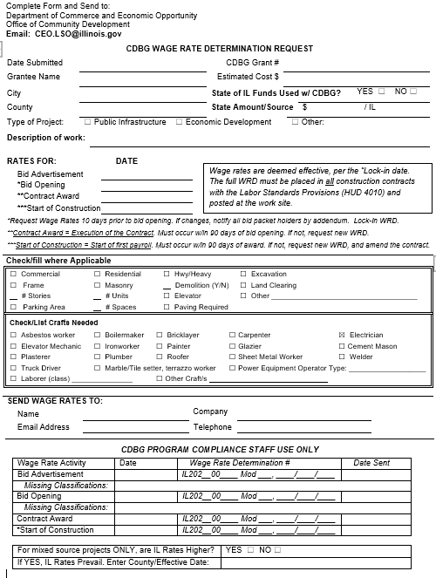
Prevailing Wage Rates
General Information – Complete all fields. Check for accuracy.
Is this a mixed-source project (CDBG/IL funds)? Information must be verifiable/documented.
Type of Project – Check the box
Description of Work – Indicate a complete description
Rates Requested for? Project Timeline – Pay attention to notes.
Classifications of Work – HWY/Heavy - Public Infrastructure
Classifications of Work – Building - Water/Sewage Treatment Plant (building only), Warehouses
Crafts needed to complete project – be thorough. Water lines, connections? Plumber?
Administrator’s Information

Slide 85
Prevailing Wage Rates
Initial WRD must be included in the bid packet
Lock-In WRD (issued for bid opening) must be included in the contract documents, including subcontracts
Lock-In WRD must be posted at the work site and where employees sign in for the day (in plain view and be easily accessible)
WRD must be updated if the contract is not awarded w/in 90 days of the bid opening and made part of the contract.
WRD must be updated if construction does not start w/in 90 days of contract award, and the contract must be amended to include new wages.
Conformance Process must be used for missing classifications.
Letter from US DOL with approved/prescribed rate must be posted with the WRD.

Slide 86
CDBG Grant Administration
Federal Labor Standards
Conformance Process

Slide 87
Conformance Process
Additional Classifications [29 CFR 5.5(a)(1)(ii)(A)(3)]
  An Additional Classification may be requested only when:
    The work to be performed by the classification is not performed by a classification in the wage determination; and
    The classification is utilized in the area by the construction industry; and
    The proposed wage rate, including fringe, *bears a reasonable relationship to the wage rates contained in the wage determination.
Notes:
SWAG for Courtney Eaton.

Slide 88
Conformance Process
*If the Contractor needs to request an additional classification for a Plumber, you must propose a wage that is comparable to those listed in the WRD for other “Skilled Workers” – You cannot compare rates to Laborers, Truck Drivers, or Engineers, and you cannot request a wage lower than that of the lowest paid Skilled Worker. This same process is used when a Classification within the WRD does not include the County in which the project is located. DOL will look at the wages of other skilled trades only in the county relative to the project location.

Slide 89
Conformance Process
Forms Required
  US DOL Standard Form 1444 (SF1444)
  Written request from Contract on Contractor’s letterhead and signed by Owner or authorized designee.
    See DCEO Labor Standards web page for instructions
Additional Classifications [29 CFR 5.5(a)(1)(ii)(A)(3)]
Conformance requests are not needed for bona fide:
  Apprentices;
  Trainees; or
  Welders (unless 100% welding)

Slide 90
Conformance Process
  If a wage determination does not include a rate for certain classification, the contractor must seek a conformance using the procedure outlined in the contract clause at § 5.5(a)(1).
NEW RULE – Supplemental Wage Rates
Where WHD has received insufficient data through its wage survey process to publish a prevailing wage for a classification for which conformance requests are regularly submitted, WHD may list the classification, conformed wage and fringe benefit rates for the classifications (i.e., supplemental wage rates) on the wage determination.
Supplemental wage rates may be listed on wage determinations only if they meet the basic criteria for conformed rates.

Slide 91
Adopting State Rates
  NEW RULE - The final rule amends the regulations to explicitly permit WHD to adopt State or local prevailing wage rates for both highway and nonhighway construction under certain circumstances where doing so would be consistent with the purpose of the DBA. In general, in order to adopt State or local rates, the Administrator must determine that the State or local government’s method and criteria for setting prevailing wage rates are substantially similar to those the WHD uses in making wage determinations. § 1.3(g)–(j)
DO NOT include the State Prevailing Wage Rates in your bidding/ contract documents.
DOL will issue the State PWR as part of the federal WRD upon its approval where circumstances warrant doing so.

Slide 92
CDBG Grant Administration
Federal Labor Standards
Weekly Payroll

Slide 93
Weekly Payrolls
Davis Bacon Act
Requires laborers and mechanics be paid at least the federal prevailing wage for work performed (and tools used) at least once per work week.
WH 347 or equivalent – MUST CONTAIN ALL INFORMATION
Recommend numbering payrolls
Only apprentices and trainees registered with the US Department of Labor may be paid less than the federal prevailing wage

Slide 94
Weekly Payrolls
Copeland Anti-Kickback Act
Prohibits employers from forcing employees to give up any part of their wages, except for authorized payroll deductions.
Verify deductions.
Requires payrolls be certified
Correct person signing the payrolls?

Slide 95
Weekly Payrolls
Submit copy of first payroll with all documentation to DCEO for review
  Email to ceo.lso@illinois.gov
  cc your Grant Manager
Submit copy of final payroll with all documentation to DCEO for review
  Email to ceo.lso@illinois.gov
  cc your Grant Manager
May be asked to submit payrolls throughout the project for review
Compliance staff may schedule a visit to review payroll documents and construction management files on site

Slide 96
Weekly Payrolls
Payrolls submitted to Grant Administrator every week
  Signed Statement of Compliance certifying required information is…
    Provided
    Maintained
    Correct
  Each laborer/mechanic paid wages earned;
  Laborer/mechanic paid not less than the determined wage

Slide 97
Weekly Payrolls
  Use US DOL WH347 or equivalent
    Must contain ALL information
  Number Payrolls (Initial / Final)
  List Grant Number
  Use Classifications in WRD (include Group #/Class employee being paid wage for)
  Column 7 – Only “Cash paid in lieu of fringe” may be added to the wage listed. Make note on back side.
Notes:
Use US DOL WH347 or equivalent
Must contain ALL information
Please NOTE:
Number Payrolls (Initial / Final)
List Grant Number
Use Classifications in WRD (include Group #/Class employee being paid wage for)
Column 7 – Only “Cash paid in lieu of fringe” may be added to the wage listed. Make note on back side.

Slide 98
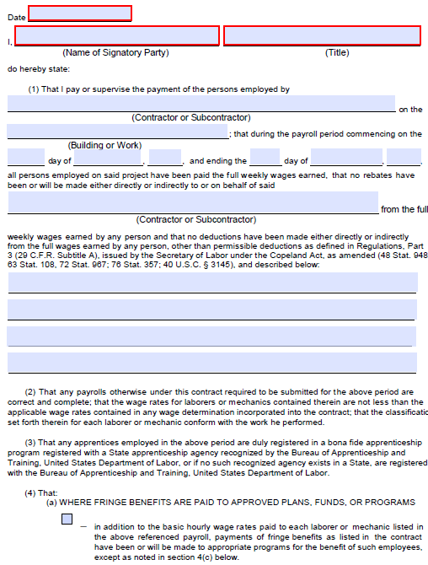
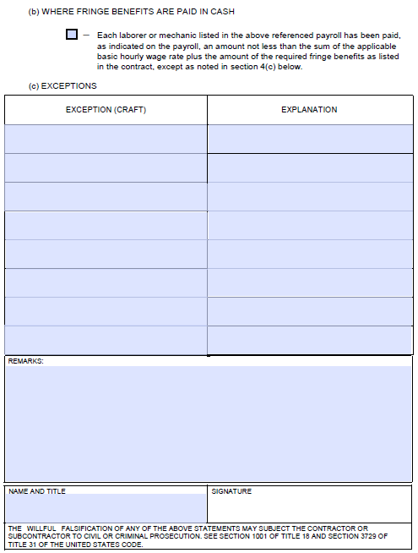
Weekly Payrolls
    Must contain Statement of Compliance – verbatim.
      Must be signed by person “Authorized to sign Payroll”

Slide 99
Weekly Payrolls
Compare payroll to wage rate decision
Total payroll amount (base + fringe) must equal or exceed federal prevailing wage rate
Any underpayments found while reviewing payroll must be reported to the CDBG Labor Standards Officer
Owner-operator subcontractor payrolls must be signed off by prime contractor

Slide 100
Weekly Payrolls
Is an apprentice on the payroll?
  Must obtain a copy of the Department of Labor’s Certification of Enrollment in an Apprentice Program.
  Must obtain a copy of the Agreement to document the approved Apprentice to Journeymen ratio for the registered program.
  NEW RULE –
    If the contractor is working within the area the apprentice program is registered, it must follow that ratio.
    If the contractor is working outside the area in which their apprenticeship program is registered they must follow the ratio and wage rate standards of the locality where the project is taking place.
    If there is no registered program where the work is taking place, the contractor must follow the ratio of its registered program.
  If an apprentice works alone or outside of the approved ratio, he must be paid the journeyman rate.

Slide 101
Weekly Payrolls
Employee working in more than one trade?
If an employee performs work in more than one trade during a work week, they can be paid the wages specified for each classification if accurate time records showing the time spent in each classification are maintained.
If accurate time records are not maintained, the employee must be paid the highest wage of all classifications of work performed.

Slide 102
Weekly Payrolls - Wage Restitution
Underpayment of Wages
  Total wages (base + fringe) earned minus total wages paid
Administrator notifies Prime Contractor in writing
  Describe underpayments
  Instructions for computing/documenting restitution to be paid
  Prime Contractor is allowed 30 days to correct underpayments

Slide 103
Weekly Payrolls - Wage Restitution
Corrected Certified Payroll
  Must reflect period of time restitution is due (Payroll #s)
  Signed Statement of Compliance
  Must be reviewed by Administrator
  Proof of payment – Front and back of cancelled check, bank statement
  Copy of payrolls and documentation to DCEO LSO

Slide 104
Weekly Payrolls - Wage Restitution
Corrected Certified Payroll, cont.
  If discrepancies are found
    Notify contractor of discrepancies in writing
    Additional payments must be made w/in 30 days
  Submit Corrected Certified Payroll (B)
    Signed Statement of Compliance
    Must be reviewed by Administrator
  Proof of payment – Front and back of cancelled check, bank statement
  Copy of payrolls and documentation to LSO

Slide 105
Weekly Payrolls - Wage Restitution
Withholding
  Against prime contractor to ensure the payment of wages due and unpaid
    If wage underpayments are not corrected within 30 days after written notification
    Only amounts needed to meet the contractor’s liability

Slide 106
Weekly Payrolls - Wage Restitution
NEW RULE -
  Upper-tier subcontractors (in addition to prime contractors) may be liable for lower-tier subcontractors’ violations.
  Both prime contractors and any responsible upper-tier subcontractors are required to pay back wages on behalf of their lower-tier subcontractors.
  Lower-tier subcontractors’ violations may subject prime and upper-tier contractors to debarment in appropriate circumstances.

Slide 107
Weekly Payrolls - Wage Restitution
NEW RULE -
  Prime Contractor is defined as any person or entity that enters into a contract with an agency, including:
    Controlling shareholders or member of an entity holding a prime contract,
    Joint venturers or partners in any joint venture or partnership holding a prime contract,
    Any contractor (e.g., a general contractor) that has been delegated responsibility for overseeing all or substantially all of the construction anticipated by the prime contract.

Slide 108
Weekly Payrolls - Recordkeeping
NEW RULE – Clarifications made
The final rule adds requirements that contractors and subcontractors maintain DBRA contracts, subcontracts, and related documents, as well as worker telephone numbers and email addresses.
The final rule clarifies that the required records must be retained for at least 3 years after all the work on the prime contract is completed.

Slide 109
CDBG Grant Administration
Federal Labor Standards
At the Work Site

Slide 110
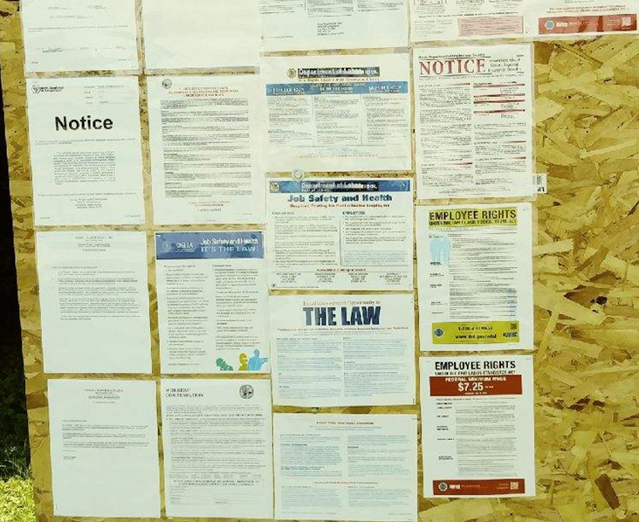
Work Site Postings
Check that the following documents are posted at the work site
Federal Prevailing Wage Rate Decision (Lock-in WRD)
Notice to Employees (WH 1321)
Posters available in English and Spanish on DCEO’s website.
To document compliance, take a picture of the postings and keep in the project file.

Slide 111
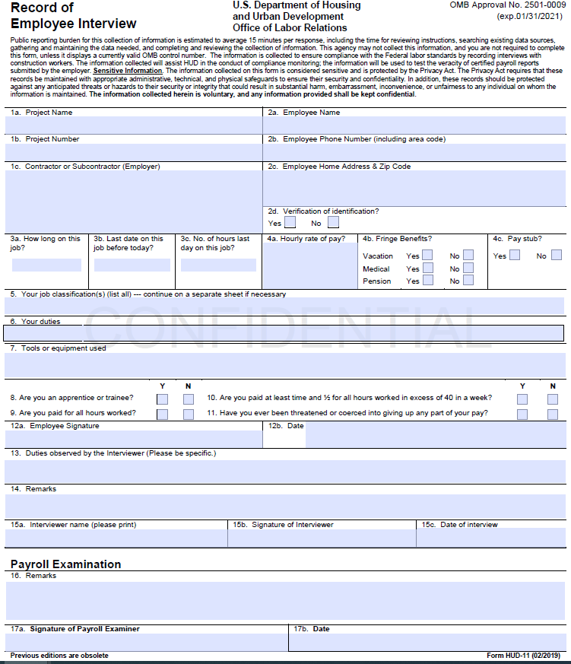
Employee Interviews
Conduct Employee Interviews
HUD 11 form
Must be conducted in-person.
Conduct several interviews of at least each craft
  Minimum of one in each craft/ classification
Notes:
This is something that has been missing from a lot of the on-site monitoring reviews.

Slide 112
Employee Interviews
Assigned Labor Standards Officer Conducts Interviews
1a-1b: Project Name and Number = CDBG Grantee and Grant Number
2a-2d: Enter employee’s full name, phone #, and permanent home address.
  Ask for ID to verify name.
3a-4c: Job Facts - Enter employee’s responses.
  Ask for pay stub to verify consistency with info provided by employer.
5-7: Classification Info - Responses should be specific.
  Trade; not journeyman or mechanic’

Slide 113
Employee Interviews
8-12b: Compliance check for Davis Bacon/CWHSSA –
Ask questions and take notes for “No” responses
13-14: Observations/Remarks – Take time to observe the work performed prior to interviewing the workers.
What did you observe? Be specific.
Working with a crew? How many?
Was the interviewee forthcoming?
15a-c: Interview
Signature Required.
16-17b: Verify interviews against certified payrolls.
Must be signed by signed by designated LSO.
If discrepancies found, must be resolved.

Slide 114
CDBG Grant Administration
Federal Labor Standards
Definitions

Slide 115
Definitions
NEW RULE – Building or Work
Building or work includes modern construction activities such as solar panels, wind turbines, broadband installation, and installation of electric car chargers to the non-exclusive list of examples of construction activities.
Includes a portion of a building or work, or the installation (where appropriate) of equipment or components into a building or work.
  Remember this for Economic Development Projects

Slide 116
Definitions
NEW RULE – Demolition clarified in construction
The final rule adds a new subdefinition to the term construction, prosecution, completion, or repair in § 5.2, to codify the DOL’s guidance that demolition work is covered under DBRA when the demolition itself constitutes construction, alteration, or repair, or when future construction that will be subject to the DBRA is contemplated on a demolition site.

Slide 117
Definitions
Site of the Work
The physical place or places where the building or work called for in the contract will remain once the contract work has been completed and any other site where a significant portion of the building or work is constructed, provided that such site is established specifically for the performance of the contract or project.
NEW RULE - Also includes any site where a significant portion of a building or work is constructed if the site is dedicated exclusively or nearly so to the performance of a single DBRA-covered project or contract for a specific period of time. The final rule also provides clarification on the meaning of “significant portion,” explaining that term encompasses one or more entire portion(s) or module(s) of the building or work, such as a completed room or structure, but does not include materials or prefabricated component parts such as prefabricated housing components.

Slide 118
Definitions
Site of the Work
NEW RULE –
Flaggers - The final rule clarifies that flaggers are working on the site of the work if they work at a location adjacent or virtually adjacent to the primary construction site, such as a few blocks away or a short distance down a highway.

Slide 119
Definitions
Site of the Work
NEW RULE –
Material Suppliers - The final rule excludes material suppliers from the definition of contractor. Material suppliers are entities whose only contractual responsibilities are the delivery of materials/supplies and activities incidental to those tasks.
An entity that engages in other construction work at the site of the work is not a material supplier, but a contractor or subcontractor under the DBA.
  Material suppliers may both deliver and pick up materials
  An entity that is solely engaged in picking up and hauling away materials is not a material supplier.

Slide 120
Definitions
Site of the Work
NEW RULE –
Truck Drivers - Truck drivers employed by contractors or subcontractors must be paid applicable prevailing wage rates for:
  All onsite driving time unrelated to offsite delivery (e.g., hauling materials from one location on the site of the work to another)
  Any time spent transporting “significant portions” of public works from secondary construction sites
  Any time spent transporting materials to or from adjacent or virtually adjacent dedicated support sites
  Any onsite time related to offsite delivery if such time is not de minimis

Slide 121
Definitions
NEW RULE –
…if such time is not de minimis –
  The final rule clarifies that where workers spend a significant portion of their day or week onsite, short periods of time that in isolation might be considered de minimis may be added together.
  The total amount of time a driver spends on the site of the work during a typical day or workweek—not just the amount of time that each delivery takes—is relevant to a determination of whether the onsite time is de minimis.

Slide 122
Definitions
Laborer or Mechanic – Survey Worker clarified
NEW RULE –
Survey crew members working on a covered project are subject to DBLS as laborer/mechanic when:
  Perform primarily physical and/or manual work; and
  Spend most of their time taking or assisting in taking measurements
    If not exempted as professional, executive, or administrative employees
    If work is performed on the site of the work
    If work is performed immediately prior to or during construction in direct support of construction crews
    If survey crew members are employed by contractors or subcontractors

Slide 123
CDBG Grant Administration
Federal Labor Standards
Economic Development Projects

Slide 124

CDBG Economic Development Projects
Davis Bacon Applies to all construction activities using CDBG funds whether on public or private property.
  Infrastructure improvements for the benefit of a business;
  Direct Capital investment to a business (building improvements, installation and purchase of equipment, construction costs, leased improvements).
Any construction contract over $2,000 is subject to Federal Labor Standards – Davis Bacon and Related Acts (DBrA).
Construction includes alteration and/or repair, including painting and decorating, of public buildings or public works. NEW RULE - Includes installation of equipment.

Slide 125
CDBG Grant Administration
Section 3 Mandate: Employment & Training Requirements
Sameena Aghi

Slide 126
Section 3
24 CFR Part 75
Applies to CDBG-assisted housing rehabilitation and public construction projects when the total amount of assistance to the project exceeds $200,000.
The project is the site or sites together with any buildings and improvements located on the site(s) that are under common ownership, management, and financing.
Applies to CDBG Grantees, and Contractors and subcontractors working on CDBG-grant funded projects.

Slide 127
Section 3
Priority should be given to recipients of government assistance for housing and business concerns which provide economic opportunities to low- and very-low income persons.
Requires economic opportunities be directed to low- and very low-income persons.

Slide 128
Section 3
To the greatest extent possible, businesses and employers working on CDBG-funded projects must make a good faith effort to:
Train and employ low-income individuals living in the local area and,
Contract with businesses owned by or that employ Section 3 workers.

Slide 129
S Section 3 Worker Comparison
Section 3 Worker
Targeted Section 3 Worker
Any worker who currently fits, or when hired within the past five years fit, at least one (documented):
The worker’s income for the previous or annualized calendar year is below the income limit established by HUD
The worker is employed by a Section 3 business concern
The worker is a YouthBuild participant.
Meets definition of a Section 3 Worker AND
Currently employed by a Section 3 Worker business concern; or
Currently fits or when hired in the past five years fit at least one of the following categories (must be documented):
  Low- or very low-income workers residing within the service area, as defined; or
  A YouthBuild participant

Slide 130
Reporting of Labor Hours (HUD requirement)
When reporting Section 3 worker and Targeted Section 3 worker labor hours, it is important to note that the count of Targeted worker labor hours is contained within the count of the overall Section 3 worker labor hours as illustrated in the following chart. Therefore, the total percentage of total labor hours that need to be performed by a combination of Section 3 workers and Targeted Section 3 workers is 25 percent, with at least 5 percent of the total labor hours performed by Targeted Section 3 workers.

Slide 131
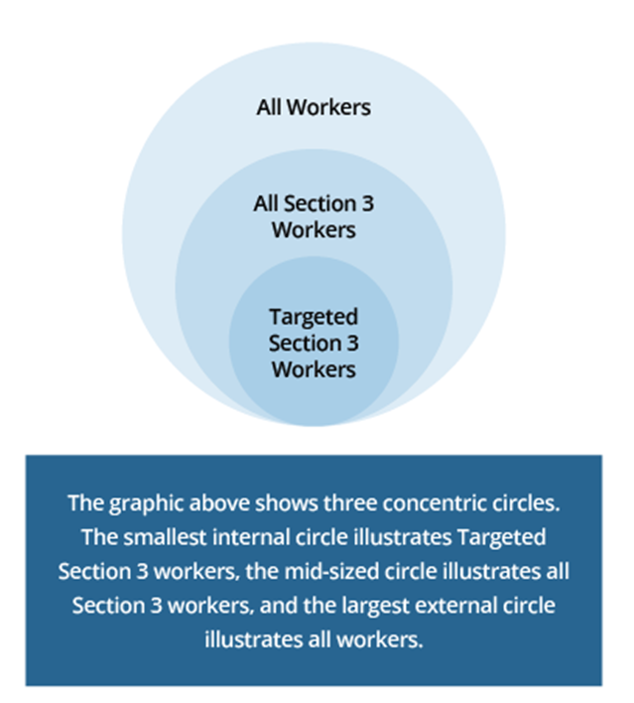
Universe of Workers

Slide 132
What is a Section 3 Business Concern?
A business that meets at least one of the following criteria within the last six (6) months (must be documented):
  It is at least 51 percent owned and controlled by low- or very low-income persons;
  Over 75 percent of the labor hours performed by the business are performed by low- or very low-income persons; or,
  Is a business at least 51 percent owned and controlled by current public housing residents or residents who currently live in Section 8- assisted housing.

Slide 133
Definition of Section 3 Project
Section 3 Project: A Section 3 covered project means housing rehabilitation, housing construction, and other public construction projects assisted under U.S. Department of Housing and Urban Development programs that provide housing and community development financial assistance when the total amount of assistance to the project exceeds a threshold of $200,000. The project is the site or sites together with any building(s) and improvements located on the site(s) that are under common ownership, management, and financing. Section 3 requirements apply to an entire Section 3 covered project, regardless of whether the project is fully or partially assisted.

Slide 134
Definition
Section 3 Worker: any worker who currently fits or when hired within the past 5 years fit at least one of the following categories, as documented: (1) The worker’s income for the previous or annualized calendar year is below the income limit established by HUD; (2) The worker is employed by a Section 3 business concern; or (3) The worker is a YouthBuild participant. Definition does not exclude an individual that has a prior arrest or conviction.
Targeted Section 3 Worker: A targeted Section 3 worker for housing and community development financial assistance means a Section 3 worker who is: (1) A worker employed by a Section 3 business concern; or (2) A worker who currently fits or when hired fit at least one of the following categories, as documented within the past 5 years: (i) Living within the service area or the neighborhood of the project; or (ii) A YouthBuild

Slide 135
Definition of Service Area
An area within one mile of the Section 3 project
If fewer than 5,000 people live within one mile of the project, within a circle centered on the project location that is sufficient to encompass a population of 5,000 people according to the most recent U.S. Census.

Slide 136
Section 3 GOALS and BENCHMARKS
Contractors and sub-contractors will be required, to the greatest extent feasible, meet both benchmarks.
  25% Total Labor Hours = Section 3 Workers
  5% Total Labor Hours = Targeted Section 3
If these benchmarks are not met, the Grantee and contractors must report on activities pursued in the absence of not meeting Section 3 benchmarks through Safe Harbor compliance.

Slide 137
Grantee Requirements
A local government that receives CDBG funding has the responsibility to:
Comply with Section 3 requirements in its own operations; and
Ensure compliance in the operations of its contractors/subcontractors.
CDBG recipients must include Section 3 language and forms in all procurement and bid documents, including:
  “Section 3 Clause”
  “Intent to Comply with Section 3 form”
  “Contractor’s Requirements form”

Slide 138
SECTION 3
GRANTEE REQUIREMENTS
Notify Section 3 Workers and business concerns about jobs and contracts generated by Section 3 covered assistance so that they may submit bids/proposals for available contracts and job openings with the grantee.
Notify potential contractors of their responsibilities under Section 3.
Include Section 3 language in all applicable contracts.
Require contractors and sub-contractors to meet the requirements of §75.19, regardless of whether Section 3 language is included in contracts.
Document action(s) taken to meet the HUD benchmarks.
Respond to Section 3 complaints.
Complete and submit the required Section 3 Forms to the Department.

Slide 139
Contractor’s Requirements
The Prime Contractor must submit the “Intent to Comply with Section 3” form with the bid packet. Failure to do so shall result in the bid being incomplete.
The Prime Contractor must notify all sub-contractors of their responsibilities under Section 3
The Prime Contractor must provide a permanent workforce breakdown of all current employees and identify those Section 3 workers that were hired within the last five years.
The Prime Contractor must provide an estimated breakdown of potential hires for the awarded project and timeline of anticipated hiring
The Prime Contractor must refrain from contracting with sub-contractors as to whom they have received notice or have knowledge that the sub-contractors have been found in violation of the regulations in 24 CFR 75.

Slide 140
Contractor’s Requirements
Maintain records that document a good faith effort to utilize Section 3 workers and Target Section 3 workers as trainees and employees and any other qualitative efforts to comply with Section 3. (Requirement applies to both contractors and sub-contractors.)
Recordkeeping requirements for recipients are found at 24 CFR § 75.31. The contractor is required to maintain documentation to demonstrate compliance with the regulations and is responsible for requiring their subcontractors to maintain or provide any documentation that will assist recipients in demonstrating compliance, including documentation that shows hours worked by Section 3 workers and Targeted Section 3 workers.

Slide 141
Penalties for Non-Compliance
Failure to comply with the requirements of Section 3 may result in a monitoring finding or sanctions that may include:
Debarment or suspension of funds
Termination of Grant Agreement/Contract
Limited denial of participation in State of Illinois CDBG programs

Slide 142
Reporting Requirements
Can be found on DCEO’s website in the Section 3 Plan
Forms are specifically located in the Appendix, of the Plan
https://dceo.illinois.gov/content/dam/soi/en/web/dceo/communitydevelopment/section3/section-3-plan-appendix_forms.pdf
The requirements include certifications, Section 3 Contractor’s report, safe harbor compliance (if goal not met), and utilization report

Slide 143
KEEP RECORDS!
DCEO is required to annually report to HUD Section 3 accomplishments including an aggregate of all labor hours worked, Section 3 labor hours, and Targeted Section 3 labor hours, as well as the efforts made to identify and engage Section Workers and businesses when the Section 3 benchmarks were not met under Safe Harbor compliance for all projects funded under its CDBG grant program, per program year.
Grantees may be asked to provide these records.

Slide 144
Examples of Safe Harbor Compliance
Provided training or apprenticeship opportunities.
Engaged in outreach efforts to generate job applicants who are Targeted Section 3 workers.
Provided technical assistance to help workers compete for jobs (e.g., resume assistance, coaching)
Provided or connected Section 3 workers with assistance in seeking employment including: drafting resumes, preparing for interviews, and finding job opportunities connecting residents to job placement services. Held one or more job fairs.
Promoted use of business registries designed to create opportunities for small businesses.
Outreach, engagement, or referrals with the state one-stop system as defined in Section 121(e)(2) of the Workforce Innovation and Opportunity Act.
Provided or referred Section 3 workers to services supporting work readiness and retention (e.g., work readiness activities, interview clothing, test fees, transportation, childcare).
Provided assistance to apply for/or attend community college, a four-year educational institution, or vocational/technical training.
Assisted Section 3 workers to obtain financial literacy training and/or coaching.

Slide 145
Steps for Section 3 Compliance Include:
Include Section 3 language in all advertisements for RFQ/RFP and bid documents.
Keep documentation of any correspondence with Section 3 businesses.
Include the “Contractors Requirements” and “Intent to Comply with Section 3 Requirements” forms with all procurement documents.
If a Section 3 business submits a bid for an opportunity associated with the CDBG project, the Grantee must give priority to the greatest extent feasible.
Describe Section 3 requirements at pre-bid meeting and the pre-construction conference. Document through notes, official meeting minutes, etc. that this discussion took place and provide all required materials to the contractor/s.

Slide 146
Steps for Section 3 Compliance Include:
Collect Section 3 data on a per project basis from every contractor and subcontractor using the “Section 3 Contractor’s Report” submitted with weekly payrolls.
Use data collected on the Contractor’s Report to report Section 3 efforts and accomplishments to DCEO.
Maintain documentation of qualitative efforts by the Grantee and contractors and subcontractors to engage Section 3 workers in employment and training opportunities and to contract with Section 3 Business Concerns for reporting of Safe Harbor Compliance when the Section 3 Goals/Benchmarks are not met.
Keep documentation of all Worker, Employer and Business Certifications, as well as outreach efforts to Section 3 Businesses and Section 3 Workers, on file for project monitoring.

Slide 147
Compliance Reviews
Business Concern Information
Lists of Section 3 workers and Section 3 business concerns maintained by the recipient to determine the extent to which the recipient is attempting to provide economic opportunities to prospective beneficiaries
Evidence of outreach efforts to determine how Section 3 workers or Section 3 business concerns were targeted or recruited for employment, training, or contracting opportunities
Lists of Section 3 business concerns that received contracts/subcontracts. This information should include name of contractor; address; telephone number; email address; contract amount; date awarded; and services provided.
Contract, Proposal, and Bid Information
Preconstruction Conference Minutes/other evidence to determine if Section 3 requirements were discussed with contractors
Plans for meeting/exceeding benchmarks by recipients/contractors (i.e., contractors' proposals or business utilization plan)
Procurement records to identify the dollar amount of each covered contract awarded.
Copies of bid solicitations to ensure that Section 3 applicability is referenced.
Contract documents to ensure that they include provisions that apply Section 3 to the contracts, or subcontracts awarded
Other Records
Other relevant data that may demonstrate Section 3 compliance

Slide 148
CDBG Grant Administration
Compliance
Construction Management

Slide 149
Construction Management Documents
Bid/Contract Document Checklist
Bid/Contract Documents
Notice of Contract Award (DOL and DCEO)
Preconstruction Conference Checklist
CDBG Contractor Profile Form
CDBG Construction Management Checklist
Project Process Guide – Suggested to ensure compliance

Slide 150
Construction Management
All CDBG construction projects must be competitively bid using the sealed bid process.
CDBG Bid/Contract documents must be used.
The only exception is joint-funded federal source projects.
  CDBG requirements and certifications must be included and appropriately identified.

Slide 151
Construction Management
Bid documents must be submitted to Compliance staff to ensure all terms, conditions and certifications are included.
  Advertise a minimum of 30 days prior to bid opening
  Request Prevailing Wage Rates a minimum 14 days prior to bid advertisement
  Submit the bid advertisement for approval
    Compliance staff will send approval or request changes
    If approved, the WRD will be issued for the BA the Monday prior to the BA date (following the Friday the update was posted)
    Submit bid packet to compliance staff for review/approval
      Can be sent with request for bid advertisement

Slide 152
Construction Management
      Submit WRD update request for bid opening
      If bid packet is approved, the WRD updated 10 days prior to the bid opening date will be issued the Monday following the Friday the update was posted
    If wages change between the bid advertisement and bid opening dates, you must send an addendum to all bid packet holders.
    WRD issued for the bid opening are the Lock-In rates and must be made part of the contract documents.

Slide 153
Construction Management
  Publicly open all bids
  Choose lowest, responsible bidder
  Award within 30 days or reject all bids and readvertise
  Must receive DCEO approval if only one bid received – retain copy in file
  Eligibility must be verified prior to contract award – retain documentation in file and include w/ NOCA
  Submit Contract documents to Compliance staff for approval
  Compliance staff will send notification of approval or request additional information
  Once approval is received, Grantee issues Notice of Award to Contractor. This IS NOT the date used for the NOCA

Slide 154

Construction Management
    MBE Notice – Post and send to PTAC/APEX Center and Darryl.Thomas@illinois.gov
    Now under the management of the Department of Defense (DoD) Office of Small Business Programs (OSBP), the Procurement Technical Assistance Centers (PTACs) are now referred to as the APEX Accelerator Centers.
    https://dceo.illinois.gov/smallbizassistance/beginhere/ptac.html
    Click on Find a Local APEX
    Center Type = “Illinois APEX Accelerator Center – Government Contracting Specialty”

Slide 155
Construction Management
    MBE Notice
    Send confirmation to grant manager and maintain in grant file
      Confirmation:
      Proof of Posting
      Proof email was sent and a copy of the completed MBE form
      This should be done when you advertise to allow for MBE participation
      New form available on OCD’s reporting web page

Slide 156
Construction Management
  Section 3 Efforts – Grantee
    Maintain in file for Safe Harbor reporting
  Section 3 Efforts – Contractor if seeking subcontracting by Section 3 Business Concerns to be included with the bid.
    Maintain in file for Safe Harbor reporting

Slide 157
Construction Management
  Contractor signs the Notice of Award and all certifications – Contract Agreement is executed.
    This is the date used for the NOCA.
  Hold preconstruction conference.
  Notice to Proceed issued after the Contractor certifies understanding of duties/responsibilities.
  One copy of the fully executed contract Agreement, including all certifications (bearing original signatures), must be retained by the grant administrator in the grant file.

Slide 158
Construction Management
Contractor’s/Respondent’s bid must include:
Bid Price in the Format Requested (lump sum or unit price)
Contractor’s Bid Guaranty
Certification of Bidder Regarding Equal Employment Opportunity
Intent to Comply with Section 3
Certification of Bidder Regarding Section 3 and Segregated Facilities
Non-Collusion Affidavit of Prime Bidder
Statement of Bidder’s Qualifications

Slide 159
Construction Management
  A Non-responsive bidder is one which fails to:
  Submit all of the required documentation with the bid
  Sign and submit all of the appropriate certifications, the Non-Collusion Affidavit(s), and/or bid bond requirements, etc.;
  Document that the individual/organization is experienced in the kinds of project construction required; or
  Is a contractor who is listed on the “List of Parties Excluded from Federal Procurement or Non-Procurement Programs”
  NOTE: If a contractor fails to complete requirements for the Grantee to issue a Notice to Proceed within 45 days of the contract award, the grantee may determine that the bidder has become a non-responsive bidder.

Slide 160
Construction Management
  NOTICE OF CONTRACT AWARD (NOCA) HUD 2516
  Must be submitted within 10 days of contract award (date executed)
  DOL Notice of Contract Award – send to email address indicated on form
    Submit Copy of DOL NOCA and proof of email submission to grant manager and DCEO Labor Standards Officer
  DCEO Notice of Contract Award – must include:
  Copy of Contractor Eligibility from sam.gov (No exclusions search results)
  Complete, certified “Contractor Profile Form”
  Copy of Bid Tabulation
    Send to: Grant Manager and DCEO Labor Standards Officer
Grant funds for Construction will NOT be released until the Contract Documents are approved; and the NOCA with all supporting documentation is submitted and approved.

Slide 161

Construction Management
Preconstruction Conference
Can the Contract Documents be executed at the preconstruction conference?

Slide 162
Construction Management
Preconstruction Conference
The grantee’s scheduling of the preconstruction conference should take place only after:
All contract documents have been fully executed by the grantee and contractor; and
All project funding resources are readily available for actual use.

Slide 163
Construction Management
Preconstruction Conference
Can participants attend the precon conference via webex or phone?

Slide 164
Construction Management
Preconstruction Conference
HUD requires all parties register to verify their attendance at the preconstruction conference.
  All public meetings must be held in person – no exceptions.

Slide 165
Construction Management
Preconstruction Conference
Can the necessary reference materials be distributed by email for the contractors to review and/or complete?

Slide 166
Construction Management
Preconstruction Conference
Before the preconstruction conference, the Labor Standards Officer must:
Obtain from DCEO the applicable federal prevailing wage determination to distribute to the Prime and subcontractors for posting at the job site;
Secure blank copies of payroll certification forms for use by the Prime and subcontractors when reporting the wages actually paid and number and classifications of employees working on the project;
Secure a sufficient number of EEO and Labor Standards posters for the contractor and subcontractors to post at all job sites; and
Carefully inspect the successful contractor’s bid documents to make sure all the appropriate certifications have been completed not only by the general contractor but by subcontractors as well.

Slide 167

Construction Management
Preconstruction Conference
Does each item in the Checklist have to be discussed?

Slide 168
Construction Management
Preconstruction Conference
Labor Standards is one of the most common problem areas in maintaining compliance within the CDBG grant-funded projects. The prime and subcontractors should be thoroughly instructed as to their specific duties and responsibilities for adhering to such federal standards.

Slide 169
Construction Management
Preconstruction Conference
Can the Notice to Proceed predate the Contract Execution date?

Slide 170
Construction Management
Preconstruction Conference
The grantee’s scheduling of the preconstruction conference should only take place after all contract documents have been fully executed by the grantee and contractor.
The preconstruction conference can conclude with the issuance of the Notice to Proceed.

Slide 171
Construction Management
Preconstruction Conference
Can construction start prior to the date indicated on the Notice to Proceed?

Slide 172
Construction Management
Preconstruction Conference
Only when the general contractor receives a Notice to Proceed is he/she authorized by the grantee to begin performing the previously agreed upon scope of work.
The Notice to Proceed (part of the DCEO Contract Documents) must establish:
The construction start date;
The scheduled project completion date; and
Describe the basis for assessing liquidated damages in the event of unsatisfactory performance by the general contractor or its subcontractors, etc.

Slide 173
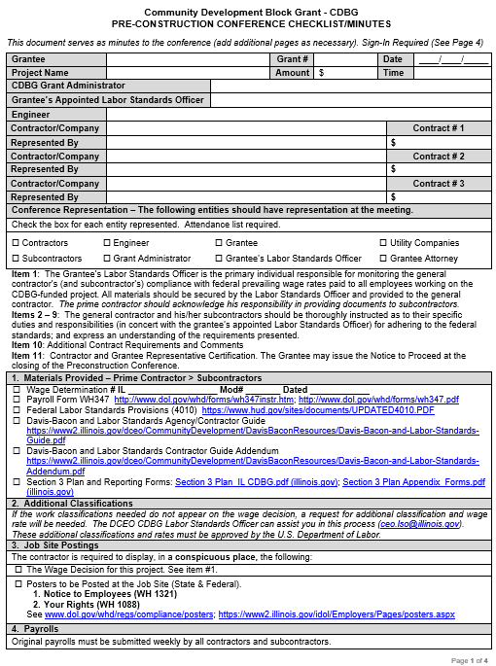
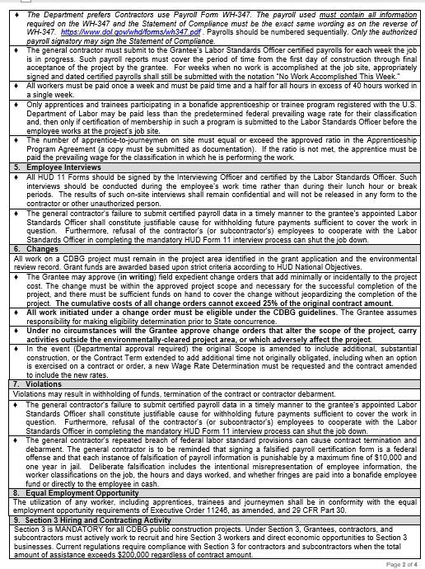
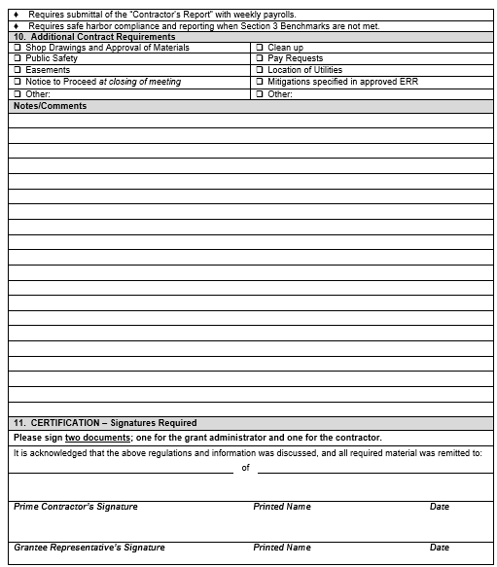
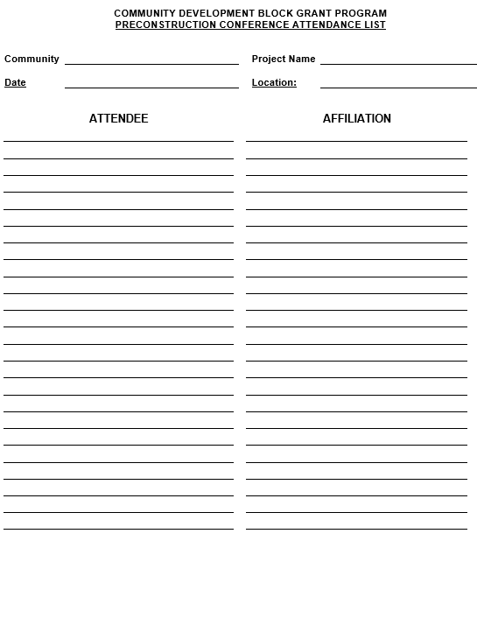
Construction Management
Preconstruction Conference Checklist
ONLY FORM ACCEPTABLE FOR USE
Check DCEO’s website for most current version or call Compliance staff

Slide 174
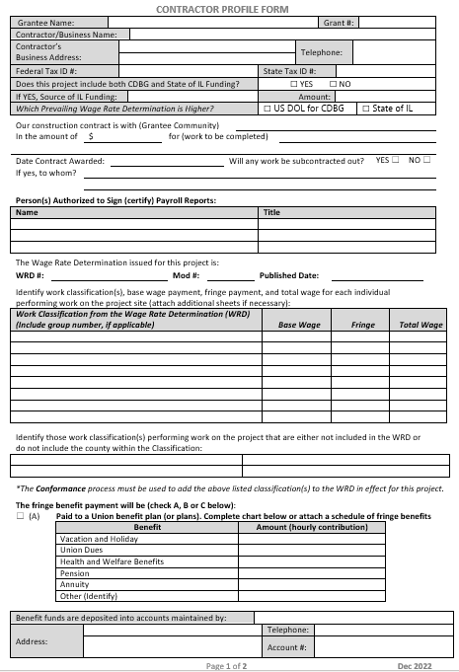
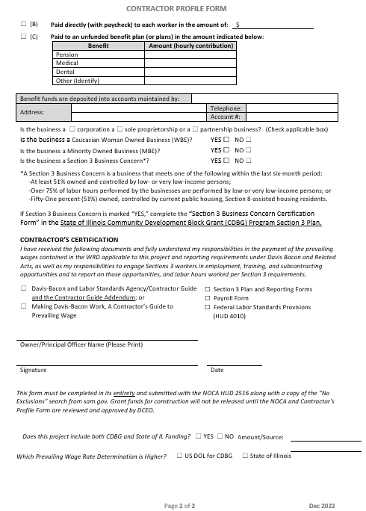
Construction Management
Contractor Profile Form
Replaces the need for:
  Certification from Contractor Appointing Officer or Employee to Supervise Payment of Employees
  Contractor Fringe Benefit Statement

Slide 175
Construction Management
Contractor Profile Form
  Grant administrator MUST complete with the Prime Contractor
    All areas must be completed
      Persons authorized to sign payroll reports
      Wage Rate Determination (Copy to be given to Contractor)
      Work Classifications from the WRD to be written in the chart with the appropriate wage to be paid
      Must identify classifications to work on the project that are not included in the WRD (for Conformance)
      Fringe Benefit payment information

Slide 176
Construction Management
Contractor Profile Form
      Contractor must certify receipt of:
        Wage Rate Determination
        DBLS Contractor’s Guide and Addendum (or Making Davis Bacon Work)
        Section 3 Plan and Reporting Forms
        Payroll Form
        Federal Labor Standards Provisions (HUD 4010)

Slide 177

Construction Management
Construction Management Checklist
  The CDBG Construction Management Checklist must be maintained as part of the Construction Contract File of the CDBG Grant Documents.
  File Sections:
  Checklist
  Bid Specs & Documents
  Contract
    WRDs
    Provisions, Certifications, Bonding
    Contractor Profile Form
    Preconstruction Conference Minutes

Slide 178
Construction Management
Construction Management Checklist
  Construction Management Checklist...
  File Sections:
  Payrolls
  Section 3 Reporting
    Contractor’s Report
    Safe Harbor Compliance – Grantee & Contractor(s)

Slide 179
Construction Management
Project Process Guide
Helpful Resource
From NOSAF to Closeout
Project Activity | Date Complete
Notice of State Award Finalist (NOSAF)
If Activity Delivery is awarded in grant funds: Procure Activity Delivery if not done by an IGA or IEI such as a Regional Planning Commission or an Economic Development Corporation
If Activity Delivery is awarded in grant funds: Environmental Review for Activity/Project that is Exempt or Categorically Excluded Not Subject to Section 58.5.
If Activity Delivery is awarded in grant funds: Activity Delivery Contract
Special Grant Conditions - (Other than the Environmental) Cleared
Special Grant Condition - Environmental Review Cleared
Notice of State Award (NOSA) emailed by GATA to Grantee; Grantee read and accept
Notice of Grant Agreement to sign (NOGA) - Signed and Returned to DCEO
Executed Grant Agreement (GA) - Paper Copy Filed
Fair Housing Poster Displayed - at Grantee community's location
Fair Housing Complaint Forms Available - at Grantee community's location
Section 504 Compliance Review - completed by Grantee
CDBG Grant-specific Checking Account Opened
Remind Grantee - Only CDBG grant funds in account (no comingling of funds) / non-interest bearing
Remind Grantee - 2 signatures on all CDBG grant fund checks
Remind Grantee - CDBG funds disbursed within 20 days after receipt from State Comptroller
Remind Grantee - Audits due to External Audit Unit each fiscal year grant is open via GATA system
Remind Grantee - to maintain SAM.gov registration and GATA fiscal year Internal Control Questionnaire (ICQ)
Journal/Ledger established for CDBG and Other Funds listed in GA only
Calendar set up for quarterly Periodic Financial and Performance Reports for DCEO
Review Grantee Fidelity Bonds that they are sufficient to cover CDBG funds
Submit Advertisement for Bid and Bid Packet to CEO.LSO@illinois.gov for review and approval - minimum 14 days prior to bid advertisement
Request Prevailing Wage Rate - minimum of 14 days prior to advertisement
Start "Construction Management Checklist"
Review Bid Packet (Correct Prevailing Wage Rates)
Review Bid Packet (EEO, Davis Bacon, and Section 3 Contractors Requirements and Intent to Comply included)
Section 3 Efforts
MBE Bid Notification to Grantee for posting, local PTAC, and Darryl Thomas (Copy DCEO Grant Manager) before or the day of the bid advertisement
Advertise for Bids / Copy of Bid Advertisement and publisher certification in file
Pre-Bid Conference Held - if applicable
Prevailing Wage Rates - Confirm 10 days prior to bid opening
Send notice to all bid holders if PWRs changed
Bid Opening - Bid Tab sheet in file
Contractor eligibility verified in sam.gov (No exclusions)
Sub-contractor eligibility verified in sam.gov (No exclusions)
Section 3 Intent to Comply submitted with bid? Must be obtained and submitted to CEO.LSO@illinois.gov
Contract documents must be submitted to CEO.LSO @illinois.gov prior to award.
Contract Executed (Within 90 days of bid opening). If not executed w/in 90 days, must request new WRD.
Contract Agreement (All agreements must include the PWR and DB provisions, including subcontracts)
Bid Guarantee, Performance Bond, Payment Bond, Certificate of Insurance
Meet with Contractor. Complete Contractor Profile Form. Disseminate Documents.
Create Notice of Contract Award - remember to include sub-contractors
Submit Notice of Contract Award to DCEO Labor Standards Officer and a copy to Grant Manager - Within 10 days of Award - Must Include:
Sam.gov "No Exclusions" Printout
Bid Tabulation
Contractor Profile Form
First few pages of construction contract
Submit Notice of Award to DOL - Within 10 days of Award (Send copy and proof of submission to grant manager)
Pre-Construction Conference - identify all parties attending, minutes, certification
Submit Pre-Con Conference Checklist (copy) to DCEO Labor Standards Officer and Grant Manager
Submit Notice to Proceed (copy) to DCEO Labor Standards Officer and Grant Manager
Missing Classifications in WRD? Conformance Request (letter & SF1444) to Labor Standards Officer
Submit First Payroll Reviewed (copy) to DCEO Labor Standards Officer and Grant Manager with relevant documentation
Section 3 Contractor's Report Submitted with Payrolls?
Employee Interviews Conducted - verify against payroll
Wage Restitution? - Submit original and corrected payroll, and proof of restitution to DCEO Labor Standards Officer
Apprentice - Certificate of Enrollment from DOL; Agreement showing approved Apprentice to Journeyman ratio
Submit Final Payroll Reviewed (copy) to DCEO Labor Standards Officer and Grant Manager with relevant documentation
Section 3 - Cumulative Contractor's Report, Safe Harbor Compliance Forms and Documentation
Finish "Construction Management Checklist"
Close Out Public Hearing Advertised
Close Out Public Hearing
Submit Final Periodic Financial Report and Periodic Performance Report to Grant Manager
Submit Grantee Evaluation Report (GER) and As-Built to DCEO Grant Manager (60 days after grant end or after all grant funds spent)
F6 Final Certify CDBG Costs on GRS 352. (If closing early, e-mail Grant Manager to request early Close Out set-up in Accounting system. Once notified set-up is complete, proceed with final certifying of costs on GRS 352.)

Slide 180
Compliance
Web Pages for Forms and Resources
https://dceo.illinois.gov/communitydevelopment.html
Under “LIBRARY” on the left-hand side of the screen…
Click on Labor Standards Materials for:
  Wage Rates
  Conformance Informaiton
  Bid Specifications & Contract Documents
  Required Postings & Documents
  Preconstruction Conference Forms
  Payroll
  HUD 11 Interview Forms
  Compliance Checklist
Click on Reporting for:
  MBE Form
Click on Grantee Support for:
  Project Process Guide

Slide 181

Compliance – Construction Management
JoLaine Miner
Please contact me if you have any questions
IL Dept of Commerce & Economic Opportunity
607 E. Adams, 3rd Floor
Springfield, IL 62701
Phone: 217.558.4222
Email: ceo.lso@Illinois.gov
Thank You!

Slide 182
SIGN OUT at the BACK OF THE ROOM if YOU ARE LEAVING THE WORKSHOP!!!!
You will not receive credit for attendance if you do not sign out.

Slide 183

Let there be lunch!

Slide 184
CDBG Grant Administration
Grantee Reporting System (GRS)
GRS Brief Refresher & Updates
Kirk Kumerow

Slide 185
Grantee Reporting System (GRS)
Is DCEO’s system for reporting costs and drawing funds;
Was created in mid to late 1980’s; Hewlett Packard based;
DCEO’s connection to State Comptroller’s (IOC) financial system;

Slide 186
Grantee Reporting System (GRS)
Connection to IOC updated via SAP software in 2022;
CDBG Grant Administrators can access through their “MHD #” (i.e., RACF ID); Rebuild Illinois administrators cannot.

Slide 187
Grantee Reporting System (GRS)
Normal Grant Administrator training and contact for GRS is Program Accountant/Acct Super in DCEO OFM;
DCEO OFM temp short-staffed and learning SAP. Bring GRS concerns to Grants Manager for now;
Request RACF ID password re-set to: ceo.racfsecurity@illinois.gov; provide RACF ID (i.e., MHD #) & organization name. No need to contact GM for re-set.

Slide 188
NEW All CDBG GRS Thresholds
New Grant Agreement. All Special Grant Conditions (SGC’s) set to “No” on GRS;
SGC’s for Activity Delivery or Admin-Inspection will only be turned to “Yes” on GRS by assigned GM after receipt of respective AD or Admin-Inspection Contract(s) and 1st detailed invoice.

Slide 189
NEW CDBG PI & ED-PI GRS Thresholds
SGC’s for Construction activities only turned to “Yes” by either Labor Standards Officer or PI Program Manager after proper labor standards docs submitted and approved for PI or ED-PI. If in doubt on new Labor Standards document processes, please ask LSO.

Slide 190
NEW CDBG Draw Rates – AD or Admin-Inspection
Since June 2023, all AD and/or HR Admin-Inspection to be billed on actual hours worked basis;
Must include DCEO OCD-provided hours worked Excel;
May also include your firm’s invoice sheet;
May report and draw on GRS as hours are earned, or report and draw proportionally during grant term, based on hours worked;
Draw proportionate with underlying construction costs.

Slide 191
NEW CDBG PI & ED-PI Construction Draw Rates
Starting Fall 2023, for any CDBG PI or ED-PI grant with budgeted “Other Funds” for construction, those other funds must be spent and reported on a 1:1 ratio with CDBG construction funds until the Other construction funds are exhausted;
Exhausted to lesser of 1:1 with CDBG funds or the (less than CDBG) Other construction funds stated in grant application/Grant Agreement are fully spent;
All funders want timely expenditure of their funds,
including DCEO for CDBG!!!

Slide 192
GRS Entries
Once an SGC has been turned to “Yes”, Grant Administrator may report and draw that line-item on GRS Screens 351-353.
If unable to process a transaction, contact assigned CDBG Grants Manager.
To reduce a reported cost, place “-”
after amount to be reduced.

Slide 193
GRS Entries
“GRS Grantee Handbook” available at https://dceo.illinois.gov/communitydevelopment/commgranteesupport.html
Your detailed reference for GRS use;
Last updated January 2016. Administrators won’t see any internal SAP connection changes
using GRS.

Slide 194
CDBG Grant Administration
Modifications and Waivers
Kirk Kumerow

Slide 195
Grant Modifications
Consult well ahead of time with your CDBG Grants Manager regarding proposed changes:
Project Location(s)
Project Beneficiaries (incl. Project area)
Environmental Impact (i.e., changes from completed ERR)
Scope of Work
Budget
Project End Date

Slide 196
Grant Modifications
Modifications Not Allowed For:
Requests for activities outside the original project area
Requests to decrease or increase Scope of Work/Budget due to greater or less than estimated project costs
In addition:
If proposal alters LMI benefit, the resulting LMI benefit must still be 51% or greater (a HUD and application threshold)

Slide 197
Waivers
Cover modifications to an expired Grant Agreement
Avoid if at all possible
Causes extra work for Grantee, DCEO Grants Manager, Legal & Accounting (i.e., adds Notarized Contract Renewal Affidavits & other possible “paper” forms)
Reminder that if a potential Modification arises, discuss it with your Grants Manager about 1 to 2 months prior to expiration; earlier if grant will expire in period from June 30th to August 31st (i.e., State Fiscal Year “rollover period”).

Slide 198
Potential Pitfalls
Unapproved changes can result in repayment of Grant funds;
Modifications of an expired grant may not be allowed at DCEO discretion;
Always contact your Grant Manager prior to changing a CDBG grant project in any way.

Slide 199
Grant Modification/Waiver Request Process
After an initial phone or e-mail consultation initiated by Grantee’s grant administrator, the CDBG Grant Manager will determine if a written Modification or Waiver request is required and potentially acceptable;
Grant Manager will consult internally with Program Manager and potentially Deputy Director regarding appropriateness of request;

Slide 200
Grant Modification/Waiver Request Process
If a request is deemed appropriate, Grant Manager will advise grant administrator to submit Modification or Waiver request forms via e-mailed PDFs;
After receipt, Grant Manager will initiate Modification or Waiver request on DCEO eGrants & GRS & HUD IDIS (if applicable);

Slide 201
Grant Modification/Waiver Request Process
Once DCEO Legal Counsel has approved Mod request, Grants Manager will send grant administrator the new GATA-required Grant Modification Agreement for dated signature by Authorized Designee or Authorized Signatory listed in Grant Agreement;
Signed and dated Grant Modification Agreement is returned to GM by Grant Administrator via e-mailed PDF;

Slide 202
Grant Modification/Waiver Request Process
Once Modification/Waiver is executed, Grant Manager will e-mail a PDF copy to Grant Administrator for filing and copying to Grantee;

Slide 203
Modification/Waiver Request – Required Forms
Letter signed by the Grantee’s Chief Elected Official on Grantee letterhead
Detail why change(s) are necessary
What exactly needs to be changed
Include Grant #

Slide 204
Modification/Waiver Request – Required Forms
DCEO CDBG Modification/Waiver Information Sheet
Fill-in header information fields;
Check applicable “Purpose” boxes;
Fill-in proposed new end date, if applicable;
Fill-in DCEO Grants Manager’s name at bottom;
Signature neither required nor desired.
DO NOT use former DCEO CDBG
Modification/Waiver Request Form

Slide 205
Modification/Waiver Request – Required Forms
Budget Modification Requests
Completed GATA Uniform Grant Budget Modification Template - CDBG
Grantee’s Chief Elected Official and Treasurer or Clerk must sign and date on Certification page
Member of Grantee’s legislative body may co-sign if both Clerk and Treasurer are vacant and/or on LOA
DO NOT use revision of original GATA Budget

Slide 206
Modification/Waiver Request – Required Forms
Scope of Work Modification Requests
Grant Manager will determine if proposed change(s), including to “Project Activities” line-items in Grant Agreement Exhibit B, require a Scope Modification;
If so, GM will prepare a revised Scope of Work to include in Mod packet; e-mail copy to Grant Administrator; and check Scope box on Mod/Waiver Info Sheet if not already checked by Administrator.

Slide 207
Modification/Waiver Request – Required Forms
Revised Project Location Map
Required for changes of site location(s) within the approved project area;
Must clearly indicate proposed location(s) to be added and proposed location(s) to be deleted.

Slide 208
Modification/Waiver Request – Required Forms
For Unused CDBG PI LMI Connection Funds, include
Form (Appendix 1-4-D) from the Grant Management Handbook
Required when trying to move unused LMI Connection funds to the Construction line-item, because a documented insufficient number of LMI households did not income qualify;
Rarely approved by DCEO, so budget initial LMI Connection funds carefully in grant application.

Slide 209
CDBG Grant Administration
Quarterly Reporting and Financial Monitoring
Jeff Davis, Cietta Gower

Slide 210
Quarterly Reporting / Financial Monitoring
2 CFR 200.302 – 200.332 / 24 CFR 570
State CDBG Programs are required to establish record keeping methods to review and monitor CDBG Federal funds and confirm that Grantees:
Carry out community development program requirements and activities described in the Application and Grant Agreement;
Carry out activities in a timely manner;
Charge eligible costs to the project;
Conduct program and financial responsibilities to minimize opportunities for waste, mismanagement, fraud
and abuse.

Slide 211
Quarterly Reporting / Financial Monitoring
The Department’s Office of Community Development (OCD) requires that Grantees submit financial and performance reports quarterly to confirm their compliance with program regulations and performance goals.
Quarterly, Grantees will submit -
“Periodic Financial Report” (PFR).
“Periodic Performance Report” (PPR).
Two forms scanned for one combined quarterly report - PFPR.
Email to the Grant Manager: *22-242999 Grantee PFPR 06-30-24.
*Grant #, Grantee Name, PFPR, End Date of the
Reporting Quarter

Slide 212
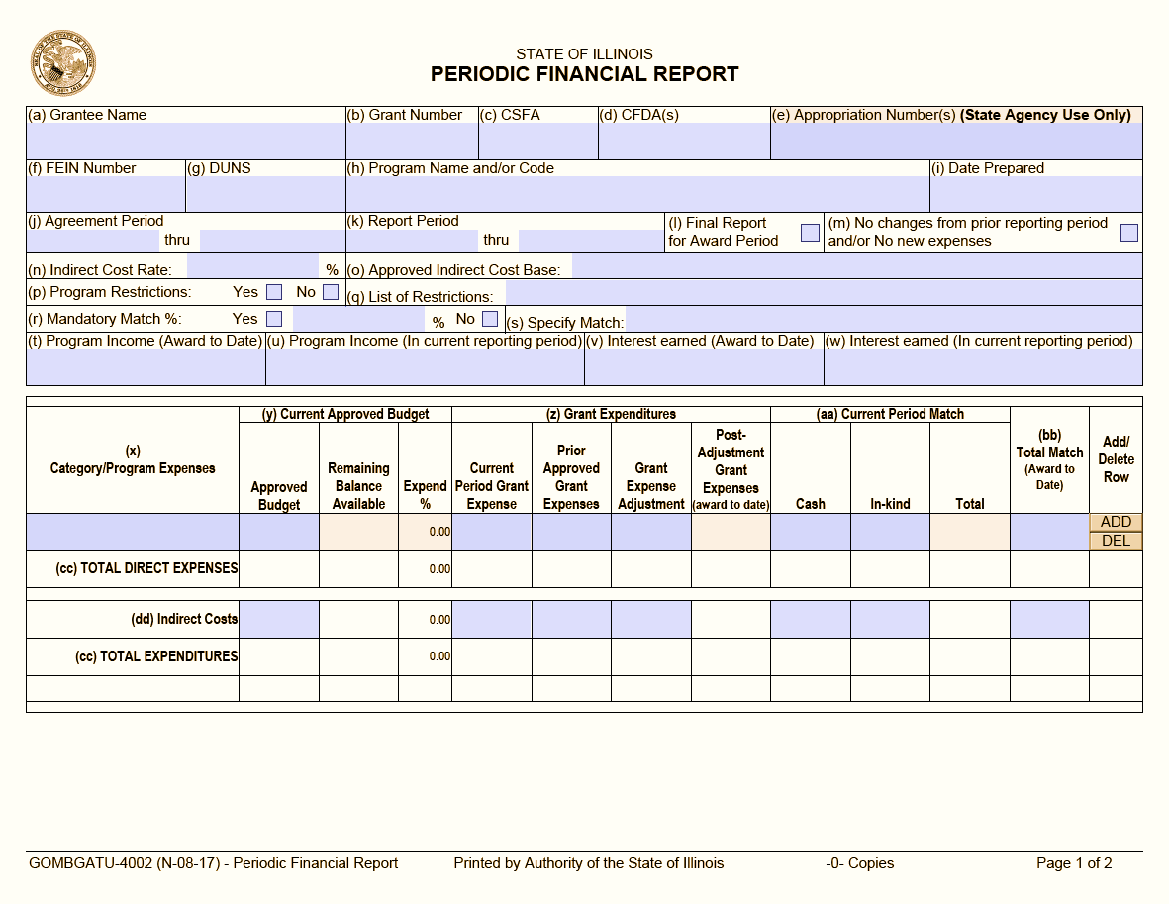
Quarterly Reporting / Financial Monitoring

Slide 213
Quarterly Reporting / Financial Monitoring
Periodic Financial Report
The (a) Grantee Name, (b) Grant Number, (c) CSFA, (d) CFDA, (f) FEIN, (g) DUNS or the UEI, (h) Program Name and/or Code, (i) Date Prepared, (j) Agreement Period and (k) Report Period can be found in the Grant Agreement.
For CDBG, there is no (n) Indirect Cost Rate and no (p) Program Restrictions.
If the project has Other funds committed to complete the project, listed in Exhibit B of the Grant Agreement, select Yes for (r) Mandatory Match, then in cell (s) Specify Match list the source of the Other funds.
The (t) Program Income and (v) Interest Earned cells should be left blank.
The (x) Category/Program Expenses, and (y) Current Approved Budget are filled in using the “Cost Category”, “Activity”, and “CDBG” grant funds listed in Exhibit B (e.g., 03JW Construction, 03JD Activity Delivery, 14A Rehab-Single Unit Residential, 14H Activity Delivery). Add lines if necessary.
Cell (z) Grant Expenditures is to report the Current Period Grant Expenses and the Prior Approved Grant Expenses.
Cell (aa) Current Period Match should contain Other funds spent, as part of a
complete transaction, by the Grantee in the reporting period.
Cell (bb) Total Match enter the Other funds spent to date.
*To “Add” or “Delete” lines use the Add/Delete tab on the right end of page.

Slide 214
Quarterly Reporting / Financial Monitoring

Slide 215

Quarterly Reporting / Financial Monitoring
Periodic Financial Report – page 2
The Authorized Signatory (listed in the Grant Agreement) or the Authorized Designee from Exhibit D, of the Grant Agreement, must sign the form. Please include the signature, typed name, title, phone number and date.
Reminder - When reporting data in cell (z) Current Period Grant Expenses, supporting documentation must be attached that exactly matches the expenses being reported. Current Period Grant Expenses are reported in the quarter the Grantee has a complete transaction that demonstrates the expense, the payment verification of the expense, and the Grantee’s deposit of grant funds covering the expense. Examples of supporting documentation may include contractor’s pay estimates, invoices, cancelled checks, and bank statements. Supporting documentation for Activity Delivery expenses being reported must include the completed Activity Delivery Invoice (template) that details the work completed and the amount of time spent on the project. A financial ledger showing the receipts and payouts of grant and Other project funds is helpful.

Slide 216
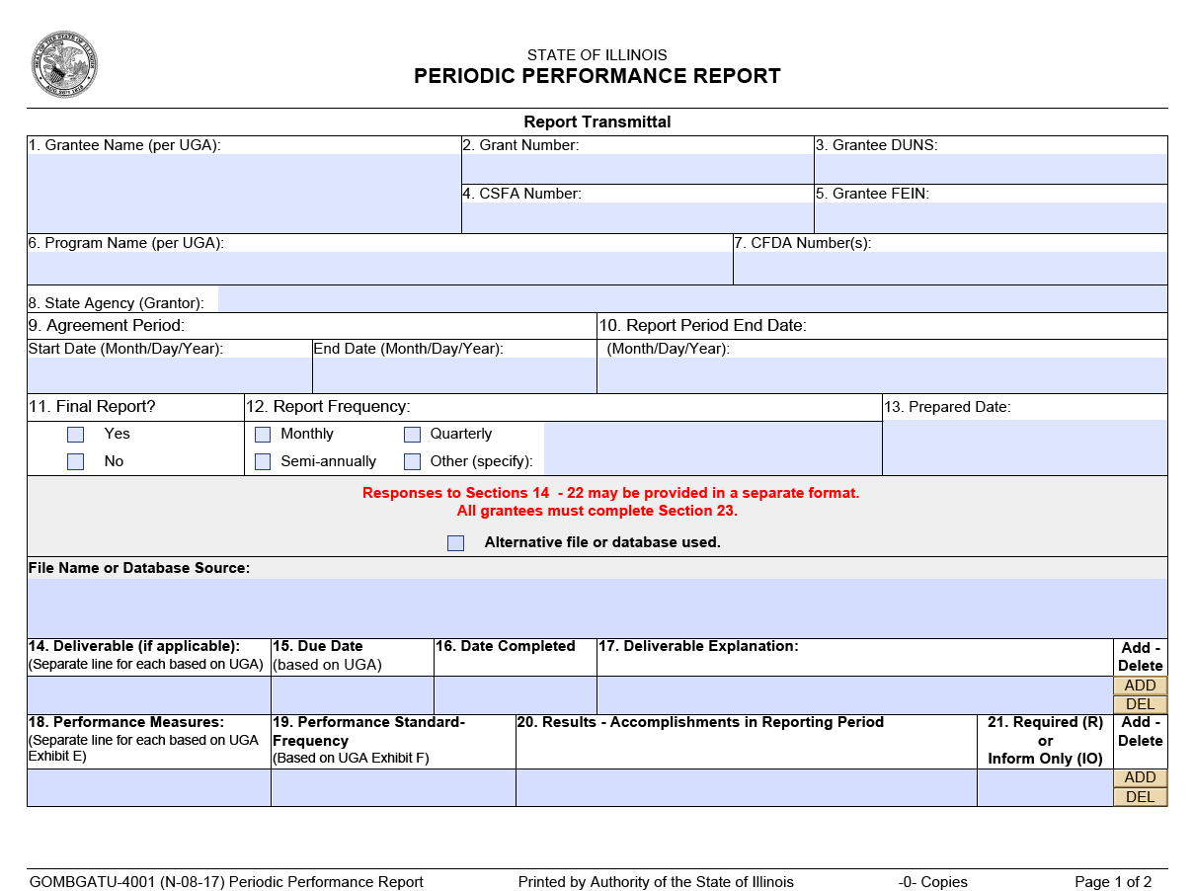
Quarterly Reporting / Financial Monitoring
Sample Text-Franklin Gothic Book – 28 pt

Slide 217
Quarterly Reporting / Financial Monitoring
Periodic Performance Report
Cell (1) Grantee Name, (2) Grant Number, (3) DUNS or the UEI, (4) CSFA, (5) FEIN, (6) Program Name, (7) CFDA, (8) State Agency, and (9) Agreement Period can be found in the Grant Agreement.
Cell (10) Report Period End Date, end of a reporting quarter, (11) Final Report, (12) Report Frequency and (13) Prepared Date.
Cell (14) Deliverable include one line for each Cost Category/Activity listed in Exhibit B of the Grant Agreement (e.g., 03JW Construction, 03JD Activity Delivery, Other Funds – “Grantee Commits $50,000 in Other funds”, 14A Rehab-Single Unit Residential, 14H Activity Delivery). Add lines if necessary.
Cell (15) Due Date enter the date the Deliverable (cell 14) is due to be completed - the Grant Agreement end date.
Cell (16) Date Completed enter the date the Deliverable (cell 14) is completed, should be blank until the final report when reporting that the project is complete.
Cell (17) Deliverable Explanation blank until the final report.
Cell (18) Performance Measures enter Performance Measures from Exhibit E of the Grant Agreement (e.g., Total persons served 500; Total LMI persons served 300 /60% LMI).
Cell (19) Performance Standard Frequency enter Performance Standard from Exhibit F and when its due (e.g., Benefit 51% LMI/End of Project.
Cell (20) Results – Accomplishments in Reporting Period - cell must be completed each
quarter, do not it leave blank. Enter actual results (details about the progress)
for each Deliverable (cell 14) and Performance Measure (cell 18) for the specific
reporting period. Leaving this blank may cause the report to be rejected.

Slide 218
Quarterly Reporting / Financial Monitoring
Sample Text-Franklin Gothic Book – 28 pt

Slide 219
Quarterly Reporting / Financial Monitoring
Periodic Performance Report – Page 2
Cell (22) Performance Explanation – Award to Date and cell (23) Performance Accomplishments Correlated to Reported Expenses – answer both questions.
The PPR must be signed by the Authorized Signatory (from the Grant Agreement) or the Authorized Designee from Exhibit D of the Grant Agreement. There must be a signature, a typed name, title, phone number and date.
To “Add” or “Delete” lines use the Add/Delete tab on the right end of the page.

Slide 220

Quarterly Reporting / Financial Monitoring
Things to Remember
When reporting data in cell (z) Current Period Grant Expenses, there must be supporting documentation that exactly matches the expenses being reported. Current Period Grant Expenses are reported in the quarter the Grantee has a complete transaction that demonstrates the expense, the payment verification of the expense, and the Grantee’s deposit of grant funds covering the expense. Examples of supporting documentation may include pay estimates, invoices, cancelled checks, and bank statements. A complete Activity Delivery Invoice must be included to document Activity Delivery expenses.
Other funds committed to a project must be drawn/spent at a ratio of no less than 1:1 until all Other funds are drawn or CDBG funds are exhausted.
Both, CDBG and Other, funds being reported must be supported by source documentation.
Two forms (PFR and PPR), with supporting documents, are scanned as one combined quarterly report - PFPR.
Email to the Grant Manager: *22-242999 Grantee PFPR 06-30-24.
Use the Grant Number, Grantee Name, End date of the Reporting Period to name the report.
The PFR and the PPR forms are also the forms you will use at Closeout.
The Report Schedule is in the Grant Agreement.

Slide 221
Quarterly Reporting / Financial Monitoring
More Things to Remember
Do NOT reuse report forms. Start a new form for each grant each quarter.
Activity Delivery invoices must include the Activity Delivery Invoice (template) or they will be returned
A “Scheduled Report Item Due” notice will be sent out by eGrants one week before the report is due.
A “Notification of Reporting Non-Compliance” will be sent out by eGrants when a required report is not received.
Delinquent/late reports are subject to FEIN locks and the Illinois Stop Pay List.
Reports initially submitted that are not correct or contain errors will be sent back to the grant administrator with notes on how to correct.
Reports re-submitted that are still not correct will be rejected. An email notification of the rejection will be sent to the grant administrator and the Grantee indicating why the report is not correct.
If correct reports are not received within 30 days of the notification of errors, then a FEIN lock will be placed on the grant/Grantee.
If a correct report is not received within 30 days after a FEIN lock has been placed, then the Grantee may be placed on the Illinois Stop Pay List.
The PFR and the PPR are on the website at:
https://dceo.illinois.gov/communitydevelopment/commgranteereport.html

Slide 222

Quarterly Reporting / Financial Monitoring
“A Few Notes for Financial Monitoring“
The Grant project file should include supporting documents with the names and titles of the Grantee’s representatives that have fiscal responsibility (signature authority/those who handle book entries, check preparation, bank reconciliations) for CDBG funds.
The Grant project file should include a copy of the Grantee fidelity bond that covers the Grantee’s representatives, who have fiscal responsibility for CDBG funds. The bond amount should be at least equal to the amount of CDBG grant funds the Grantee may have custody of at one time.
Information submitted must be accurate and include expenses for which there is a complete transaction.
The Grant project file must include a financial ledger showing CDBG funds, and any Other funds, received and disbursed to complete the project.
CDBG Grant Funds:
Must be spent on allowable items and be approved by the responsible Grantee official;
Are for eligible expenses actually incurred and are not to exceed actual cash requirements;
Should be deposited into a separate (their own) non-interest-bearing bank account;
Require two signatures for disbursement to a contractor; and
Must be disbursed within 20 days of receipt by the Grantee.

Slide 223
CDBG Grant Administration
Other Required Reporting
Jeff Davis, Cietta Gower

Slide 224
Required Reporting
Reminder - Construction (PI) Documents to be submitted
Bid Advertisement/Packet
Publisher Certification
Minority Business Enterprise (MBE) Bid Notification with submission and posting verification
Section 3 Contractor Intent to Comply
Bid Tab
Notice of (Bid) Award
Contractor Profile Form
Construction Contract
Notice of Contract Award – HUD 2516 with contractorr/sub eligibility verified
Notice of Contract Award – DOL with submission verification
Preconstruction Minutes
Notice to Proceed
Job Site EEO Documents/Wage Rates – Posting Verification
Payroll – First/Last
Section 3 Contractor’s Report
and Safe Harbor Form
The following are Grantee requirements in addition to the quarterly reporting:
Fair Housing Poster/Complaint Form
Section 504 Grantee Self-Evaluation for Persons with Disabilities
Grant Agreement Exhibit G
Compliance Monitoring
External Audit Reporting
Grantee Evaluation Report (GER)
As Built Map/Drawing (PI)

Slide 225

Required Reporting – Fair Housing
Grant Agreement - ARTICLE XXXVII, Grant Specific Terms and Conditions
Title VIII of the Civil Rights Act of 1968 (P.L. 90-283), as amended, administering all programs and activities relating to housing and community development in a manner to affirmatively further fair housing; and will take action to affirmatively further fair housing in the sale or rental of housing, the financing of housing, and the provision of brokerage services.
Grantees must post a Fair Housing Poster, where public notices are posted.
Grantees must make Fair Housing Complaint forms available to the public.
Verification of these postings are to be in your grant file.
Fair Housing Poster: https://www.hud.gov/sites/documents/FAIR_HOUSING_POSTER_ENG.PDF
Fair Housing Complaint form: https://www.hud.gov/sites/documents/DOC_12150.PDF

Slide 226
Required Reporting – Section 504/Exhibit G
Grant Agreement Section 3.5 Specific Certifications
Anti-Discrimination
Grantee shall comply with applicable provisions of State and Federal laws and regulations.
(p) Section 504 of the Rehabilitation Act of 1973 (29 USC 794)
A copy of a completed Section 504 Self-Evaluation Review Form must be in place and available for public review. A copy of the completed Section 504 Self-Evaluation form must be in the grant file.
Grant Agreement Exhibit G – Fiscal and Administrative
Additional documents may be requested based on the Grantees answers to the GATA Internal Control Questionnaire (ICQ).

Slide 227
Required Reporting – Audit / Monitoring
Grant Agreement Exhibit G – Programmatic On-Site Monitoring
Grantees are initially selected for On-site Compliance Monitoring based on answers provided in the GATA Internal Control Questionnaire (ICQ). Grant Managers may conduct an on-site monitoring visit for other reasons.
Grant Agreement Article XII – Audit Requirements
Grantees must adhere to applicable Audit Requirements. Deficient audit reports lead to Grantee FEIN locks and placement on the Illinois Stop Pay List.
Audit Unit: ceo.externalauditunit@illinois.gov

Slide 228

Required Reporting – GER / As-built
Grantee Evaluation Report (GER) is the Grant Agreement programmatic closeout document. The GER is due to the Grant Manager either 60 days after the end date of the Grant Agreement or 60 days after all grant funds are spent.
The As-built Map/Drawing (PI) is to describe/illustrate
the project that was actually built. The As-built is due
to the Grant Manager with the GER and other closeout
documents.

Slide 229
CDBG Grant Administration
Grant Closeout
Jeff Davis, Cietta Gower

Slide 230
Grant Closeout
The Grantee should begin the closeout process when:
The project in Exhibit A of the Grant Agreement is complete.
All costs have been incurred.
All contracts have been paid in full.
Grant closeout documents are due sixty (60) days after the end date of the Grant Agreement or sixty (60) days after all grant funds have been spent; whichever is first.
Grantees have up to 45 days after the end date of the Grant Agreement to request grant funds.

Slide 231
Grant Closeout
Closeout Reports / Documents
The Final Periodic Financial and Performance Report (Final PFPR)
The Grantee Evaluation Report (GER)
As-built Map/Plan (PI)
Section 3 Contractor’s Report / Safe Harbor Report – (PI)
**Confirm that all quarterly reports, other reports and construction documents have been submitted to the Department and that the Grantee’s grant file is complete.

Slide 232
Grant Closeout
The Final Periodic Financial and Performance Report
Periodic Financial Report (PFR), same form used for quarterly reporting.
Cell (l) Final Report for Award Period, marked Yes.
Submit any final source documents (pay estimates/invoices/change orders/cancelled checks/bank statements, etc.)

Slide 233
Grant Closeout
Periodic Performance Report (PPR) same form used for quarterly reporting.
Cell (11) Final Report, marked Yes.
Cell (16) Date Completed, end date of Grant Agreement or project completion date.
Cell (17) Deliverable Explanation, enter a brief description of the completed activity. Enter any Other funds listed in Exhibit B of the Grant Agreement that were spent to complete the project.
Cell (20) Results – Accomplishments in Reporting Period include any activities completed in the reporting period.
Remember two forms (PFR) (PPR) one report (PFPR)
22-242999 Grantee Final PFPR 6-30-2024

Slide 234
Grant Closeout
Grantee Evaluation Report (GER)
The GER document requires that the Grantee hold, and facilitate, a closeout public hearing to review program performance and obtain citizens reviews regarding program activities and performance under the grant.
A Notice of Public Hearing must be published in a newspaper of general circulation in the Grantee’s community, at least seven days (excluding the date of publication and the date of the hearing) prior to the hearing; and the notice must state the purpose of the hearing.
A public comment period must coincide with the time period between the Notice and the hearing, which will conclude after the hearing has been completed. The address to submit written comments must be in the public notice.

Slide 235
Grant Closeout
Grantee Evaluation Report (GER)
The first page of the GER must be signed by the Grantee’s authorized official. It must be signed and dated after the closeout public hearing.
Submit with the Completed GER form:
Newspaper Certification of Publication, with clipping of the Notice of Public Hearing.
Certified minutes from the Public Hearing.
Public Hearing sign-in sheet.
Copy of any citizen’s written comment regarding the Grantee’s performance under the grant since the grant award date, along with the Grantee’s written assessment of any citizen’s comments and any action taken in response to the comments.
The As-built map or drawing (PI).
The Section 3 Contractor’s Report and the Safe Harbor Compliance
Form (PI)

Slide 236
Grant Closeout
Section 3 Contractor’s Report and Safe Harbor Report
Each contractor working on the project must complete the Contractor’s Report to report all hours worked, all Section 3 hours worked, and all Target Section 3 hours worked.
The Grant Administrator is responsible for maintaining a cumulative report for all contractors working on the CDBG funded project.
The Grantee and each contractor working on the project must complete the Safe Harbor Compliance Form to document its efforts to train and employ Section 3 workers, and to contract with Section 3 businesses.
The Contractor’s Reports and the Safe Harbor Compliance Forms must be maintained in the project file and submitted with the grant closeout documents.
The Qualitative efforts will be reported to HUD at the closeout of the grant-funded project.

Slide 237

Grant Closeout
Final Reminders –
The Final PFPR and GER are subject to FEIN locks and the
Illinois Stop Payment Lists the same as regular quarterly reporting.
The Department retains the right to disallow costs and/or recover funds on the basis of a later audit or other review.
The Grantee continues an obligation to return funds to the Department from subsequent refunds, corrections, or other transactions.
The Grantee continues responsibilities for records retention.
The Grantee continues Audit requirement
obligations.
GRS – Screen 352 (F6) to approve the certified costs

Slide 238
CDBG Grant Administration
Grantee Files, Record Retention & Audit Requirements
Kristy Jones

Slide 239
Grantee Files, Record Retention & Audit Requirements
Establish a Filing System
Use the CDBG Grantee Records Retention Checklist
Know your Record Retention Requirements (2 CFR 200.333)
Comply with Audit Requirements

Slide 240
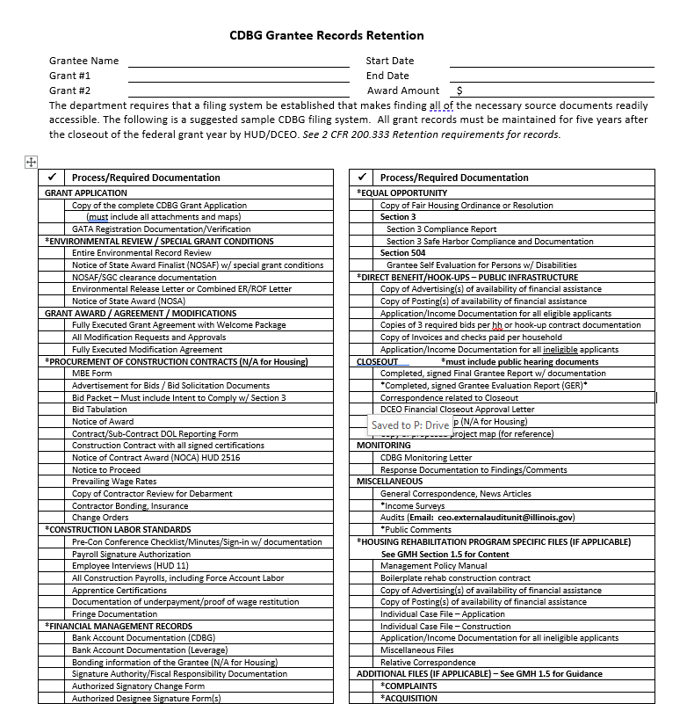
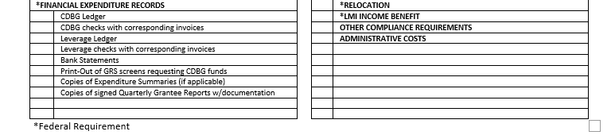
Grantee Files, Record Retention & Audit Requirements

Slide 241
Grantee Files, Record Retention & Audit Requirements
A complete file includes all records that must be maintained
    Grant Application
    Environmental Review / Special Grant Conditions
    Grant Award/Agreement/Modifications
    Procurement of Construction Contracts (N/A for Housing)
    Construction Labor Standards
    Financial Management Records
    Financial Expenditure Records
    Equal Opportunity
    Direct Benefit Connections (PI only)
    Close Out
    Monitoring
    Miscellaneous

Slide 242
Grantee Files, Record Retention & Audit Requirements
Grant Application
      Complete Grant Application
      GATA Registration Documentation/Verification

Slide 243
Grantee Files, Record Retention & Audit Requirements
Environmental Review / Special Grant Conditions
      Entire Environmental Review Record
      Notice of State Award Finalist Letter (NOSAF) with Special Grant Conditions (SGC)
      NOSAF / SGC clearance documentation
      Notice of State Award (NOSA)

Slide 244
Grantee Files, Record Retention & Audit Requirements
Grant Award / Agreement / Modifications
      Fully executed Grant Agreement and Welcome Package
      All Modification Requests and Approvals
      Fully Executed Modification Agreements

Slide 245
Grantee Files, Record Retention & Audit Requirements
Procurement of Construction Contracts (N/A for Housing)
      MBE Form
      Advertisement for Bids / Bid Solicitation Documents
      Bid Packet
      Bid Tabulation
      Notice of Award
      Contract/Sub-Contract DOL Reporting Forms
      Construction Contract with all signed certifications
      Notice of Contract Award (NOCA)
      Notice to Proceed
      Prevailing Wage Rates
      Contractor Review for Disbarment
      Contractor Bonding, Insurance
      Change Orders

Slide 246
Grantee Files, Record Retention & Audit Requirements
Construction Labor Standards
      Pre-Con Conference Checklist/Minutes/Sign-in
      Payroll Signature Authorization
      Employee Interviews
      Construction Payrolls
      Apprentice Certifications
      Documentation of Underpayment/Wage Restitution
      Fringe Documentation

Slide 247
Grantee Files, Record Retention & Audit Requirements
Financial Management Records
      Bank Account Documentation
      Bonding Information
      Signature Authority/Fiscal Responsibility Documentation
      Authorized Signatory Change Forms
      Authorized Designee Signature Forms

Slide 248
Grantee Files, Record Retention & Audit Requirements
Financial Expenditure Records
      General Ledgers
      Checks and Corresponding invoices
      Bank Statements
      Print outs of GRS screens requesting CDBG funds
      Copies of Expenditure Summaries
      Copies of Signed Quarterly Grantee Reports

Slide 249
Grantee Files, Record Retention & Audit Requirements
Equal Opportunity
      Fair Housing Ordinance or Resolution
      Section 3 Reports and Documentation
      Section 504 Grantee Self Evaluation for Persons with Disabilities

Slide 250
Grantee Files, Record Retention & Audit Requirements
Direct Benefit Connections (PI)
      Advertising of Availability of Financial Assistance
      Posting of Availability of Financial Assistance
      Application/Income Documentation of all eligible applicants
      Copies of 3 required bids per household or hook-up contract
      Invoices and checks paid per household
      Application/Income Documentation of all ineligible applicants

Slide 251
Grantee Files, Record Retention & Audit Requirements
Closeout
      Final Quarterly Grantee Reports
      Grantee Evaluation Report (GER)
      Correspondence related to Closeout
      DCEO Financial Closeout Letter
      As Built Project Map
      Proposed Project Map

Slide 252
Grantee Files, Record Retention & Audit Requirements
Monitoring
      CDBG Monitoring Letter
      Response Documentation

Slide 253
Grantee Files, Record Retention & Audit Requirements
Miscellaneous
      General Correspondence
      Income Surveys
      Public Comments
      Audits

Slide 254
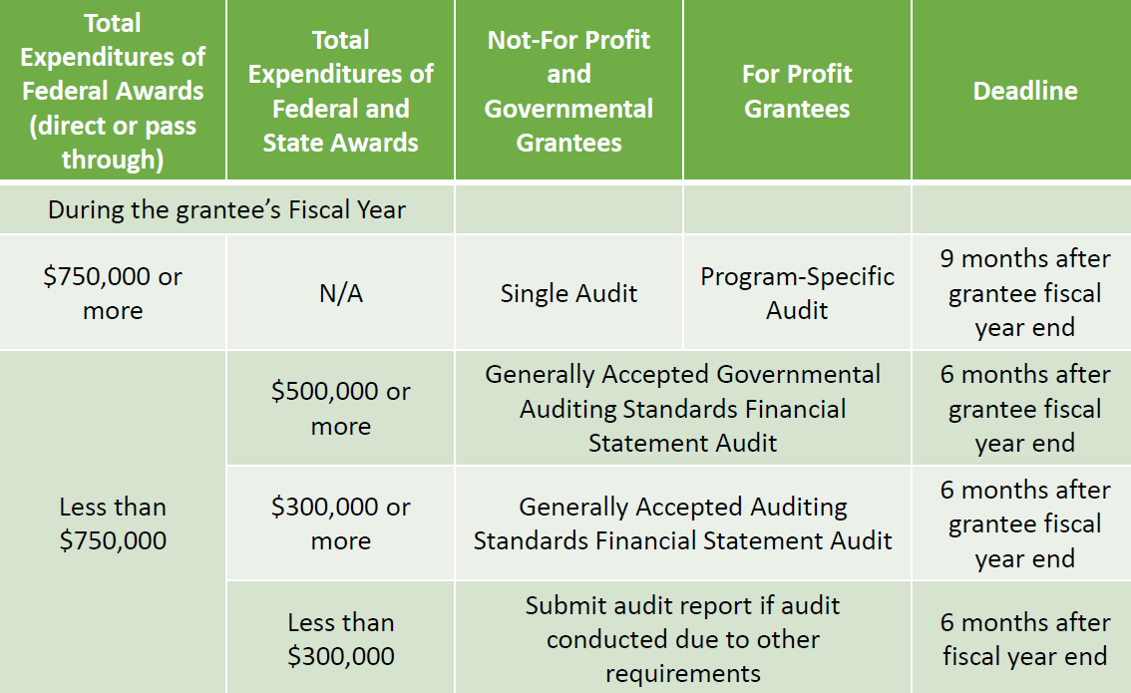
Grantee Files, Record Retention & Audit Requirements
Audit Requirements

Slide 255
Grantee Files, Record Retention & Audit Requirements
Audit Requirements
The State of Illinois is required to obtain and review the audit of all entities that had any State or Federally participating funds pass through it.
The appropriate audit reporting package must be submitted through the Grantee Portal at grants.illinois.gov/portal
Non-compliance with audit requirements could result in implementation of the Grantee Compliance Enforcement System (GCES) and may result in the inability to receive grant funds
Helpful Resources
  https://dceo.illinois.gov/aboutdceo/grantopportunities.html
  DCEO Office of Accountability-ceo.GrantHelp@illinois.gov

Slide 256
Grantee Files, Record Retention & Audit Requirements
RECAP
The CDBG Grantee Records Retention Checklist is a Useful Tool
Be Knowledgeable of Specific CDBG Program Requirements
When in Doubt….Don’t Toss it Out!

Slide 257
CDBG Grant Administration
Monitoring
Lisa Thomas Swaine

Slide 258
Monitoring
2 CFR 570.501(b); 2 CFR 200.328 and 200.331
DCEO is responsible for ensuring that CDBG funds are used in accordance with all program requirements and for determining the adequacy of performance under the Grant Agreement.

Slide 259
Monitoring
2 CFR 570.501(b); 2 CFR 200.328 and 200.33
Monitoring identifies:
  If Grantees are proceeding with the project in a timely manner.
  If Grantees are carrying out activities identified in the Grant Agreement
  Potential problem areas that Grantees may be experiencing
  Potential concerns and/or findings that require correction
  Opportunities for hands-on assistance

Slide 260
Monitoring
2 CFR 570.501(b); 2 CFR 200.328 and 200.331
DCEO’s role is NOT to simply “catch” grantees making mistakes/errors.
CDBG staff conduct oversight activities to ensure:
  All funds are spent effectively and accomplish their intended purpose; and
  Confirm compliance with Federal statutes, regulations and the terms of the Grant Agreement
    This includes established timeframes and performance goals as they relate to the activities included in the Scope of Work.

Slide 261
Monitoring
2 CFR 570.501(b); 2 CFR 200.328 and 200.331
Required Grant Reporting and On-site Compliance Monitoring
  Conducted to ensure compliance deficiencies are corrected.
  Can also be utilized for the Grantee to obtain on-site technical assistance from their Grant Manager.

Slide 262
Monitoring: How Grantees are selected
Grantees are initially selected for On-site Compliance Monitoring based on answers provided in the GATA Internal Control Questionnaire (ICQ).
Grant Managers may conduct an on-site monitoring visit for other reasons.
Grant Managers may conduct an on-site monitoring visit for other reasons. may conduct an on-site monitoring visit for other reasons.

Slide 263
Monitoring: What is Reviewed?
On-site Compliance Monitoring of CDBG funded activities will review:
  Timeliness
  LMI Benefit
  EEO/MBE
  Fair Housing
  Section 504
  Financial Management
  Project Construction

Slide 264
Monitoring: Preparation for Grantee
Prior to monitoring, your Grant Manager will reach out to you and select a mutually agreeable monitoring date.
Your Grant Manager will follow up with an email (typically 15-30 days prior to monitoring) confirming the Grantee being monitored, the date(s) of monitoring, the monitoring location(s), and the description of the project to be monitored. The email will also contain 4 important attachments: Grantee Records Retention Checklist ,CDBG Monitoring Review Checklist, CDBG Monitoring Reference sheet, and HUD/CDBG Requirements.

Slide 265
Monitoring: Preparation for Grantee
t The CDBG Grantee Records Retention Checklist is a document that is initially sent out with the Grant Agreement. This document is the guideline for organizing your file. It is re-sent with upcoming monitoring as a reminder to what documents are required for your files.

Slide 266
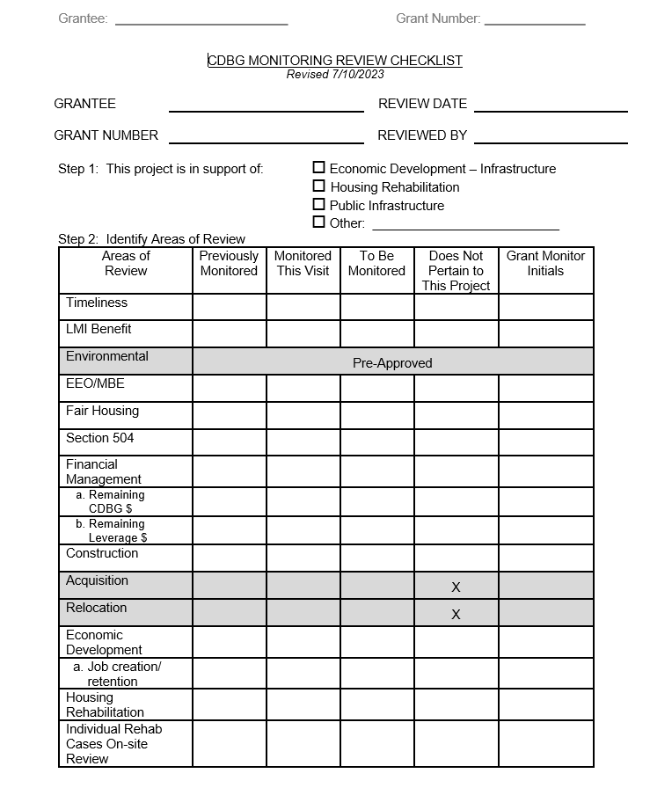
Monitoring: Preparation for Grantee
The CDBG Review Monitoring Checklist is a 28-page document with questions specific to the type of CDBG Grant, and the project’s state of completion. Not all pages are applicable; however, your Grant Manager will identify areas to be addressed.

Slide 267
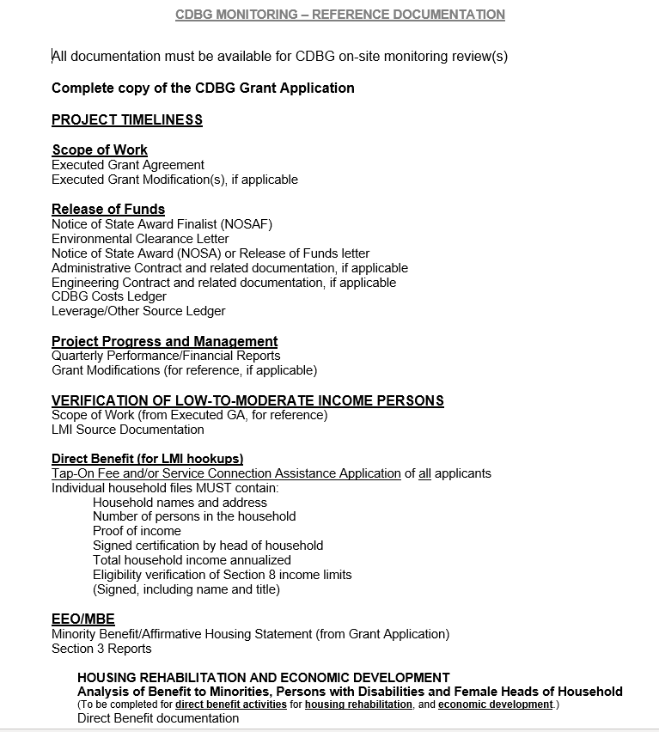
Monitoring: Preparation for Grantee
The CDBG Monitoring Reference Documentation is a 3-page document which specifically outlines documentation that should be made available for the on-site monitoring review(s).

Slide 268
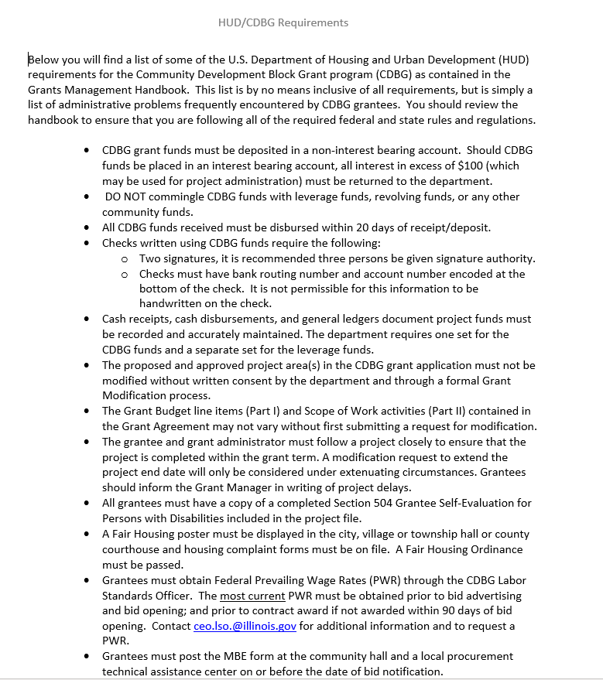
Monitoring: Preparation for Grantee
The HUD/CDBG Requirements is a 3-page document that addresses administrative problems frequently encountered by CDBG grantees. This was initially sent out with the Executed Grant Agreement.

Slide 269
Post-Monitoring
2 CFR 570.501(b); 2 CFR 200.328 and 200.33
The results of the monitoring will be discussed with the Grantee/Grant Administrator at the end of the monitoring visit. A Monitoring Report Letter will then be issued to the Grantee with the results of the on-site monitoring visit. Deficiencies not corrected at the on-site visit will be identified in the letter, and the Grantee will be required to address them within the timeframe provided. This means, if any of those Findings call for Corrective Actions, the Grantee must put those in place, to resolve the issue and avoid any further measures taken by the Department.

Slide 270
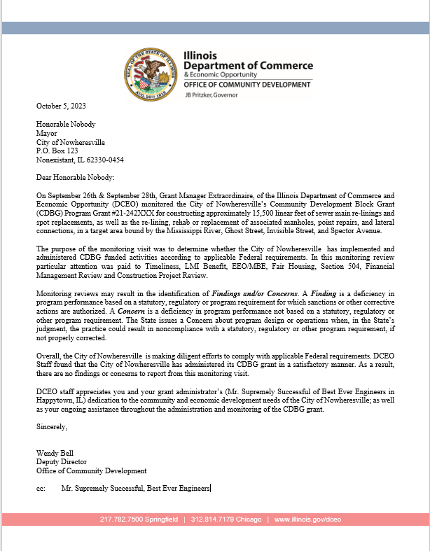
Monitoring: Potential Outcomes
2 CFR 570.501(b); 2 CFR 200.328 and 200.331
The Monitoring may find the Grantee fully in compliance with Federal requirements, with grant being administered in a satisfactory manner, and no issues to rectify. A letter will be issued to the Grantee, to this effect.

Slide 271
Monitoring: Potential Outcomes
2 CFR 570.501(b); 2 CFR 200.328 and 200.33
Monitoring may result in the identification of “Findings” and/or “Concerns”:
    A Finding is a deficiency in program performance based on a statuatory, regulatory or program requirement for which sanctions or other corrective actions are authorized.
    A Concern is a deficiency in program performance not based on a statuatory, regulatory or other program requirement. A Concern about program design or operations is issued when, in DCEO’s judgment, the practice could result in noncompliancewith a statuatory, regulatory or other program requirement, if not properly corrected.

Slide 272
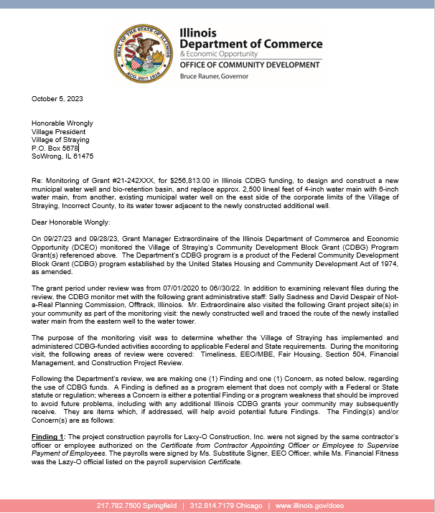
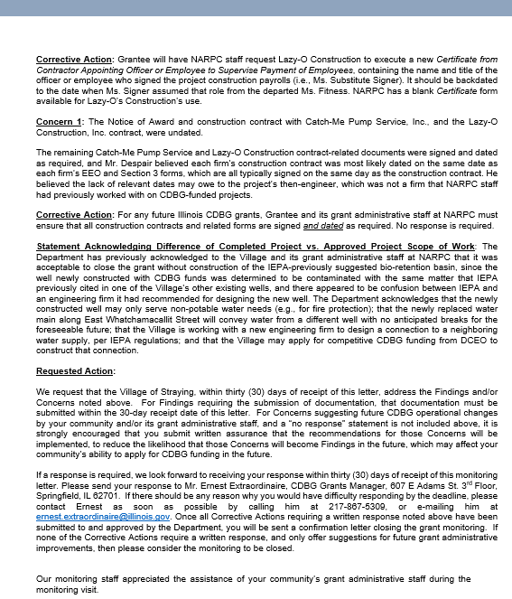
Monitoring: Potential Outcomes
If there are Findings or Concerns:

Slide 273
Monitoring: Future Impacts with Findings or Concerns
Grantee may be assigned a higher level of risk, and additional conditions to mitigate that risk of non-compliance may be assigned for this and future grants.
If a Grantee/Grant Administrator has repeated Findings/Concerns and has not implemented suggestions or utilized information provided via Technical Assistance, then DCEO can ban specific Grant Administrators or Grantees from applying for future funding; for a minimum of 1 year.
HUD may consider taking enforcement action against non-compliant grantees as required by 2 C.F.R. 200.339 which speaks to remedies for non-compliance.
Types of outcomes resulting from a Monitoring Review or Visit .

Slide 274
Monitoring: Future Impacts with Findings or Concerns
Temporarily withhold cash payments pending correction of the deficiency by the non-Federal entity or more severe enforcement action by the Federal awarding agency or pass-through entity.
Disallow (that is, deny both use of funds and any applicable matching credit for) all or part of the activity or action not in compliance.
Wholly or partly suspend or terminate the Federal award.
other remediFederal awarding agency regulations (or intj
Wholly or partly 200.521
Temporarily withhold cash payments pending correction of the deficiency by the non-Federal entity or more severe enforcement action by the Federal awarding agency or pass-through entity. ayments pending correction of the deficiency by the non-Federal entity or more severe enforcement action by the Federal awarding agency or pass-through entity.
Types of outcomes resulting from a Monitoring Review or Visit .

Slide 275

Monitoring: Future Impacts with Findings or Concerns
Initiate suspension or debarment preceedings as authorized under 2 CFR part 180 and Federal awarding agency regulations (or in the case of a pass-through entity, recommend such a proceeding be inititated by a Federal awarding agency).
Withold further Federal awards for the project or program.
Take other remedies that may be legally available.
Types of outcomes resulting from a Monitoring Review or Visit .

Slide 276
CDBG Grant Administration
Common Mistakes
Lisa Thomas Swaine

Slide 277
Mistakes lead to policy changes
Due to some recent on-site monitoring, it has become apparent that there are some areas that seem to cause repeated issues for Grantees and therefore policy changes for DCEO. Let’s discuss:

Slide 278
Bid Packets
Project bid packets are missing the signed Equal Employment Opportunity Certification (EEO) form by Contractors and Sub-contractors.

Slide 279
Contract Documents
Labor Standards and Prevailing Wage Requirements forms are missing from the Contract documents.

Slide 280
Contracts
Once the Grantee receives the Executed Grant Agreement, provisions need to be made for bid advertisement and bid specifications to be sent to OCD’s Compliance Unit for review, so that the project can be timely bid. We are seeing a number of projects delayed, which creates unnecessary end-date modifications.

Slide 281
Wage Rate Determination Issues
You must remember to update your Wage Rate Determination (WRD) if your contract is not awarded within 90 days after the bid opening.
If not completed, this may result in financial restitution being warranted.

Slide 282
Payroll
Apprentices are working alone. This should not be a common practice. If there is an unexpected event that necessitates this happening, then prevailing wage must be paid…NOT apprentice rates.

Slide 283
Payroll
Employees are working under wrong job classifications. Please make sure to mark your payrolls according to the Classifications defined in your Wage Rate Determination (WRD).

Slide 284
Payroll
Person(s) signing certified payroll reports has not always been the person(s) authorized on the Contractor Profile Form (previously the “Certificate from Contractor Appointing Officer or Employee to Supervise Payment of Employees”).

Slide 285
Payroll-Fringe Benefits
Fringe benefit information is missing from a number of grantee files.
Fringe benefits are not being paid out correctly.

Slide 286
Employee Interviews
Employee interviews are not being conducted or are not including all job classifications/trades.
Interview forms are not being reviewed and compared to the payroll by the Payroll Examiner/Project Labor Standards Officer.
Employee interviews are not being conducted in the appropriate numbers.

Slide 287
Grantee Accounts
CDBG funds should not be co-mingled with any other funds.
CDBG funds should not be deposited into interest bearing accounts.

Slide 288
Grantee Accounts
The Grantee must sign its own checks paying out CDBG and other funds tied to its grant.
The Grantee’s checks should not be signed by the CDBG Grant Administrator.

Slide 289
Grantee Accounts
Not all Grantees are following the 20-day anticipated disbursement rule. When a check is received from DCEO, those funds should be paid out within 20 days and not remain in the Grantee’s account for an extended period of time.

Slide 290
Community Development Block Grant Program
Monitoring
Lisa Thomas-Swaine
Please contact me if you have any questions
IL Dept of Commerce & Economic Opportunity
607 E. Adams, 3rd Floor
Springfield, IL 62701
Phone: 217.558.2840
Email: Lisa.Thomas-Swaine2@Illinois.gov
Thank You!

