Slide 1



Illinois Department of Commerce & Economic Opportunity
www.illinois.gov/dceo
Community Development Block Grants
The GATA Process

Slide 2


Grant Accountability & Transparency Act (GATA)
The purpose of GATA is to provide for the development of a coordinated, non-redundant process for the provision of effective and efficient oversight of the selection and monitoring of grant recipients, ensuring quality programs, limiting fraud, waste and abuse, and defining the purpose, scope, applicability and responsibilities in the life cycle of a grant.

Slide 3
GATA Process
GATA WEB PORTAL www.grants.illinois.gov
What Grants are Available?
  Catalog of State Financial Assistance (CSFA)
  Notice of Funding Opportunity (NOFO)
First Step in Getting a Grant:
  Pre Qualification Portal
Who Has Received a Grant?
  Listing of all Executed Grants
Who Can’t Get a Grant?
  STATE Debarred/Suspended List
  Comptroller’s Offset Management Information Control System

Slide 4
GATA Process
PRE QUALIFICATION PORTAL
Complete registration and pre-qualification on the Portal
  One per State Fiscal Year
    July 1st – June 30th
  Need:
    Dun & Bradstreet Verification
    SAM Cage Code Number
  Must be completed prior to application submission.

Slide 5
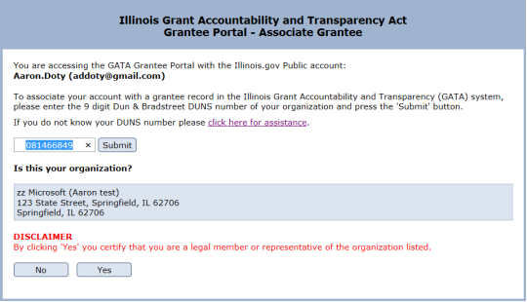
Annual Pre-Qualification Process: Steps 1 & 2
Go to the GATA Portal
Enter your username and password and click “sign in”
Fill in the DUNS number for the entity for which you are associated with and click “yes.”

Slide 6
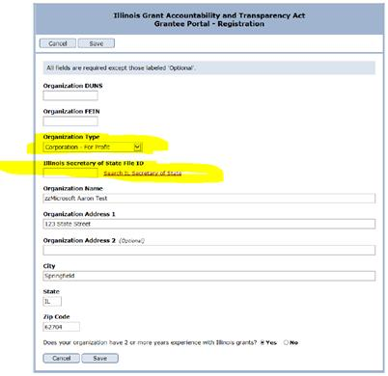
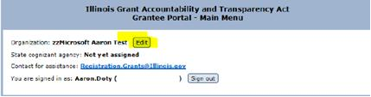
Annual Pre-Qualification Process – Step 3
Edit registration and change the “Organization Type” to appropriate classification.
Enter the entities if necessary based on the IL Secretary of State Certificate of Good Standing.
Click “Save.”

Slide 7
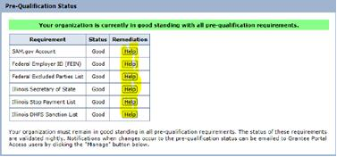
Annual Pre-Qualification Process – Step 4
Go back to Main Menu and scroll down to check pre-qualification status.
Use the “help button for anything that does not have a “Good” status to remediate.

Slide 8
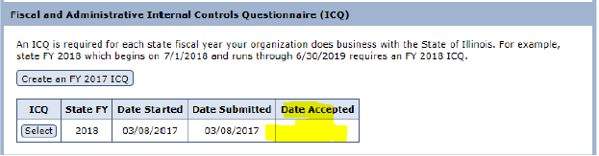
Annual Pre-Qualification Process – Step 5
Scroll down to Fiscal and Administrative Internal Control Questionnaire (ICQ) to create an ICQ for the current year.

Slide 9
GATA Process – Internal Control Questionnaire
Completed once, annually for the Entity, Includes:
  Accounting System
  Budget Controls
  Cost Principles
  Audit
  Organizational Governance
  Property Standards
  Procurement Standards
  Subrecipient Monitoring – not applicable for CDBG
  Fraud, Waste and Abuse
Submitted to cognizant agency for review.

Slide 10
Annual Pre-Qualification Process – Step 5
Be sure to click “Submit”
After completion of the ICQ, check to see if you have an accepted FY20 ICQ.
If there is not a date in the “Date Accepted” box, then the ICQ was not accepted. Reach out to Cognizant Agency.

Slide 11
Need Help?
Grantees should refer to FAQs at: https://www.illinois.gov/sites/GATA/Grantee/Pages/GranteePortalFAQ.aspx
Resource Library can be found at: https://www2.illinois.gov/sites/GATA/Pages/ResourceLibrary.aspx
E-mail: CEO.GATA@Illinois.gov

Slide 12
Indirect Costs
Once pre-qualification and ICQ approved, an email invitation will be sent to log into the State of Illinois Indirect Cost Rate Proposal System, better known as CARS.
Elect the type of indirect rate using on all Illinois grants.
All grantees are required to log into the system and make a rate selection and submit it for approval.
Even if you elect not to claim any indirect costs and not have a rate, you still need to document that in CARS and submit it for approval.
No Documentation = No Payments

Slide 13
Indirect Rates
The types of indirect rates that are available to use are:
1. Federally negotiated indirect cost rate
2. State negotiated indirect cost rate
3. 10% De Minimis rate applies to the Modified Total Direct Costs (MTDC)
4. Elect not to charge indirect and select no rate
NOTE: Regardless of your choice, Indirect Costs are not eligible for payment by grant funds for CDBG or Rebuild Illinois grants.

Slide 14
GATA Process
UNIFORM APPLICATION FOR STATE GRANT ASSISTANCE
On Agency/Program Website
PROGRAM APPLICATION
On Agency/Program Website
  CDBG Grant Programs
  Rebuild Illinois Competitive Public Infrastructure and Economic Development Grant Programs
GATA BUDGET
On Agency/Program Website
DO NOT INCLUDE WITH CDBG APPLICATION

Slide 15
GATA Process
MERIT BASED REVIEW
Completed by Committee
Appeals Process
  Written within 14 days

Slide 16
Notice of State Award Finalist (NOSAF)
Complete the outstanding grant award requirements as stated on the Notice of State Award Finalist
  Outstanding GATA requirements
    Programmatic Risk Assessment (will be e-mailed)
  Return Conflict of Interest and Mandatory Disclosures
  Environmentals
  Special Conditions
  Complete GATA Budget (CDBG grants)
  90 Days from receipt to complete

Slide 17
GATA Process
PROGRAMMATIC RISK ASSESSMENT
Evaluates past performance in the CDBG program for both the Community and the Administrator
Complete the Programmatic Risk Assessment for each Grant
Survey link will be e-mailed to you along with NOSAF.

Slide 18
GATA Process
NOTICE OF STATE AWARD (NOSA)
Similar to Grant Award Letter
Provides all the terms and conditions based on the Internal Control Questionnaire (ICQ) and the Programmatic Risk Survey.
Review the NOSA to ensure understanding of grant terms
Accept NOSA on GATA system.
  Grant will not be awarded without NOSA acceptance.

Slide 19
GATA Process
Uniform Grant Agreement
Part 1 – Uniform across the State
Part 2 – Uniform across the Agency
Part 3 – Program Specific
Sign and submit the Agreement to the Agency
Hurray, you made it!!!

Slide 20

www.illinois.gov/dceo
Questions?
Thank You!
Wendy Bell
Deputy Director of Community Development
500 East Monroe
Springfield, IL 62701
Phone # 217-558-4200
Email: wendy.bell@illinois.gov

