Slide 1



Illinois Department of Commerce & Economic Opportunity
www.illinois.gov/dceo
Community Development Block Grants
2020 Economic Development Application Workshop

Slide 2
Illinois Department of Commerce & Economic Opportunity
www.illinois.gov/dceo
Community Development Block Grants
Section I and II Highlights
Wendy Bell

Slide 3


Funding Availability
$4,000,000 Available
  Grant Ceiling of $1 million based on job creation
Applications at any time

Slide 4
Eligible Applicants
Only units of general local government may apply for funding.
Entitlement communities/counties that receive a direct appropriation of CDBG funds from HUD are not eligible to apply. (Section 1C)

Slide 5
Application Materials
All original Application Forms and Materials as shown in the Guidebook must be utilized.
Applications will be designated DO NOT FUND for:
  Using self-created forms
  Adding to or removing any language in forms
  Forged, copied, taped, pasted or any alterations to signatures or dates
All Letters, Notices, Resolutions, Agreements or other communication provided by the ULG must be of the exact verbiage contained in the Guidebook and be on government letterhead.

Slide 6
A. Requirements and Disclaimers
Costs previously incurred or for application preparation are not reimbursable.

Slide 7
A. Requirements and Disclaimers
Grant Agreements are for 24 months
  No more than one 12 month extension

Slide 8
A. Requirements and Disclaimers
Modifications
  Must be presented to the Department
  Must be within the original and environmentally-cleared project area.
  Modifications to change the scope of work due to greater than or less than estimated costs will not be considered.

Slide 9
B. State and Federal Compliance
2 CFR 200
Grant Accountability & Transparency Act (GATA)

Slide 10
C. Citizen Participation
Step by step process spelled out in the Guidebook, Section II C.
COUNT THE DAYS!
Doesn’t matter who made the mistake, if process wasn’t followed, it is a DNF. This is a federal requirement.

Slide 11
Use an experienced Writer/Administrator
All application writers and grant administrators must have administered an Illinois CDBG grant within the last two years or attend the 2020 grant administration workshop (as well as the 2020 Application Workshop).

Slide 12
Use an Environmental Specialist
All Grantees must use an experienced Environmental specialist, who has completed at least one Illinois CDBG Environmental Review since January 1, 2016 OR has successfully completed DCEO Environmental Training on July 18, 2018

Slide 13
Illinois Department of Commerce & Economic Opportunity
www.illinois.gov/dceo
Community Development Block Grants
The Guidebook
Section V
Economic Development
David Goben

Slide 14

National Goals & Objectives
Assist in building the financial and operational capacity of communities to carry out local economic development
  Locational Argument
  Financial Gap Argument

Slide 15
Low and Moderate Income Persons
"Low and Moderate-Income Persons" shall mean those individuals in a family whose income is less than 80% of the median income of the area.”

Slide 16

CDBG Economic Development
$4.0 million allocation for 2020
$1 million maximum grant award

Slide 17
Purpose
Economic Development Financial projects
  Job creation with 51% LMI
  Job retention with 51% LMI
(Participation Agreement)
Public Infrastructure in Support of Business
  Participation Agreement
  Job creation with 51% LMI
  Job retention with 51% LMI

Slide 18
Purpose
The primary objective of program is to enable grantees to carry out local economic development activities in a way that will expand economic opportunity, principally for low and moderate-income persons. Each project shall result in private sector job creation or retention. At least 51% of such jobs shall be filled or retained by persons of low and moderate-income.

Slide 19
Eligible Grant Recipients
Only units of local government recognized by the Illinois Constitution and able to support economic development activities on a sufficient scale are eligible to apply for Economic Development grant funding. This includes cities, villages, and counties.

Slide 20
Eligible Businesses
Private for-profit
Not-for-profit entities
Sub recipients must directly create or retain jobs; indirect jobs (employed by other than the participating business) are not sufficient to meet program guidelines.

Slide 21
Federal Regulations/Title 1
Job Creation/Retention with 51% LMI Benefit
Environmental Review (required prior to NOSA)
Davis-Bacon
Required for construction work using Program funds
Uniform Act
Required when real property is acquired or persons displaced

Slide 22
Policy Guidelines
Finance no more than 50% of project
Not to exceed $25,000 for every FTE created and $10,000 retained
No speculative financing
51% LMI benefit
Emphasis on “Types” of Industry

Slide 23
Eligible Use of Funds
Site development/infrastructure extension
Construct new facility/addition
Renovation of existing facility
Leasehold improvements
Purchase of machinery or equipment
Working Capital
Acquisition of land

Slide 24
Ineligible Use of Funds
Buildings used for general conduct of government
General government expenses
Costs of operating and maintaining public infrastructure and services
Servicing or refinancing existing debt
Marijuana projects for medical purposes

Slide 25
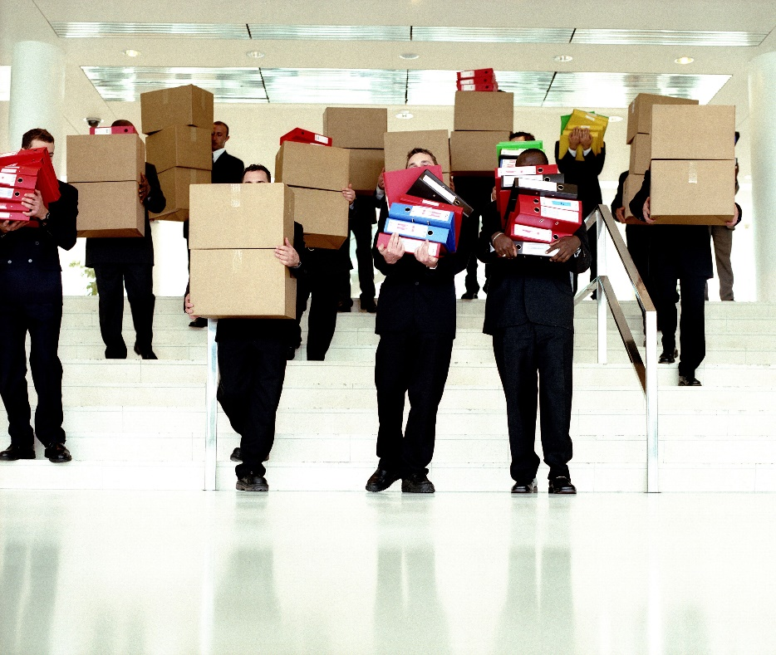
Ineligible Use of Funds
Relocation of business from one area of the state to another
Exceeding HUD’s threshold of pirating jobs
Violation of HUD’s underwriting provisions

Slide 26

Security
All financial assistance projects to businesses shall be secured with a “Claw back” agreement (Participation Agreement) for both Infrastructure and Direct Assistance type projects.
DCEO will underwrite each project.

Slide 27
Employee Income Certification Forms
  Required to demonstrate the National Objective has been met
  Use current Section 8 HUD income guidelines
  Jobs and investment created by 24th month

Slide 28
- WARNING -
Failure to comply with State or Federal Regulations will result in:
Pending, future grant requests will not be considered;
Payment requests for active grants suspended;
recovery procedures by DCEO.

Slide 29


Slide 30

www.illinois.gov/dceo
Questions?
Thank You!
Dave Goben, Program Manager
500 East Monroe
Springfield, IL 62701
Phone # 217-785-6117
Email: david.goben@illinois.gov

