Slide 1



Illinois Department of Commerce & Economic Opportunity
www.illinois.gov/dceo
Community Development Block Grants
Environmental Training

Slide 2



General requirements National environmental policy act of 1969
Kirk Kumerow

Slide 3
General Requirements Session Outline
National Environmental Policy Act (NEPA) 40 C.F.R. § 1500-1508
24 CFR Part 58

Slide 4
National Environmental Policy Act of (NEPA)1969
The “Magna Carta” of environmental laws.
Purposes to encourage harmony with environment, prevent damage to the environment, stimulate health and welfare.
Created the Council on Environmental Quality (CEQ).
Procedures must ensure that environmental information is available before decisions are made and before actions taken.
Requires - Public Disclosure of Impacts
Establishes -“Levels of Review”

Slide 5
Section 102 (2)(C) of NEPA Dictates the Process
(C) Major Federal actions significantly affecting the quality of human environment, a detailed statement by the responsible officer on
(i) The environmental impact of the proposed action,
(ii) Any adverse environmental effects which cannot be avoided should the proposal be implemented,
(iii) Alternatives to the proposed action,

Slide 6
Section 102 (2)(C) of NEPA Dictates the Process
(iv) The relationship between local short-term uses of man’s environment and the maintenance and enhancement of long term productivity,
(v) Any irreversible and irretrievable commitments of resources which would be involved in the proposed action should it be implemented.
NEPA definition of the “human environmental”:
Shall be interpreted comprehensively to include the natural and physical environment and the relationship of people with that environment.

Slide 7
NEPA & Part 1500 of the Code of Federal Regulations
Governs form and content of the Environmental Impact Statement (EIS)
Agency regulations identify what actions warrant Categorical Exclusions and Environmental Assessments.
7

Slide 8
CEQ’s Regulations Require Federal Agencies to:
NEPA is an integral part of the planning process.
The environmental review process should begin as soon as a recipient determines the projected use of HUD assistance.
The environmental document can serve during the decision-making process and will not be used to justify decisions already made.
8

Slide 9
CEQ’s Regulations Require Federal Agencies to:
Understand environmental consequences BEFORE commitments are made.
Ensure environmental information is made available to public officials and citizens BEFORE decisions are made and BEFORE actions are taken.
9

Slide 10
Housing and Community Development Act of 1974
Includes State of Illinois CDBG
Decent housing in a suitable living environment
Delegates federal environmental review to local and State government
Request for release of funds (RROF) process
Energy conservation
10

Slide 11
HUD’s Environmental Regulations
24 CFR Part 58 (Unit of Local Government accepts HUD Environmental Responsibility)
24 CFR Part 51 (Environmental Criteria and Standards)Manmade Hazards
Noise
Explosives and Thermal
Runway Clear Zones
24 CFR Part 55 (Floodplain & Wetlands)
24 CFR Part 35 (Lead Based Paint Rule)
24 CFR Part 50 -- HUD Review Requirements
Environmental review requirements for HUD staff
36 CFR Part 800 (Protection of Historic Properties)
11

Slide 12
HUD Environmental Review Procedures - Part 58
Assumption of NEPA responsibilities by Responsible Entities (RE) (i.e., Our Grantees)
Assumption by RE of environmental review for non-profits and quasi-governmental agencies (if one is a HUD Grantee, like PHA)
Incorporates CEQ regulations thresholds for EIS and EA
Defines Categorical Exclusions & Exemptions
Procedures for Release of Funds & Certifications
12

Slide 13
Types of Environmental Impacts [Section 1508.8]
Direct
Caused by the action and occur at the same time and place
Indirect
Caused by the action but effects are later in time or farther removed in distance, but are still reasonably foreseeable
e.g., growth inducing effects
Cumulative
Incremental impact of the action when added to other past, present and reasonably foreseeable future actions, regardless of who is the project proponent for those actions
13

Slide 14
Responsible Entities (RE) 58.4
Assume the responsibility for environmental review, decision-making, and action that would otherwise apply to HUD under NEPA.
RE that receives assistance directly from HUD/State assumes responsibilities by execution of a legally binding HUD Form 7015.15 (RROF) and the Grant Agreement, certifying to the assumption of environmental responsibilities.
14

Slide 15
Limitations on Actions During NEPA Process [40 CFR 1506.1] & §58.22
Until the Agency has issued a decision, no action shall be taken that will:
Have an adverse environmental impact, or
Limit the choice of reasonable alternatives
HUD policy to not allow bids for choice-limiting actions (such as construction or demolition) before the environmental review is complete.
15

Slide 16
Value of Environmental Review
Required by law
Secures the value of public investment
Results in higher quality projects
Avoids or mitigates harmful environmental impacts
Helps avoid litigation that could stop project
Grantees avoid monitoring findings and sanctions (incl. Grant re-payment)
16

Slide 17
24 C.F.R. Part 58 entities assuming hud’s environmental review responsibilities
Kirk Kumerow

Slide 18


DCEO’s ERR Mission
To not return CDBG funds to HUD for lack of proper environmental review.

Slide 19
NEPA Implementation Allows HUD to Achieve its Mission
Two HUD Regulations implement NEPA:
24 C.F.R. Part 50
Applies to HUD itself
“Protection and Enhancement of Environmental Quality”
24 C.F.R. Part 58
Applies to Tribes, States, Counties, Cities, Local Governments
“Environmental Review Procedures for Entities Assuming HUD Environmental Responsibilities”

Slide 20
NEPA Assumption Authority under Part 58 [§58.4]
Responsible Entities (REs) assume HUD’s NEPA responsibilities
Serve as the Federal Agency on behalf of HUD
RE assumes responsibility for:
Environmental Review
Environmental Decision-making
Environmental Action that would apply to HUD under NEPA and related laws
Assumed by execution of grant agreement (as HUD subrecipient) and/or by certification of the RROF
Responsibility cannot be delegated
Responsibility to ensure mitigation is incorporated into project plans and implemented

Slide 21
Who can be an RE for State CDBG?
Unit of General Local Government (UGLGs)
County, city, town, township, village or other general purpose political subdivision of the State
Have power to levy taxes and expend Federal, State, and local funds and exercise governmental powers

Slide 22
Certifying Officer
Responsible Federal Official under Section 102 of NEPA and related statutes
Chief Elected Official of CDBG Grantee Community
Authorized to execute the RROF
Accepts jurisdiction of Federal Courts for RE
Has the authority to enter into binding commitment in response to court judgements

Slide 23
States and Tribes Can Administer Programs on HUD’s Behalf [ §58.18]
The State or Tribal entity must designate, in writing, the agency responsible for administering Subpart H, Release of Funds (i.e., Governor designates DCEO for CDBG)
The designated agencies must:
Accept Request for Release of Funds
Receive objections and appeals
Issue State CDBG environmental release letter
Develop and conduct monitoring and enforcement program

Slide 24
§58.22: Limitation of Action
Prior to environmental approval / clearance, the RE may not:
Commit HUD funds
Begin bid process
Commit non-HUD funds where the activity would
Have an adverse environmental impact or
Limit the choice of reasonable alternatives
Do not take action before environmental clearance!!

Slide 25
§58.22 – Limitation on Action
Affirmative Responsibility
If RE is considering an application and is aware a party is about to take action prohibited by §58.22(a), RE must take “appropriate action” to ensure NEPA is followed
Choice-limiting Action
Examples: real property acquisition, leasing, bidding, disposition, demolition, rehabilitation, repair, renovation, construction, conversion and site improvements

Slide 26
Consequences of Violating §58.22
Regulatory violation:
Results from a commitment of Non-HUD funds
Contract, agreement, expenditure of funds
Can result in loss of all HUD assistance for the project and repayment
Statutory violation:
Results from a commitment of HUD funds
Contract, agreement, expenditure of funds
“Taints” the project: HUD funds from the same appropriation can never be used at site where violation occurred. Possible repayment.

Slide 27
Environmental Review Record [§58.38]
§58 NEPA’s administrative record for each project
Reviewable by public/HUD/State/courts
Contains all evaluations, findings, decisions, documentation, public notices, approvals
RE’s only proof of procedural compliance with Federal environmental law and defense against environmental challenges
May be subpoenaed and subject to scrutiny by a court of law
It is the RE’s defense against monitoring findings and sanctions

Slide 28
Overview of environmental review process
Kirk Kumerow

Slide 29


The Environmental Review Process
Define Project
Determine “Level of Review”
Conduct the Environmental Review
Finalize Review (RROF → Env Release Ltr)
Commit / Expend HUD funds

Slide 30
Step 1: Develop a Meaningful Project Description

Slide 31
Why is the project description important?
Basis for determining the level of environmental review required
Basis for informing the public about the action
Basis for monitoring compliance
If funds are used for something not included in the project description, it could be in violation of §58.22, and result in refund to DCEO/HUD.

Slide 32
Poor project descriptions can result in…
Failure to inform the public
Incorrect environmental review determinations, leading to violations and sanctions
Project activities being left out of review, requiring additional environmental review (more time, more money)
Monitoring findings

Slide 33
Defining the Project – The Narrative
Best to use a few sentences to a few paragraphs of the Project Description from your successful CDBG Grant Application
Ensures that the env. clearance covers what DCEO actually approved for funding
Example: “Reline/spot replace approx. 1500 l.f. of sewer mains in the southwest portion of the corporate area, bounded by……..”

Slide 34
Meaningful Project Descriptions Include:
Location: describe so the public can locate (i.e. street address, cross streets)
Purpose and Need: describe what is being done and why it is necessary, trends likely in the absence of the project
Type of environmental review: individual (geographically-aggregated) versus tiered (functionally aggregated)
Tiering, if applied: describe the environmental requirements to be addressed in the Tier 1 review and environmental requirements to be addressed in the Tier 2 review
Project Beneficiaries: ex: affordable housing project, mixed use housing project, etc.
Description: provide complete details about the project and what will be done
Type of project (i.e. new construction of single family home, roof replacement of community center, etc.)
Capture the maximum anticipated scope of the proposal, even if it isn’t solidified yet
Physical description of existing and/or proposed new buildings
Timeframe for implementation
Size of the project (area coverage, number of units, population served, etc.)
All funding sources
All development partners

Slide 35
Step 2: Determine the Level of Environmental Review

Slide 36
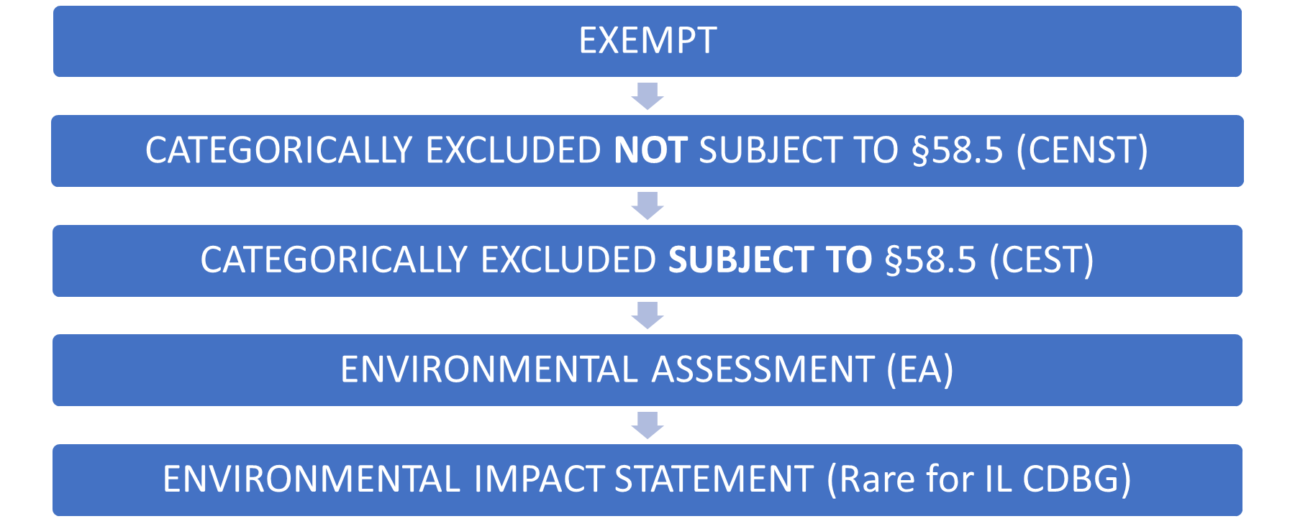
Levels of Review

Slide 37

Typical Timelines for Review
EIS – one to two years
EA – 45 to 100 days to complete depending on consultations required
CEST – 30 to 75 days depending on consultations required
CENST – less than an hour
Exempt & CoC – less than an hour

Slide 38
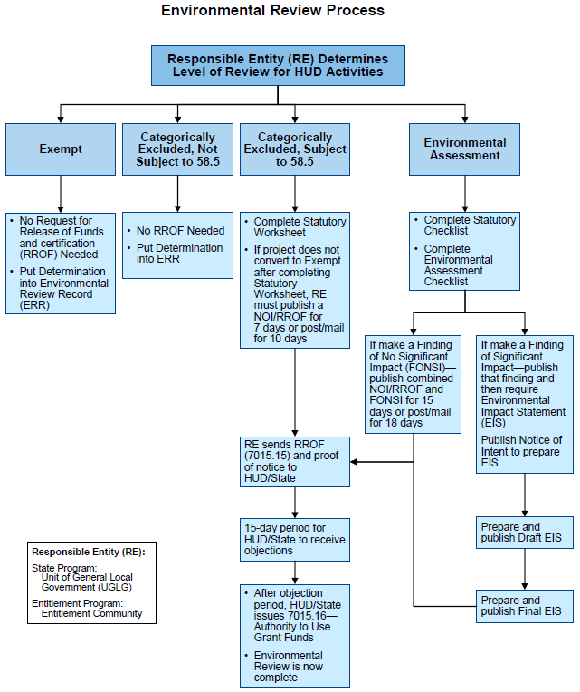

Slide 39
Exempt Activities [§58.34]
Most Common Types For DCEO CDBG:
Environmental and other studies
Administrative and management activities
Engineering or design costs
Assistance for temp or perm improvements following disaster, or imminent threats to public safety, incl. from physical deterioration***

Slide 40
Emergency Exemption [§58.34(a)(10)]
***Project consists solely of:
Assistance for temporary or permanent improvements that do not alter environmental conditions
And limited to protection, repair, or restoration activities necessary only to control or arrest the effects from disasters or imminent threats to public safety including those resulting from physical deterioration
DCEO ERO must preapprove use of this type of Exemption
For more information see Dec 2012 policy memo Exemptions for Disasters and Imminent Threats

Slide 41
Documenting an Exempt Activity
Determination must be in writing [§58.34(b)]
Use HUD example format provided by DCEO
Describe activity (grant number, funding amount, location, project description)
Exempt from NEPA review requirements per 24 C.F.R. 58.34(a)(_)
Address §58.6 requirements
National Flood Insurance Program
Coastal Barrier Resource Act
Runway Clear Zones
Sign and date (preparer and CEO), place in ERR
DCEO ERO reviews as part of its ERR review

Slide 42
Categorical Exclusions – two types
Categorically Excluded NOT Subject to Related Authorities
§58.35(b)
CENST
Categorically Excluded SUBJECT TO Related Authorities
§58 .35(a)
CEST
42

Slide 43
Cat Ex NOT Subject to §58.5
§58.35(b) for DCEO CDBG, generally only:
Operating costs including maintenance*, security, operation, utilities, furnishings, equipment, supplies, staff training and recruitment and other incidental costs (rare for DCEO CDBG)
Economic Development (ED) activities not associated with construction or expansion of existing operations (e.g., purchase of equipment, inventory purchase)

Slide 44
*Maintenance vs. Repair
Maintenance (CENST)
Cleaning, yardwork
Re-painting previously painted surface
Replacing kitchen appliances not attached to building and that would not damage building when removed
Patching a roof leak
Replacing broken windows
Repair (CEST)
Work that is not maintenance
See notice CPD-16-02 Guidance for Categorizing an Activity as Maintenance for Compliance with HUD Environmental Regulations, 24 CFR Parts 50 and 58
44

Slide 45
Documenting a CENST Activity
Determination must be in writing [§58.34(b)]
Use HUD example format provided by DCEO
Describe activity (grant number, funding amount, location, project description)
Categorically Excluded NOT Subject to §58.5 requirements per 24 C.F.R. 58.35(b)(_)
Address §58.6 requirements
National Flood Insurance Program
Coastal Barrier Resource Act
Runway Clear Zones
Sign and date (preparer and CEO), place in ERR
DCEO ERO reviews as part of its ERR review

Slide 46
Cat Ex SUBJECT to 58.5 [§58.35(a)]
Most Common For DCEO CDBG:
Acquisition, repair, improvement, reconstruction or rehabilitation of public facilities and improvements (other than buildings) when the facilities and improvements are:
Already in place
Retained for the same use
Without change in size or capacity by more than 20%
(e.g., Replacement of water or sewer lines, reconstruction of curbs and sidewalks, repaving of streets (NOT maintenance))
Removal of architectural barriers that restrict mobility of, and accessibility to, the elderly and handicapped

Slide 47
Cat Ex SUBJECT to 58.5 [§58.35(a)]
(i) Single family housing rehabilitation
Unit density not increased beyond 4 units
Project doesn’t involve changes in land use from residential to non-residential
The footprint of the building is not increased in a floodplain or wetland

Slide 48
Cat Ex SUBJECT to 58.5 [§58.35(a)]
(iii) Non-residential structures
Facilities and improvements were in place and will not be changed in size or capacity by more than 20%
Project doesn’t involve changes in land use from non-residential to residential, commercial to industrial, or one industrial use to another
Individual action (disposition, new construction, demolition, acquisition) on a 1 to 4 unit dwelling; or individual action on 5 or more units scattered on sites more than 2000 ft. apart and no more than 4 units per site
Acquisition (including leasing) or disposition of, or equity loans on, an existing structure or acquisition (including leasing) of vacant land provided that the structure or land acquired or disposed of will be retained for the same use
Combinations of the above activities

Slide 49
Documenting a CEST Activity
Determination must be in writing
Use HUD example format provided by DCEO
Describe activity (grant number, funding amount, location, project description)
Categorically Excluded SUBJECT to §58.5 authorities per 24 C.F.R. 58.35(a)(_)
Sign and date (preparer and CEO) determination and place in ERR that is also provided to DCEO
Complete Statutory Worksheet (now part of CEST form) with supporting documentation
Two potential results…

Slide 50
Two CEST Potential Outcomes
CEST converts to EXEMPT
Complete Statutory Worksheet with all supporting documentation
“All No’s” for 16 bodies of law
No circumstances requiring compliance / mitigation
Document the file and proceed with project once DCEO approves
CEST cannot convert to EXEMPT
Complete Statutory Worksheet with all supporting documentation
Something requires mitigation or further compliance actions
Proceed with approval process
NOI/RROF publication/posting
RROF (HUD Form 7015.15)
DCEO Env Release Ltr
50

Slide 51
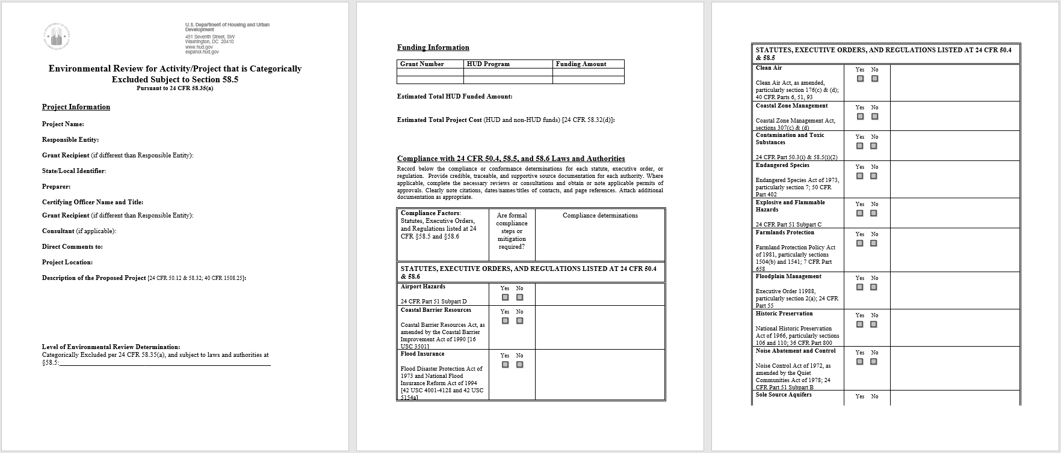

Slide 52
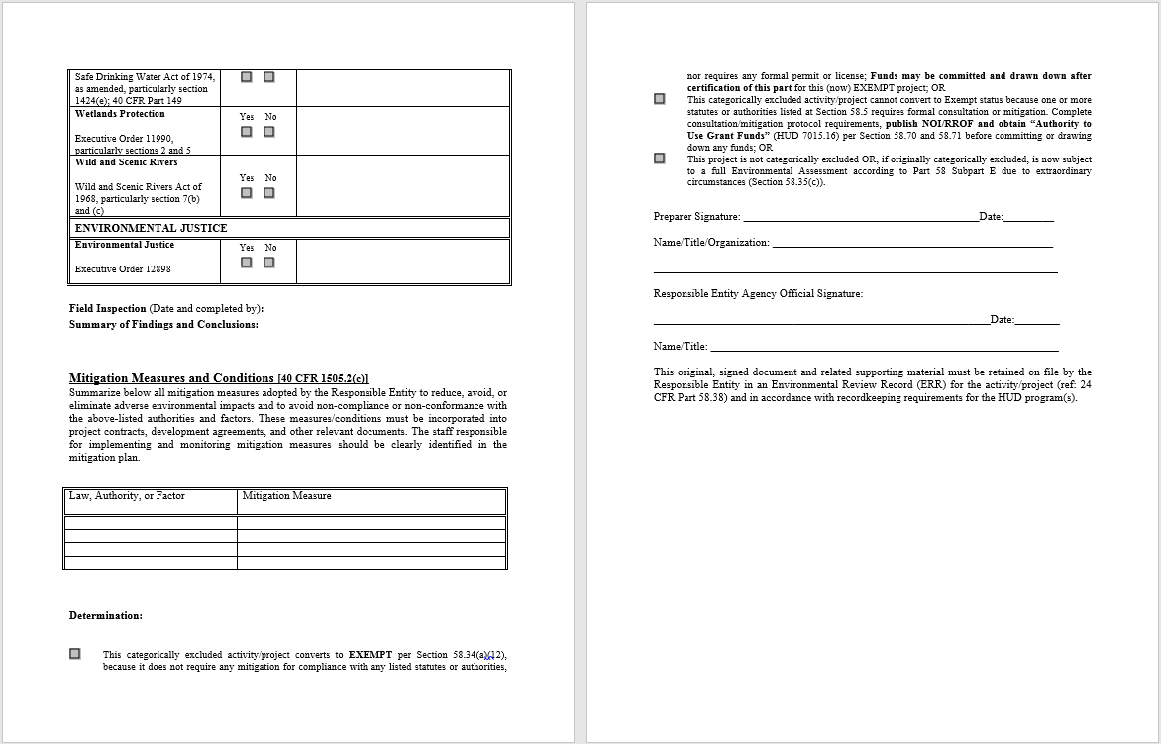

Slide 53
Sample CDBG CEST Conversions to Exempt
Water or sewer main replacements in place (and no extensions)
Sewer re-linings w/spot replacements
Rebuild sewer lift station in place
Sidewalk replacements (no extensions) - for RLF Closeouts
Road repaving (no extension or expansion) - for RLF Closeout or ED
And none of the above are in a FEMA-mapped Flood Plain and/or a USF&WS-mapped Wetlands, and also do not require IDNR Wetlands mitigation
Use 1st box under “Determination” on CEST

Slide 54
Environmental Assessment [§58.36]
Any project not Exempt, Categorically Excluded, and does not meet EIS thresholds. Some IL CDBG examples:
Extension of water or sewer lines to an unserved community
Water tower replacement
The purpose is to evaluate the project as a whole
Determine existing conditions and trends
Identify all impacts (direct, indirect, cumulative)
Examine and recommend feasible ways to eliminate or minimize adverse environmental impacts
Examine alternatives to project itself, if applicable

Slide 55
Documenting an Environmental Assessment
Environmental Assessment (EA) format provided by DCEO that follows §58.40
Includes separate EA Checklist and Statutory Checklist and all supporting documentation indicating a Finding of No Significant Impact (FONSI)
Sign and date (by preparer and CEO), for ERR (& DCEO review)
FONSI and NOI/RROF publication/posting (& dissemination)
RROF (HUD Form 7015.15)
DCEO Env Release Letter

Slide 56
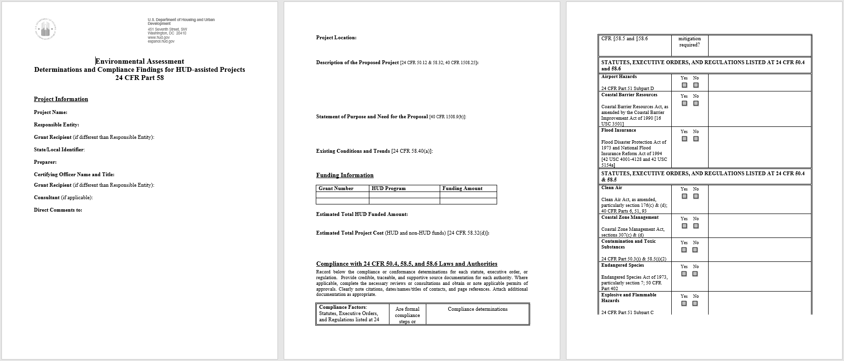

Slide 57
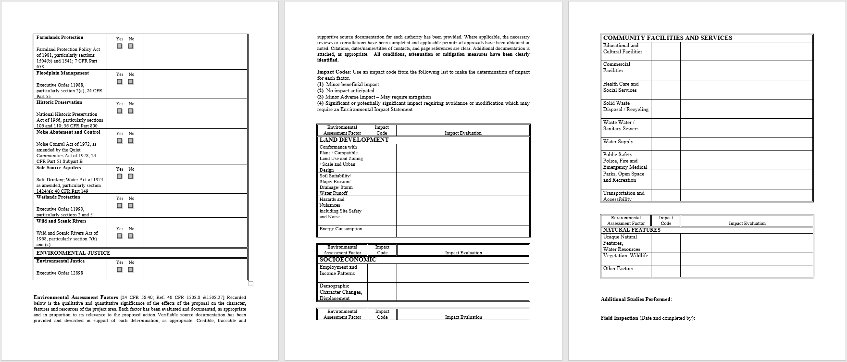

Slide 58
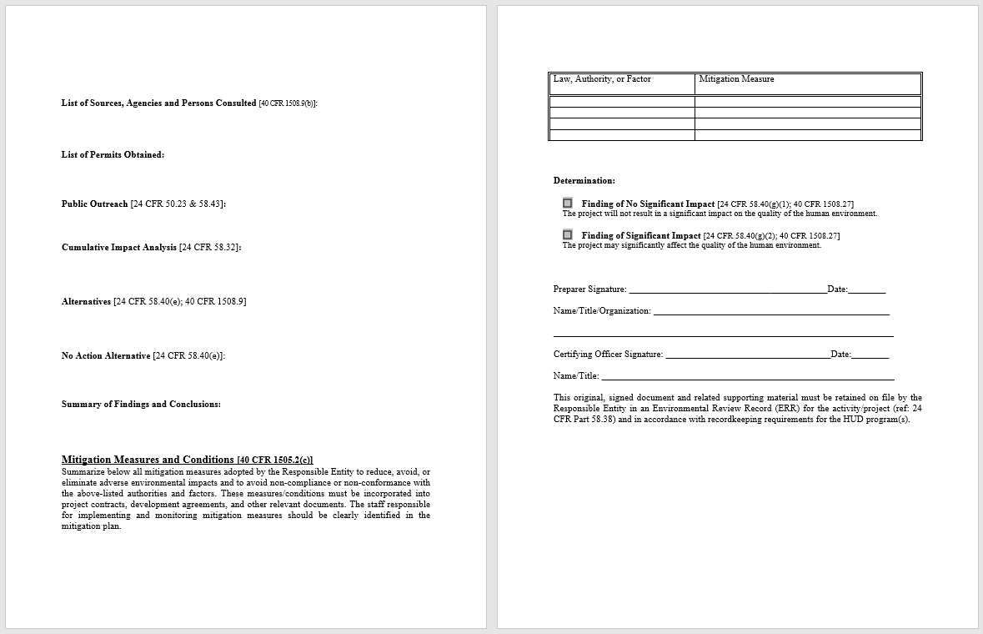

Slide 59
EA Determination
Will either be:
Finding of No Significant Impact (FONSI) – No Environmental Impact Statement (EIS) Required
Or
Finding of Significant Impact (FOSI) – Will Require an EIS (Extremely Rare for DCEO CDBG)

Slide 60
Environmental Impact Statement [§58.37]
Required when the project is determined to have a potentially significant impact on the human environment (can’t declare a FONSI). HUD specific examples:
Construction of hospitals or nursing homes with 2500+ beds
Remove, demolish, convert / sub-rehab 2500+ existing housing units
Construction of 2500+ new housing units – or provide the site for said units
Provide enough additional water and sewer capacity to support 2500+ additional housing units
All extremely rare for Illinois DCEO CDBG funding
GET IN TOUCH WITH DCEO ERO ASAP!!

Slide 61
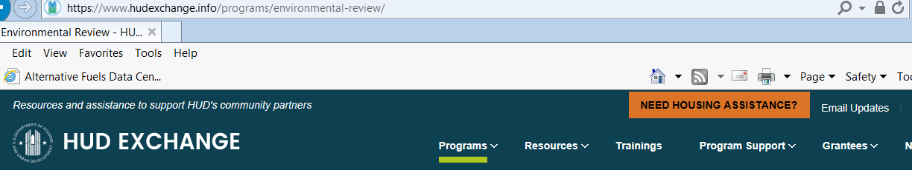
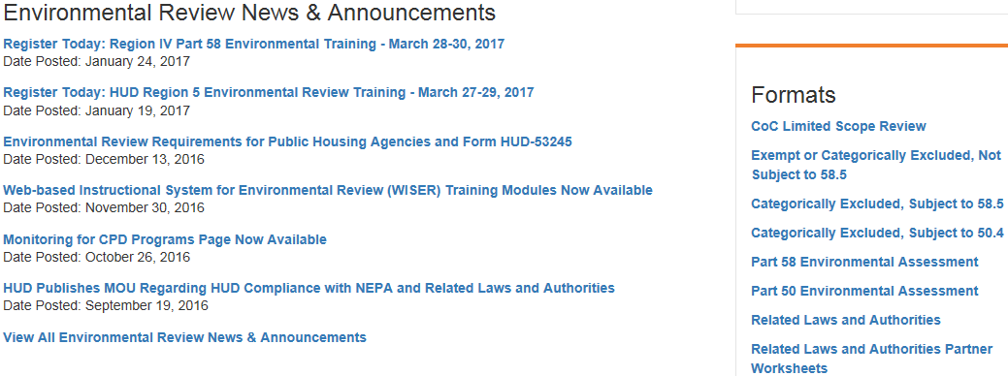
The HUD Exchange Website
Notes:
Demonstrate - Search box terms that work for “HUD Exchange” that can Google:
- Coc limited scope
- CoC limited scope review
FAQ’s:
1. “Manage a program”
2. “Environmental Review”
2. Select “CoC Limited Scope Review” (bottom right under Suggested Formats)
3. Click Limited Scope Environmental Review Instructions-- CoC
4. Limited Scope Environmental Review Format-- CoC

Slide 62
Step 3: conduct the environmental review
Kara Cozadd

Slide 63
An Early Start is Important!
Ensures decisions reflect environmental values
Avoids project delays and heads off potential conflicts
Procedural reasons:
Grantee may not commit HUD funds on an activity prior to RROF approval and Grantee may not commit non-HUD funds prior to RROF approval if the activity or project would have an adverse enviro. impact or limit choice
ERR must be submitted to DCEO ERO within 90 days of date of NOSAF, like any other Special Grant Condition specified in NOSAF

Slide 64
RE’s Capacity [§58.12]
The RE must develop the capacity to conduct environmental reviews:
Technical capacity: Professional expertise in subject matter
In-house: attend HUD-sanctioned training (incl. Today’s)!
Outside consultants (e.g., IL CDBG-familiar RPC’s, EDC’s, engineers and/or independents)
Administrative capacity:
Procedural
Record-keeping

Slide 65
Costs of Performing the Review [§58.23]
If Activity Delivery (AD) is budgeted, Grantee may reimburse ERR prep costs from AD (Now more for HR, ED, RLF Close-out, and not PI)
If a formal mitigation cost is incurred during ERR prep (e.g., an IDNR Incidental Take Authorization for Illinois Chorus Frog or Franklin’s Ground Squirrel), Grantee may reimburse with Construction or Housing Rehab funds (as applicable)

Slide 66
Use of Contractors
Contractor may prepare supporting documentation
RE’s must independently evaluate their work and prepare the environmental review itself (i.e., CEO signature on HUD/DCEO ERR forms)
Correspondence to interested tribes and public Notices must be sent under the RE’s signature and on its letterhead
Contractor should never address Tribes directly (i.e., Grantee letterhead/CEO signature)
Contractor should not sign or address public Notices

Slide 67
Source Documentation [§58.38]
Source documentation must be:
Credible & Qualified
Federal or State oversight agency, or recognized authoritative source considered a professional in their field
Verifiable
City/County land use plans, FEMA/USF&WS maps, aerial photographs, etc.
Relevant
Field observations, Interviews, Printed materials (letters, emails, etc.)

Slide 68
Source Documentation
If applicable, proprietary material or special studies not generally accessible to the public shall be included in the ERR:
ASTM Phase I Environmental Site Assessments (IL CDBG use: for acquisition or development of non-residential property)
Historic or archeological surveys
Noise analysis
Soil/geographical studies
Grading plans
Asbestos surveys
Wetland delineation

Slide 69
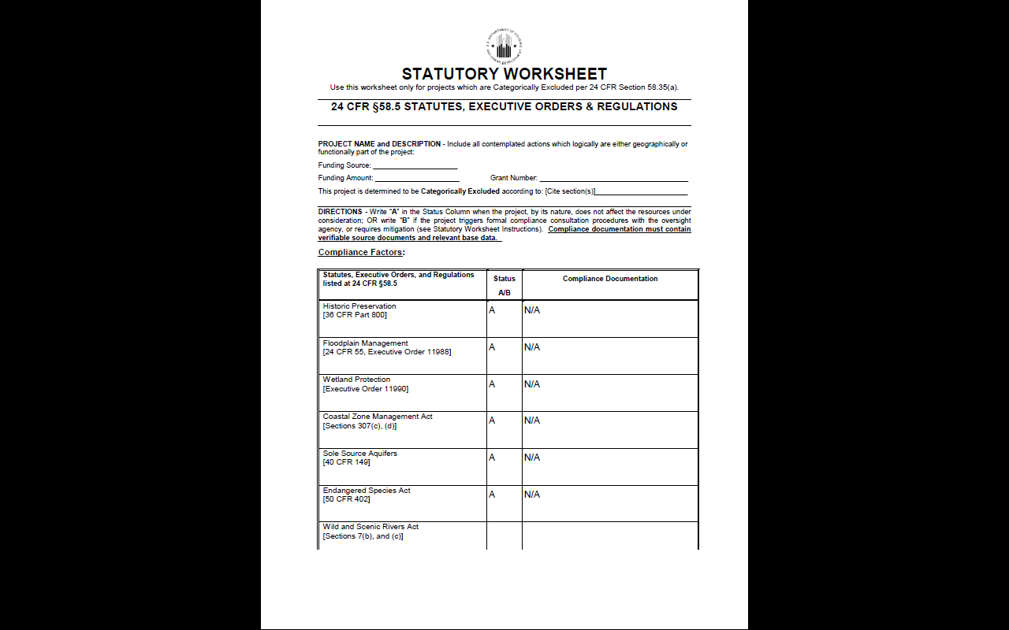
Compliance Documentation
“N/A” =
Not Acceptable…
Not Allowed…
Not Appropriate…

Slide 70
Use of Other / Prior EA
May request copy of other Federal, State, or Local Agency’s EA and use to the extent practicable (e.g., USDA-RD if that is source of “Other-funded”)
Grantee must:
Independently review that environmental analysis
CDBG RE must prepare their own EA incorporating all HUD conditions
RE is responsible for the required environmental finding (FONSI or FOSI)
Complete the RROF process and obtain DCEO environmental release letter

Slide 71
Adding funds? Updating the ERR [§58.47]
Re-evaluation of a project is required when new activities are added, unexpected conditions arise, or substantial changes are made to the nature, magnitude or extent of the project.
If original environmental finding is still valid:
Update the ERR with new project description / funding amount and CENST documentation [§58.35(b)(7)]
New RROF with changes to DCEO, no publication or waiting period for new Env. Release Letter (this is a Chicago HUD OEE office policy)
If original environmental finding is no longer valid or project significantly changed: RE must prepare new review and proceed with approval process (RROF → publication/posting → env release)

Slide 72
Tiered Review [§58.15] CDBG HR
Begins CDBG HR NOSAF issued
Project area identified, but specific addresses unknown
TWO STEP PROCESS
Tier 1: CEST project area-wide review
Tier 2: CEST home-specific review
Best suited for CEST projects such as scattered site single family
HR Tiered CEST projects CANNOT convert to exempt!
There will always be NOI/RROF publication/posting for Tier 1

Slide 73
Tiered Review – CDBG HR
Tier 1
Area-wide (addresses unknown)
A reasonable geographic area (i.e., the application’s project area)
Answers as many factors in the environmental review as feasible (for CDBG HR, 12 of 16 bodies of Federal environmental law)
Tier 2
Site-specific (now know home address)
This is separate ERR. Each home must have its own Tier 2 review complementing the Tier 1 review
Will cite the Tier 1 for all previously answered factors (12 of 16)
Will answer factors unanswered in Tier 1 requiring specific address (4 of 16)

Slide 74
Tiered Review – CDBG HR
Tier 1 12 Bodies of Law
Airport Hazards; Coastal Barriers, Flood Insurance; Clean Air; Coastal Zone; Endangered Species; Explosive & Flammable Hazards; Farmland Protection; Floodplain Management; Sole Source Aquifers; Wetlands Protection; & Wild and Scenic Rivers
Tier 2 4 Bodies of Law
Contamination & Toxic Substances
Historic Preservation
Noise Abatement & Control
Environmental Justice

Slide 75
HR Tiered Review: Do I Submit a RROF?
YES! You cannot convert ANY tiered reviews to Exempt at the target area Tier 1 level!
This means you must:
Publish/post NOI/RROF as appropriate, stating it is a tiered review and identifying what aspects of the review will be evaluated at each level (12 Tier 1 vs. 4 Tier 2)
Submit Tier 1 CEST ERR with RROF to DCEO HR ERO for review
Receive DCEO Tier 1 environmental release letter that will be contingent on complete Tier 2 reviews for each home being completed/DCEO-approved prior to award of a home’s housing rehab contract.

Slide 76
HR Tiered Review: When Do I Draw Funds?
For Activity Delivery and/or Rehabilitation Administration, you may draw AFTER DCEO approval of the target area Tier 1 CEST review and Grant Agreement is executed
For an individual home’s Housing Rehabilitation, you may draw AFTER DCEO approval of that home’s individual Tier 2 CEST review, without having to publish/post, submit a new RROF, or receive a new environmental release letter (only email approval from DCEO HR ERO)

Slide 77
Implementing Actions [§58.77c]
For All IL CDBG Grants:
Grantee must assure environmental review decisions are carried out during project development and implementation
Establish binding commitments and enforce them
i.e. Construction and rehab contracts must contain required Mitigation language
Educate contractors/workers on formal Mitigation conditions (e.g., Copper Belly Water Snake habitat/migration routes)
Track/monitor implementation and update ERR accordingly

Slide 78
Laws and authorities 24 Cfr 58.6
John McCarthy

Slide 79
The law and authorities listed at 24 CFR 58.6 (i.e., Airport Hazards, Coastal Barriers Resources & Flood Insurance) must be reviewed under each level of ERR (i.e., Exempt, CENST, CEST, EA & EIS)
Good news is that Coastal Barriers & Flood Insurance generally don’t apply to IL DCEO CDBG

Slide 80
Laws and Authorities 58.6 Runway Clear Zones
Airport Clear Zones Part 51 Subpart D
Basic Premise: Developments in aircraft accident zones pose hazards to end users
HUD discourages development in these Accident Potential Zones (APZ) or
Runway Protection Zones/Clear Zones (RPZ/CZ)

Slide 81
Runway Clear Zones
To document, include a copy of on-line airport search tool results showing distance from project site to nearest airports
If project site is within a runway clear zone, documentation from airport owner that it has no plans to buy the land

Slide 82
Runway Clear Zone Policy
For transfer of existing property in CZ buyer must be notified that property is in clear zone, shown implications, sign acknowledgement and
Disclosure Statement

Slide 83
Examples
Lift station to be located in clear zone; acceptable, if airport has no plans to buy land; facility NOT occupied frequently
Convert industrial structure in clear zone to residential use; NOT acceptable
Sale as is of HUD home in clear zone; acceptable if buyer signs disclosure form

Slide 84
Clear Zones Notification
Notification mandatory for acquisition or leasing including minor rehab in Clear Zone
Leasing, purchase or sale in Clear Zone or APZ
Requires Notice
Notice
Signature

Slide 85
Notice to Prospective Buyers of Properties Located in Runway Clear Zones and Clear Zones
In accordance with 24 CFR 51.303(a)(3), this Notice must be given to anyone interested in using HUD assistance, subsidy or insurance to buy an existing property which is located in either a runway Clear Zone 1 at a civil airport or a Clear Zone at a military installation. The original signed copy of the Notice to Prospective Buyers must be maintained as part of the project file on this action.

Slide 86
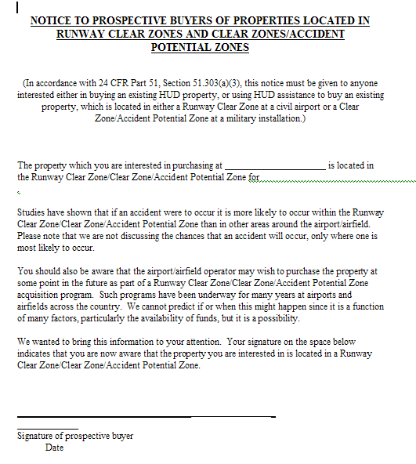

Slide 87
COASTAL BARRIERS Laws and Authorities 58.6 Coastal Barrier Resources Act (CBRA, Public Law 97-348)

Slide 88
COASTAL BARRIERS
Does not apply to HUD grants in Illinois, because there are no covered barriers along Illinois’ Lake Michigan shoreline
DCEO’s HUD ERR Formats are pre-marked “Illinois is not a covered state under these Acts.”

Slide 89
Laws and Authorities 58.6 Flood Insurance
Flood Disaster Protection Act of 1973(as amended)- requires property owners to purchase (mandatory) flood insurance for buildings located within Special Flood Hazard Areas (SFHA), 100-year flood plain when Federal financial assistance is used to acquire, repair, improve, or construct a building.

Slide 90
Flood Insurance
DCEO CDBG grants are exempt from those Acts, because they are funded by a HUD formula grant made to a state.
DCEO’s HUD ERR Formats are pre-marked “The project is exempt pursuant to Section 58.6(a)(3), because it is funded through a HUD formula grant made to a state.”
Many grants funded through a CDBG-DR special appropriation have a similar, but not identical, exemption. Other CDBG-DR project sites may have to purchase flood insurance.

Slide 91
Levels of Review that Require §58.5 Compliance
Projects that are Categorically Excluded Subject to 58.5 (CEST)
24 C.F.R. 58.35(a)
Projects that require an Environmental Assessment (EA)
24 C.F.R. 58.36
Projects that require an Environmental Impact Statement (EIS)
24 C.F.R. 58.37

Slide 92
§58.5 Laws & Authorities
Clean Air Act
Coastal Zone Management Act
Contamination and Toxic Substances (HUD reg)
Endangered Species Act
Explosive & Flammable Hazards (HUD reg)
Farmlands Protection Policy Act
Floodplain Management (E.O. 11988)
National Historic Preservation Act
Noise Control Act
Safe Drinking Water Act (Sole Source Aquifers)
Wetlands Protection (E.O. 11990)
Wild & Scenic Rivers Act
Environmental Justice (E.O. 12898)

Slide 93
Clear act compliance
Kirk Kumerow

Slide 94
National Ambient Air Quality Standards (NAAQS) Criteria Pollutants
EPA has set NAAQS for 6 criteria pollutants:
1) Sulfur Dioxide
2) Nitrogen Dioxide
3) Carbon Monoxide- No color/odor,
poisonous gas
4) Lead
5) Particle Pollution (aka Particulate Matter)
PM2.5 & PM10
6) Ozone
Parts per million (ppm) by volume, parts per billion (ppb) by volume, and micrograms per cubic meter of air (µg/m³).
Based on Averaged Concentrations Applied to the General Population within a Geographic Area
Major sources: Industrial Plants and Automobile Traffic

Slide 95


Pollutants, Implementation of NAAQS and State Implementation Plan (SIP’s)!
Federal standards represent the minimum level of protection
Primary standards protect public health
Secondary standards protect
public health and the environment
States can adopt:
More stringent standards
Cannot adopt standards less
stringent than federal levels

Slide 96
What is a SIP?
State Implementation Plans (SIP) include information to understand and track air quality:
Emissions inventories (what area sources/emissions).
Air quality monitoring.
Modeling to show how the plan will achieve or maintain good air quality.
SIP’s include control strategies for all the sources of pollution in an area, which can include.
IEPA implements Illinois’ SIP.

Slide 97
Section 176—Limitations on Federal Assistance
176 (c): Prohibits federal assistance which does not conform with a State Implementation Plan
176 (d): Mandates each Federal Agency and its program implementers :
To give priority to air quality transportation consequences
Ensure consistency with Plan implementation that achieves and maintains National Ambient Air Quality Standards.
Extends this to the Housing and Urban Development Act. [42 U.S.C. 7506]
Demolition, New Construction and Rehabilitations
Notes:
35

Slide 98
Exceptions:
Air Quality 24 CFR Part 58.5(g)
Actions outside non-attainment areas
Emission levels below de minimus level
Rehabilitation activities (incl. CDBG HR)
Acquisition for continued use
Land banking (required when site is developed)
Notes:
35

Slide 99
Example Projects that Could Contribute to NAAQPS Non-Attainment
Industrial and Commercial activities with airborne emissions – manufacturing, dry cleaning, painting operations
Agricultural facilities – concentrated animal feeding operations
Large traffic-generating projects
Projects with wood-burning and coal-burning components
Ethanol, biodiesel and fuel mixing plants

Slide 100
HUD Compliance with Ambient Air Standards
Generally concerned only with projects that require an EA or EIS level of review (still must document for CEST)
Types of activities that would not likely contribute to non-attainment of the NAAQS
Single family housing projects 5 or fewer dwelling units
Housing Rehabilitation
Play ground improvements
Focus on projects that either
Increase traffic, OR
Increase power generation

Slide 101
Attainment vs Non-Attainment
Attainment areas are where the pollutants are less than the NAAQS/ threshold level.
Non-Attainment (NA) areas are where the pollutants are greater than the NAAQS/ threshold level.

Slide 102
CDBG Air Quality Compliance
For HR:
At Tier 1 target area review, copies of the US EPA Illinois & National Non-Attainment Status Lists to document not in a covered area
If project location is in a Non-Attainment area, then also complete HUD Air Quality (CEST and EA) Worksheet. Question 1 is “No” and complete Worksheet Summary stating project is rehab of existing single-family homes

Slide 103
CDBG Air Quality Compliance
For PI and ED-PI:
Copies of the US EPA Illinois & National Non-Attainment Status Lists to document not in a covered area
If project location is in a Non-Attainment area, then also complete HUD Air Quality (CEST and EA) Worksheet, including any mitigation explanations and documentation
A copy of your project’s IEPA clearance letter

Slide 104
Coastal zone management act
John McCarthy

Slide 105
Purpose of CZMA
Preserve, protect, develop, restore & enhance the resources of the coastal zone for current and future generations.
Manage development in hazard areas, prioritize coastal-dependent uses, provide public access, coordinate state and federal actions.
Preserve ecologic, historic, aesthetic values while considering compatible economic development.

Slide 106
Coastal Zone Management Act
Enacted in 1972 and administered by National Oceanic and Atmospheric Administration, Office for Costal Management. Authorized states to develop CZ plans & designate permitted uses.
IDNR administers for Illinois’ Lake Michigan coastal zone.
Because DCEO CDBG not granted in Cook or Lake Counties, simply mark your project community’s location on the IDNR Illinois Coastal Zone map to show separation from Lake Michigan and state that on CEST or EA.

Slide 107
Source Documentation
1) Map and statement on CEST or EA showing that there are no CZMA in the community (for DCEO CDBG) or state
2) Map/statement from local planning department or state coastal commission or district showing project is not in CZMA (more common for Direct Entitlement CDBG in Cook or Lake Counties)
or
3) A “federal consistency determination” from the state coastal commission or district (more common for Direct Entitlement CDBG in Cook or Lake Counties)

Slide 108
Illinois Coastal Zone Boundaries Map

Slide 109

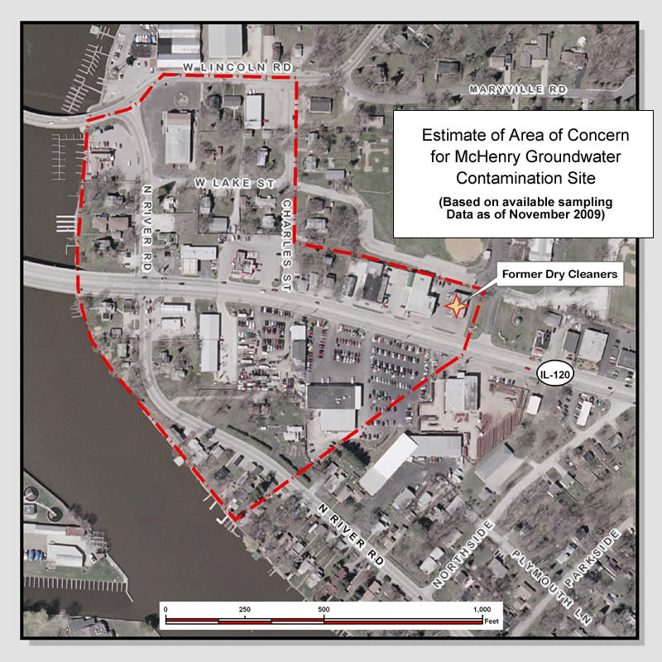
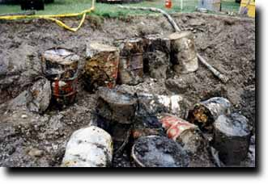
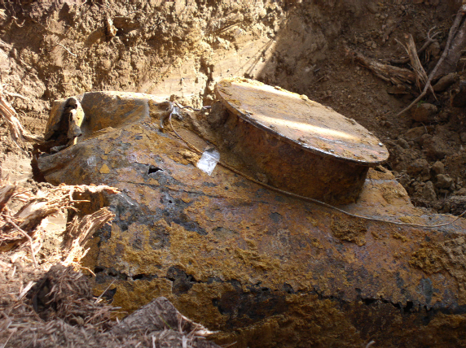
SITE CONTAMINATION 58.5(i)(2) Kirk Kumerow
Dry
Cleaners
Landfills
Buried Waste
Underground Tanks
Notes:
Site contamination can be the result of many different past and current activities. It’s not just major industrial operations. For example, dry cleaners are also a major consideration.
Potential Sources:
Railroad yards
Foundries & incinerators
Auto & truck garages, gas stations & service centers
Dry cleaners
Dumps – landfills and junkyards
Commercial printing operations
Hospitals
Waste treatment, storage, disposal, processing or recycling facilities
Agricultural operations
Tanneries
Mining operations
Caused by:
Industrial or commercial operations not properly managed, resulting in spills and careless waste disposal practices
Leakage of gasoline or other products from underground storage tanks
Municipal waste disposal sites may contain solvents, paints and heavy metals which can leach out if not properly managed
Agricultural and other land with past use of pesticide and herbicides
Intentional and illegal discharges on and in land, air and water

Slide 110
SITE CONTAMINATION
HUD Policy on Contamination
24 CFR §58.5(i)(2)
…all property being proposed for use in HUD programs be free of hazardous materials, contamination, toxic chemicals and gases, and radioactive substances, where a hazard could affect the health and safety of occupants or conflict with the intended utilization of the property.

Slide 111
Why Care about Site Contamination?
HUD’s Mission
Decent, safe, and sanitary home and suitable living environment for every American
Strong, sustainable, inclusive communities
Public Health Implications
Financial Implications
Liability Considerations
Notes:
HUD Mission/Policy – 1949 Housing Act, Section 2 = Provide a decent home and a suitable living environment for every American.
Sustainability is reflected in the Department’s current management plan.

Slide 112

When Site Contamination must be Evaluated
Due diligence must be completed before acquisition or any other project activity (except exempt activities)
Prior to HUD/State environmental approval, neither recipient nor any participant in the development process, may take action that will limit the choice of reasonable alternatives
24 CFR Part 58.22(a)
Notes:
Choice-limiting actions include real property acquisition, leasing, disposition, demolition, rehabilitation, repair, construction and site improvements
Commit = legally binding agreement or contract.

Slide 113
IL CDBG Acceptable Documentation
Completed US EPA Enviromapper/Envirofacts/NEPA Assist showing no site contamination in/near project site
HUD Contamination & Toxic Substances Worksheet (Single Family) for HR Tier 2

Slide 114
IL CDBG Acceptable Documentation
HUD Contamination & Toxic Substances Worksheet (Multi-Family & Non-Residential) if Non-Residential Property is acquired or developed (ED).

Slide 115
IL CDBG Acceptable Documentation
Completed Phase I ASTM Survey by Licensed Professional if non-residential property acquired or developed (ED)
ASTM International (formerly American Society for Testing and Materials), HQ in Pennsylvania

Slide 116
IL CDBG Acceptable Documentation
Any site contamination for any CDBG project and/or project site must already be documented as mitigated before completion/signature of CEST or EA.
e.g., Tier 2’s for Havana HR Grant had US EPA docs that nearby Brownfield site was already fenced and encapsulated.

Slide 117
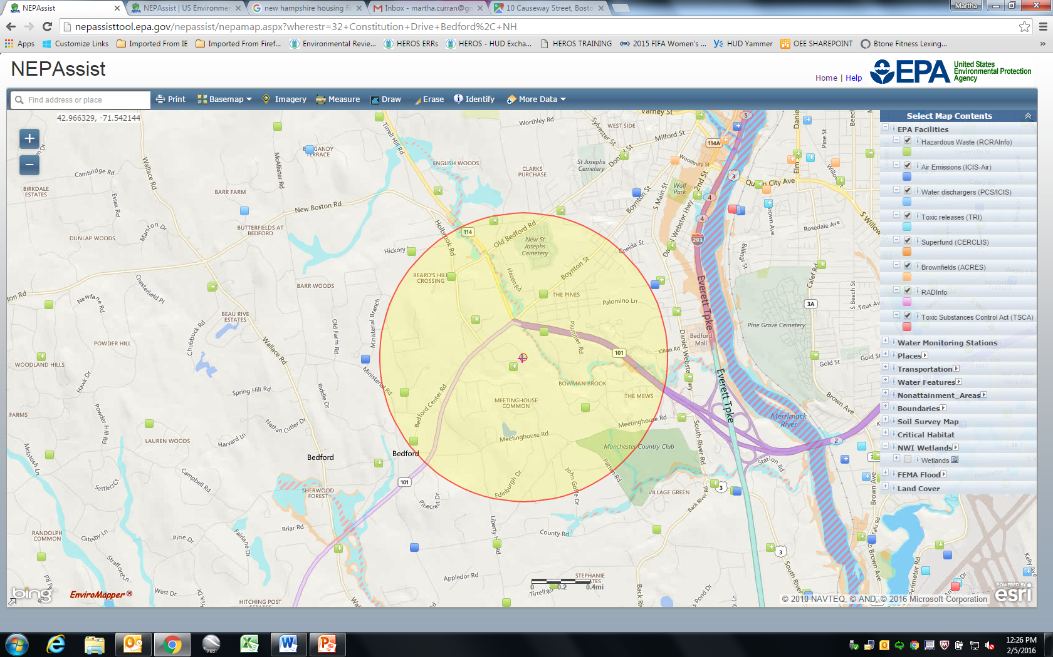
NEPA ASSIST SCREENING TOOL
http://nepassisttool.epa.gov/nepassist/entry.aspx
117

Slide 118
Phase I Environmental Site Assessment ASTM Standard E 1527-13
Objective: To identify conditions indicative of
release or threatened release of hazardous
substances or petroleum product
Voluntary, non-intrusive investigation into
historical uses of the site and visible evidence
of environmental conditions
Must be conducted by qualified professional
Uses specific vocabulary – defined in standard
Recognized Environmental Condition (REC)
Historical Recognized Environmental Condition (HREC)
Vapor Encroachment
Screening
Phase I ESA
Phase II ESA
Site Remediation
Notes:
ASTM International (formerly known as the American Society for Testing and Materials (ASTM)) is a globally recognized leader in the development and delivery of international voluntary consensus standards. Today, some 12,000 ASTM standards are used around the world to improve product quality, enhance safety, facilitate market access and trade, and build consumer confidence.
ASTM Phase I
Used primarily for commercial real estate transactions and CERCLA liability protections.
Also used to assess business environmental risk concerns .
Does NOT delineate contamination or quantify the risk of contamination.
Current online price = $57. Download directly from ASTM website.
(Note: An equivalent “Phase I” due diligence may be achieved by conducting “All Appropriate Inquiries” (AAI) using 40 CFR Part 312. AAI was added as amendment to Small Business Liability Relief and Brownfields Revitalization Act of 2002. Rule became effective Nov 2006.)

Slide 119
ASTM Phase I ESA
Can help understand potential environmental risk/liability associated with a property prior to acquisition, construction, rehabilitation, etc.
Typically does not include “Non-scope considerations:” asbestos, lead, mold, radon, NEPA, etc. Can be added as non-scope item(s)
A Phase I ESA is not synonymous with an environmental assessment (EA) under NEPA
Notes:
Vapor Encroachment (aka, vapor migration):
Short term problems = respiratory, headaches, nausea, eye irritation
Long-term exposure = cancer
VE analysis often appropriate to conduct because a VEC (vapor encroachment condition) may not otherwise be identified by the ASTM Phase I – e.g., where vapor source is down-gradient of the target property.
ASTM E 2600-10 “Standard Guide for Vapor Encroachment Screening.”
Uses iterative approach – are known or suspected sites in proximity that may have vapor contamination (e.g., drycleaners, gas stations, industrial uses)…If yes, perform further assessment & may include sampling for soil gas or groundwater contamination…Depending on various factors, a VEC may or may not be considered a REC.
VE is relevant to the earlier slide about “different programs, different requirements” – The VE analysis is required in MAP Chapter 9 – While only MAP requires it (for FHAinsurance programs), it may well be appropriate to conduct VE analysis for other projects, e.g., Part 58.

Slide 120
ASTM Phase I Shelf-life
A past Phase I report cannot be used indefinitely
Phase I must be conducted within one year of the date of property acquisition or development
If Phase I is more than 180 days old and less than one year old, it must be updated
Notes:
If between 180 days and 1 year old, the following sections must be updated: Interviews, Environmental cleanup liens, Government records searches, Site/visual inspections, Report & EP’s declaration.
If over 1-year, prior report can be used as a reference, but a new Phase I must be completed.

Slide 121
Endangered species 24 CFR part 58.5 (e)
Kirk Kumerow

Slide 122
IL CDBG Acceptable Documentation
For HR, pre-provided explanation on Tier 1 CEST of why no effect (i.e., rehab only)
For PI & ED-PI:
IDNR Endangered Species Release From Consultation (results and release letter, if one)
USF&WS Endangered Species review info. See below.

Slide 123
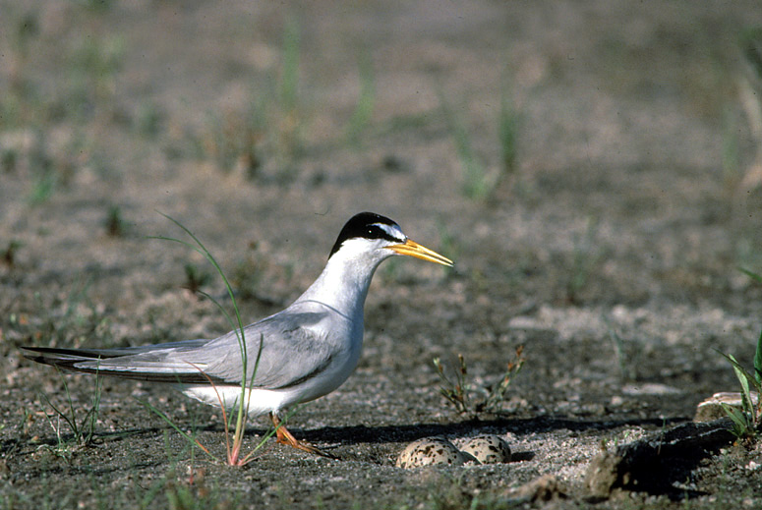
Endangered Species §58.5(e)
Section 9 of ESA
Section 7 of ESA
ESA Section 7 Consultation Process
Statutory Checklist
Interior Least Tern
Sterna antillarum
Status: Endangered

Slide 124
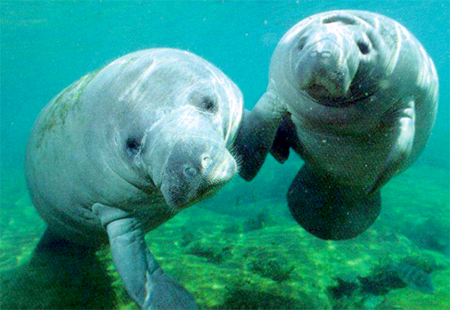
Section 7 of Endangered Species Act
Congress passed Endangered Species Act of 1973
Section 7 of ESA outlines Federal agency responsibilities
Section 7 requires Federal agencies to use their authorities to further the conservation of listed species
Responsible Entity compliance required by 24 CFR Part 58.5(e)
West Indian Manatee
Trichechus mantus
Status: Endangered
124

Slide 125
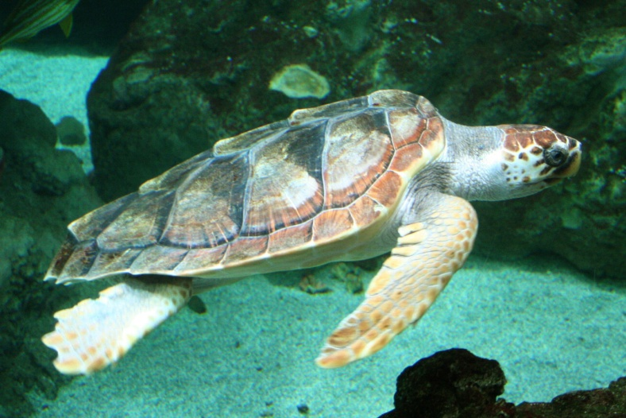
Federal Agency Consultation Requirements
Section 7 requires Federal agencies (Responsible Entities) to consult with the Services to ensure that they are not undertaking, funding, permitting, or authorizing actions likely to jeopardize the continued existence of listed species or destroy or adversely modify designated critical habitat.
U.S. Fish and Wildlife Service – terrestrial species
NOAA National Marine Fisheries Service – marine species
Collectively called “Services”
Loggerhead Sea Turtle
Caretta caretta
Status: Endangered

Slide 126
ESA Section 7 Consultation Protocol
Step 1: Determine whether project is the type that could affect listed species or critical habitat, if present
Step 2: Determine potential presence of listed species
Step 3: Determine potential for adverse impacts
Step 4: “Is Not Likely to Adversely Affect” determination
Step 5: “Is Likely to Adversely Affect” determination

Slide 127
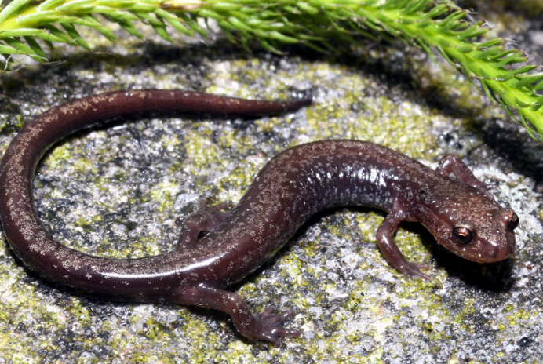
Step 1: Determine whether project is the type could affect listed species or critical habitat, if present
Types of activities likely to have “No Effect” on listed species or critical habitat…
Construction or placement of a single family residence within a developed lot
Rehabilitation or renovation activities associated with existing structures (e.g., houses, buildings), including additional structures attached to or associated with the primary structure
Cheat Mountain salamander
Plethodon nettingi
Status: Threatened

Slide 128

Types of activities likely to have “No Effect” on listed species or critical habitat (cont.)
Acquisition of existing structures (e.g., houses, buildings), including additional structures attached to or associated with the primary structure
Purchase and placement of playground equipment within existing parks
Resurfacing, repairing, or maintaining existing streets, sidewalks, curbs, trails, parking lots and/or any other existing paved surfaces where additional ground disturbance, outside of the existing surface is not necessary
Attwater’s Greater Prairie Chicken
Tympanuchus cupido attwateri
Status: Endangered

Slide 129

Is this the type of project or action that could realistically have an impact on T&E species?
If no, then the project is likely to have “No Effect” on federally protected species and critical habitat.
Informal consultation with the Services is not necessary.
ERR must include documentation supporting of the finding of “No Effect”.
Small whorled pogonia
Isotria medeoloides
Status: Endangered

Slide 130
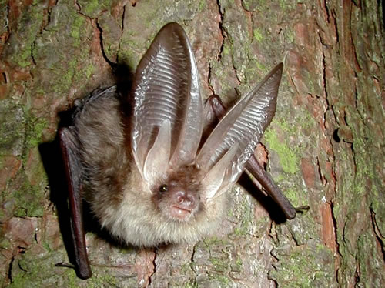
Step 2: Determine potential presence of listed species
Are there listed species or critical habitat near my project site?
Define the action area
For purposes of the ESA, the “action area” includes all areas that your project will affect either directly, indirectly, and/or cumulatively, and is not merely the immediate area involved in the project.
Obtain list of species from the Services

Slide 131
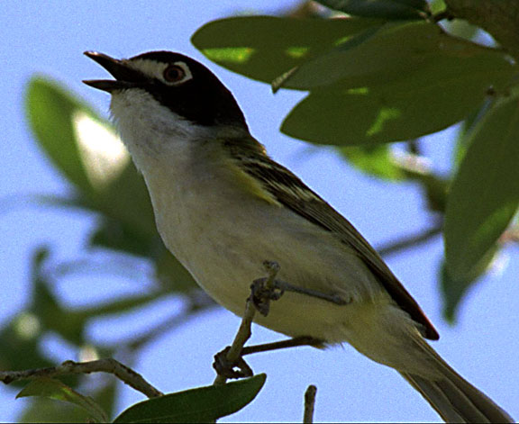
No Effect Determination Based on Finding that No Species Are Present
If no listed species or critical habitat is identified in the project area, then the project is likely to have “No Effect” on federally protected species and critical habitat.
Informal consultation with the Services is not necessary.
The ERR should include all documents used to make this determination, including letters from the Services, species lists from the Services’ websites, surveys and/or other documents and analysis showing that there are no species in the action area.
Black-capped Vireo
Vireo atricapilla
Status: Endangered

Slide 132

No Effect Determination Based on Habitat Assessment and Specifics of Project
RE may make a finding of “No Effect” if you determine, based on any listed species in the area and the specifics of your project, that there are no potential impacts.
However, this finding must be based on technically valid information.
For example, if there are species present, and a habitat assessment shows that there is no suitable habitat in the project area, then a “No Effect” finding can be made based on habitat assessment.
Louisiana Black Bear
Ursus americanus luteolus
Status: Threatened

Slide 133

Step 3: Determine potential for adverse impacts
When species are present and project is type to impact species…
A special study is conducted by a qualified professional to determine the effects of the project on each species and critical habitat
Contact resource experts for assistance– USFWS or NMFS
Prepare biological assessment
Possible outcomes of findings:
May affect, but “ is not likely to adversely affect” federally protected species or critical habitat
May affect, and ”is likely to adversely affect” federally protected species or critical habitat
Gulf Coast Jaguarundi
Herpailurus yagouaroundi cacomitli
Status: Endangered

Slide 134

Consulting with the Services
The RE is responsible for interacting with the Services.
It is the responsibility of the RE to make the determination and conduct all consultations.
It is not appropriate for a consultant to consult directly with the Services, although they may provide information to the RE for it to make its determination.
Golden-cheeked Warbler
Dendroica chrysoparia
Status: Status: Endangered

Slide 135
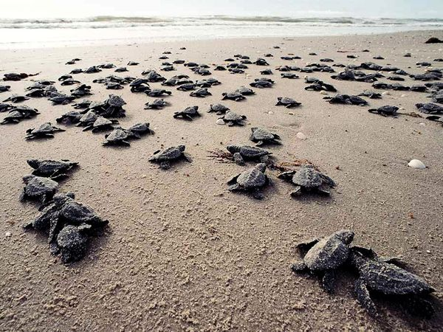
Step 4: “Is Not Likely to Adversely Affect” determination
Effects are expected to be discountable, insignificant, or completely beneficial
Discountable effects are extremely unlikely to occur
Insignificant effects relate to the size of the impact and should never involve “take”
Beneficial effects are contemporaneous positive effects without any adverse effects
RE submits findings, determination and all documentation to Services with request for informal consultation
Services must concur with “Not Likely to Adversely Affect” determination, and associated mitigation measures and conditions
Kemp’s Ridley Sea Turtle
Lepidochelys kempii
Status: Endangered

Slide 136

Step 5: “Is Likely to Adversely Affect” determination
For any adverse effects to listed species
If incidental take is anticipated to occur as a result of the proposed action
An "is likely to adversely affect" determination requires RE to initiate formal Section 7 consultation
Biological Assessment/Evaluation is submitted to Services with request for formal consultation
Photo: Texas Prairie Dawn

Slide 137
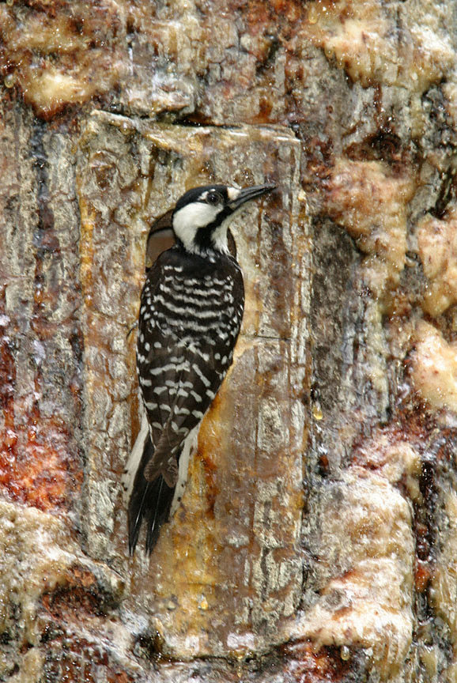
Formal Consultation
Formal consultation will result in a Biological Opinion from the Services
Services will determine whether an action is likely to jeopardize a listed species or adversely modify their critical habitats
Provides reasonable and prudent measures to minimize impacts
May provide reasonable and prudent alternatives to the proposed project
Makes exceptions for “incidental take” of listed species (otherwise illegal)
Red Cockaded Woodpecker
Picoides borealis
Status: Endangered

Slide 138
Project Options Resulting from Formal Consultation
RE’s decision completes formal consultation process:
Adopt reasonable and prudent measures or reasonable and prudent alternatives as recommended by Services.
Not undertake project
Modify proposed action or develop a new alternative and continue formal consultation with Services
RE must notify Services of final decision

Slide 139
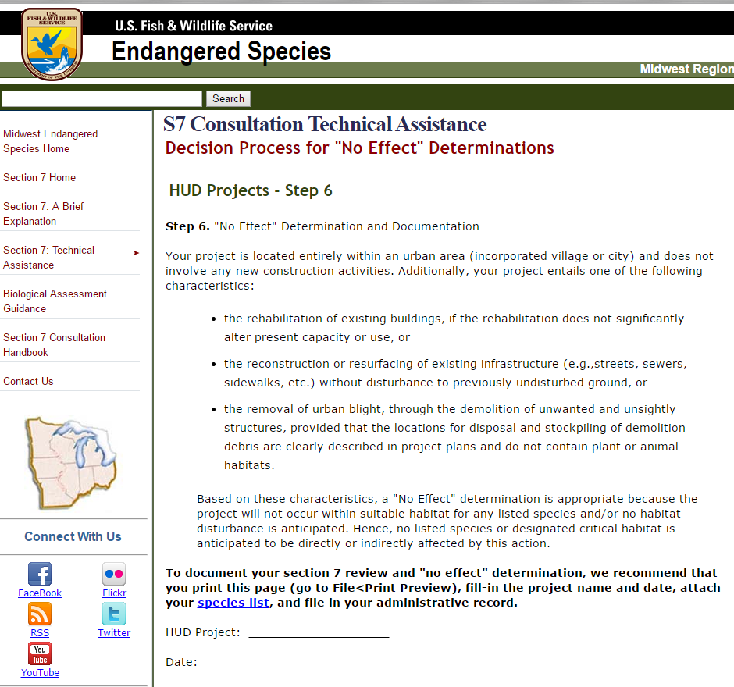
Resource
Step-by-step Section 7 website:
http://www.fws.gov/midwest/endangered/section7/s7process/step1.html
Document the species list AND your determination

Slide 140
ERR Documentation
The environmental review record should contain one of the following determinations and supporting documentation:
No Effect, include a determination that the project does not involve any activities that have a potential to affect species or habitats, evidence that there are no federally listed species in the area, or other analysis supporting a No Effect finding
May Affect, Not Likely to Adversely Affect, include all correspondence with Services, including concurrence with finding
Likely to Adversely Affect, include all correspondence with the Services, including the Biological Opinion and RE final decision

Slide 141
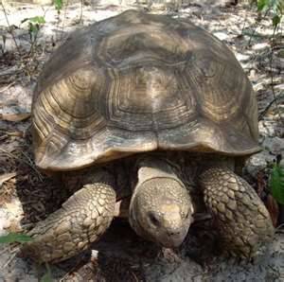
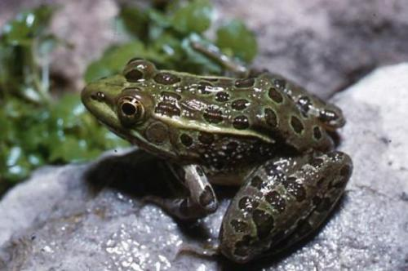


Questions?
Gopher Tortoise
Gopherus polyphemus
Status: Threatened
Chiricahua Leopard Frog
Rana chiricahuensis
Status: Threatened
American Burying Beetle
Nicrophorus americanus
Status: Endangered
https://www.hudexchange.info/environmental-review/endangered-species

Slide 142
Explosive and flammable hazards
Kirk Kumerow

Slide 143
IL CDBG Acceptable Documentation
For HR, pre-supplied language on Tier 1 CEST that project doesn’t involve a hazardous facility, and won’t increase residential densities, or conversion
For PI, completed US EPA Enviro Mapper/ Envirofacts/NEPA Assist search results, and usually that same statement as with HR

Slide 144
IL CDBG Acceptable Documentation
For ED projects, completed US EPA Enviro Mapper/ Envirofacts/NEPA Assist search results
Completed HUD Explosive and Flammable Hazards (CEST and EA) Worksheet
Documentation of any required mitigations (e.g., for Acceptable Separation Distance)

Slide 145
Acceptable Separation Distance (ASD) 24 CFR Part 51 Subpart C
Applies to stationary, above-ground storage containers holding:
In excess of 100 gallon capacity of common liquid industrial fuels (such as gasoline, fuel oil, kerosene and crude oil) listed in Appendix I of the Regulation (along with other hazardous substances), and
Containers of any capacity, that hold hazardous liquids or gases that are not common liquid industrial fuels

Slide 146
Farmland protection
John McCarthy

Slide 147
Farmland Protection Policy Act
Congress passed the Agriculture and Food Act of 1981 (Public Law 97-98) containing the Farmland Protection Policy Act (FPPA) subtitle I of Title XV, Section 1539-1549

Slide 148
Purpose of FPPA
“minimize the extent to which Federal programs contribute to the unnecessary conversion of farmland to non agricultural use”
Stipulates that Federal programs be compatible with state, local and private efforts to protect farmland

Slide 149
FPPA Exemptions
Rehabilitation of existing units (IL CDBG HR)
Minor secondary structures
On farm structures for farm operation
Land used for water storage
Land already on or committed to urban development

Slide 150
Committed to Urban Development
urban area (UA) on the Census Bureau Map
urban area mapped with a “tint overprint” on the USGS topographical maps
“urban built-up” on the USDA Important Farmland Maps
Land with a density of 30 structures per 40 acre area

Slide 151
IL CDBG Acceptable Documentation
For HR, pre-filled statement of exemption from Act on Tier 1 CEST
For PI & ED-PI:
Illinois Dept. of Agriculture (IDOA) clearance letter citing compliance with Federal FPPA (i.e., not reviewed solely under Illinois Farmland Preservation Act).
Notes:
Over a year ago, DCEO CDBG ERO worked with IDOA to make sure they also reviewed our PI, ED-PI & RLF Closeout Projects under Federal law.

Slide 152
IL CDBG Acceptable Documentation
If project involves conversion of farmland, FPPA and IDOA also require completion of USDA Form AD-1006 as part of IDOA’s review
Printed copy of USDA Web Soil Survey (WSS) search results of project site(s)
https://websoilsurvey.nrcs.usda.gov/app/HomePage.htm

Slide 153
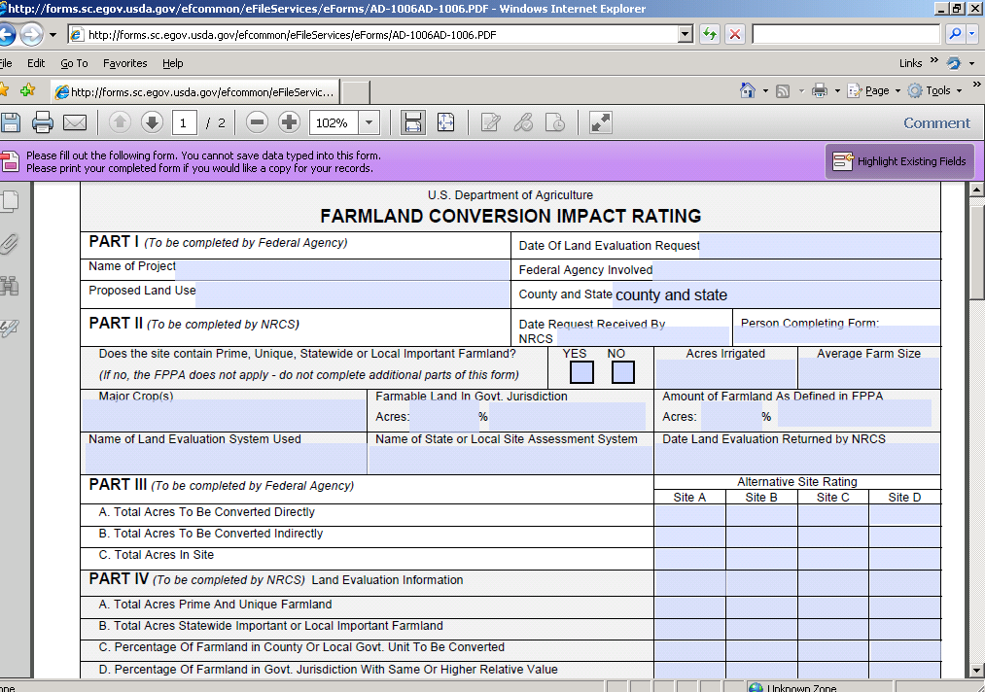
USDA Form AD-1006
153

Slide 154
?’s for IDOA Review of DCEO CDBG
Please contact either (Not in Particular Order):
Terry Savko, 217-785-4458 terry.savko@Illinois.gov
John Lohse, 217-785-4389 john.lohse@Illinois.gov
Brian Rennecker, 217-785-7658 brian.rennecker@Illinois.gov
All of IDOA Bureau of Land and Water Resources
Notes:
Terry and John prefer phone calls to start a conversation on a topic, because each feels it lets everyone know what’s being asked upfront. Haven’t worked directly with Brian yet.

Slide 155
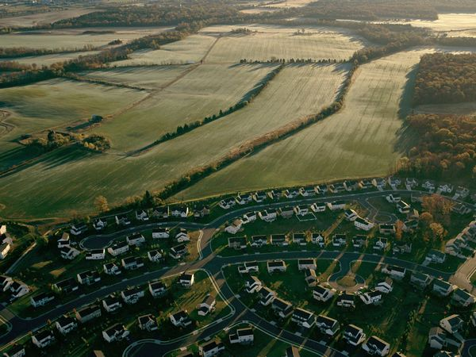
Once developed-it is gone forever
155

Slide 156
Floodplain management
Kirk Kumerow

Slide 157
Executive Order 11988 of 1977
Requires Federal agencies to avoid development in floodplains, wherever practicable, and created regulations to implement this goal (i.e., 24 CFR Part 55)
Established HUD’s 8-step process for decision making on projects that have potential impacts on the floodplain
157

Slide 158
Executive Order 11988 of 1977
Applies to the following:
Acquisition, management, and disposition of Federal lands, and facilities construction and improvement projects that are undertaken, financed, or assisted by Federal agencies
Federal activities and programs affecting land use, including but not limited to, water and related land resources planning, regulation, and licensing activities
158

Slide 159
24 CFR Part 55 “Floodplain and Wetland Protection
Applies to the following:
Updated in 2013 to include protection of wetlands; created a streamlined 5-Step Process for certain activities; and prohibited new construction in the Coastal High Hazard Areas
Implements EO 11988 for Floodplain Management & EO 11990 for Protection of Wetlands
Compliance requirements vary depending on the type of floodplain and the activities proposed
159

Slide 160
100-Year FLOODPLAIN
Area subject to inundation from a flood having a 1% or greater chance of flooding in any given year (1 in 100 years)
The area is designated on a Federal Emergency Management Agency (FEMA) Flood Insurance Rate Map (FIRM or FIRMette) under FEMA regulations as Zone A1-30, AE, A, AH, AO, AR, or A99
On a color FIRMette, is usually denoted by bluish-greenish dots (……) or (now) a field of that same color
160

Slide 161
500-Year FLOODPLAIN
Area subject to inundation from a flood having a 0.2% chance of occurring in any given year
Designated on a FIRM under FEMA regulations as Zone B, or a Shaded Zone X (usually denoted by black dots (……) or (now) a yellow-orange field or yellow-orange diagonal lines (/////)
Mitigation required for “critical actions” located in 500-year floodplain
161

Slide 162
FLOODWAY
The portion of the floodplain which is effective in carrying flow, where the flood hazard is generally the greatest, and where water depths and velocities are the highest
For purposes of Part 55, the Floodway doesn’t have a vertical limit
Designated on a FIRM under FEMA regulations as Zone AE “hatched” (i.e., denoted by diagonal lines /////// or //////// or alternating ////////
162

Slide 163
FLOODWAY
The only Illinois CDBG assistance that may be committed in a Floodway is for a functionally dependent use, which is a purpose that can only be located or carried out in close proximity to water (e.g., dams, marinas, water-front park, ship repair, & etc.)
Since almost no IL CDBG funds are used for functionally dependent purposes, the IL CDBG ERO refers to these zones as “prohibited” Floodways in training documents
163

Slide 164
COASTAL HIGH HAZARD AREA
Area subject to high velocity waters, including but not limited to, hurricane wave wash or tsunamis
Designated on a FIRM under FEMA regulations as Zone V1-30, VE, or V
Good news for our Grantees: Since Illinois’ coastal zone is at least two counties away from the Illinois CDBG service territory, not a concern for our programs
164

Slide 165
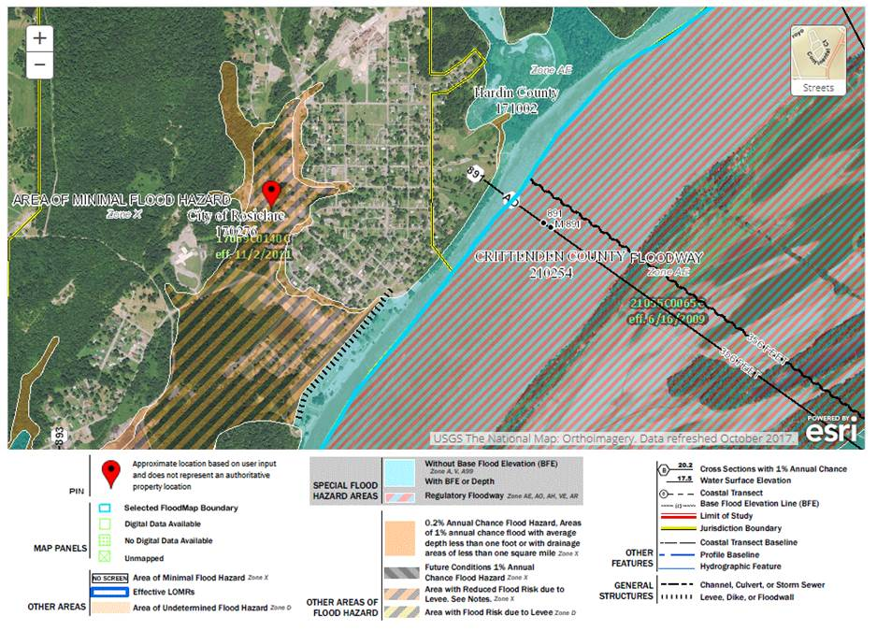
165

Slide 166
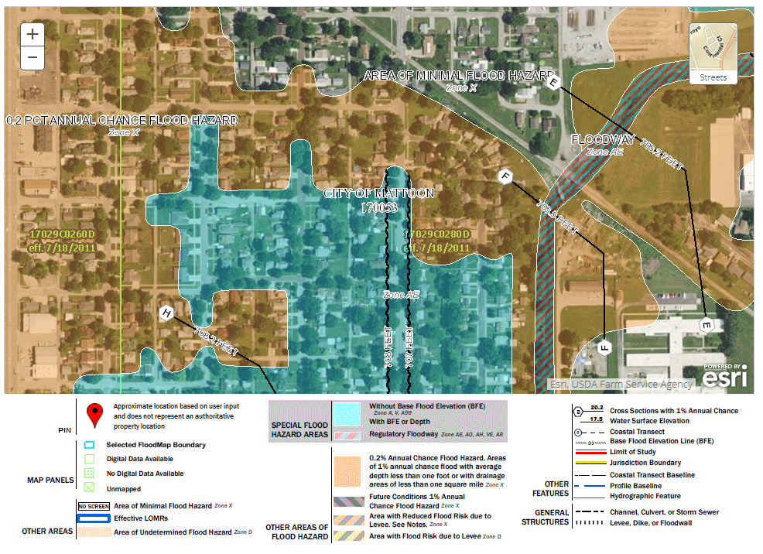
166

Slide 167
CRITICAL ACTIONS
Prohibited in Floodways & Coastal High Hazard Areas
Should be avoided in the 100- and 500-year Floodplains
Allowed if processed under 24 CFR Part 55.20
Defined in Section 55.2(b)(3)(i) as any activity for which even a slight risk of flooding would be too great, because such flooding might result in loss of life, injury, or property damage
Some examples include: emergency services; hospitals; nursing homes; structures holding sensitive documents or hazardous materials
167

Slide 168
FEMA FIRMette FEMA FLOOD INSURANCE RATE MAP
Can be produced on the FEMA Map Service Center (MSC) website (www.msc.fema.gov)
Most of the developed areas of the US have been FEMA-mapped
FEMA designates the floodplains and the FEMA MSC provides the info in the form of a FIRM
FEMA maps can be ordered or printed as “FIRMettes” from the FEMA MSC
168

Slide 169
Locate Your Project on the FIRM
If the project site(s) are not in a floodplain as identified on FIRM, print and include copy of FIRM with project location noted in your ERR and explanation (incl. map, panel #’s & date) on CEST or EA under Floodplain Management (FM)
If project site(s) are in a 100-year FP, then complete the 8-Step FP review process, incl. both required Publications
If project is not a “critical action” and is located in a 500-year FP, the 8-step review is not required
169

Slide 170
Locate Your Project on the FIRM
If the project site(s) are in a “prohibited” Floodway, then either find new location(s) not in a Floodway, or abandon the project. It will NOT be approved by DCEO in a Floodway.
If project site(s) are in a FEMA-”Unmapped” location, or an older black-and-white “paper map”, print and include a copy of that search result, and draw your project’s approximate location(s) on it. The 8-step review is not required
170

Slide 171
Locate Your Project on the FIRM
For HR, the Tier 1 CEST has a pre-populated explanation that project is only considered to be a minor improvement under 24 CFR 55.2(b)(10)(iii), and thus not subject to the decision-making process under 24 CFR 55.12.
Print and include copy of target area’s FIRMette
The 8-step review is not required
No rehab of home located partially or wholly in a prohibited Floodway. Please do not ask!
171

Slide 172
8-Step Process Overview
Step 1: Determine if project is in a 100-year FP, or is a “critical action” proposed in a 500-year FP
Step 2: Publish Early FP notice, and mail to Federal, State & local public agencies, organizations & individuals known to be interested in project. Provide for a full 15 calendar-day public comment period
Step 3: Identify and evaluate practicable alternatives outside the FP
Step 4: Identify adverse impacts to lives, property & natural & beneficial FP values
172

Slide 173
8-Step Process Overview
Step 5: Deign or modify the proposed CDBG action to minimize potential adverse effects
Step 6: Reevaluate alternatives rejected in Step 3 based on info gathered in Steps 4 & 5
Step 7: Publish Final FP notice, and mail to Federal, State & local public agencies, organizations & individuals known to be interested in project. Provide for a full 7-calendar day public comment period
Step 8: After taking all public comments received into consideration, the project can be implemented (once ERR completed and DCEO approves)
173

Slide 174
ERR Documentation
Upon request, the DCEO PI/ED-PI ERO can send both HUD’s 8-step Floodplain Management or Wetlands decision-making case study instructional sheets and a sample of a completed PI ERR that includes an 8-step Floodplain review (the former was already provided to PY’17 PI Administrators).
174

Slide 175
Historic preservation section 106 of the national historic preservation act of 1966
Kirk Kumerow

Slide 176

Historic Preservation – An Overview
What do we want to preserve?
Places important to communities
Public buildings
Homes of great Americans
Historic landscapes
Archaeological sites
Other important properties
176

Slide 177
What is Section 106 and Its Purpose?
Requires Federal agencies to take into account effects of their undertakings on historic properties
Historic properties are those listed on or eligible for listing on the National Register of Historic Places
Agencies are required to afford the Federal Advisory Council on Historic Preservation (ACHP) opportunity to comment on project effects on such properties
177

Slide 178
Mission of Advisory Council on Historic Preservation
Major policy advisor to Gov’t in the field of HP
Majority of Council appointed by President
ACHP issues regs. to implement Section 106; provides guidance and advice; generally oversees Section 106 process
Council consults with and comments to agency officials on individual undertakings and programs that may affect historic properties.
178

Slide 179
Section 106 Participants
Agency Official with jurisdiction over an undertaking takes legal and financial responsibility (HUD/DCEO/Community’s CEO)
Applicants for Federal assistance or permits and their hired consultants
Designees authorized by Federal agency
179

Slide 180
Section 106 Consulting Parties
State Historic Preservation Officer (SHPO). In Illinois, Historic Preservation Division of Ill Dept. of Natural Resources (IDNR-HP), which advises Federal agencies (incl. DCEO for CDBG) in exercising their Sect. 106 duties, and cooperates with such agencies, local govt’s, NFP’s and individuals to ensure that historic properties are taken into account at all levels of project planning and development.
180

Slide 181

IDNR – Historic Preservation (HP)
State Historic Pres. Office
IDNR – One Natural Resources Way, Springfield, IL 62702-1271
217-782-4836; https://www2.illinois.gov/dnrhistoric/Pages/default.aspx
181

Slide 182
IDNR – Historic Preservation (HP)
We are aware that due to staffing issues, IDNR-HP is currently taking at least 6 weeks to process Section 106 clearance requests for our projects.
We are aware that under Federal law the SHPO has a “30 day clock” to process the request.
We’ve heard rumors that HUD’s ERO has advised PHA ERR preparers to conclude their Section 106 review if IDNR-HP takes longer than 30 days:
YOU MUST WAIT for IDNR HP CLEARANCE for DCEO CDBG ERR’s;
We do not want to pay back HUD with State General Revenue funds for Grantee non-compliance, and seek Grantee reimbursement.
182

Slide 183
Section 106 Consulting Parties
Indian Tribes and Native Hawaiian organizations that might attach religious and cultural significance to historic properties within project’s area of potential effect. THPO assumes SHPO duties for Section 106 on tribal land.
The public, whose views are essential for informed Federal decision-making.
Local govt’s and applicants, because of their interest in project.
183

Slide 184
Section 106 Compliance for DCEO CDBG
Every CEST or EA level ERR for a DCEO CDBG project must obtain a “Federal” Section 106 clearance letter from IDNR-HP.
For HR, the CDBG HR ERO will obtain the Section 106 letter for the Tier 1 CEST review of the target area as a whole once an HR round of grants is awarded.
For HR, Grant administrator will obtain the individual Section 106 letter for each Tier 2 CEST review for each home actually proposed for rehab after Tier 1 released. IDNR-HP prefers 2 or more home review requests at a time.
184

Slide 185
Section 106 Consulting Parties
For CEST’s and EA’s for PI and ED-PI, Grant administrator will obtain the individual “Federal” Section 106 clearance letter from IDNR-HP for the proposed project.
Note: For all CDBG projects requiring a Section 106 clearance letter from IDNR HP, that letter MUST be a “Federal” Section 106 clearance letter and not a “State” letter covering clearance under State of Illinois statute. If not “Federal”, you will be referred back to IDNR-HP for correct review letter, which will cause re-publication if CEST not converting, or EA.
185

Slide 186
Section 106 Tribal Consultation
Section 106 of the NHPA of 1966 states that tribes are a “Consulting Party” for HP reviews for Federally-funded projects.
For HUD-funded projects, tribes express an interest in such projects by listing themselves on a county basis on HUD’s Tribal Directory Assessment Tool (TDAT) (https://egis.hud.gov/tdat/).
IDNR HP defines all HUD interested tribes in Illinois as “historic tribes”, because they were made extinct or pushed westwards by settlement just prior to, during, or after statehood. There are no current tribal reservations in Illinois, as there are in neighboring WI and IA.
186

Slide 187
Section 106 Tribal Consultation Checklist
For ALL DCEO CDBG CEST and EA level reviews, a HUD Section 106 Tribal Consultation Checklist must be completed, signed and dated by ERR preparer.
For HR, “None of the above apply” will be checked, and tribal consultation ends. Include copy in Tier 1 CEST.
Depending on the type of PI or ED-PI activity, either “Significant ground disturbance (digging)”, “New construction in undeveloped natural areas” or “None of the above apply” will be checked. The other 5 check boxes usually haven’t applied to DCEO CDBG.
187

Slide 188
Section 106 Tribal Consultation Checklist
If “None of the above apply” is checked, tribal consultation ends. Usually if PI involves sewer re-lining/spot replacements; water/sewer main replacements w/out increasing size of trench; sidewalk replacements. Not allowed for extensions. Incl. copy in ERR documents.
If “Significant ground disturbance (digging)” or “New construction in undeveloped natural areas” is checked, must consult with tribes interested in HUD projects in county, as listed on HUD TDAT. Include copy in ERR documents.
188

Slide 189
Section 106 Tribal Consultation Checklist
189

Slide 190
Tribal Consultation Highlights
To find HUD TDAT website, web search “HUD TDAT”. Site contains search tools to find tribes interested in counties nationwide, incl. Illinois counties. More tribes have added themselves each year.
TDAT contains detailed instructions for contacting tribes, incl. letter templates, timeframes, signature authority. DCEO ERO can provide blank Tribal Consultation Checklist & “How to consult” sheets from HUD.
190

Slide 191
Tribal Consultation Letters
Consultation is head of gov’t to head of gov’t. Letters MUST BE On Grantee Gov’t letterhead, signed and dated by Grantee Chief Elected Official (CEO), and addressed to tribal Chief or Chairman.
CC any listed THPO for a tribe.
ERR preparer may e-mail, fax or mail the letter. Send to every TDAT-listed Chief, Chairman and THPO.
191

Slide 192
Tribal Consultation Letters
Starting day after date of transmission, allow tribe 30 full days following e-mail or fax, 35 full days if mailed. If no response by the 31st or 36th day, that tribe’s consultation ends.
If tribe responds with letter or e-mail of non-interest, its consultation ends.
192

Slide 193
Tribal Consultation Letters
If tribe responds that e-mailed consultation requests are not allowed (e.g., Osage Nation), then mail a copy of letter with current date to tribe, and allow 35 full days starting day after mailing.
Don’t rush the tribe. Give them their time. Usually no response from most tribes. Miami Tribe almost always submits courteous letter expressing non-interest.
193

Slide 194
Tribal Consultation Letters
If tribe desires full consultation after their initial review, incl. hiring an archaeologist, contact SHPO (i.e., IDNR-HP) & DCEO ERO ASAP. Note: This doesn’t incl. the Osage Nation e-mailed response stating no e-mailed consults and giving long list of consultation requirements while asking for mailed consultation letter (discussed above).
194

Slide 195
Tribal Consultation Letters
If tribe (e.g. Miami Tribe) sends letter expressing non-interest, but states they want to be advised if human remains or archaeological artifacts are discovered during construction, then still would be a “No” to CEST or EA “formal compliance steps or mitigation” for HP, but would list that tribe, IDNR-HP & law enforcement for “Historic Preservation” “Law” under “Mitigation Measure” if remains or artifacts discovered during construction.
195

Slide 196
Tribal Consultation Document Summary
In summary, for Section 106 Tribal review, the CEST or EA should have:
Completed Tribal Consultation Checklist, and if applicable:
Copy of HUD TDAT web search results (with search date) for each Grant project county (use a screen print and not the TDAT Excel)
Copies of letters from Grantee CEO to Tribal CEO (with cc to THPO)
Copies of proof of transmission to each tribe (e.g., envelope copy, sent e-mail, or fax transmission sheet)
Copies of any tribal responses, subsequent correspondence, and any contact with SHPO (IDNR-HP) and/or DCEO ERO because of a tribe
196

Slide 197
Tribal Consultation Document Summary
As our HUD Environmental Review Officers and CDBG Reps like to remind us:
DOCUMENT, DOCUMENT, DOCUMENT!
197

Slide 198
Noise abatement hud noise standards 24 cfr part 51, subpart b 24 cfr part 58.5 (i)(1)
Kara Cozadd

Slide 199
Noise Can Be Detrimental
Noise affects people’s ability to:
Talk to one another
Hear threats around them
Enjoy recreational pursuits
Learn and concentrate
Noise causes physical harm – hearing loss, stress, and threats to mental and social well-being
Noise reduces property value and resale potential

Slide 200
Noise Assessment Goals
Noise affects the quality of housing and its economic value.
Comply with the Housing Act of 1949 by creating and enforcing a standard for “a decent home in a suitable living environment.”
Comply with the HUD Act of 1965 mandate “to determine feasible methods of reducing the economic loss and hardships suffered by homeowners…following the construction of airports…”
Comply with the Compatible Land Use at Federal Airfields to not promote incompatible land uses within the influence of military and other federal air installations.

Slide 201
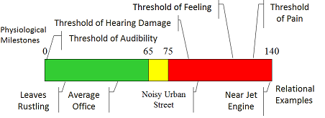
Noise Standards
Outdoor Standards (24CFR51.103):
HUD Goal: ≤ 55 dBs
Acceptable Range: ≤ 65 dBs
Normally Unacceptable Range: > 65 dBs ≤ 75 dBs
Unacceptable Range: > 75 dBs
Indoor Standard (24CFR51.101(a)(9)): 45 dBs Max.

Slide 202
Common Audible Sounds
Rustle of leaves in wind: 10 dB
Average whisper: 20 dB
Soft Radio music in house: 40 dB
Range of speech: 48-72 dB
Noisy urban street: 90 dB
Loud horn at 10 feet: 100 dB

Slide 203
HUD Noise Worksheet
Per Questions on HUD Noise (CEST and EA level Review) Worksheets:
CEST and EA ERR’s for PI and ED-PI only require statement that “project does not involve housing construction or rehabilitation.” No worksheet.
For HR Tier 1 reviews, CEST is pre-marked that review will occur at the Tier 2 level for each home to be rehabbed.

Slide 204
HUD Noise Worksheet
For HR Tier 2 level reviews, for Noise CEST Worksheet Question 1-check box for “Rehabilitation of an existing residential property”, and proceed to Question 2.
Question 2-Standardized Noise Attenuation Measures (e.g., better windows/doors, sealed gaps, & etc.)- if “Yes”, then continue to question 6, last part called “Worksheet Summary”-give project synopsis. You are done with Noise!

Slide 205
HUD Noise Worksheet
Question 2-Standardized Noise Attenuation Measures-If “No”, then continue to Question 3 and complete the preliminary screening to identify potential noise generators in the vicinity of project.
1000 feet (1 mile=5,280 feet) from a major road (greater than 10,000 Annual Average Daily Traffic (AADT)). E.g., downstate may only be stretch of I-55-70 from Troy into St. Louis.
3000 Feet from a railroad
15 miles from a civilian airport or military airfield.

Slide 206
HUD Noise Worksheet
Sample Noise Generator Calculation Tools:
Roads: If AADT is estimated to exceed 10,000 vehicles per day, research traffic volumes on IDOT website or consult with County or Municipal engineer.
Railroads: Check Federal Railroad Administration’s (FRA) Crossing Inventory Database http://safetydata.fra.dot.gov/OfficeofSafety/publicsite/crossing/xingqryloc.aspx)

Slide 207
HUD Noise Worksheet
Airports: Airnav.com or any other airport location website (to map distance from home to airport);If within 15 miles, contact Airport Manager to obtain it’s Noise Plan or Military “Air Installation Compatible Use Plan”; use airport noise contour maps to determine decibel level at airport site.
Generally, outside of O’Hare, Midway and StL Lambert, noise level of downstate airports does not reach a threshold of concern for HR.

Slide 208
HUD DNL Calculator
As applicable for each of the 3 potential Noise Generator sources (Road, Rail and Airport), enter the calculated decibels on the HUD Day-Night Noise Level (DNL) Calculator (https://www.hudexchange.info/programs/environmental-review/dnl-calculator) to calculate the approximate DNL for the home being rehabbed.
65 decibels or less is the “acceptable range” for HUD-assisted projects. Although HUD has a goal of 55 decibels or less.

Slide 209
HUD Noise Worksheet
Proceed to Worksheet Question 6 and detail whether or not Mitigations will be undertaken and why.
State the calculated decibel level of the home and the noise sources.
Is that level 65 or less?
If “yes”, state no mitigations will be undertaken.
If “no”, state what mitigations will be undertaken.
Complete “Worksheet Summary” at bottom and file Worksheet in Tier 2 CEST.

Slide 210
Sole source aquifers 24 CFR Part §58.5(d)
John McCarthy

Slide 211
Safe Drinking Water Act (1974); SSA Under Sect 1424
No physically, legally, and economically-available alternative for drinking water source exists
Federal assistance prohibited for projects that might contaminate an aquifer designated as SSA

Slide 212
Safe Drinking Water Act (1974); SSA Under Sect 1424
SSA designation protects an area's ground and drinking water
All proposed projects located in a SSA area that are receiving federal funds are subject to EPA review to ensure they do not endanger the water source

Slide 213
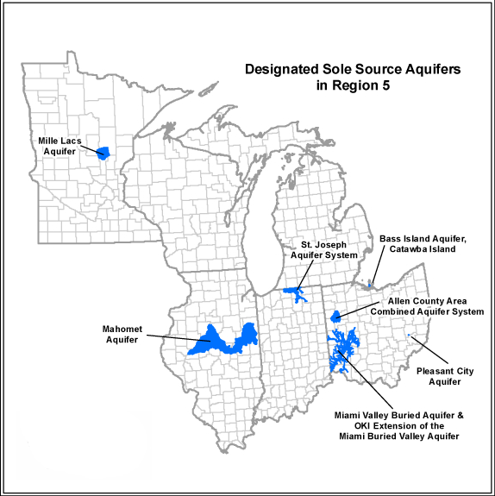
Sole Source Aquifers of Region 5
Any person or organization may petition US EPA to designate an aquifer as a sole source
Currently 7 SSA designations in Region 5
Mahomet Aquifer in Central IL only SSA in IL
Notes:
Federal SSA Designation for Mahomet Aquifer only applies to those areas in blue on the map. Doesn’t include other portions of the Mahomet Aquifer that are not in blue on the map (e.g., west of Illinois River, and in Indiana).

Slide 214
Mahomet Sole Source Aquifer

Slide 215
Documentation for the ERR
If the project is not within area of concern for Mahomet SSA in Central IL
Include the US EPA Region 5 SSA Map with the project community’s location indicated on the map showing it is outside the area of concern

Slide 216
Documentation for the ERR
If the project is within area of concern for Mahomet SSA, but not type of project that will adversely affect SSA (e.g., HR and some PI’s), should document such with a memo to the ERR file, and include a copy of the US EPA Region 5 SSA Map with the project community’s location marked

Slide 217
Documentation for the ERR
If the project is within the area of concern for Mahomet SSA and requires Chicago Office of US EPA review (i.e., some PI’s and ED-PI’s), include:
Request for US EPA review
Completed US EPA review
Project mitigation measures and project conditions must be included as a project requirement and noted in the CEST or EA and the HUD RROF (7015.15)

Slide 218
US EPA Review Requirements
Be proactive: When considering applying for any Federal funds, if community located in area of concern for Mahomet SSA:
Contact the Chicago Regional Office of the US EPA to determine what types of projects need their review
Affected communities could consider entering into a Memorandum of Understanding with US EPA on SSA review requirements

Slide 219
Region 3 EPA Review Guidelines “The Barbara Smith Letter (1996)”
A project is considered for US EPA SSA review if all three of the following questions can be answered with "yes":
is the project/action located in an area designated as a Sole Source Aquifer?
(2) is the project/action partially Federally funded?, and

Slide 220
Region 3 EPA Review Guidelines “The Barbara Smith Letter (1996)”
(3) does the project/action have the potential to create a 'significant hazard to public health' by adversely impacting ground water either during construction or after completion and facility is in operation?
FOR DCEO CDBG, potentially could apply to some PI or ED-PI if in Mahomet SSA in Central IL.

Slide 221
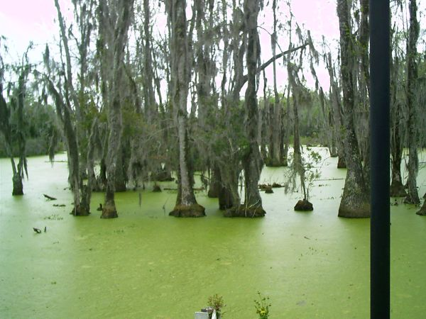
Wetland protection 24 CFR Part 58.5(b)(2)
Kirk Kumerow

Slide 222
What are wetlands?
Contain hydric soil - saturated by water.
Soil lacks oxygen when saturated
Land that is seasonally wet.
Habitat for many aquatic and terrestrial species.
Some found only in wetlands.
Wetland plants known as hydrophytes.
Swamps, Marshes, Bogs, Similar areas

Slide 223
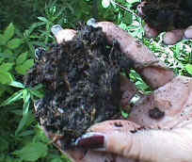
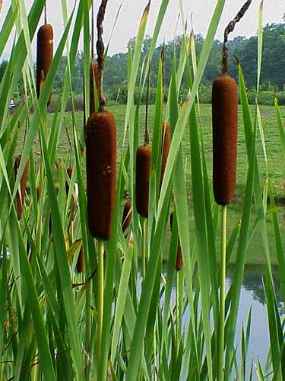
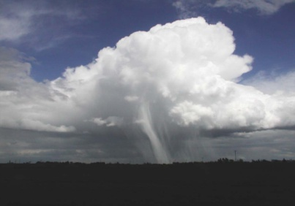
Wetlands Require the Presence of Three Conditions:
Hydric soils
Hydrophilic vegetation
Year-round & seasonal water
requirements

Slide 224
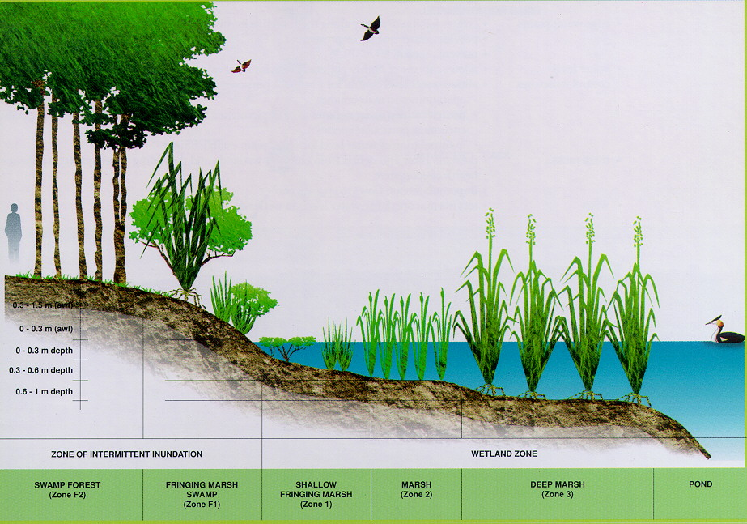
Wetlands System

Slide 225
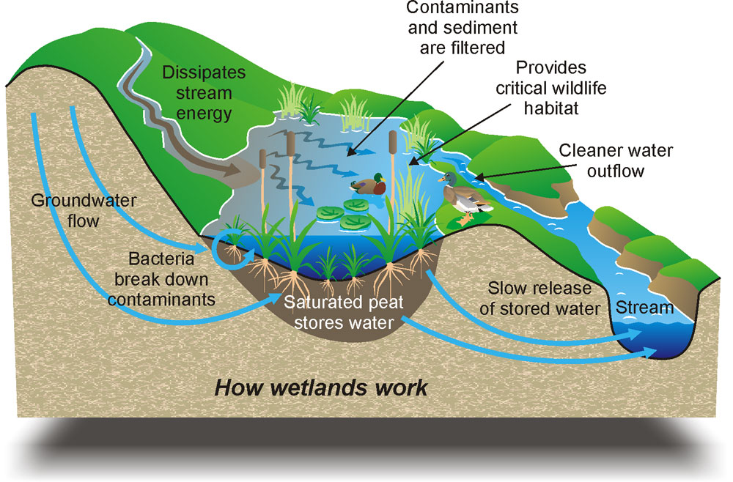
Wetland Processes

Slide 226

Wetland Regulations Executive Order 11990 requires:
Federal Agencies to:
“Avoid to the extent possible the long and short term adverse impacts associated with the destruction or modification of wetlands and to avoid direct or indirect support of new construction in wetlands wherever there is a practicable alternative”

Slide 227
24 CFR Part 55
HUD Final Rule effective December 16, 2013
Codified HUD’s existing policies and procedures implementing EO 11990 under Part 55 regulations
Adopted E.O. 11990 Sec. 7 (c) wetland definition and modified it to include manmade wetlands to ensure that constructed wetlands for mitigation would be preserved as natural wetlands

Slide 228
24 CFR Part 55
Introduced the use of Individual Permits under Section 404 of Clean Water Act to:
Streamline EO 11990 processing time
Reduce costs of compliance with parts of the 8 Step

Slide 229
Wetlands Determination
RE makes determination whether action is new construction that is located in wetland – subject to §55.20 decision making process

Slide 230
Wetlands Determination
Primary screening – determine if project area is in proximity to wetlands identified on FWS National Wetlands Inventory (NWI)
If yes, must make reasonable attempt to consult with FWS
FWS staff must find no wetlands present in order to proceed without further processing
If FWS staff not available, appropriate wetland professional must find that no wetland is present in order for action to proceed

Slide 231
Wetlands Determination
Secondary screening – used in conjunction with NWI maps, use NRCS National Soil Survey (NSS) and any state and local information concerning the location, boundaries, scale and classification of wetlands in the area.
Challenges to wetlands determination must be made in writing to RE during comment period and must be substantiated with verifiable scientific information.

Slide 232
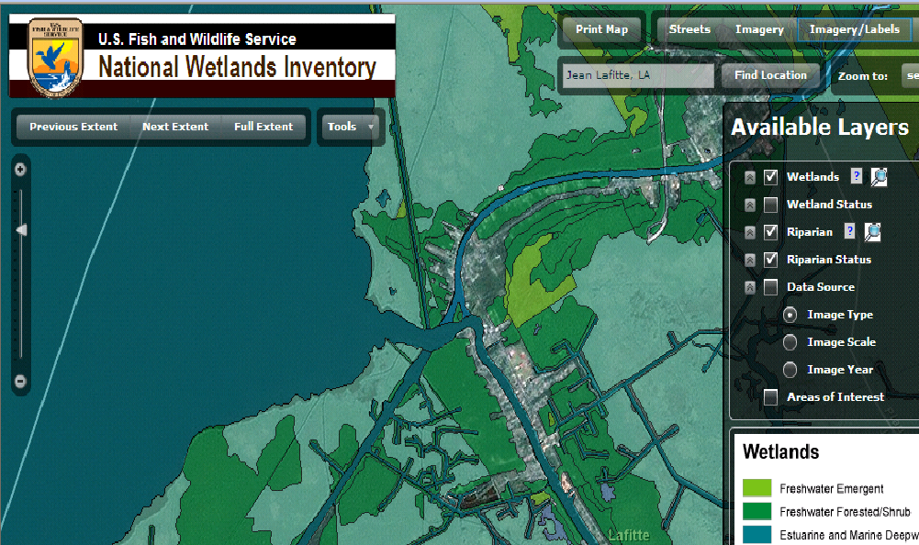
National Wetlands Inventory Map

Slide 233
WETLANDS: COMPLIANCE STEPS REQUIRED & Applicability (§55.11)
Under E.O. 11990, the decision making process in §55.20 applies only to Federal assistance for “New Construction” in wetlands locations.
New Construction, as defined in the E.O. Includes draining, dredging, channelizing, filling, diking, impounding and related activities
Complete and implement the 8-step decision making process identified in 24 CFR 55. (Projects may be approved only if there is no practicable alternative outside the wetland area. However, such activities require a Section 404 permit from the U.S. Corps of Engineers)

Slide 234
Inapplicability (§55.12)
Part 55 does not apply to:
§55.12(c)(3) – the approval of financial assistance for restoring and preserving the natural and beneficial values of floodplains and wetlands, including through acquisition of such floodplain and wetland property, but only if:

Slide 235
Inapplicability (§55.12)
The property is cleared of all existing structures and related improvements
The property is dedicated for permanent use for flood control, wetland protection, park land or open space; and
A permanent covenant or comparable restriction is placed on the property’s continued use to preserve the floodplain or wetland from future development.

Slide 236
Inapplicability (§55.12)
DCEO CDBG is of the opinion that the Inapplicability outlined above extends to PI or ED-PI projects solely comprised of dredging sewage lagoons (as listed on the USF&WS Wetlands Mapper) to increase their capacity to hold future sewage.
However, any on-site disposal of the dredged sludge must be mapped to demonstrate it will not be placed in or near any other nearby USF&WS mapped wetlands.

Slide 237
Inapplicability (§55.12)
§55.12(c)(6) – A minor amendment to a previously approved action with no additional adverse impact on or from a floodplain or wetland.
§55.12(c)(7) – Approval of a project site, an adjacent portion of which is situated in an adjacent…wetland, but only if:
The proposed construction and landscaping activities do not occupy the… wetland;
Appropriate provision is made for site drainage that would not have an adverse affect on the wetland; and
A permanent covenant or comparable restriction is placed on the property’s continued use to preserve the floodplain or wetland.

Slide 238
Individual Permits under Section 404 of Clean Water Act (§55.28)
If Grantee already possesses a United States Army Corps of Engineers (USACE) permit issued under Section 404 of the Clean Water Act (CWA) for the identical project proposed for funding by DCEO CDBG, please contact the CDBG ERO ASAP to determine how that permit intersects with the requirements of E.O. 11990, and what steps remain for Wetlands Protection compliance.

Slide 239
New Construction in Wetlands
Agencies are to avoid construction in wetlands unless they find:
No practicable alternative
Action includes all practicable measures to minimize harm to wetlands
Factors that can be considered in making finding:
Economic
Environmental
Other pertinent factors
Follow 8-Step decision-making process at §55.20

Slide 240
Compensatory Mitigation
Practicable compensatory mitigation is recommended for unavoidable adverse impacts to more than 1 acre of wetland. Compensatory mitigation includes:
permit-responsible mitigation,
mitigation banking,
in-lieu fee mitigation,

Slide 241
Compensatory Mitigation
preservation easements/protective covenants, and any form of mitigation promoted by state or Federal agencies.
**The use of compensatory mitigation may not substitute for the requirement to avoid and minimize impacts to the maximum extent practicable.

Slide 242
Sources for Wetlands Identification
Army Corp of Engineers (USACE) 1989 Manual:
http://www.wetlands.com/pdf/89manv3b.pdf
Fish and Wildlife Services Classification Manual: http://www.fws.gov/wetlands/_documents/gNSDI/ClassificationWetlandsDeepwaterHabitatsUS.pdf
http://www.fws.gov/wetlands/Data/Mapper.html

Slide 243
ERR Documentation
Identification of wetland - Document mapping or identification source:
NWI Maps
USGS Topo Maps
USDA Soil Survey Maps
Include project location on map
Wetlands delineation studies
Evaluation of Impacts –
8-Step Analysis (24 CFR Part 55.20)
Include Direct and Indirect impacts
Include Cumulative Effects
USACE Section 404 (Clean Water Act) individual permit

Slide 244
ERR Documentation
Incorporation of Mitigation & Conditions into Project
USACE Section 404 (Clean Water Act) individual permit requirements
FONSI Notice
RROF
Contracts
State of Illinois Specific Requirement
IDNR EcoCat Wetlands Release from Consultation (incl. separate letter if applicable). PI & ED-PI
For HR, a statement on Tier 1 CEST that project does not meet EO 11990 Def. of New Construction

Slide 245
ERR Documentation
Upon request, the DCEO PI/ED-PI ERO can send both HUD’s 8-step Floodplain Management or Wetlands decision-making case study instructional sheets and a recent sample of a completed 8-step Wetlands review (each was already provided to PY’17 PI Administrators).

Slide 246
Wild & scenic rivers act
John McCarthy

Slide 247
Wild & Scenic Rivers Act
National Wild and Scenic Rivers System was created by Congress in 1968 (Public Law 90-542; 16 U.S.C. 1271 et seq.) to preserve certain rivers with outstanding natural, cultural, and recreational values in a free-flowing condition for the enjoyment of present and future generations.

Slide 248
IL Wild & Scenic River
The only National Wild & Scenic River in Illinois is the Middle Fork of the Vermilion River near Danville in Eastern IL
In last 5 years, not one CDBG project near it
Notes:
No stretch of the Mississippi, Illinois or Ohio Rivers are Federal Wild & Scenic Rivers

Slide 249
IL Wild & Scenic River
Notes:
DCEO CDBG ERO has and will provide copies of this map. Mark your project’s location (incl. Community’s name) on it.

Slide 250
Protection from Federal Activities
Determine if your project is near a Wild and Scenic River
Designated Wild and Scenic Rivers
Study Wild and Scenic Rivers http://www.rivers.gov/rivers/

Slide 251
Protection from Federal Activities
Mark your project community’s location on the map found on that site in proximity to the Middle Fork Vermilion River, or use the IL Wild & Scenic Rivers map DCEO ERO provides
Print and file map in your CEST or EA, and state not near that river on CEST or EA

Slide 252
Protection from Federal Activities
If proposed CDBG project is on or near the Middle Fork Vermilion River near Danville, then please contact DCEO CDBG PI ERO to obtain guidance on remainder of Wild and Scenic River Section 7 compliance steps.

Slide 253
Environmental justice executive order 12898 why, what, how
Kara Cozadd

Slide 254
1994- Executive Order 12898
“…each federal agency shall make achieving environmental justice part of its mission by identifying and addressing, as appropriate, disproportionately high and adverse human health or environmental effects of its programs, policies, and activities on minority populations and low income populations.”

Slide 255
Environmental Justice 58.5 (j)
Executive Order 12898
Addresses: Disproportionate potential for
adverse effects on human health
Environmental effects
Low income and minority populations
.

Slide 256
EJ’s Importance
Added “low income” as a protected class not in the Civil Rights Act
Empowered communities with participation and data
Required federal agencies to integrate EJ into their missions

Slide 257
EJ-Agency Roles
Environmental Justice built on Title VI of the 1964 Civil Rights Act which prohibits discrimination on the basis of race, color, sex and national origin in programs and activities receiving federal financial assistance.
All federal agencies must comply-the President directed all federal agencies to make EJ part of their missions and to identify and address the effects of their programs, policies and activities on minority and low income populations.

Slide 258
Terminology
Environmental Justice-Equal access to safe and healthy housing by all Americans; mitigating risks to communities in disaster-prone areas; providing access to affordable, accessible, quality housing free of hazards to residents’ health; and working to achieve inclusive, sustainable communities free from discrimination.

Slide 259
What you need to consider
Does the project create adverse environmental impacts? (e.g. noise is essentially an EJ issue)
If it does, are the impacts disproportionately high for low income or minority communities?
http://www.epa.gov/ejscreen
EJSCREEN users choose a geographic area; the tool then provides demographic and environmental information for that area.
If yes, adverse impacts must be mitigated and affected low income or minority community must be engaged and involved in the decision on what mitigation actions will be taken

Slide 260
EJ: Key Considerations
Does an EJ population exist in or near our project area? (low income, minority, tribal)
Does the project entail any adverse impact?
Does the adverse impact disproportionately affect the EJ population?
Does the proposed action cause an adverse environmental impact? (e.g. constructing industrial facility next to minority community)
Does the proposed action subject people to adverse environmental impact? (e.g. building housing for low-income people in a floodplain)
Does the project entail multiple hazards or cumulative adverse impacts? (e.g. conversion of a warehouse for residential use next to interstate highway)

Slide 261
How to address EJ?
1. Is there an adverse environmental impact caused by the proposed action? Generally, no for most DCEO CDBG projects. Individual proposed ED-PI projects may have to have mitigations if an adverse environmental impact is found during other 15 bodies of Federal Environmental Law.
2. Is the project subject to an adverse environmental impact? If yes, then must be mitigated and must educate affected population.

Slide 262
EJ Compliance: What’s necessary?
Include copy of US EPA NEPAssist search results for project site and vicinity.
ED PI projects may also have to complete and include a HUD EJ Worksheet to show if any mitigations were required and document if performed.

Slide 263
EPA NEPAssist:
http://nepassisttool.epa/gov/nepassist/entry.aspx
NEPAssist is a tool that facilitates the environmental review process and project planning in relation to environmental considerations. The web-based application draws environmental data dynamically from EPA’s Geographic Information System databases and web services and provides immediate screening of environmental assessment indicators for user-defined area of interest.

Slide 264
Ensure public participation in the nepa decision making process After completion of a CEST or EA level review
Kirk Kumerow

Slide 265
Reasons for Public Participation
It is a public right under NEPA
Public input can improve the quality of a project
Can resolve differences that could otherwise stop or delay a project

Slide 266
Types of Public Notices under Part 58
Notice of Intent to Request the Release of Funds (NOI/RROF)
Required for projects that are CEST (Not Converting to Exempt), EA, or EIS
Notice of Finding of No Significant Impact (FONSI)
Required for EA
Combined NOI/RROF and FONSI notice
May be used for EAs, but not CEST (DCEO encourages because only 1 “Combined” Notice)

Slide 267
Public Notifications: Comment Periods
NOI/RROF
7 full days for publication
10 full days for posting
Combined NOI/RROF and FONSI
15 full days for publication & dissemination
18 full days for posting & dissemination
Comment period starts the day after publication/posting and lasts until C.O.B. on the 7th/10th (NOI/RROF) or 15th/18th (NOI/RROF FONSI) full day after that date.

Slide 268
Public Notifications: Comment Periods
FONSI must also be disseminated to interested parties
If posting, must prominently display in 3 local locations available to the public. If feasible, one should be at subject site (rare for IL CDBG projects)
Need to use applicable language(s) for posting (i.e., reflect your project community’s composition)
RE must consider comments from the public prior to signature by the Certifying Officer on CEST or EA; mitigate or not following comments

Slide 269
Who Are Interested Parties?
Local news media
Appropriate Tribal, Local, State, and Federal agencies
DCEO CDBG ERO in place of HUD OEE
Environmental groups or individuals with known interest in area or project
Regulatory oversight agencies with known interest in project area
Chicago Regional office of the US EPA

Slide 270
Timing and Counting Days
Counted in calendar days
RE starts counting the day after publication/posting
If last day of comment period falls on a weekend or holiday, accept public comments received through the following business day
RE may extend comment period for any reason, but must extend as needed per §58.46
RE signs and submits RROF after last day of comment period (on or after the “On or about” date at start of Notice)

Slide 271
Example: 15-day Comment Period
S | M | T | W | T | F | S
 |  |  | 1 - Pub | 2 | 3 | 4
5 | 6 | 7 | 8 | 9 | 10 | 11
12 | 13 | 14 | 15 | 16 | 17 - RROF | 18
19 | 20 | 21 | 22 | 23 | 24 | 25
26 | 27 | 28 | 29 | 30 | 31
271
Notes:
271

Slide 272
Obtain environmental clearance
Kirk Kumerow

Slide 273
Environmental Clearance Process
HUD Form 7015.15 (RROF) signed by Certifying Officer
DCEO issues Env. Release Letter
Submit RROF to DCEO ERO

Slide 274
HUD Form 7015.15 (RROF)
Required submittal for each DCEO CDBG CEST (Not Convert to Exempt) or EA
Must use current non-expired form (IL CDBG specific PI/ED-PI & HR Tier 1 versions available from DCEO CDBG ERO)
This is the legal document and its pre-filled language should not be changed
When completing the form:
Location of the project (incl. GPS coordinates) in Box 10 (i.e., not City Hall)
BOX 11: Complete project description, incl. completion sched., estimated project cost, incl. estimated funding from CDBG & non-CDBG. HR version incl. Tiered review language

Slide 275
Submitting the ERR to DCEO CDBG ERO
Scan & E-mail (or mail) color copy of entire CDBG ERR (Keep original in your files) to respective DCEO CDBG ERO (i.e., Kirk for PI/ED-PI/Non-HR RLF Close-out or Kara for HR)
May be broken into 2 or 3 scans, but identify each separate e-mail by Grantee Name and Grant #.

Slide 276
Submitting the ERR to DCEO CDBG ERO
If EA or CEST (Not Converting To Exempt), include:
RROF (HUD Form 7015.15) Signed, dated, and completed correctly
Proof of publication or posting of NOI/RROF or FONSI/NOI/RROF (incl. dissemination of FONSI)

Slide 277
DCEO Objection Period
DCEO CDBG has a 15-day objection period for EA and CEST (Not convert to Exempt)
Reasons for objection (§58.75):
7015.15 not signed by correct person
Failed to make a FONSI or FOSI determination or §58.35 or §58.47 determination
RE omitted steps in the preparation, publication, or completion of EA
Funds committed prior to RROF
Another Federal Agency objects
DCEO may ask for re-publication or re-submission if:
Notice periods too short
RROF signed prior to end of local public comment period
RROF incorrectly completed
Long lapse between Notice and submission of RROF to DCEO (“On or about” date)

Slide 278
Post err actions
Kirk Kumerow

Slide 279
Continuing Obligations
Any mitigations or contingencies identified in the ERR must be relayed to applicable parties and/or put into applicable agreements and contracts
Grantee Chief Elected Official has certified this with submission of HUD RROF form
DCEO CDBG ERO and/or Grant Manager can verify through monitoring, periodic spot-check and/or verification of Pre-Construction Conference docs.

Slide 280
In Conclusion….
Correct application of 24 CFR Part 58 is essential for avoiding sanctions, litigation, and unexpected mitigation or remediation costs!
Follow all required steps in the environmental review and decision-making process
Carefully document compliance with NEPA and its related authorities, and State of Illinois specific requirements

Slide 281
In Conclusion….
Exercise due diligence in investigations
Use reasonable approaches that are neither arbitrary nor capricious
Carefully maintain the Environmental Review Record (or Environmental Record Review)!

Slide 282

www.illinois.gov/dceo
Questions?
Thanks Much!
Kirk Kumerow
CDBG PI Grants Mgr/ERO
500 East Monroe
Springfield, IL 62701
Phone # 217-558-4016
Email: kirk.kumerow@Illinois.gov
Kara Cozadd
CDBG HR Grants Mgr/ERO
500 East Monroe
Springfield, IL 62701
217-558-2834
kara.cozadd@Illinois.gov
John McCarthy
CDBG PI Grants Mgr/Asst. ERO
500 East Monroe
Springfield, IL 62701
Phone # 217-558-2840
Email: john.mccarthy@Illinois.gov

