Slide 1
Step 3: Conduct the Environmental Review
Environmental Assessments

Slide 2
Environmental Assessment Factors
HUD Exchange Environmental Review Guidance:
https://www.hudexchange.info/environmental-review/
HUD Exchange Environmental Assessment Guidance:
https://www.hudexchange.info/environmental-review/environmental-assessments
EPA NEPAssist:
https://www.epa.gov/nepa/nepassist

Slide 3
Purpose of the Environmental Assessment
To enhance the quality of the human environment
To evaluate and document each Environmental Assessment (EA) factor:
Land development
Socioeconomic
Community facilities and services
Natural Features
To make a determination of anticipated impact

Slide 4

4 Stages of Review
Stage 1: Early planning / assessment procedures
Stage 2: Beginning the EA
Stage 3: Completing the EA and reporting the findings
Stage 4 (if necessary): Preparing the Environmental Impact Statement (EIS)

Slide 5
The EA: 6 steps
Develop a meaningful project description
Complete the Statutory Checklist (§58.5) and other requirements (§58.6)
Complete the EA Checklist
Identify any mitigating measures
Make and document a FONSI or FOSI determination
Complete the EA - including public notice, RROF, AUGF – and put in your ERR

Slide 6
Determination of Significance
Determination of impact for each EA factor:
Minor beneficial impact
Document beneficial impacts. No additional analysis needed.
No impact anticipated
Clearly document why no more analysis is needed
Minor adverse impact
Document the adverse condition, and specify if more studies, mitigation measures and/or project modifications are required
Significant or potentially significant impact
Requiring avoidance or modification which may require EIS

Slide 7
EA Factor - Land Development
Conformance with comprehensive plans
Compatible land use
Conformance with zoning
Scale and urban design

Slide 8
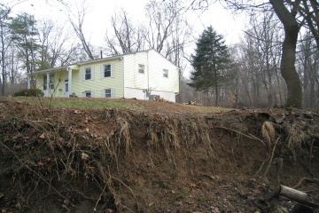
Land Development
Soil suitability
Slope
Erosion
Drainage
Storm water runoff
Hazards and nuisances, including site safety and noise
Energy consumption
Energy efficiency

Slide 9
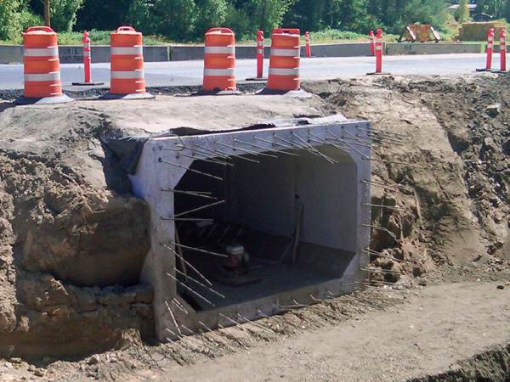
Land Development – Careful Site Planning
Are there negative environmental impacts?
Eliminate
Minimize
Mitigate
Consider constraints such as
Opportunities for site amenities
Design features

Slide 10
Land Development - Resources
Local and regional planning agency
Zoning administrator
Planning commission
City/county architect/engineer/planner
State planning office
USDA soil survey
Landscape architect
Civil engineer
Geologist-soils specialist

Slide 11

EA Factor - Socioeconomic
Employment and income patterns
Temporary jobs
Permanent jobs
Job requirements
Demographic character changes
Community characteristics
Physical, social, psychological dimensions
Displacement
Direct
Indirect
Assess degree of conflict or consistency with the community

Slide 12
Socioeconomic Factors - Resources
Local economic development authority
Local planning department
Local employment agency
Economist at State Employment service
Chamber of Commerce
U.S. Census
Local neighborhood organizations or advocacy groups
Local health or building department – housing code compliance officer
Local community action agencies
Local advocacy groups

Slide 13

EA Factor - Community Facilities and Services
Key Considerations:
Adequate capacity
Impact and potential effect
Availability
Accessibility
Suitability
Quality

Slide 14
Community Facilities and Services
Functional aspects residents and users need to succeed:
Educational and cultural facilities
Commercial facilities
Health care and social services
Public safety – police, fire, EMS
Parks, open space, recreation
Infrastructure capacity to support investments:
Solid waste disposal / recycling
Waste water / sanitary sewers
Water supply
Transportation and accessibility

Slide 15
Community Facilities and Services - Resources
School board or superintendent
Commercial realtor, developer or project sponsor
Local Chamber of Commerce
Commercial development specialist
Local planning department
Local public health department
Area agency on aging
Local Red Cross
Local social services department
Local human services department
Local fire department
Local police department
Local parks and recreation department
Local cultural commission
Local solid waste disposal agency
Local engineer, planner, environmental specialist
Local sanitary district/agency
Local planning department
Soils scientist
Local municipal water authority
Local transportation department
Regional transportation authority
State highway department
Metropolis planning organizations

Slide 16
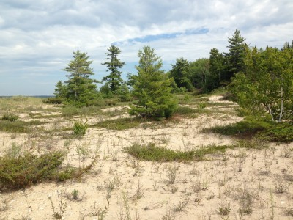
Natural Features
Unique Natural Features and Water Resources
Vegetation and Wildlife
Other Factors
Assess the impact of your proposed project on the natural features

Slide 17
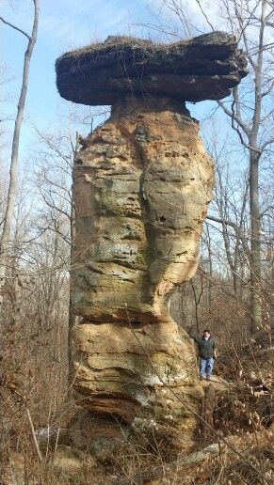
Natural Features
Unique Natural Features
Key Criteria:
Rareness of the feature, information content
Examples: sand dunes, waterfalls, unique rock formations, caves, canyons, petrified forests, unique stands of trees, unique colonies of animals

Slide 18

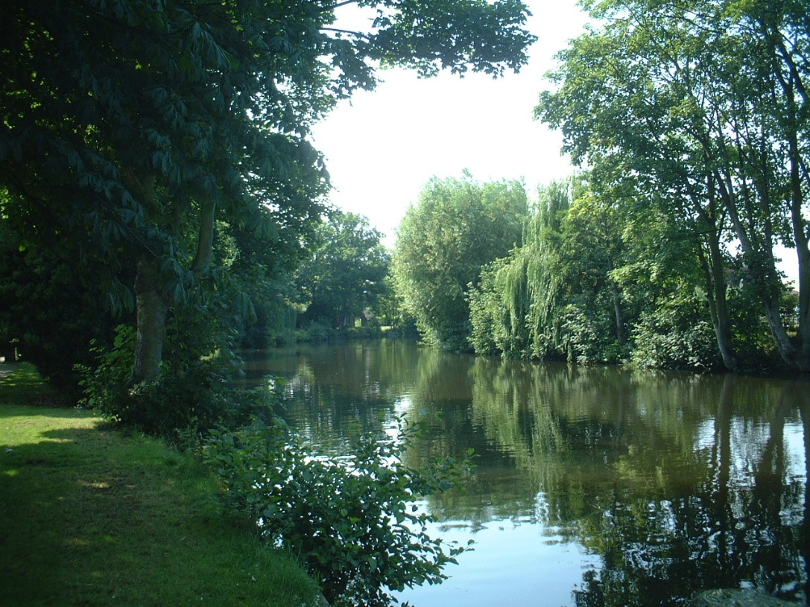
Natural Features
Water Resources
Groundwater
Surface water
Vegetation and Wildlife
Types of damage
On Vegetation:
Disruption
Alteration of habitat
On Wildlife:
Disruption
Habitat alteration or removal
Rare / pest / game species

Slide 19
Natural Features - Resources
State and Federal Park Service (Naturalists/Geologists)
State natural heritage programs
State wildlife resource management agencies
Natural resource conservation service
Local planning department
Local public works department (engineer)
US Soil Conservation Service (soil scientist)
US Geological Survey (hydrologist)
Local biologist or ecologist
Department of Interior Fish and Wildlife Service

