Slide 1
E.O. 11990 Wetlands 8 Step process

Slide 2
Step 1: Designated Wetlands
National Wetlands Inventory as primary and can use NRCS, State, and Local Wetlands Data
Contact FWS or a wetlands professional if the presence is not shown on maps but is suspected or known.
Contact your local HUD FEO or REO if you have a project that already has a 404 Individual Permit.
*A site visit or delineation by a wetland professional may also be used to confirm the map’s accuracy, but it is not required.

Slide 3
National Wetlands Inventory Map

Slide 4
Step 2: Public Notice
Involve public in decision making
15 calendar day minimum comment period
Notice content: project description, location, wetland acreage, contact, office address/hours
May combine wetland notice with floodplain notice or Draft EIS-if wetland notice is identified in title
Published in local printed newspaper
Mailed to federal, state, and local public agencies, organizations, and individuals known to be interested

Slide 5
Step 3: Practicable Alternatives
Identify and evaluate alternatives to construction in wetlands:
Construction locations outside the wetlands
Alternative methods to serve the identical project objective
Alternative not to approve any construction proposing to occupy or modify a wetland

Slide 6
Step 4: Evaluate Impacts to wetlands
Identify and evaluate potential direct and indirect impacts of the proposed construction on the wetland.
Sec.5 (EO 11990) consider factors relevant to a proposal's effect on the survival and quality of the wetland
Public health, safety, and welfare (incl. Water supply, quality, recharge and discharge; pollution, flood and storm hazards; sediment and erosion
Maintenance of natural systems
Other uses of wetlands in the public interest (recreation, scientific, cultural uses)

Slide 7
Step 4: Evaluation Cont’d
Sec.2(a)(EO 11990) agency (decision-maker) may take into account economic, environmental, and other pertinent factors in making a finding such as:
(i) cost increases attributed directly to wetland-required construction and mitigation measures to minimize harm to the wetland;
(ii) increased costs to affordability of housing

Slide 8
Step 5: Minimization
Design or modify the proposed construction to minimize the potential adverse impacts to wetlands; and
Restore and preserve its natural and beneficial functions and values.
Reject the proposal if minimization is financially or physically unworkable.

Slide 9
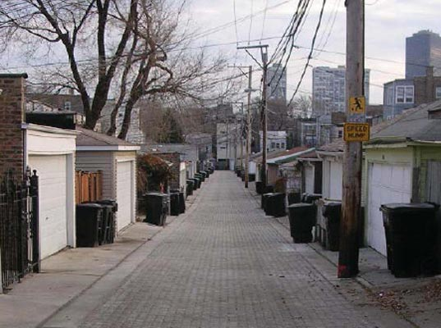
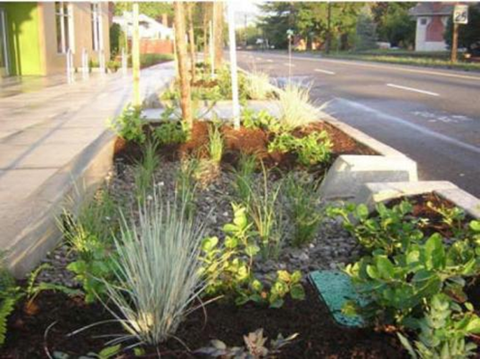
Step 5: Minimization (cont’d)
Minimization techniques can be manmade swales, permeable surfaces (e.g. green alleys), green roofs, site planning around sensitive areas, stormwater capture, and
compensatory
mitigation.
Chicago Green Alley and a Portland, OR swale.
Notes:
Chicago Green Alley and a Portland, OR swale.

Slide 10
Compensatory Mitigation
Practicable compensatory mitigation is recommended for unavoidable adverse impacts to more than 1 acre of wetland. Compensatory mitigation includes:
permitee-responsible mitigation,
mitigation banking,
in-lieu fee mitigation,
preservation easements/protective covenants, and any form of mitigation promoted by state or Federal agencies.
**The use of compensatory mitigation may not substitute for the requirement to avoid and minimize impacts to the maximum extent practicable.

Slide 11
Step 6: Revaluate
Is project still practicable, in light of
1) possible adverse impact to the on-site wetland; or
2) whether other neighboring wetlands will be impacted; and
3) potential to disrupt the natural and beneficial values of wetlands.
Whether alternatives preliminarily rejected in Step 3 remain practicable in light of information gained in Steps 4 and 5.
Reevaluation shall include impacts avoided or caused in and out of the floodplain or wetland and are:
protection of human life, real property
NBFV served by the floodplain or wetland.
economic costs (savings or costs of flood insurance; flood proofing; lost services or functions of critical actions; elevation to the BFE; cost of filling the wetland and mitigation.
Notes:
NBFV: Natural and beneficial functions & values

Slide 12
Step 7: No Practicable Alternative Finding
If reevaluation results in a finding of no practicable alternative, publish the final notice for 7 calendar days according to Step 2.
Final notice content also includes:
(i) reasons why the construction must be located in the wetland;
(ii) list of alternatives considered under Step 3; and
(iii) cite all mitigation measures to be taken to minimize adverse impact and to restore and preserve the natural and beneficial functions and values.

Slide 13
Step 8: Implementation
Complete the decision making process for protection of wetlands and environmental review compliance.
Continuing responsibility exists on part of HUD or RE/sub-grantees to ensure that the mitigation measures identified in Step 7 are implemented.

