Slide 1
Phase II Presentation to ETWC – First Steps
Kenneth A. Kriz
June 7, 2023

Slide 2
Phase II Study
Improved energy demand model – this presentation
Improved economic/labor force model – next presentation
Improved environmental metrics – final presentation

Slide 3
Energy Demand Model

Slide 4
ReEDS
The Regional Energy Deployment System (ReEDS) is NREL's flagship capacity planning model for the power sector
The model simulates the evolution of the bulk power system—generation and transmission—from present day through 2050 or later
It is a “mathematical programming model” of the electric power sector
Modules
  Supply module
  Demand module
  Variable renewable energy and storage module (VRE)

Slide 5
How ReEDS Works

Slide 6
ReEDS Regional Structure

Slide 7
ReEDS Time Slices

Slide 8
Technology Definitions – Wind Resource Classes

Slide 9
Technology Definitions – UPV Resource Classes

Slide 10
Results – Total Capacity - “Mid-Case” and “High Electrification Case” – Balancing Area p80 (Chicagoland & Northern Illinois)

Slide 11
Results – Renewables Capacity – High Electrification Case – Balancing Area p80

Slide 12
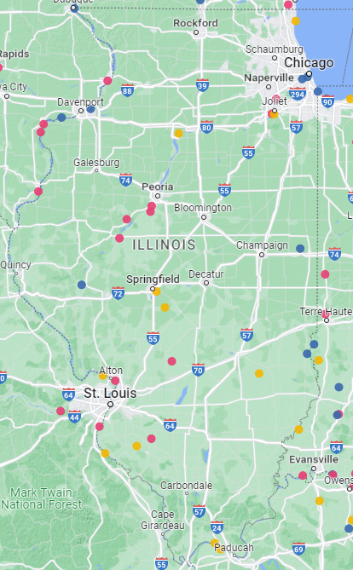
Coal Ash Impoundment Sites

