Slide 1
EDGE Tax Credit Program
Economic Development for a Growing Economy
2026 Reporting Requirements & FAQs

Slide 2
2026 EDGE Reporting Updates
Employee Project Location Certification Form
Policy Clarification Employee Location Certification
Company COVID-19 Payroll Certification is no longer required.

Slide 3
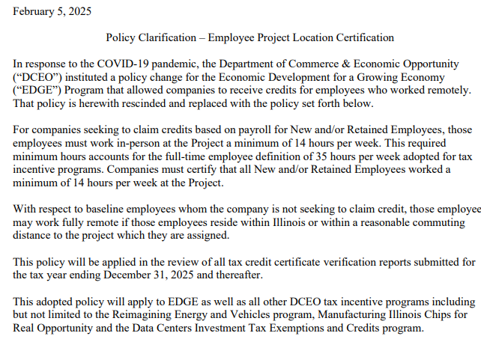

Slide 4

2026 EDGE Tax Reporting Requirements
Agreed Upon Procedures Audit (AUP)
  Companies seeking to claim their first tax credit certificate are required to submit an Agreed-Upon Procedures audit (AUP) within 90 days after its tax year-end (3/31 for companies with a 12/31 tax-year end).

Slide 5
2026 EDGE Tax Reporting Requirements
Annual Tax Credit Report
  EDGE Annual Reporting Requirements
  Exhibit D (Jobs Report)
  Exhibit E (Payroll Report)
  Employee Project Location Certification Form
  Vendor Diversity Report
  Sexual Harassment Policy Reporting
  EDGE Submission Portal
  Illinois Corporate Accountability

Slide 6
2026 EDGE Tax Reporting Requirements
Vendor Diversity Policy Report & Sexual Harassment Policy Report
  Reporting is required for companies that entered into EDGE Agreements (or amended an existing agreement) after October 1, 2017, AND the related companies identified in the EDGE application employ over 100 individuals worldwide. In these cases, the company responsible for new job creation is required to complete the Vendor Diversity Report and the Sexual Harassment Policy Report by April 15 each year. Failure to submit this form annually by April 15 will result in a loss of tax credits for that taxable year.

Slide 7
2026 EDGE Tax Reporting Requirements
Corporate Accountability
  Pursuant to the Corporate Accountability for Tax Expenditure Act, the first annual report is due the year after the year in which the EDGE agreement was executed. For example, companies with EDGE agreements dated in 2025 must submit their first online report during 2026 for the period ending 12/31/2025. Notice of reporting is sent annually and includes filing instructions and due dates.

Slide 8

2026 EDGE Submission Portal
EDGE Submission Portal
  All Annual EDGE Tax Reports must be submitted using the EDGE Submission Portal. Using this portal will help guide you through your submission requirements, ensuring the submission of complete EDGE Annual Tax Reports.

Slide 9
EDGE Tax Report FAQs – Exhibit D (Jobs Report)
Where do I find the information required to complete Exhibit D?
Where do I find the number of jobs to be created or retained?
All information required to complete the Exhibit D can be found in your EDGE Agreement or any subsequent amendment(s).
  Ex. What is the “Name of Business(s)”?
    The full Company Name, as listed in the EDGE agreement or any subsequent amendment(s).
  Ex. What “Address(s)” do I include?
    All Project Locations listed in the EDGE agreement or any subsequent amendment(s).
The number of jobs to be created (or retained) can be found in your EDGE agreement, or possibly within subsequent amendment(s). This is typically addressed in Section 4 (or IV) Company’s Covenants.

Slide 10
EDGE Tax Report FAQs – Exhibit D (Jobs Report)
What is the difference between retained employees and baseline employees?
  Some EDGE recipients may receive credit for Retained Employees, while others are required to maintain a Project Baseline, Statewide Baseline, both a Project and Statewide Baseline, or all the above. EDGE agreements dated October 2017 or later will have a Baseline Employee requirement.
  If your EDGE agreement provides credit for Retained Employees, that can be found in your EDGE agreement, or possibly within subsequent amendment(s). This is typically addressed in Section 4 (or IV) Company’s Covenants. If your EDGE agreement requires Baseline Employees, that can also be found in your EDGE agreement, or possibly within subsequent amendment(s). This is typically addressed in Section 4 (or IV) Company’s Covenants, specifically under New Employees.
  When completing the Exhibit D, please pay close attention to your EDGE agreement and how it addresses Retained Employees or Baseline Employees. If your Retained Employee requirement is zero (0), you must put zero (0) where applicable. There is a section on the Exhibit D that specifically addresses Baseline Employees.

Slide 11
EDGE Tax Report FAQs – Exhibit D (Jobs Report)
The 2026 EDGE FAQ document includes a line-by-line breakdown to help you complete your Exhibit D. Items addressed include:
    Business Contact Information
    Exhibit D Preparer Contact Information
    Job-Creation/Retention
      Includes 5 bullet point items
    Project Baseline/Statewide Baseline
      Includes 2 bullet point items
    Signature

Slide 12
Sample Exhibit D (Jobs Report)

Slide 13
EDGE Tax Report FAQs – Exhibit E (Payroll Report)
What tab on the Payroll report am I supposed to use?
What information is required on the top of each payroll tab?
For any New Employees, please use the “Master Payroll New Employees” tab. For any Retained Employees, please use the “Master Payroll Retained Empl” tab. For any Baseline Employees, please use the “Master Payroll Baseline Empl” tab.
If your agreement has a requirement for both Project and Statewide Baseline employees, feel free to duplicate the “Master Payroll Baseline Empl”, and please note which employee report is which.
The full Company Name, as listed in the EDGE agreement or any subsequent amendment(s). All Project Locations listed in the EDGE agreement or any subsequent amendment(s). The EDGE Agreement date. Company’s tax year-end date for the period you are seeking EDGE credit. Tax credit percentage per agreement for New Employees. If applicable, required Statewide Full-Time Employment Baseline and actual Statewide Full-Time Employment. If applicable, the actual Project Full-Time Employment Baseline and required Project Full-Time Employment Baseline.

Slide 14
EDGE Tax Report FAQs – Exhibit E (Payroll Report)
What is my project location?
What if I have employees who reside outside of the State of Illinois?
Employees may reside outside the State of Illinois if they are actively working a minimum of 14 hours per week at the Project. If an employee resides beyond a reasonable daily commute to the facility, please attest in an additional column on the report that they are actively working a minimum of 14 hours per week at the Project in a hybrid capacity.
If an employee who actively works at the Project but resides outside of the State of Illinois pays a nonreciprocal income tax, they may count towards your New, Retained, or Baseline requirements. You will not receive credit for this employee, but please include $0.00 in the “IL Withholding” column.
If your project only includes one address, you may put whatever project identifying information you wish. If your project includes multiple addresses, you must break down the project location for each individual employee, specific to the location they are assigned to. If your project includes an address that is no longer in use by the Company, you must inform us immediately.

Slide 15
EDGE Tax Report FAQs – Exhibit E (Payroll Report)
What if I have Employees who were terminated during the tax year?
What W-2 wages do I include?
Please do not include employees who were terminated during the tax year.
Please include all W-2 wages earned during the taxable year, regardless of State residence or job position within the Company.
Why is there a column to include termination date if I am not supposed to include these employees?
This is a safeguard to make sure that your Company is not seeking credit for an employee who was terminated during the tax year.

Slide 16
EDGE Tax Report Common Pitfalls
Incomplete or Missing Information
Retained vs. Baseline Employees
When completing the Exhibit D and Exhibit E, please reference your EDGE agreement or any subsequent amendment(s) to verify that you are including accurate information. For example, please include the full Company name, all addresses listed, correct number of jobs to be created or retained.
Some EDGE recipients may receive credit for Retained Employees, while others are required to maintain a Project Baseline, Statewide Baseline, both a Project and Statewide Baseline, or all the above. EDGE agreements dated October 2017 or later will have a Baseline Employee requirement.

Slide 17
EDGE Tax Report Common Pitfalls
Employees with low wages
Employees with zero (O) Illinois Withholding
For employees who have wages under the equivalent of $27,300/year based on hire date, we will require additional information to explain why the employee’s wages fall under the State minimum wage. This could mean the employee was on leave during the tax year, was part-time, terminated, etc. Please provide an explanation for the low wages. If this employee had a leave of absence, please provide the exact dates.
If an employee does not have Illinois Withholding and is an Illinois resident, we will require an explanation (i.e., claimed exempt, multiple allowances, etc.) Please include further explanation on the report.
If an employee is not an Illinois resident, we understand that they may not pay Illinois Withholding due to reciprocity.
Please verify that any non-Illinois resident who paid Illinois Withholding did in fact pay Illinois Withholding. Some States have reciprocity with Illinois, and you may not receive credit for withholdings paid to another State.

Slide 18
Sample Exhibit E (Payroll Report)

Slide 19
Questions?
Please contact EDGE staff at CEO.EDGE@Illinois.gov
After this Webinar, we will send out the following to all participants:
  A recording of this webinar
  2026 EDGE Reporting Requirements
  EDGE Submission Portal
  EDGE FAQs
  Thank you for joining us!

