Slide 1
Illinois Angel Investment Tax Credit Program
Presented by: Ashley Knight, Tax Incentive Program Manager

Slide 2
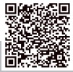
Angel Investment Tax Credit Program
Tax incentive program which encourages investments in innovative, early-stage, technology-focused companies by providing their investors with a state tax credit.
Website: bit.ly/ilangeltax (case-sensitive)

Slide 3
What would constitute a qualifying investment?
Investment cannot be less than $10,000
Investment cannot be more than $2,000,000
Notes:
An investment can be larger than 2,000,000 dollars but only the initial 2,000,000 will count towards the calculation of the tax credit. It is permissible for multiple banking transactions to comprise one investor claimant application, but the transactions must total at least 10,000 dollars and proof of each transaction must be attached. The total dollar value of the transactions should be clearly indicated on the contract between the business and the investor.

Slide 4
Set-Aside Businesses
$2,500,000
Minority-Owned Businesses
$1,250,000
Woman-Owned, Person with a Disability-Owned Businesses*
$1,250,000
Rural Businesses*
*as defined in the Business Enterprise for Minorities, Women, and Persons with Disabilities Act - https://bit.ly/2EGTixs
*principal place of business in a county with population not more than 250,000.
This includes all counties aside from Cook, DuPage, Lake, Will, Kane, McHenry, Winnebago, St. Clair and Madison.
Notes:
Minority, woman, and person with a disability are terms defined in the BEP (Business Enterprise Program) Statute. (ilga.gov) Rural counties include all counties except: Cook DuPage Lake Will Kane McHenry Winnebago St Clair and Madison.

Slide 5
Investments in set-aside businesses will yield a 35% tax credit.
All other investments will yield a 25% tax credit.
Notes:
As of January 1, 2024 the legislature has increased the tax credit amounts for set-aside Qualified New Business Ventures.

Slide 6
2025 Quarterly Set-Aside Allocation Goals
Notes:
The Angel statute seeks to incentivize investments into set-aside businesses. The chart represents the department’s goals for each quarter. Please note these amounts are the program’s tax credit amounts, not investment amounts. For the fourth quarter, the department will attempt to utilize the remaining amount of tax credits without regard to set-aside status in order to meet the program’s 15 million dollar appropriation.

Slide 7
Qualified New Business Venture (QNBV) Information
All business, once accepted into the program, are called Qualified New Business Ventures.

Slide 8
A business must apply to be certified as a Qualified New Business Venture (QNBV) through the online application form.
Notes:
In order for an investor to claim tax credits, the business must first be approved as a QNBV, the investments must be made on or after the QNBV certification date, and the investment must meet all eligibility requirements.

Slide 9
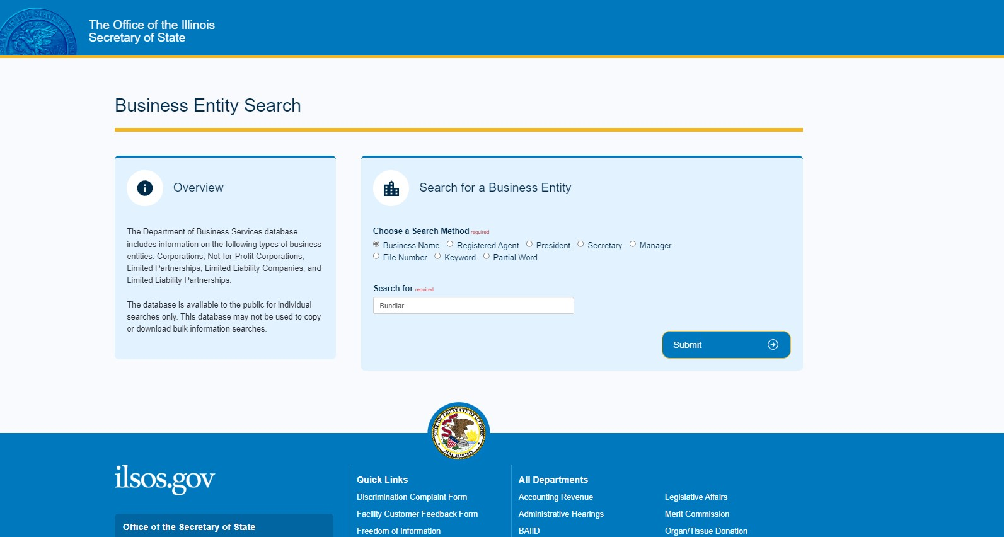
Documents Needed for QNBV Application
A copy (left) or a screenshot (right) of a current and active Illinois Secretary of State Certificate of Good Standing.
Notes:
A link to obtain the certificate is included on the QNBV Application form.

Slide 10
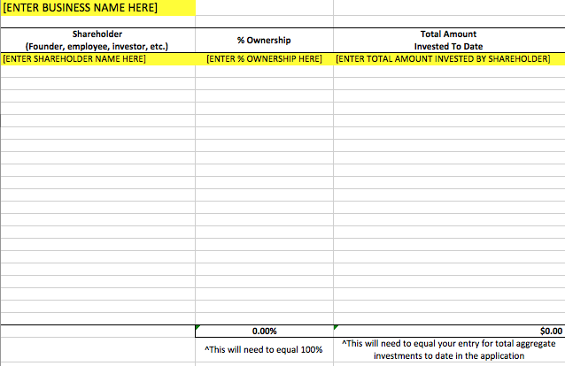
Documents Needed for QNBV Application
A current capitalization table.
Applicants must use the template provided.
Notes:
NOTE: If the cap table does not clearly reflect the dollar amount invested by each investor and provide a total equaling the application’s Total Aggregate Investments Received to Date field, the application review may be delayed.

Slide 11
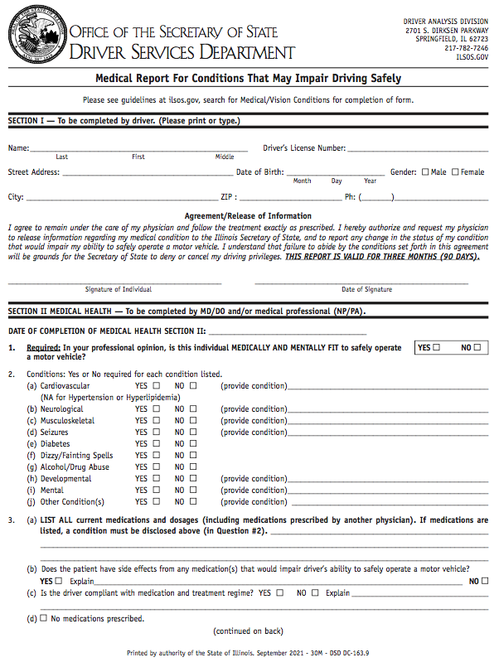
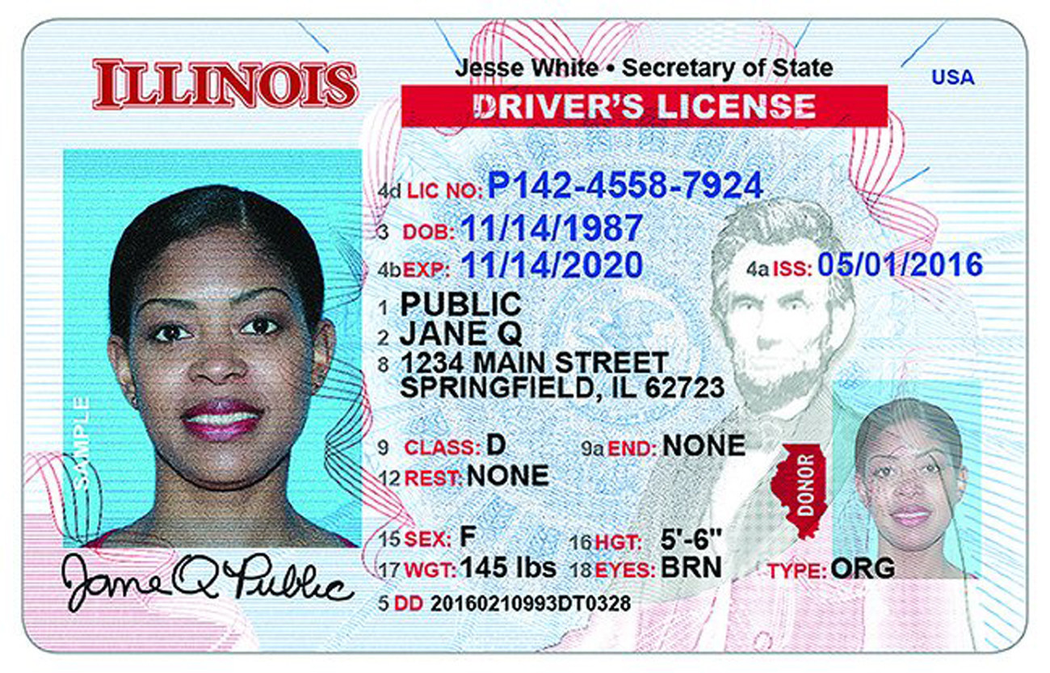
Documents Needed for QNBV Application
If the business qualifies as a minority-owned, woman-owned, or person with a disability-owned business, documentation attesting to this status.
This could include, but is not limited to, any of the following:
- Passport
- State ID
- Driver’s License
- Any certifications obtained

Slide 12
Eligibility Requirements for Businesses (to be certified QNBVs)
Notes:
Now that we’ve discussed the components of any business application, what do those documents and the questions on the application have to show in order to be approved?

Slide 13
Eligibility Requirements for Businesses
Must have the potential for increasing jobs in Illinois, increasing capital investment in Illinois, or both.

Slide 14
Eligibility Requirements for Businesses
At least 51% of the employees (employed by the business) are employed in Illinois.
Notes:
An employee is defined as any founder, FTE or FTE equivalent.

Slide 15
Eligibility Requirements for Businesses
Must be principally engaged in innovation in a qualifying sector as defined in the statute OR undertaking pre-commercialization activity related to proprietary technology that includes one of the following:
- Conducting research
- Developing a new product or business process
- Developing a service that is principally reliant on applying proprietary technology

Slide 16
Eligibility Requirements for Businesses
Must not be principally engaged in a disqualifying sector as defined by statute (outlined on the next slide).

Slide 17
Eligibility Requirements for Businesses
Qualifying sectors for innovation:
Manufacturing
Biotechnology
Nanotechnology
Communications
Agricultural sciences
Clean energy creation or storage technology
Processing or assembling products including any of the following:
Medical devices
Pharmaceuticals
Computer Software
Computer Hardware
Semiconductors
Other innovative technology products
Products that are produced using manufacturing methods that are enabled by applying proprietary technology
Providing services that are enabled by applying proprietary technology
Disqualifying sectors for innovation:
Real estate development
Insurance
Banking
Lending
Lobbying
Political consulting
Professional services provided by:
Attorneys
Accountants
Business consultants
Physicians
Health care consultants
Wholesale or retail trade
Leisure
Hospitality
Transportation
Construction (except construction of power production plants that derive energy from a renewable energy resource as defined in Section 1 of the Illinois Power Agency Act)
Notes:
The application will ask two questions. One question rules an applicant in by selecting a qualifying sector on the left. The other question rules an applicant in by attesting the business is not involved with any disqualifying sectors on the right. An applicant will need to re-submit the application if a selection from the right is accidently chosen.

Slide 18
Eligibility Requirements for Businesses
Must have fewer than 100 employees.

Slide 19
Eligibility Requirements for Businesses
Must have been in operation in Illinois for less than 10 consecutive years.

Slide 20
Eligibility Requirements for Businesses
Has received not more than $10,000,000 in aggregate investments.

Slide 21
Eligibility Requirements for Businesses
At least 51% business’ employee positions must be in Illinois or the ‘principal place of business’ must be in Illinois.
Notes:
“Principal place of business” means the place where the business’ high-level officers direct, control, and coordinate the business’ activities.

Slide 22
Eligibility Requirements for Businesses
Must have received not more than $4,000,000 in investments that qualified for Angel tax credits.

Slide 23
Applying for QNBV Certification
A business is given a determination within 2 weeks (10 business days).
Every two weeks a committee meets, via the schedule posted on the program website, to approve QNBVs.
Eligibility Requirements for Businesses
Top Causes for Delay: | Capitalization table that does not clearly and directly reflect the dollar amount invested by each investor and a total equaling the entry for Total Aggregate Investments Received to Date entered in the application form itself.
If Approved: | The applicant will receive an email stating the business has been approved as a QNBV and the email will include an attached QNBV certificate which should be shared with their investors.
If Denied: | The applicant will receive an email stating the business has been denied and will provide reasoning for such determination. If the applicant would like to appeal the determination, they can do so by following the instructions provided in the denial email.
There is no renewal process for QNBVs. Each calendar year is its own program.

Slide 24
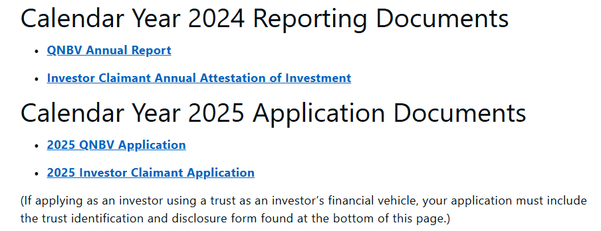
QNBV Report
Each business certified as a QNBV which receives an investment leading to the issuance of a tax credit certificate needs to submit a QNBV Annual Report to Illinois Department of Commerce and Economic Opportunity for each of the 3 years following the last tax credit certificate issued.
Notes:
If no tax credit certificates are issued to investors for investments in a QNBV, the annual report is not required.

Slide 25
QNBV Report
The report asks questions about terms of any liquidity event, number of employees, average employee salary, and capital raised.
Reporting Period Start Date | Reporting Period End Date | Report Number | Due Date
QNBV Certification Date (2025) | 12/31/2026 | 1st Report | 1/31/2027
1/1/2026 | 12/31/2026 | 2nd Report | 1/31/2027
1/1/2027 | 12/31/2027 | 3rd Report | 1/31/2028
Notes:
THIS REPORT IS ONLY NECESSARY IF A QNBV HAS RECEIVED AN INVESTMENT LEADING TO THE ISSUANCE OF A TAX CREDIT CERTIFICATE.

Slide 26
Claimant/Investor Information

Slide 27
Claimant Application (3 Documents Filed by Investor)
1. The complete and executed legal document detailing the investment.
2. Proof funds were transferred AND received by the business.
Acceptable documentation may include front and back of check or incoming wire documentation from the QNBV.
Proof for both transferred and received funds must include dates. “Pending” will not be accepted.
3. The complete application form.

Slide 28
Eligibility Requirements for Investors
Eligible applicants are any of the following who has made an investment in a QNBV and has a direct or indirect ownership interest of LESS THAN 51% in the profits, capital, or value of the QNBV receiving the investment and is NOT a “related member”:
Corporation
Partnership
Limited Liability Company
Natural person
Ineligible applicants are as follows:
Any investor who has a direct or indirect ownership interest of 51% OR MORE in the profits, capital, or value of the QNBV receiving the investment.
A “related member”

Slide 29
Eligibility Requirements for Investors
“Related Member”
Individual
An individual, if the individual and the members of the individual’s family (as defined in Section 318 of the Internal Revenue Code) own directly, indirectly, beneficially, or constructively in the aggregate, at least 50% of the value of the outstanding profits, capital, stock, or other ownership interest in the QNBV that is the recipient of the applicant’s investment.
The Internal Revenue Code defines members of family as follows:
A spouse (other than a spouse who is legally separated from the individual under a decree of divorce or separate maintenance), and
Children, grandchildren and parents.
(A legally adopted child of an individual shall be treated as a child of such individual by blood.)
Partnership, Estate, or Trust
A partnership, estate, or trust and any partner or beneficiary, if the partnership, estate, or trust and its partners or beneficiaries own directly, indirectly, beneficially, or constructively, in the aggregate, at least 50% of the profits, capital, stock, or other ownership interest in the QNBV that is the recipient of the applicant’s investment.

Slide 30
Eligibility Requirements for Investors
“Related Member”
Corporation
A corporation and any party related to the corporation in a manner that would require an attribution of stock from the corporation under the attribution rules of Section 318 of the Internal Revenue Code, if the applicant and any other related member own, in the aggregate, directly, indirectly, beneficially, or constructively, at least 50% of the value of the outstanding stock of the QNBV that is the recipient of the applicant’s investment.
The Internal Revenue Code notes attribution from corporations as follows:
If 50 percent or more in value of the stock in a corporation is owned, directly or indirectly, by or for any person, such person shall be considered as owning the stock owned, directly or indirectly, by or for such corporation, in that proportion which the value of the stock which such person so owns bears to the value of all the stock in such corporation.
A corporation and any party related to that corporation in a manner that would require an attribution of stock from the corporation to the party or from the party to the corporation under the attribution rules of Section 318 of the Internal Revenue Code, if the corporation and all such related parties own, in the aggregate, at least 50% of the profits, capital, stock or other ownership interest in the QNBV that is the recipient of the applicant’s investment.

Slide 31
Eligibility Requirements for Investors
“Related Member”
Person
A person to or from whom there is an attribution of ownership of stock in the QNBV that is the recipient of the applicant’s investment in accordance with Section 1563(e) of the Internal Revenue Code, except that for purposes of determining whether a person is a related member under this paragraph, “20%” shall be substituted for “5%” whenever “5%” appears in Section 1563(e) of the Internal Revenue Code.

Slide 32
Eligible investments are those that meet the following five requirements:

Slide 33
Eligibility Requirements for Investors
1. Investments must be made in a certified QNBV.

Slide 34
Eligibility Requirements for Investors
2. Investments must be made on, or after the date the QNBV was certified to participate in the program and within the eligible calendar year.

Slide 35
Eligibility Requirements for Investors
3. Investment must be a minimum of $10,000 (and the basis for any single investment cannot exceed $2,000,000).

Slide 36
Eligibility Requirements for Investors
4. Investment must remain (except in the event of a “qualifying liquidity event”) in the QNBV for a minimum of 3 years.
Notes:
“Qualifying liquidity event" means any event that would be considered an exit for an illiquid investment, including any event that allows the equity holders of the business (or any material portion of the business) to cash out some or all of their respective equity interests in which the claimant does not convey an equity interest to the QNBV or a related member of the qualified new business venture.

Slide 37
Eligibility Requirements for Investors
5. The investment must be given at a risk of loss and in consideration for an equity interest of the QNBV. An investment is at risk of loss if its repayment depends entirely upon the success of the business operations of the QNBV. A contingent equity investment is an investment.
Notes:
“Contingent equity investment" means money (or its equivalent) given to a qualified new business venture in consideration for a future equity interest that matures or converts to equity within three years after the investment. If the agreement governing the investment does not provide for mandatory and unconditional conversion within three years after the investment, the investment will not be considered a contingent equity investment. Contingent equity investments that have features of a debt instrument may be ineligible for a tax credit if the agreement contains unreasonable risk mitigation provisions. "Unreasonable risk mitigation provisions" means investment terms that remove a significant degree of the risk of loss during the three years following the investment. Examples include provisions for interest payments, security, and priority in the event of liquidation.

Slide 38
Applying for the Investor Tax Credit
DCEO hosts an easy-to-complete digital application portal.
Tax credits are issued on a first-come, first-serve basis and will be 25% (35% for set-asides) of the investment made into a QNBV so long as the investor and investment meet eligibility criteria, and the program has not reached its issuance limit of $15,000,000 in tax credits.
Tax credits will be issued at the end of each quarter.

Slide 39
Applying for the Investor Tax Credit
Top Causes for Delay: | Using a QNBV number from a previous year. (For 2025, all QNBV numbers end with “P”.) Date of Investment entered in application not matching date shown in proof for transfer of funds to QNBV. Not including proof for BOTH transferring and receiving of funds. Submission of incomplete agreement. Rounding dollar amount when entering Investment Amount in application. (Example: Entering $125,000.00 when actual investment is $124,999.01.) Not including a mandatory 3 year conversion clause for a SAFE.
If Approved: | The applicant will receive an email stating the investor application has been approved and the email will include an attached tax credit certificate stating the amount of the tax credit to which the applicant is entitled.
If Denied: | The applicant will receive an email stating the application has been denied and will provide reasoning for such determination. If the applicant would like to appeal the determination, they can do so by following the instructions provided in the denial email.

Slide 40
Investor Attestation
Each investor who received tax credits through the Program must submit an Annual Attestation of Investment to the Illinois Department of Commerce and Economic Opportunity for each of the 3 years following the date of their investment into the QNBV. The Attestation can be found on the website.

Slide 41
Claiming the Tax Credit

Slide 42
Claiming the Investor Tax Credit
The tax credit can be applied toward the investor’s Illinois income tax liability for the taxable year in which the investment was made.

Slide 43
Claiming the Investor Tax Credit
Although the credit may not exceed the taxpayer’s Illinois income tax liability for the taxable year…

Slide 44
Claiming the Investor Tax Credit
…should the amount of the credit exceed the Illinois income tax liability for the year, the excess may be carried forward and applied to the tax liability of the 5 taxable years following the excess credit year.

Slide 45
Claiming the Investor Tax Credit
The credit shall be applied to the earliest year for which there is a tax liability.

Slide 46
Claiming the Investor Tax Credit
If there are credits from more than one tax year that are available to offset a liability, the earlier credit shall be applied first.

Slide 47
Claiming the Investor Tax Credit
In the case of a partnership or Subchapter S Corporation, the credit is allowed to the partners or shareholders in accordance with the determination of income and distributive share of income under Sections 702 and 704 and Subchapter S of the Internal Revenue Code.

Slide 48
Claiming the Investor Tax Credit
A claimant may not sell or otherwise transfer a credit award for this program to another person or entity.

Slide 49
Program Compliance
If the Illinois Department of Commerce and Economic Opportunity determines that a claimant who has received tax credits through the program OR a QNBV that was the recipient of an investment through the program is not in compliance with the requirements of the program, the claimant shall pay to Illinois Department of Revenue, in the manner prescribed by Illinois Department of Revenue, the amount of the credit that the claimant received related to the investment.

Slide 50
Q&A

