Slide 1
Illinois Emergency Management Agency
Radon in Construction
Patrick Daniels & Melinda Lewis

Slide 2
What is Radon?
Radon is an indoor air pollutant.
Radon is a colorless, odorless radioactive gas that comes from naturally occurring uranium in the soil.
The only way to tell how much radon a home has is to TEST.

Slide 3
Surgeon General’s Warning
“Indoor radon is the second-leading cause of lung cancer in the United States and breathing it over prolonged periods can present a significant health risk to families all over the country.”

Slide 4
Radon is a Class A Human Carcinogen
Environmental Protection Agency
US Surgeon General
National Academy of Sciences
American Medical Association
American Cancer Society and
American Lung Association

Slide 5
Radon Exposure
Radon and Radon Decay Products (RDPs) are breathed in and the Radon is exhaled.
RDPs remain in lung tissue and are trapped in the bronchial epithelium and emit alpha particles which strike individual lung cells and may cause physical and/or chemical damage to DNA.

Slide 6
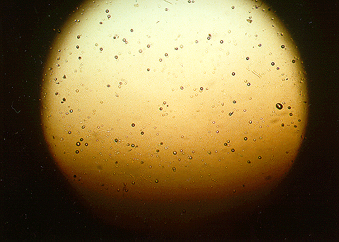
Alpha Particle Damage
The damage that radon decay products can do. Alpha Particles are strong enough to pit plastic.
Notes:
6
To provide an idea of just how destructive the particles that are released when the decay products radioactively decay, the picture above shows a piece of plastic from a radon testing device that was placed in a home for 3 months containing, on the average, 4.0 pCi/L of radon. During this period of time the air in the room would diffuse (no air pump) through a paper filter into a small container where the piece of plastic was housed. When radon, and its decay products, decay within the container the resultant alpha particles strike the plastic hard enough to create pits. These pits are large enough to be seen under relatively low magnification (100 power). Note that the plastic is similar to plastics used in some eyewear.
Consider, if the alpha particles are forceful enough to create pits in plastic they are certainly forceful enough to impact, penetrate, and damage soft tissue. This is what happens in the lungs. Also consider that the act of breathing causes approximately 20,000 liters of air to b inhaled and exhaled on a daily basis, thus bringing far more radon decay products into the lungs than would have diffused (drifted) through a paper filter and into the plastic casing that housed this piece of plastic.

Slide 7
Radon Risk Estimates
USEPA’s 2003 Assessment of Risks from Radon in Homes estimates radon causes about 21,000 lung cancer deaths per year.
The Illinois Emergency Management Agency and the USEPA estimate that as many as 1,160 Illinois citizens are at risk of developing radon related lung cancer each year.

Slide 8

R. William Field, PhD. College of Public Health
Radon is our leading environmental cause of cancer mortality in the United States and seventh leading cause of cancer mortality overall.

Slide 9
Did you know?
More Americans die each year from lung cancer than from breast, prostate, and colorectal cancers combined.

Slide 10
Lung Cancer Mortality Rates

Slide 11
Sources of Radiation Exposure to US public 2009
Other - 1%
Average Exposure 620 mrem
Assumes average indoor radon concentration of 1.3 pCi/L.
Radon is by far the greatest single source of radiation exposure to the general public.
Medical X-Rays - 12%
Radon - 37%
Internal - 5%
Nuclear Medicine – 12%
CAT Scans - 24%
Consumer Products - 2%
Cosmic - 5%
Terrestrial - 3%
Source: National Council on Radiation Protection (NCRP Report 160)
Notes:
11
Script: 55% of the radiation that people are exposed to comes from radon and its progeny. The average indoor radon concentration nationwide is 1.3 pCi/L and the ambient air is approximately 0.4 pCi/L. In Illinois, the average ambient level is almost 0.6 pCi/L according to the results reported by USEPA in their study, the National Ambient Radon Study that was mandated by the Indoor Radon Abatement Act of 1988. Radon is the greatest source of radiation exposure to the public.

Slide 12
Sources of Radiation Exposure in Illinois
Other - < 1%
Average Exposure 1,170 mrem
Assumes average Illinois indoor radon concentration of 4.9 pCi/L.
Radon is by far the greatest single source of radiation exposure to the general public in Illinois.
Medical X-Rays - 6%
Internal - 2%
Radon - 67%
Nuclear Medicine – 6%
Consumer Products - 1%
Terrestrial - 2%
Cosmic - 3%
CAT Scans - 24%
Notes:
Script: 55% of the radiation that people are exposed to comes from radon and its progeny. The average indoor radon concentration nationwide is 1.3 pCi/L and the ambient air is approximately 0.4 pCi/L. In Illinois, the average ambient level is almost 0.6 pCi/L according to the results reported by USEPA in their study, the National Ambient Radon Study that was mandated by the Indoor Radon Abatement Act of 1988. Radon is the greatest source of radiation exposure to the public.

Slide 13
Radon Risk in Perspective
Comparative Risk Assessments by EPA and its Science Advisory Board have consistently ranked Radon among the top four Environmental risks to the Public
In 1998 Harvard Risk in Perspective, by John Graham, ranked Radon the #1 risk in the Home

Slide 14

Did You Know?
Top five causes of accidental home injury deaths:
  Falls
  Poisoning
  Fires
  Choking
  Drowning
Deaths due to radon induced lung cancer is greater than all of these

Slide 15
Home Safety Council Risks

Slide 16
Statewide Results from IEMA
Professional Licensee Measurements
118,447 Homes Tested
48,978 of the homes tested were > 4.0 pCi/L
41% of the homes tests were > 4.0 pCi/L
Average Radon Concentration 4.9 pCi/L

Slide 17
Radon Entry
Radon enters through any opening between the building and the soil.
radon
radium
uranium
Notes:
Script: Radon enters houses and other buildings through openings to the soil. Air pressure and temperature differentials between the interior and exterior of the structure causes it to act like a vacuum cleaner and to draw in radon and other soil gases through openings to the soil. Uranium, thorium and radium are solids, but when radium decays to radon the element radon is a gas and that facilitates entry into homes and other buildings.
Radon comes from the radioactive decay of naturally-occurring uranium and thorium in the soil. Radioactive decay is not like biological decay. When radioactive decay occurs, the original element (uranium, in this case) is called the parent and a new element (radium) is created and is called the decay product (or progeny). If the decay product is also radioactive - which radium is - it will decay creating another element (radon) and so on… The sequence of consecutive elements formed by radioactive decay is called a decay series or decay chain. In the uranium decay series, radon is the only gaseous element. Inhalation is the exposure pathway.

Slide 18
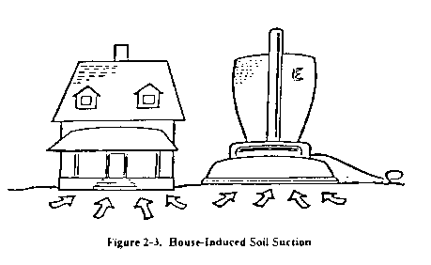
Pressure Differentials and Radon Entry
Air pressure differentials between the building and outside air.

Slide 19
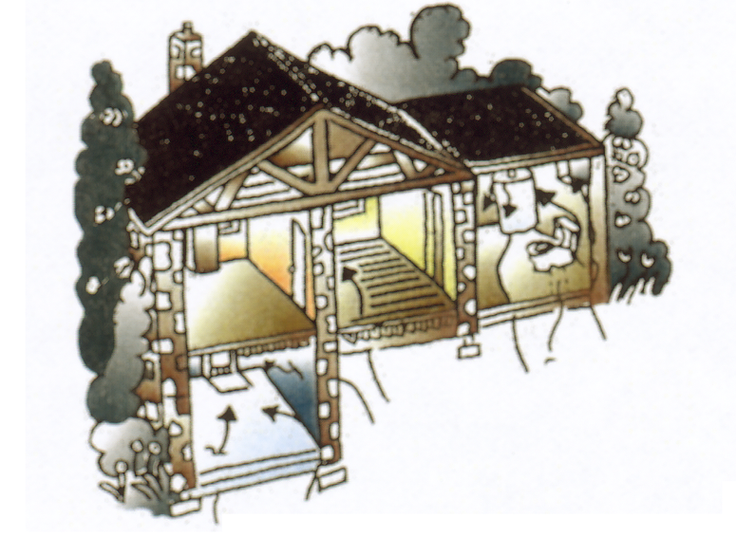
Common Entry Points
Foundation Wall Joint
Crawlspace
Sump Pits
Cracks in Floors
Utility Penetrations

Slide 20
Stopping Radon at the Beginning
Radon Resistant New Construction (RRNC)

Slide 21
Radon Resistant Construction Act
(PA 97-981) 420 ILCS 52
Effective June 1, 2013, all new residential construction throughout Illinois must include passive radon resistant construction.
Requires the Task Force on Radon-Resistant Building Codes to make recommendations to the Agency by December 31, 2012.
Notes:
Requires the Task Force on Radon-Resistant Building Codes to make recommendations to the Agency by January 1, 2014.
IEMA will have to revise the Regulations for Radon Service Providers to incorporate the recommendations from the Task Force (most likely as a new section 160) and present them through the normal Joint Committee on Administrative Rules procedures.
The new act allows residential building contractors (builders) or their subcontractors to install a “passive new construction pipe” without a license.
Radon Contactors can install the passive new construction pipe and active mitigation systems. Only a radon contractor can install active mitigation systems or upgrade a passive new construction pipe to an active mitigation system.

Slide 22
Task Force on Radon-Resistant Building Codes
IEMA / Task Force Chair
Home Builders Association of Illinois
National Association of Certified Home Inspectors, Illinois Chapter
South Suburban Building Officials Association
Illinois Association of Realtors
American Lung Association of Illinois
Respiratory Health Association of Chicago
American Cancer Society of Illinois
Illinois Municipal League
Speaker of the House Appointee
Minority Leader of the House Appointee
President of the Senate Appointee
Minority Leader of the Senate Appointee

Slide 23
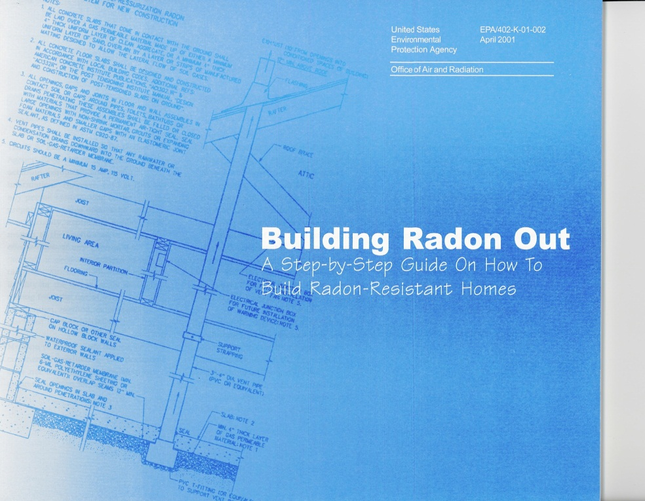
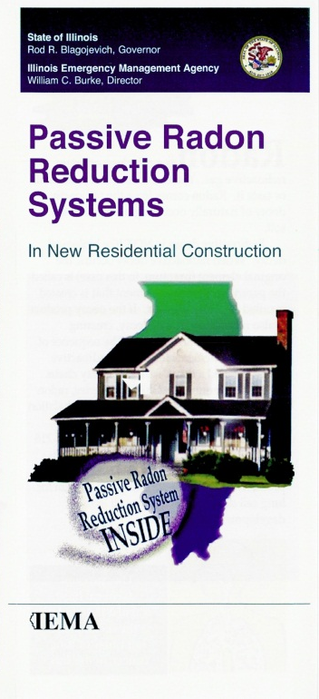
Radon Resistant New Construction Guidance

Slide 24
Radon Resistant New Construction is Effective
According to the USEPA, Radon Resistant New Construction effectively reduces radon levels by an average of about 50% and, in most cases, to levels below the the 4.0 pCi/L action level.

Slide 25
Who can Install a RRNC?
The installation of an active mitigation system shall only be performed by a radon contractor.
The installation of radon resistant construction may be performed by a residential building contractor or his or her subcontractors or a radon contractor.

Slide 26
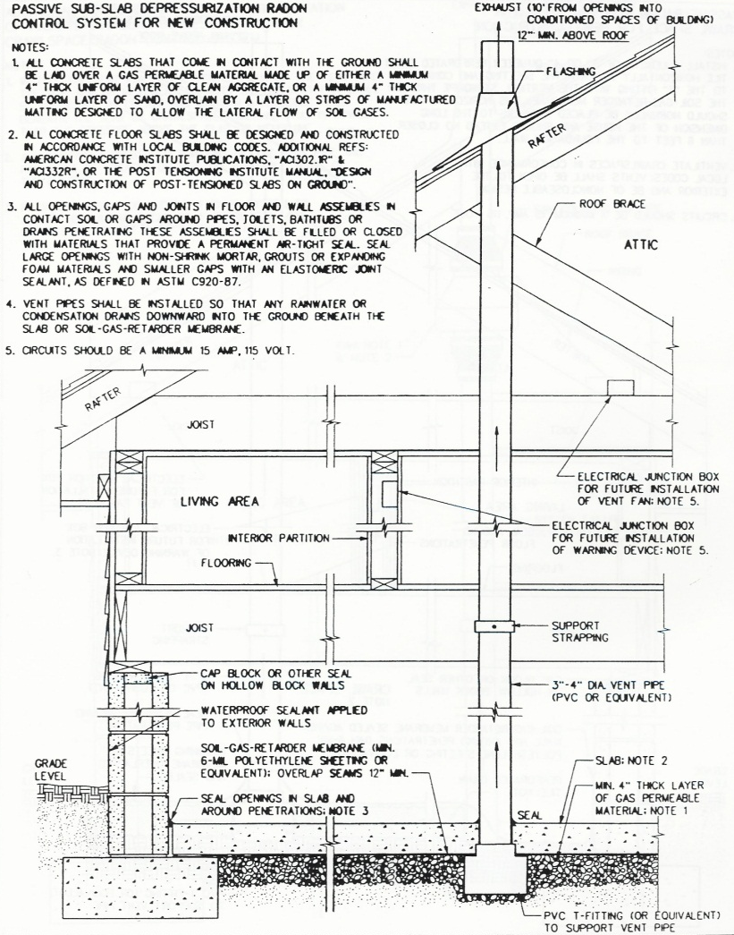
RRNC System Components
A passive new construction system consists of a vent pipe for a Sub-Slab Depressurization system.
This system does not use a fan but relies on the convective flow (natural draft) of air upward in the vent pipe.

Slide 27
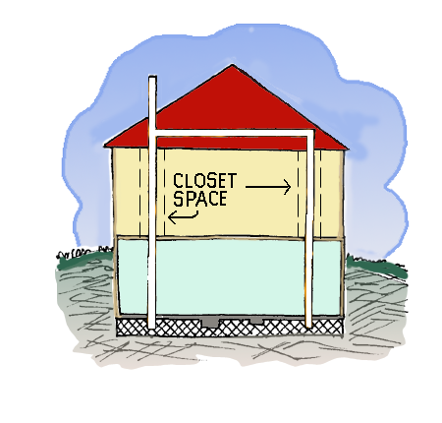
Radon Resistant New Construction
May consist of multiple vent pipes that may be joined to a single termination above the roof or may terminate separately above the roof.
May require installation of a vent fan after construction.

Slide 28
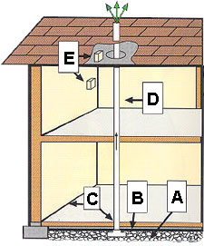
RRNC Techniques
Gas Permeable Layer - This layer is placed beneath the slab or flooring system to allow the soil gas to move freely underneath the house. In many cases, the material used is a 4-inch layer of clean gravel.
Plastic Sheeting - Plastic sheeting is placed on top of the gas permeable layer and under the slab to help prevent the soil gas from entering the home. In crawlspaces, the sheeting is placed over the crawlspace floor.
Sealing and Caulking - All openings in the concrete foundation floor are sealed to reduce soil gas entry into the home.
Vent Pipe - A 3 or 4-inch Schedule 40 PVC pipe runs from the gas permeable layer through the house to the roof to safely vent radon and other soil gases above the house.
Junction Box - An electrical junction box is installed in case an electric venting fan is needed later.

Slide 29
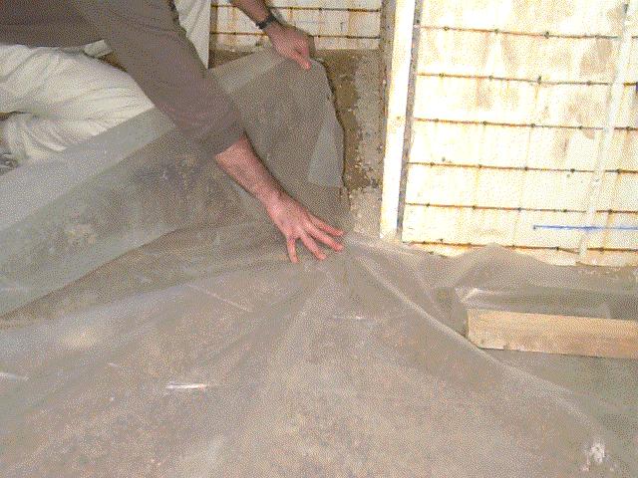
Passive System Components
6 Mil Polyethylene Sheeting

Slide 30
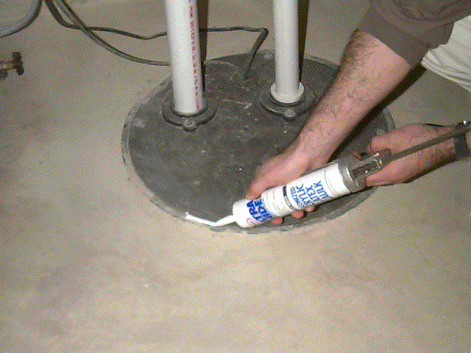
Passive System Components
Seal and Caulk All Openings in the Foundation Floor.

Slide 31
Ensure Cost Savings at Activation
Allow space for future fan installation in attic or outside habitable space.
On each floor and in the attic label the radon vent piping…..
Radon Reduction System

Slide 32
Vent Stack Discharge Point Requirements
Above the highest eave (at least 12 inches above the roof) and as close to the roof ridge line as possible.
10 feet from any window, door or other opening (into the building) that is less than 2 feet below the exhaust point.
10 feet or more from any opening into an adjacent building.

Slide 33
Radon Systems Must Be Able to Drain
All radon piping must be sloped to allow drainage.
Water in radon system is primarily from condensation inside piping.

Slide 34
Upgrading is Easy
If, after construction is completed, radon levels are at or above 4.0 pCi/L, contact a Licensed Mitigator and simply activate the system.
Homes with a passive system can be upgraded to an active system with the simple installation of an in-line fan.

Slide 35
Interested in being a licensed mitigation professional?
Take the state approved qualification course and pass the state licensing exam.
Complete a Quality Assurance Plan and a Worker Protection Plan

Slide 36
Can Radon Mitigation System Cause a Water Problem?
A properly installed radon mitigation system should not cause a water problem nor will it typically fix a wet basement.

Slide 37
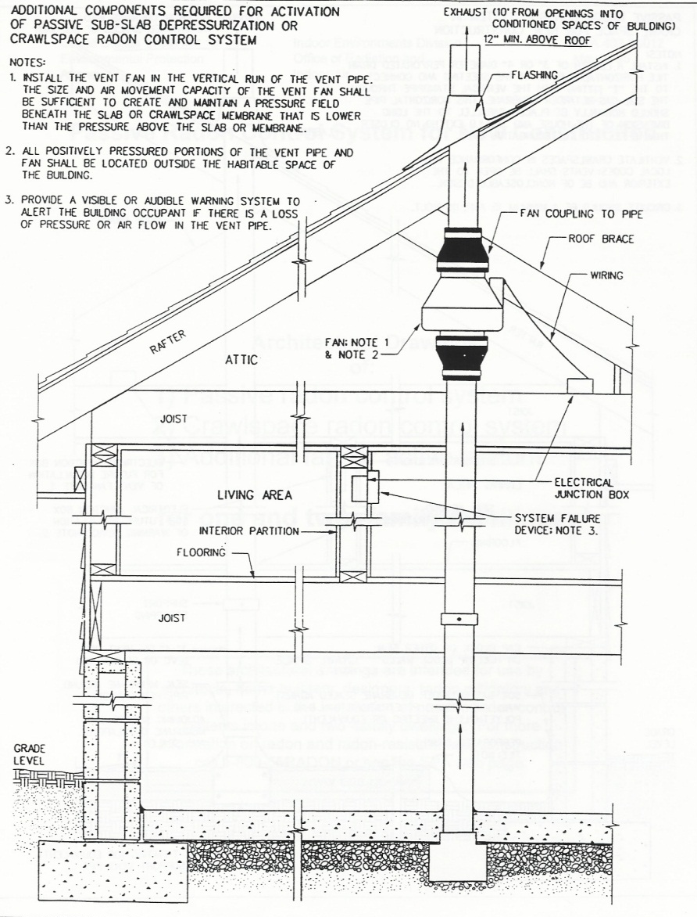
Sub-Slab Depressurization
Sub-Slab Depressurization means a radon control technique designed to achieve lower sub-slab pressure relative to indoor air pressure by use of a fan-powered vent drawing air from beneath the concrete slab.

Slide 38
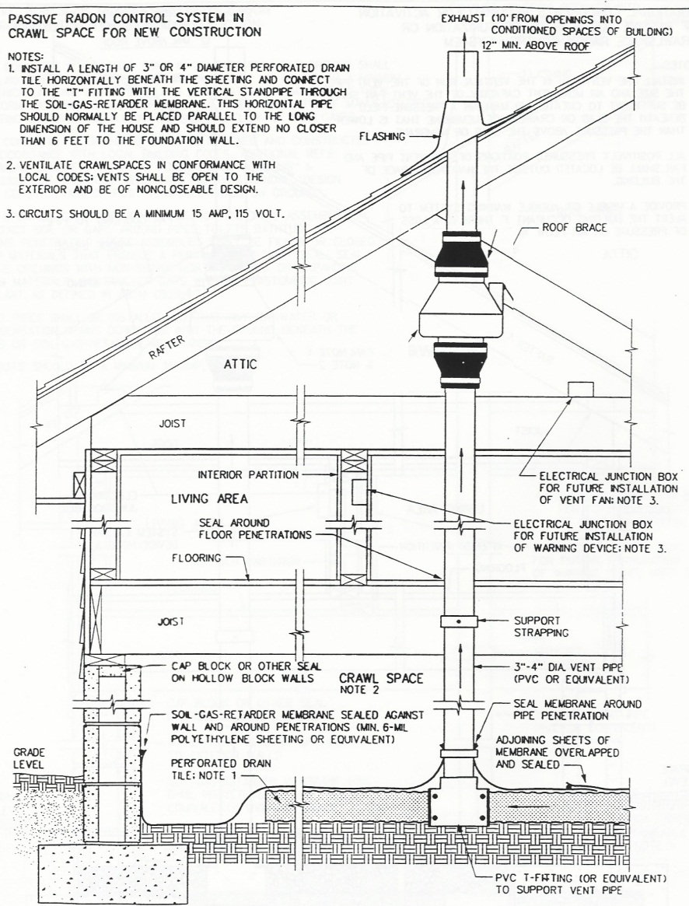
Sub-Membrane Depressurization
Sub-Membrane Depressurization means a radon control technique designed to achieve lower air pressure in the space under a soil gas retarder membrane laid on the crawlspace floor and sealed, relative to air pressure in the crawlspace, by use of a fan-powered vent drawing air from beneath the membrane.

Slide 39
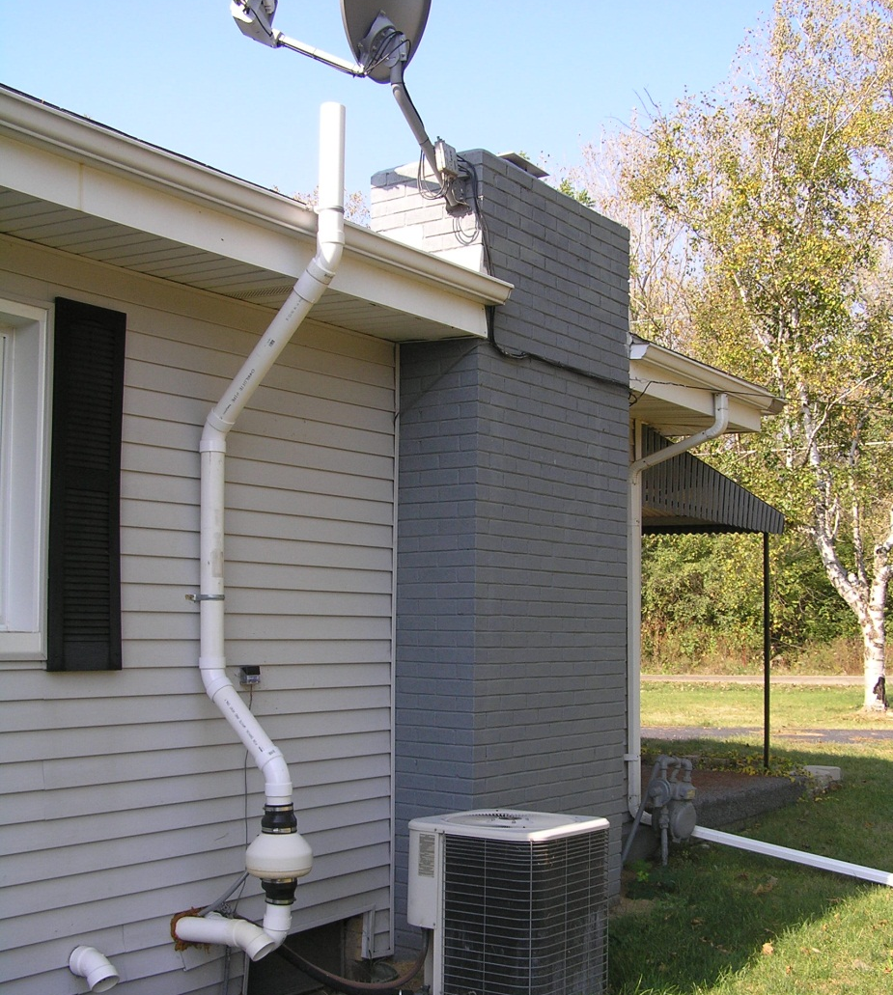
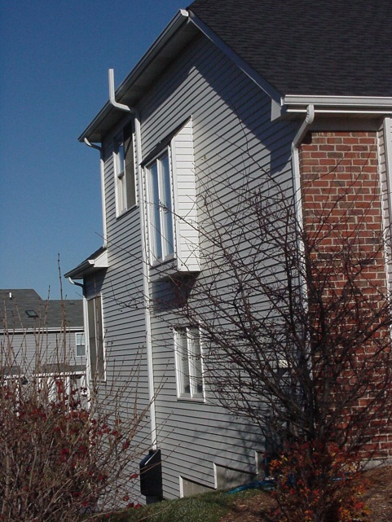
Systems on Existing Housing

Slide 40
All Homes Should Be Tested
All homes should be tested for radon, even those built with radon resistant features.
Radon resistant homes do not guarantee radon reduction below the action level, only reduce cost and assist with aesthetics.
Notes:
Based on our experience, an occupant installed fan is more likely to raise issues during a real estate transaction.

Slide 41
Upgrading is Easy
If, after construction is completed, radon levels are at or above 4.0 pCi/L, contact a Licensed Mitigator and simply activate the system.
Homes with a passive system can be upgraded to an active system with the simple installation of an in-line fan.

Slide 42
Contact Information
Radon Hotline (800) 325-1245
Radon Website www.radon.illinois.gov
Melinda Lewis (217) 785-9889
melinda.lewis@illinois.gov
Patrick Daniels (217) 782-1325
patrick.daniels@illinois.gov

