Slide 1
Illinois EPA
Bureau of Air Pollution
Federal NESHAP Program

Slide 2
Bureau Of Air
Director –John Kim
Bureau Chief—Laurel Kroack
Division of Air Pollution Control—Jim Ross
Field Operations Manager– Steve Youngblut
Acting Asbestos Unit Manager-Ron Robeen

Slide 3
NESHAP
National Emission Standard for Hazardous Air Pollutants
40 CFR Part 61

Slide 4
NESHAP
Federal Regulation since 1990.
Part of the Clean Air Act.
Requires inspections for asbestos.
Requires notification to EPA.
Regulates the removal of friable asbestos in regulated facilities when quantities are at least 160sf of surfacing material or 260lf on pipes.

Slide 5
Regulated Facility
Institutional
Commercial
Public
Industrial
Apartment units greater than 4 units.
A group of residential structures under the control of the same owner/operator as part of a larger project.

Slide 6
Regulated Facilities (Cont.)
Farm buildings
Any structure previously regulated by the NESHAP is not excluded.
Residential dwellings used for fire training purposes.

Slide 7
Residential Facility
“EPA does not consider residential structures that are demolished or renovated as part of a commercial or public project to be exempt from this rule. For example, the demolition of one or more houses as part of an urban renewal project, a highway construction project, or a project to develop a shopping mall, industrial facility, or other private development would be subject to the NESHAP....The owner of a home that renovates his house or demolishes it to construct another house is not to be subject to the NESHAP”.

Slide 8
Friable Material
Any material that when dry can be reduced to powder by hand pressure.
Nonfriable material that is in poor condition.
Nonfriable material that is subjected to sanding, grinding, abrading, sawing, mechanical chipping crumbled pulverized or somehow reduced to powder.

Slide 9
Friable Asbestos

Slide 10
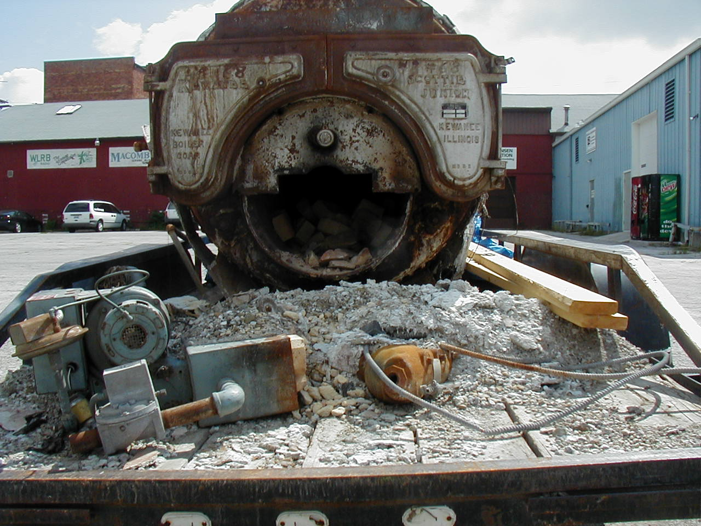
Friable Asbestos

Slide 11
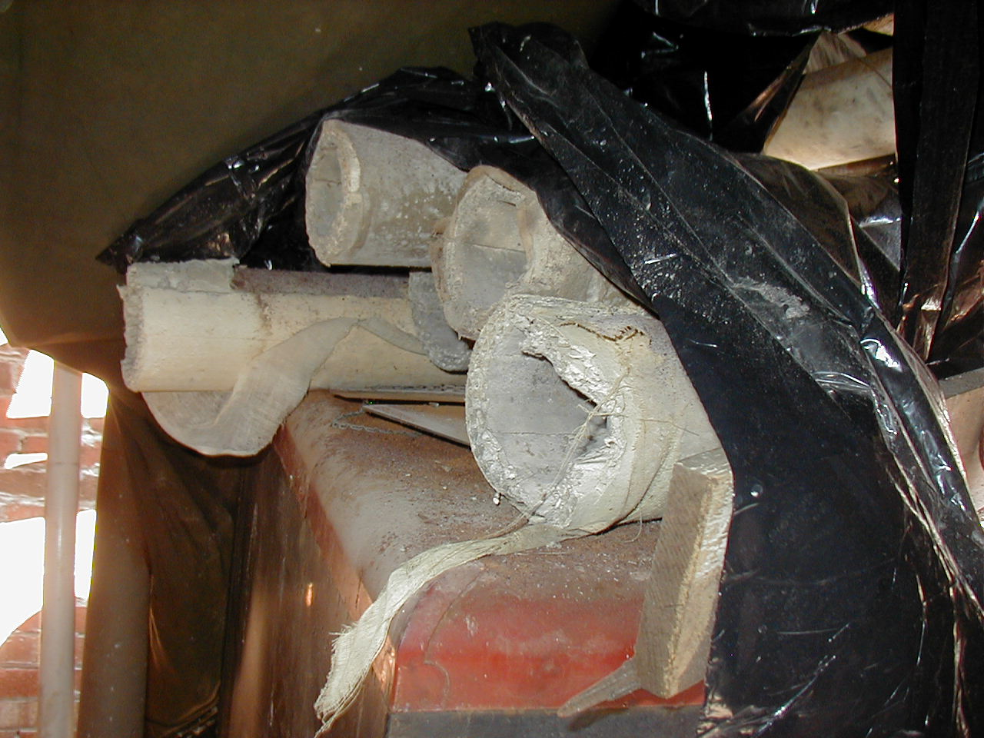
Friable Thermal Insulation

Slide 12
Category I non-friable
Floor tile, along with packing and gaskets and asphalt roofing that contains more than 1% asbestos is considered a Category I non-friable as defined in the asbestos NESHAP, 40 CFR 61.141.

Slide 13
Category II Non Friable
Means any material, excluding Category I Non-Friable that when dry cannot be crumbled, pulverized or reduced to powder by hand pressure.

Slide 14
Floor Tile issues
When is floor tile friable?
When is floor tile in poor condition?
When is floor tile regulated?

Slide 15
Floor Tile
Floor tiles are considered a Category I non-friable material and may remain in a facility being demolished, providing the floor tiles are in good condition prior to the start of demolition and are not rendered friable during the course of demolition.

Slide 16
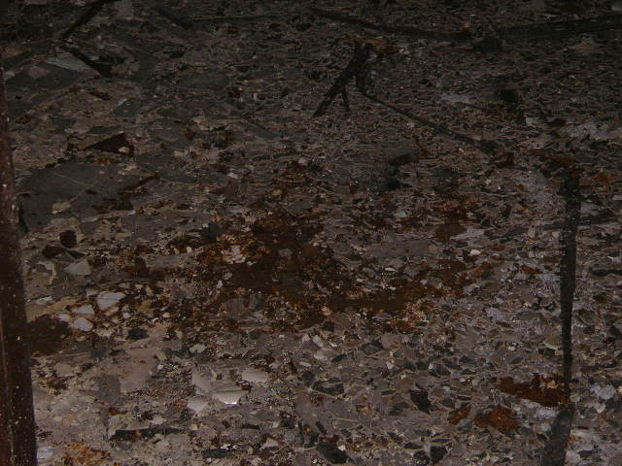
Floor Tile in Poor Condition

Slide 17
In Poor Condition

Slide 18
Regulated Floor Tile
Floor tile is considered friable/regulated if it is in poor condition prior to commencement of demolition.
Floor tile will become friable/ regulated if it is subjected to sanding, grinding, cutting, abrading or mechanically chipped during renovation.
Floor tile will become friable/regulated if it is subjected to sanding, grinding, cutting or abrading during the course of demolition or renovation.

Slide 19
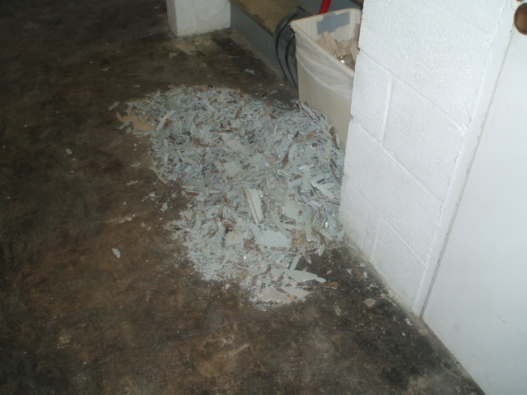
Friable Floor Tile

Slide 20
Category II Non-Friable
Transite Siding
Cement Board
Water & Sewer Pipes
Roofing, (Slate Shingles)
Furnace Ducts

Slide 21
Category II Non-Friable
Category II non-friable that has a high probability or has become crumbled, pulverized or reduced to powder by the forces expected to act on the material in the course of demolition or renovation activity will render the material friable (or regulated).

Slide 22
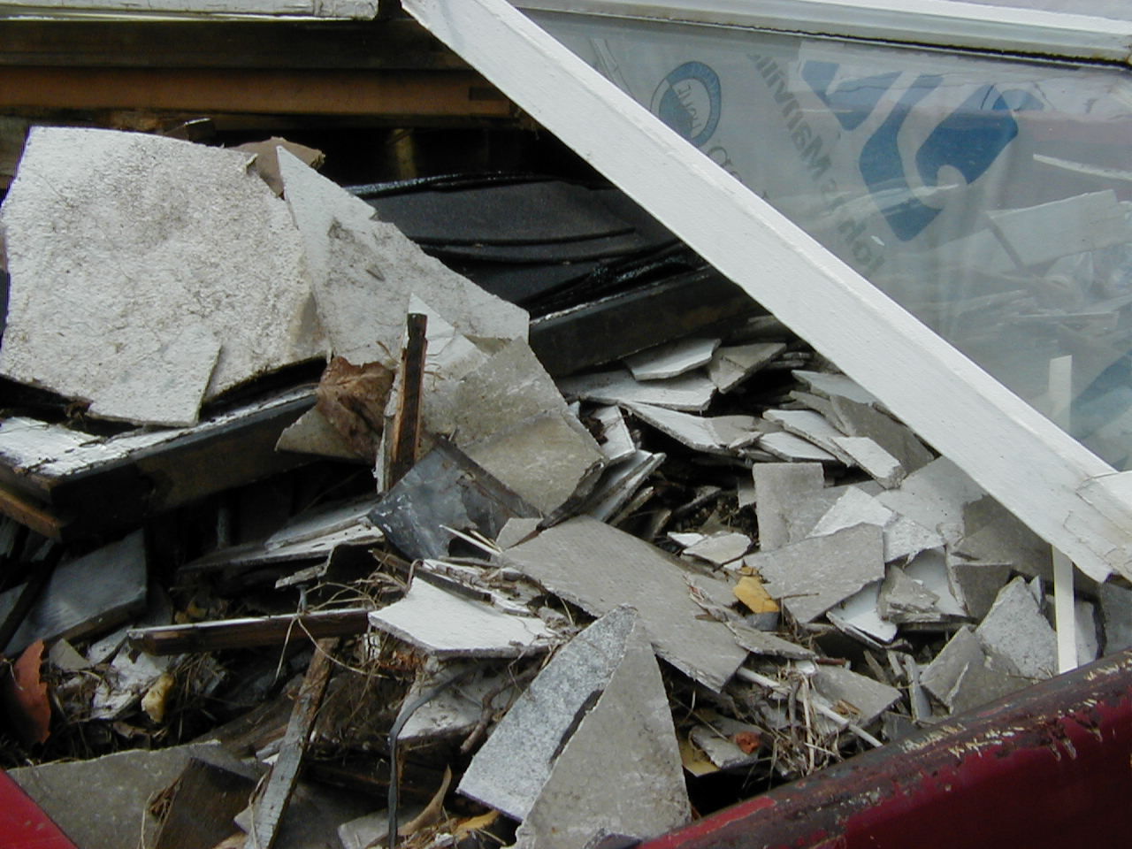
Regulated Category II Non-Friable

Slide 23
Demolition
The wrecking or taking out of any load supporting structural member.

Slide 24
Renovation
Means altering a facility component in any way including the stripping or removal of friable/regulated asbestos.
Operations in which load supporting structural members are wrecked or taken out are demolitions and not renovations.

Slide 25
DEMOLITIONS
Must provide notification for all demolitions even if no asbestos is present.
Should wet the debris or use alternative dust suppression methods to be in compliance with the Illinois Environmental Protection Act.
Must dispose of C & D debris at approved landfill.

Slide 26
Demolition (Cont.)
Cannot burn debris
Cannot bury debris
Cannot recycle debris containing asbestos

Slide 27
Renovations of Regulated Facilities
Must conduct a thorough inspection for the presence, location and condition of asbestos containing building materials.
Inspections must be conducted by qualified Asbestos Inspectors in accordance with State and Federal law.
.

Slide 28
Renovation Cont.
All friable/regulated asbestos that will be impacted by renovation must be removed prior to commencement of renovation activities in accordance with State and Federal law.
Notification must be submitted to EPA at least 10 working days prior to commencement of the asbestos removal.

Slide 29
Renovations Cont.
Unlike demolition, notification is not required unless friable/regulated asbestos is being removed in quantities greater than 160sf or 260lf on pipes.

Slide 30
Fire Safety Training & Open Burning
Burn permit application must be submitted to IEPA.
Inspection of the facility for the presence and location of asbestos must be conducted and all asbestos must be removed prior to the burn.
Notification for demolition must be submitted 10 Working Days (14 calendar days) prior to the burn.

Slide 31
Illegal Open Burning

Slide 32
Open Burning

Slide 33
Open Burning OF Demolition Debris

Slide 34
Other Asbestos Regulations
Federal Occupation Safety and Health Administration (OHSA)
Commercial and Public Building Act (IDPH)

Slide 35
OSHA
Worker Protection
Employee Training
Medical Monitoring for Employees

Slide 36
IDPH
Regulates all friable and non-friable asbestos projects in quantities greater than 3 SF/LF up to 160 SF/260 LF.
Requires a 2 day notification for all friable and non friable projects from 3 SF/LF up to 160/260 LF in Commercial and Public Facilities
Notifications can be faxed and there is no fee.

Slide 37
IDPH Questions?
Telephone
217/782-3517
Website
www.idph.state.il.us/envhealth/asbestos

Slide 38
Illegal/Criminal Removal of Asbestos/Open Dumping
Persons who knowingly violate subsection (c) of 40 CFR 61.145 can be charged with a Class 4 felony and are subject to a maximum fine of $25,000.00 per day.
Open dumping of demolition debris exceeding 250 cubic feet is also a class 4 felony.

Slide 39
Criminal Continued
415 ILCS5/44.1 Allows forfeiture of profits and vehicles
Any person who knowingly makes a false, fictitious, or fraudulent material statement, orally or in writing, to the Illinois EPA commits a Class 4 felony. A second or subsequent offense after conviction is a Class 3 felony. (415 ILCS 5/44(h)).

Slide 40
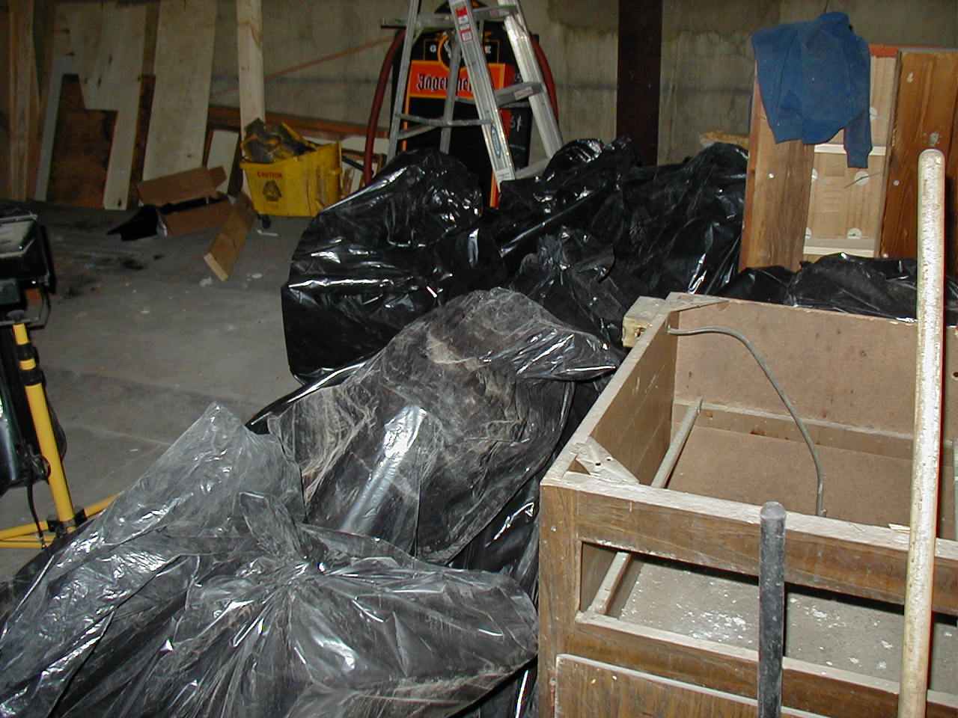
Improper Asbestos Removal

Slide 41
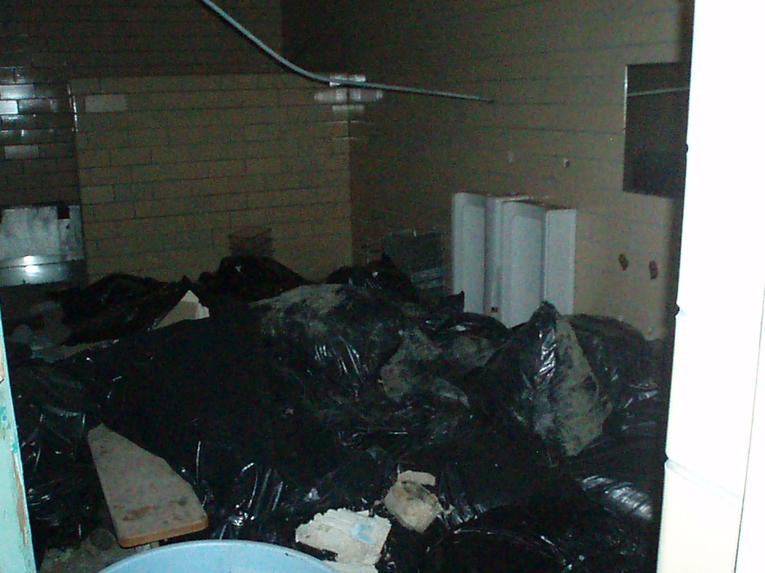
Improper Asbestos Removal

Slide 42
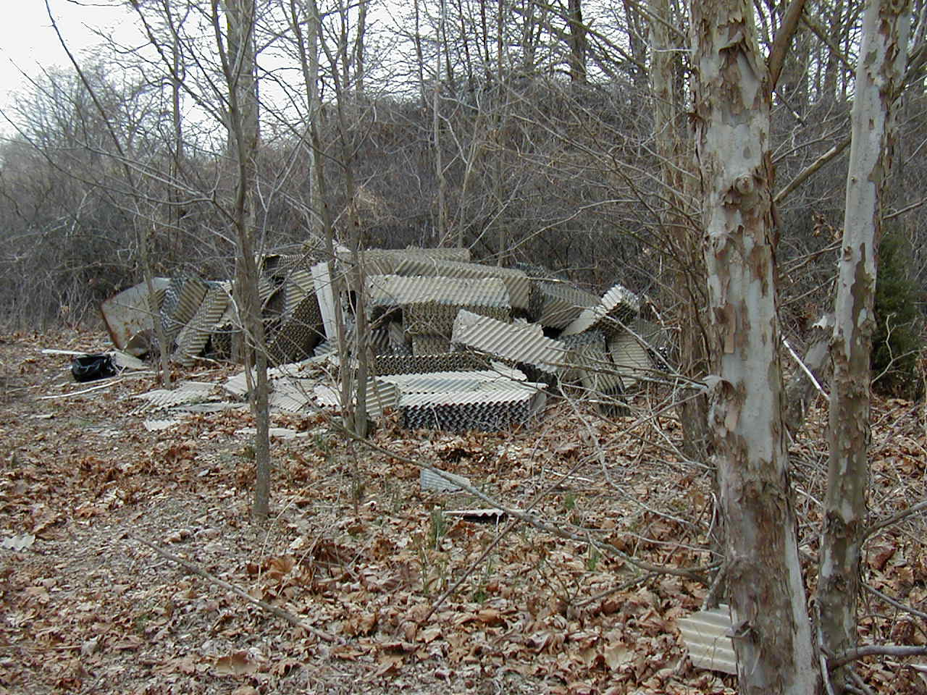
Open Dumping of Asbestos

Slide 43
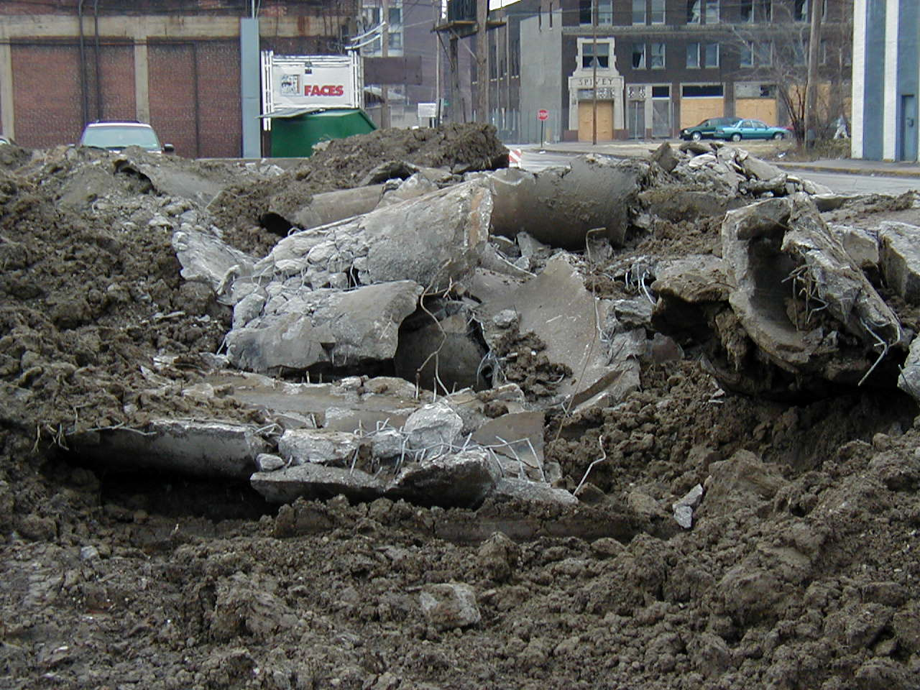
Open Dumping of Asbestos Pipe

Slide 44
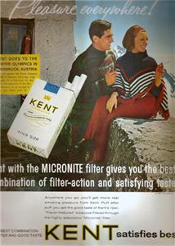

Slide 45
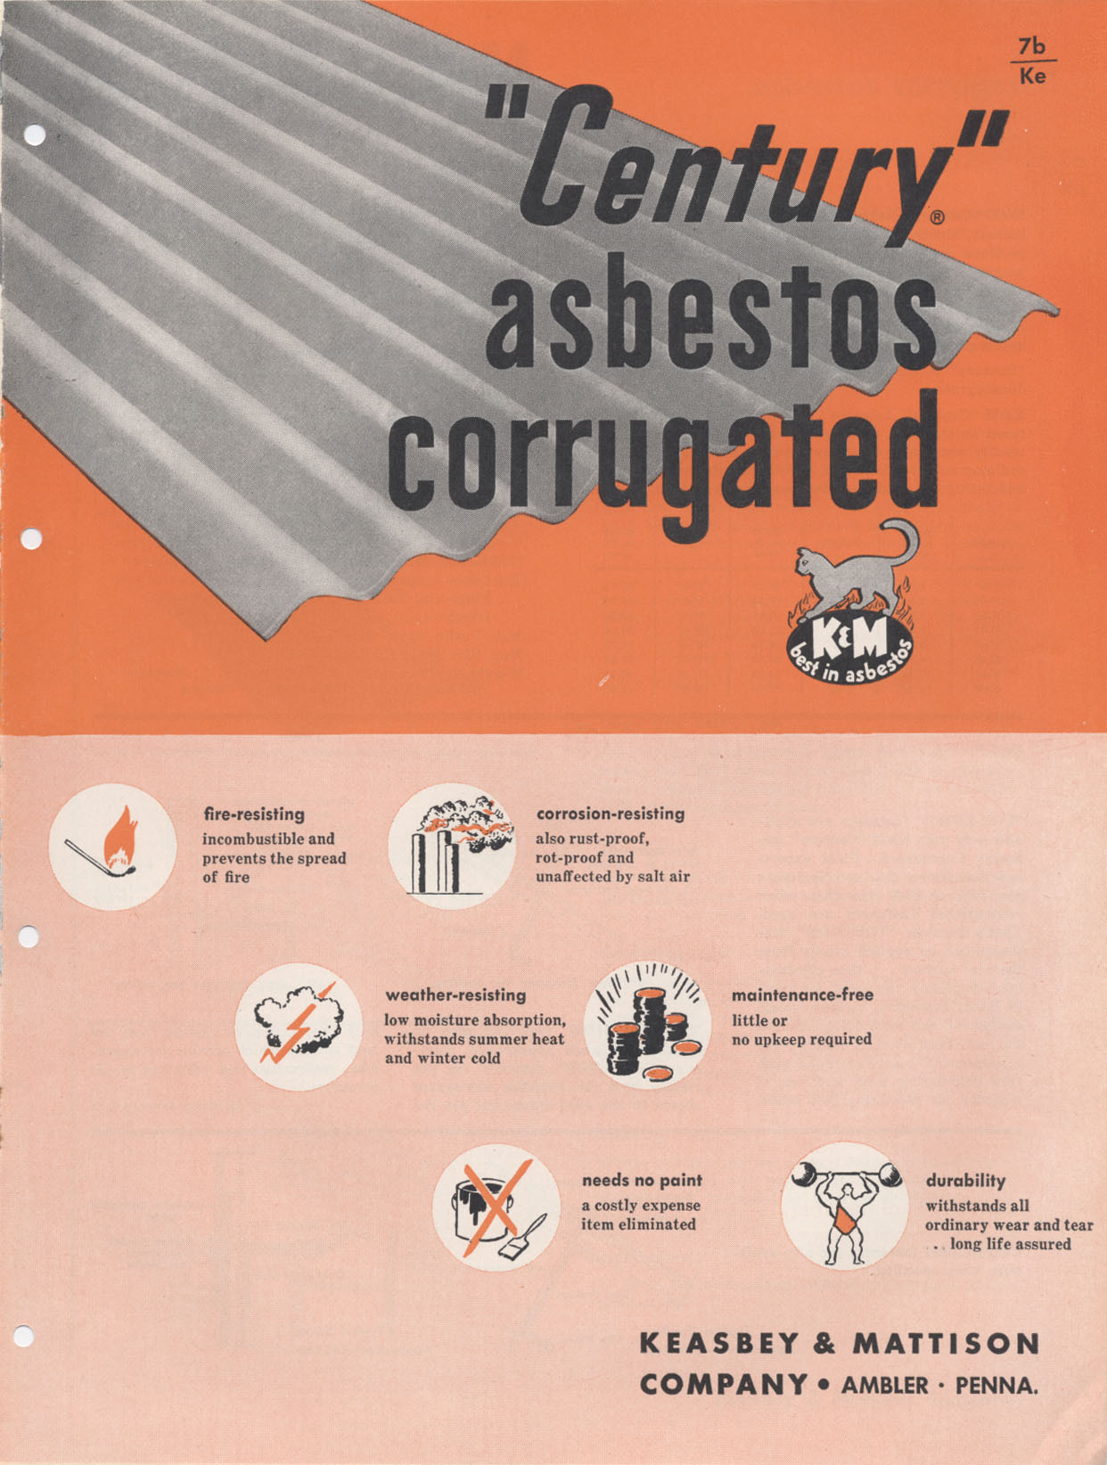

Slide 46
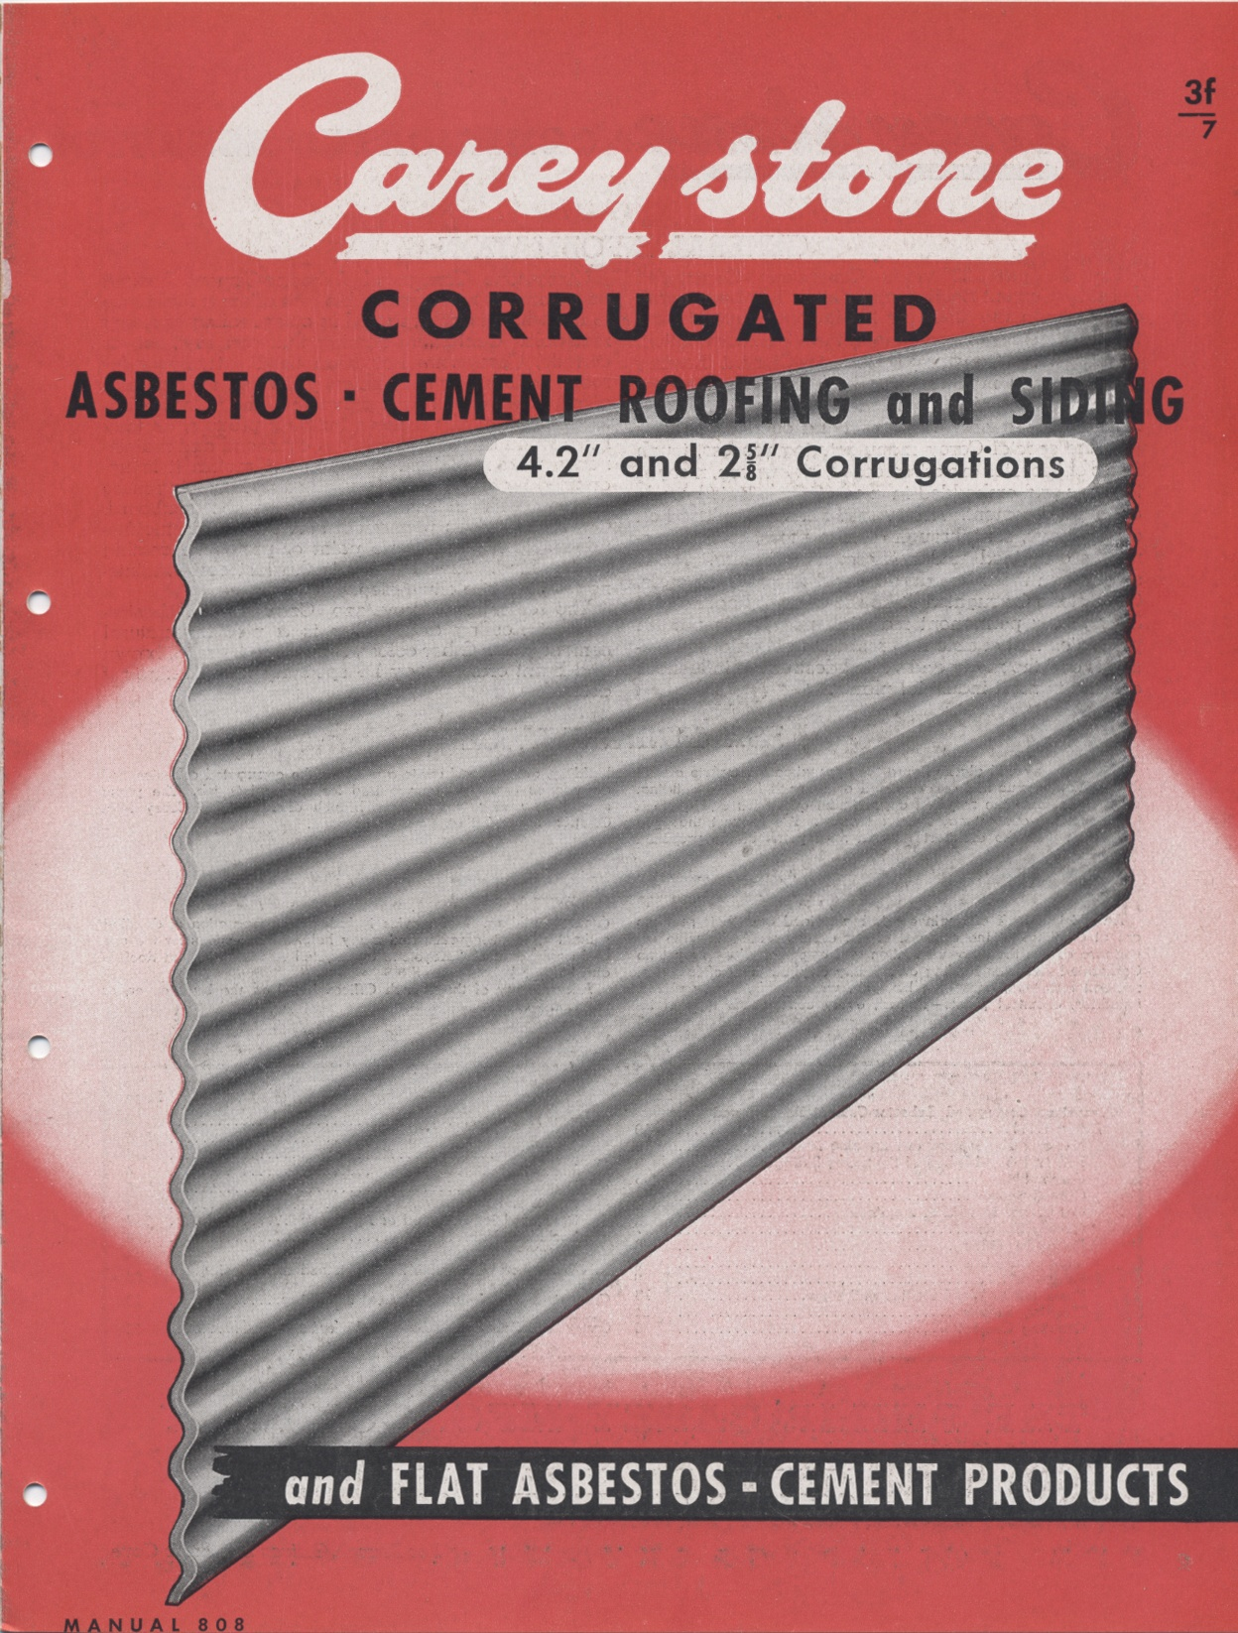

Slide 47
For Additional Information
Telephone: 217/785-2011
Fax: 217/782-1875
Web Site: www.epa.state.il.us/air/asbestos

Slide 48
Any Questions?

Slide 49
Thank you very much!

