Slide 1
Illinois Department of Commerce & Economic Opportunity
Small Business Environmental Assistance
2013
ENVIRONMENTAL WORKSHOPS

Slide 2
MANAGEMENT OF CONSTRUCTION WASTE

Slide 3
Illinois Environmental Protection Agency
PAUL PURSEGLOVE – Manager
Field Operation Section
Bureau of Land
217/524-5597
paul.purseglove@illinois.gov

Slide 4
Illinois EPA’s Bureau of Land -- Goal Statement
Protection and restoration of land and groundwater resources in the State of Illinois

Slide 5
The Mission of the Bureau of Land
Ensure that hazardous and non-hazardous wastes are managed in an environmentally sound manner;
Encourage the recycling and recovery of waste materials through suitable incentive/disincentive efforts;
Provide remedial responses and/or provide oversight to the uncontrolled releases of hazardous and petroleum substances into the environment.

Slide 6
SAFE WASTE MANAGEMENT

Slide 7
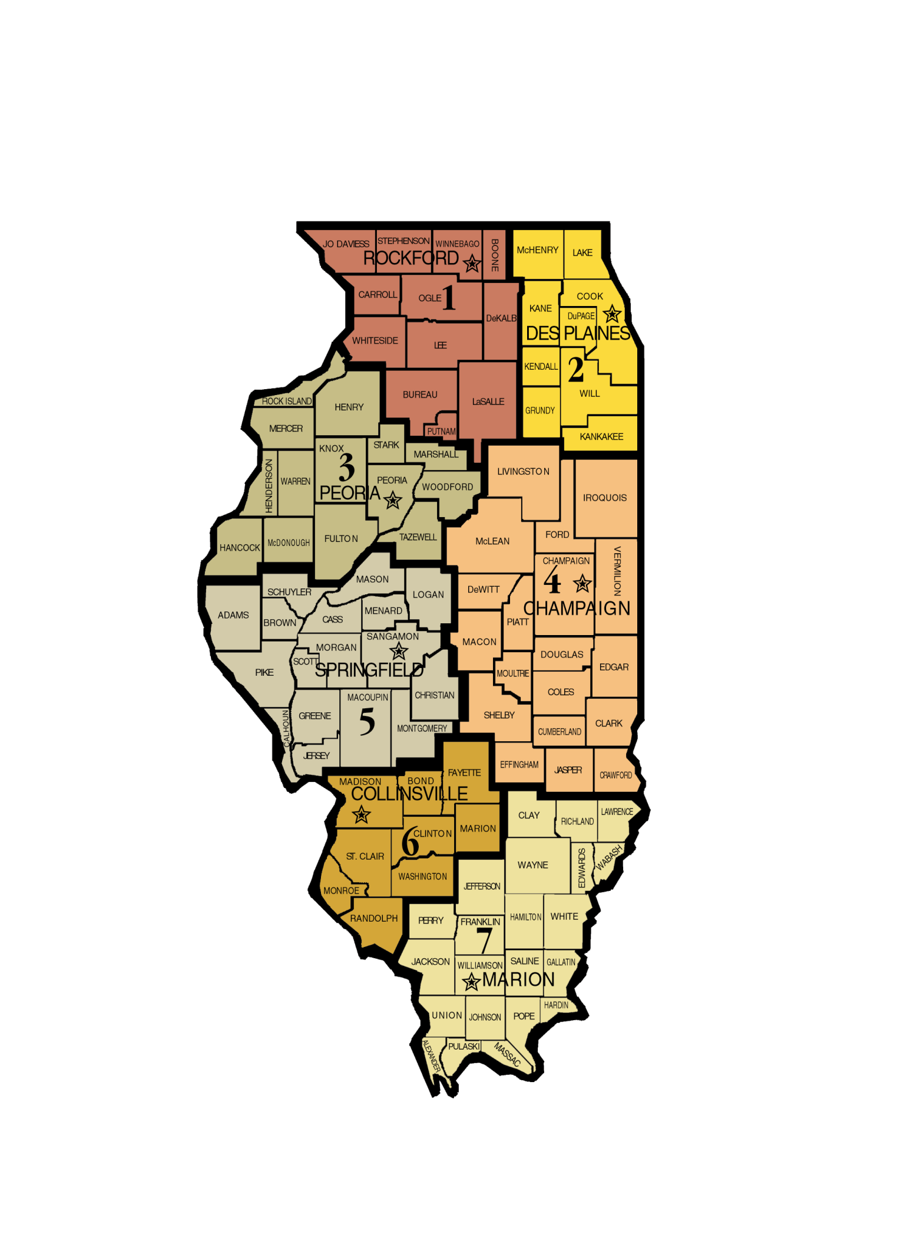

Slide 8
Waste … discarded material Sec 3.53 (1986)
Municipal Waste …. “means garbage, general household and commercial waste, landscape waste….and CONSTRUCTION OR DEMOLITION DEBRIS
Section 3.290 (1986)

Slide 9
General Construction Demolition Debris
GCDD
BRICKS
SOIL
ROCKS
RECLAIMED ASPHALT
MASONRY MATERIALS
WOOD
PLASTER
DRYWALL
WALL COVERINGS
GLASS
PLUMBING FICTURES
NON-ASBESTOS INSULATION
SHINGLES
WIRING
Clean Construction Demolition Debris
CCDD
UNCONTAMINATED
BRICKS
SOIL
ROCKS
STONE
CONCRETE W/OUT PROTRUDING REBAR
RECLAIMED ASPHALT

Slide 10
CCDD = a subset of GCDD
BUT…..CCDD is not waste if:
i. Used as fill below grade
(no higher than the highest point of elevation existing prior to the filling immediately adjacent to the fill area)
ii. Separated and processed and returned to the economic mainstream
iii. Broken concrete w/out exposed rebar used for erosion control
iv. Generated on site and used to build a functional structure < 20 ft. tall
Sec. 3.160(b) [1989;1997;2005]

Slide 11
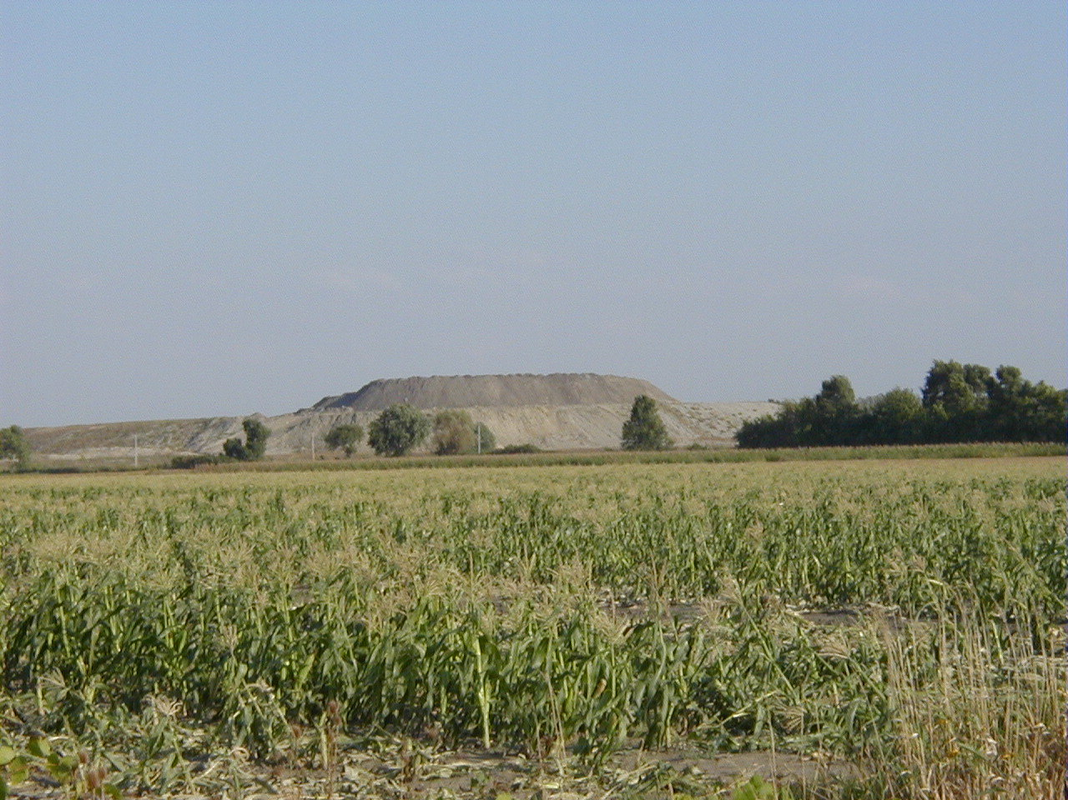

Slide 12
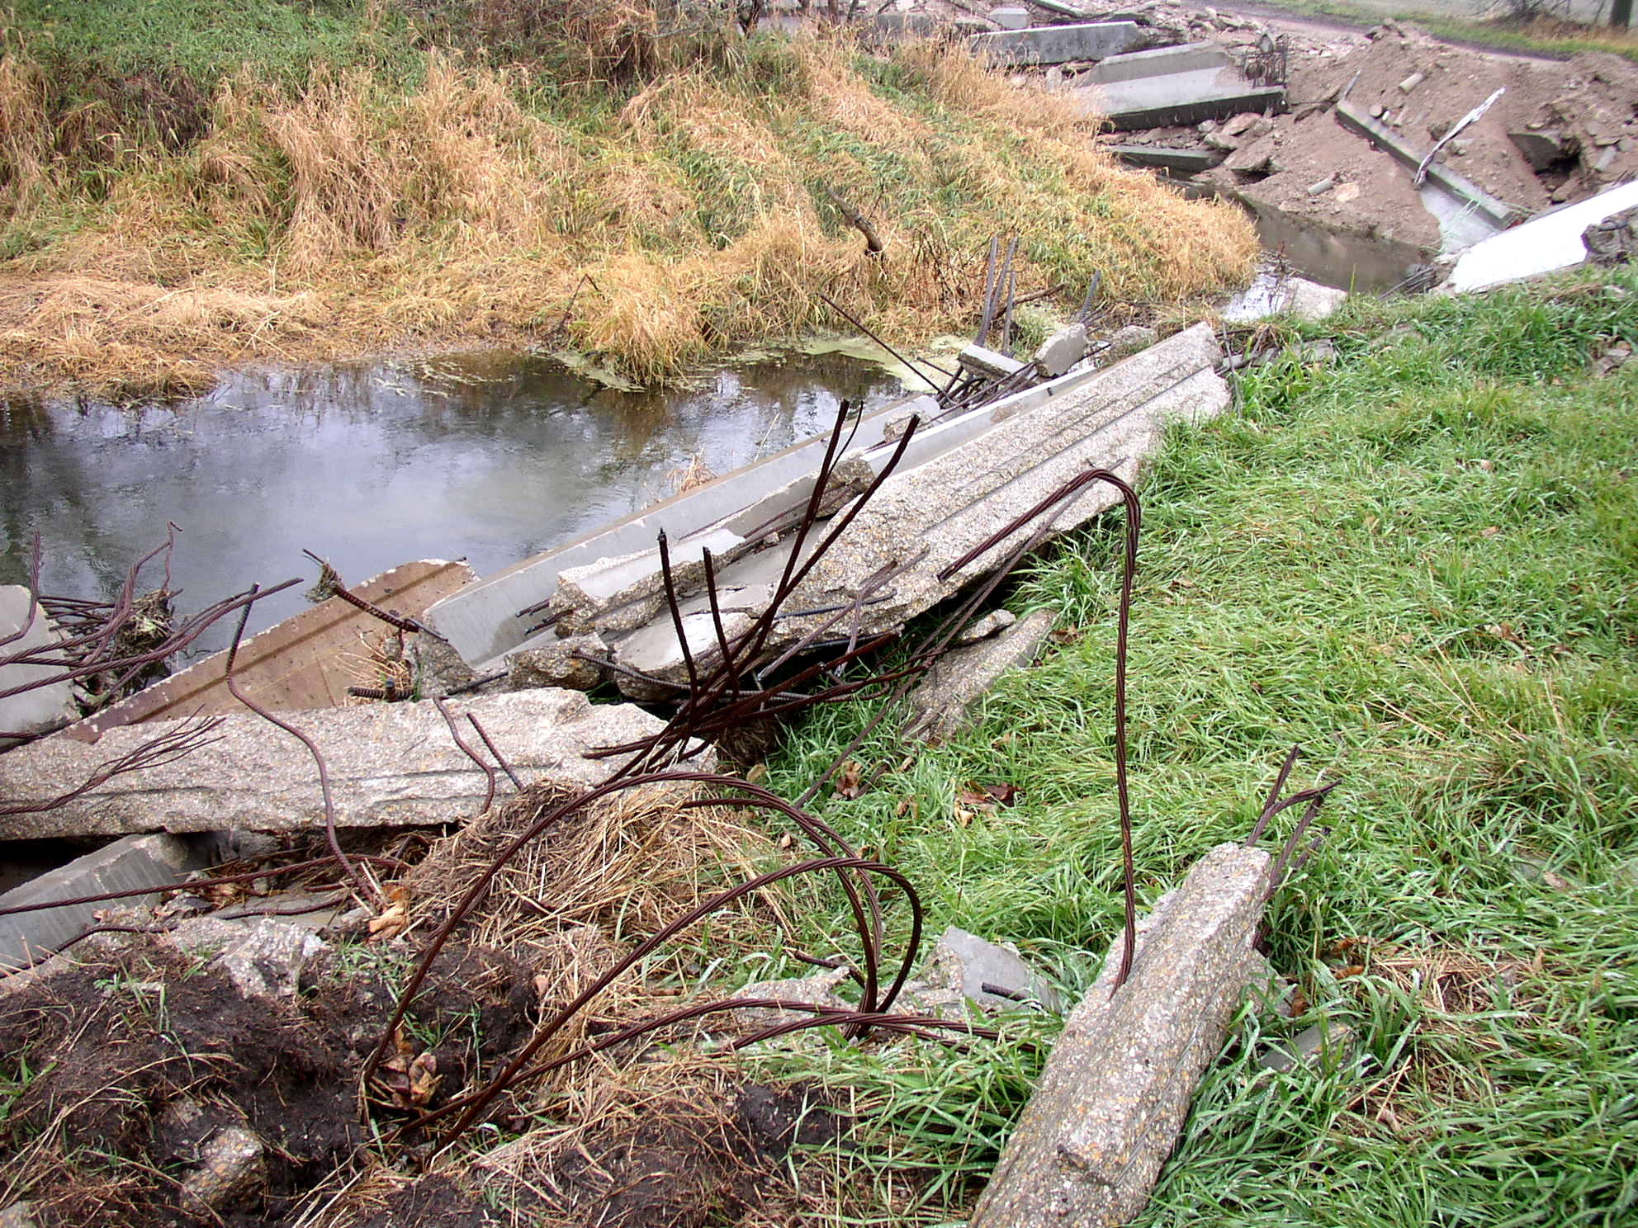

Slide 13
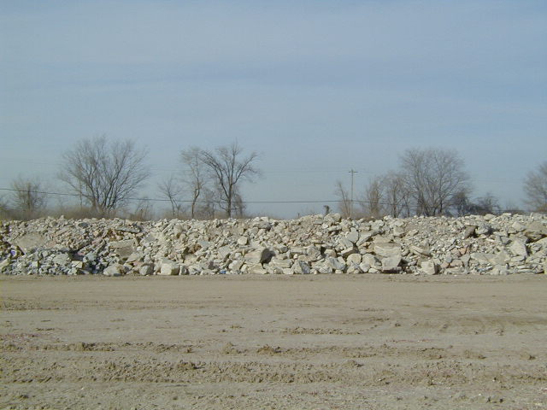

Slide 14
Management of CCDD
Section 3.160 of the Act
(2005 & 2007 amendments)
Uncontaminated concrete with protruding rebar and reclaimed asphalt pavement is not “waste” if separated or processed and returned to the economic mainstream within 4 years
25% removed each year

Slide 15
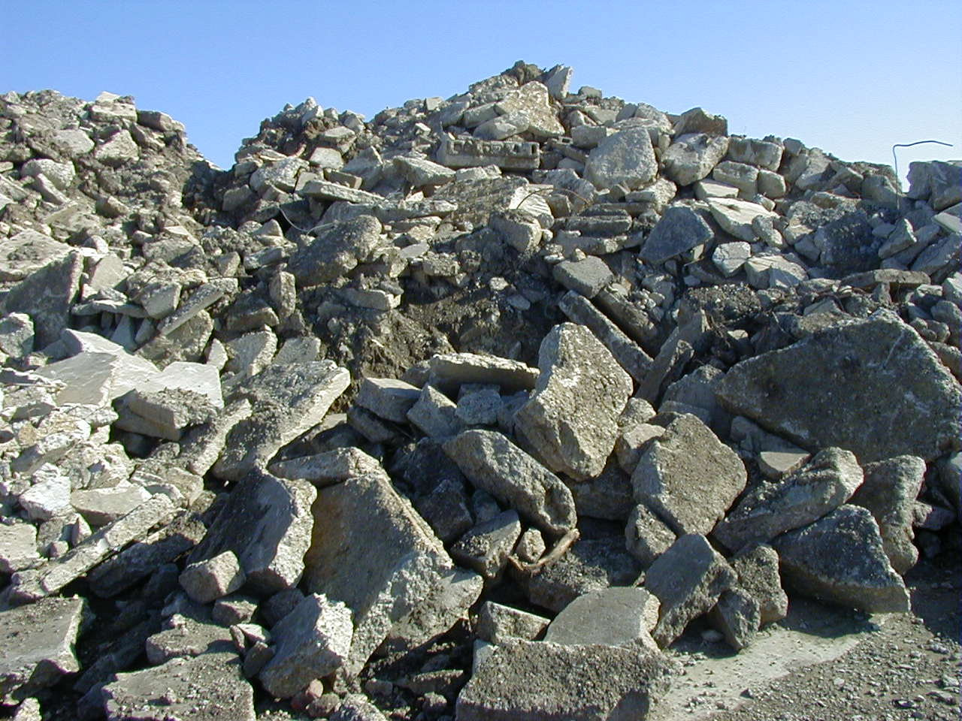

Slide 16
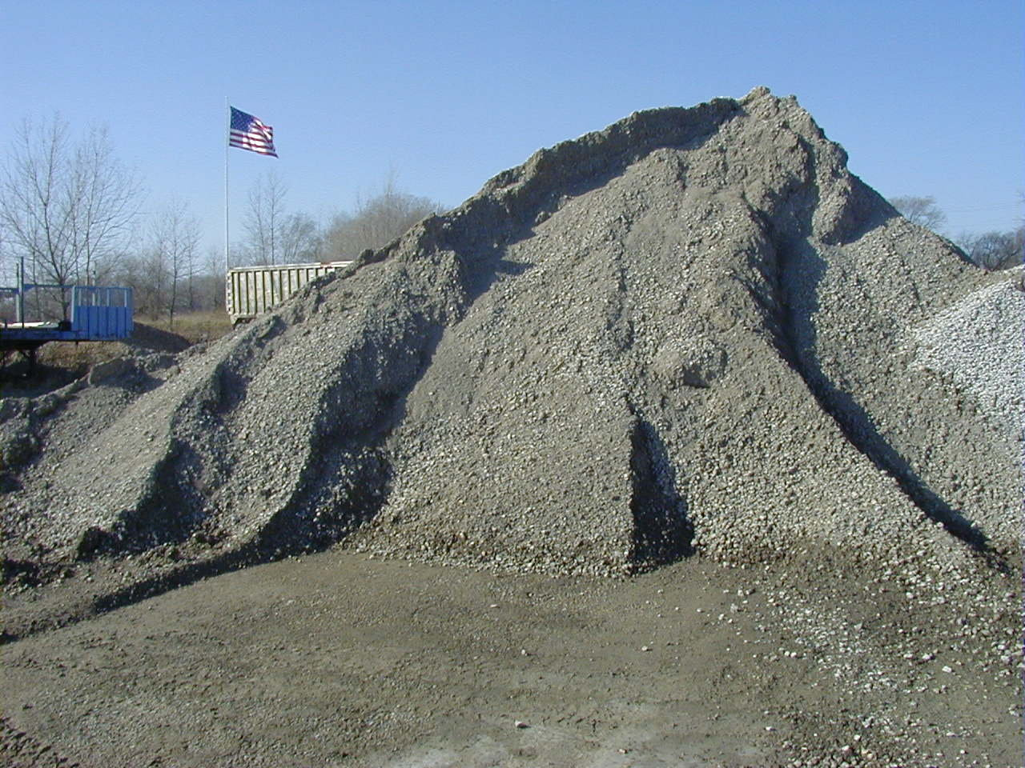

Slide 17
Illinois Environmental Protection Agency
The Illinois EPA is authorized to conduct inspections at construction and demolition sites pursuant to the Illinois Environmental Protection Act

Slide 19
MANAGEMENT OF GENERAL C&D DEBRIS

Slide 20
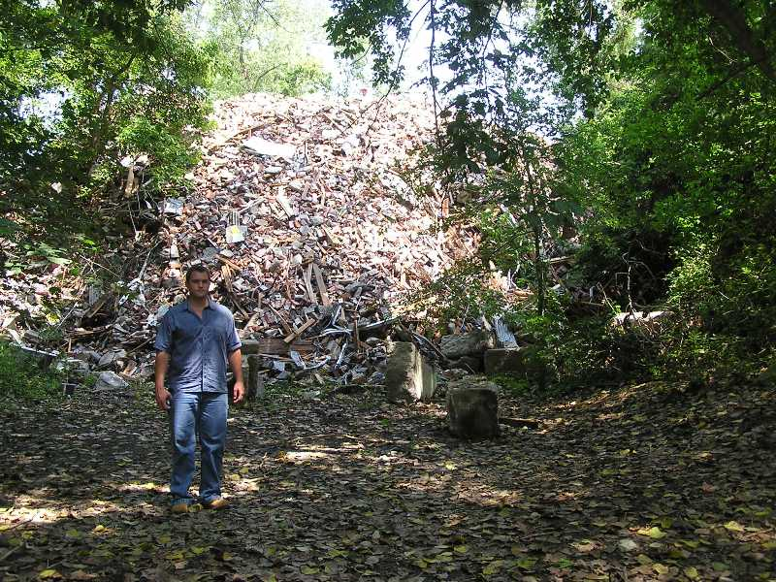

Slide 21
ILLINOIS ENVIRONMENTAL PROTECTION ACT
Prohibitions of the “Act”
NO open dumping of C&D waste
NO open burning of C&D waste

Slide 22
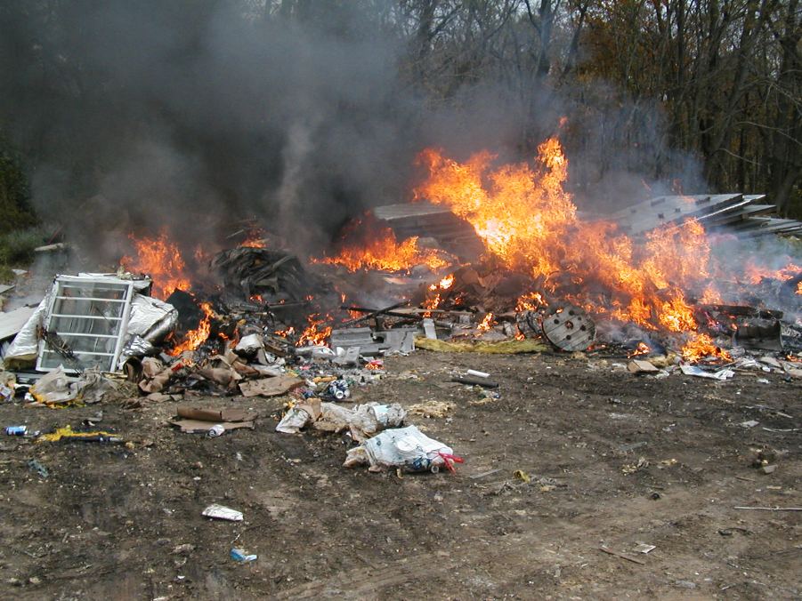

Slide 23
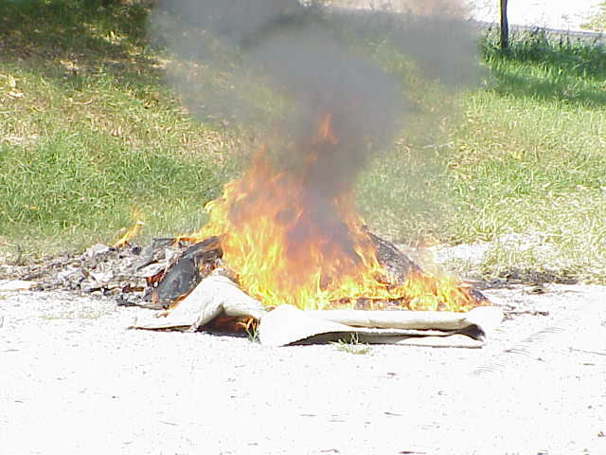

Slide 24
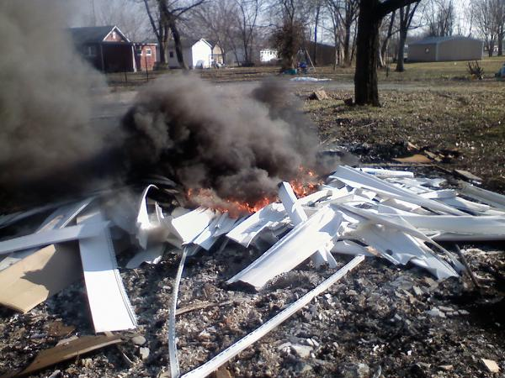

Slide 25
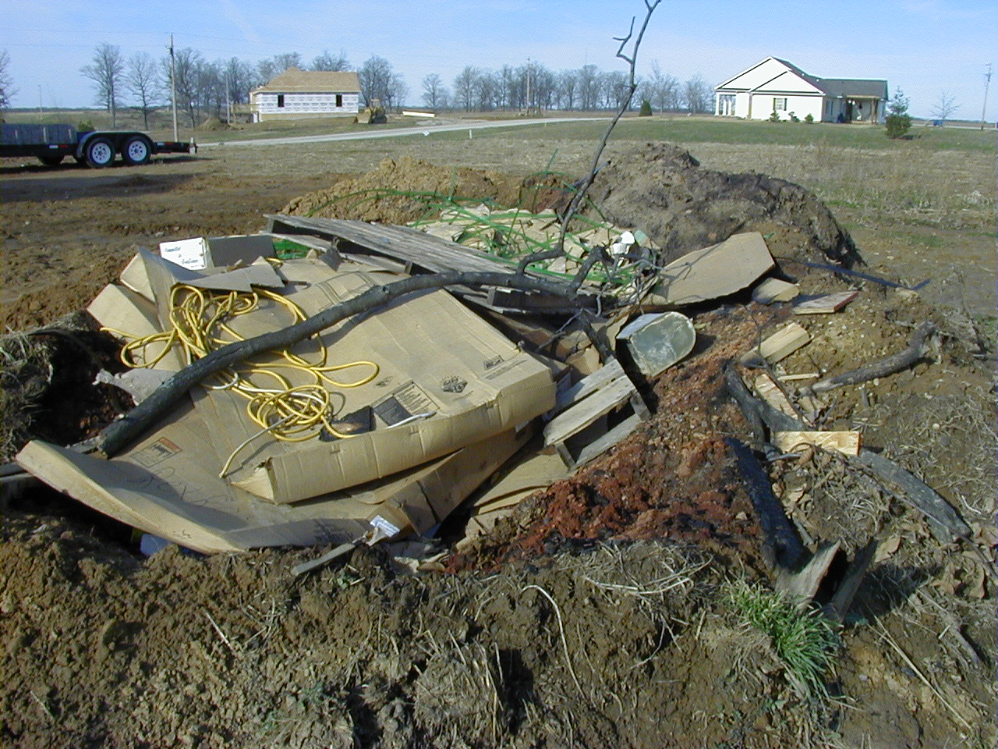

Slide 26
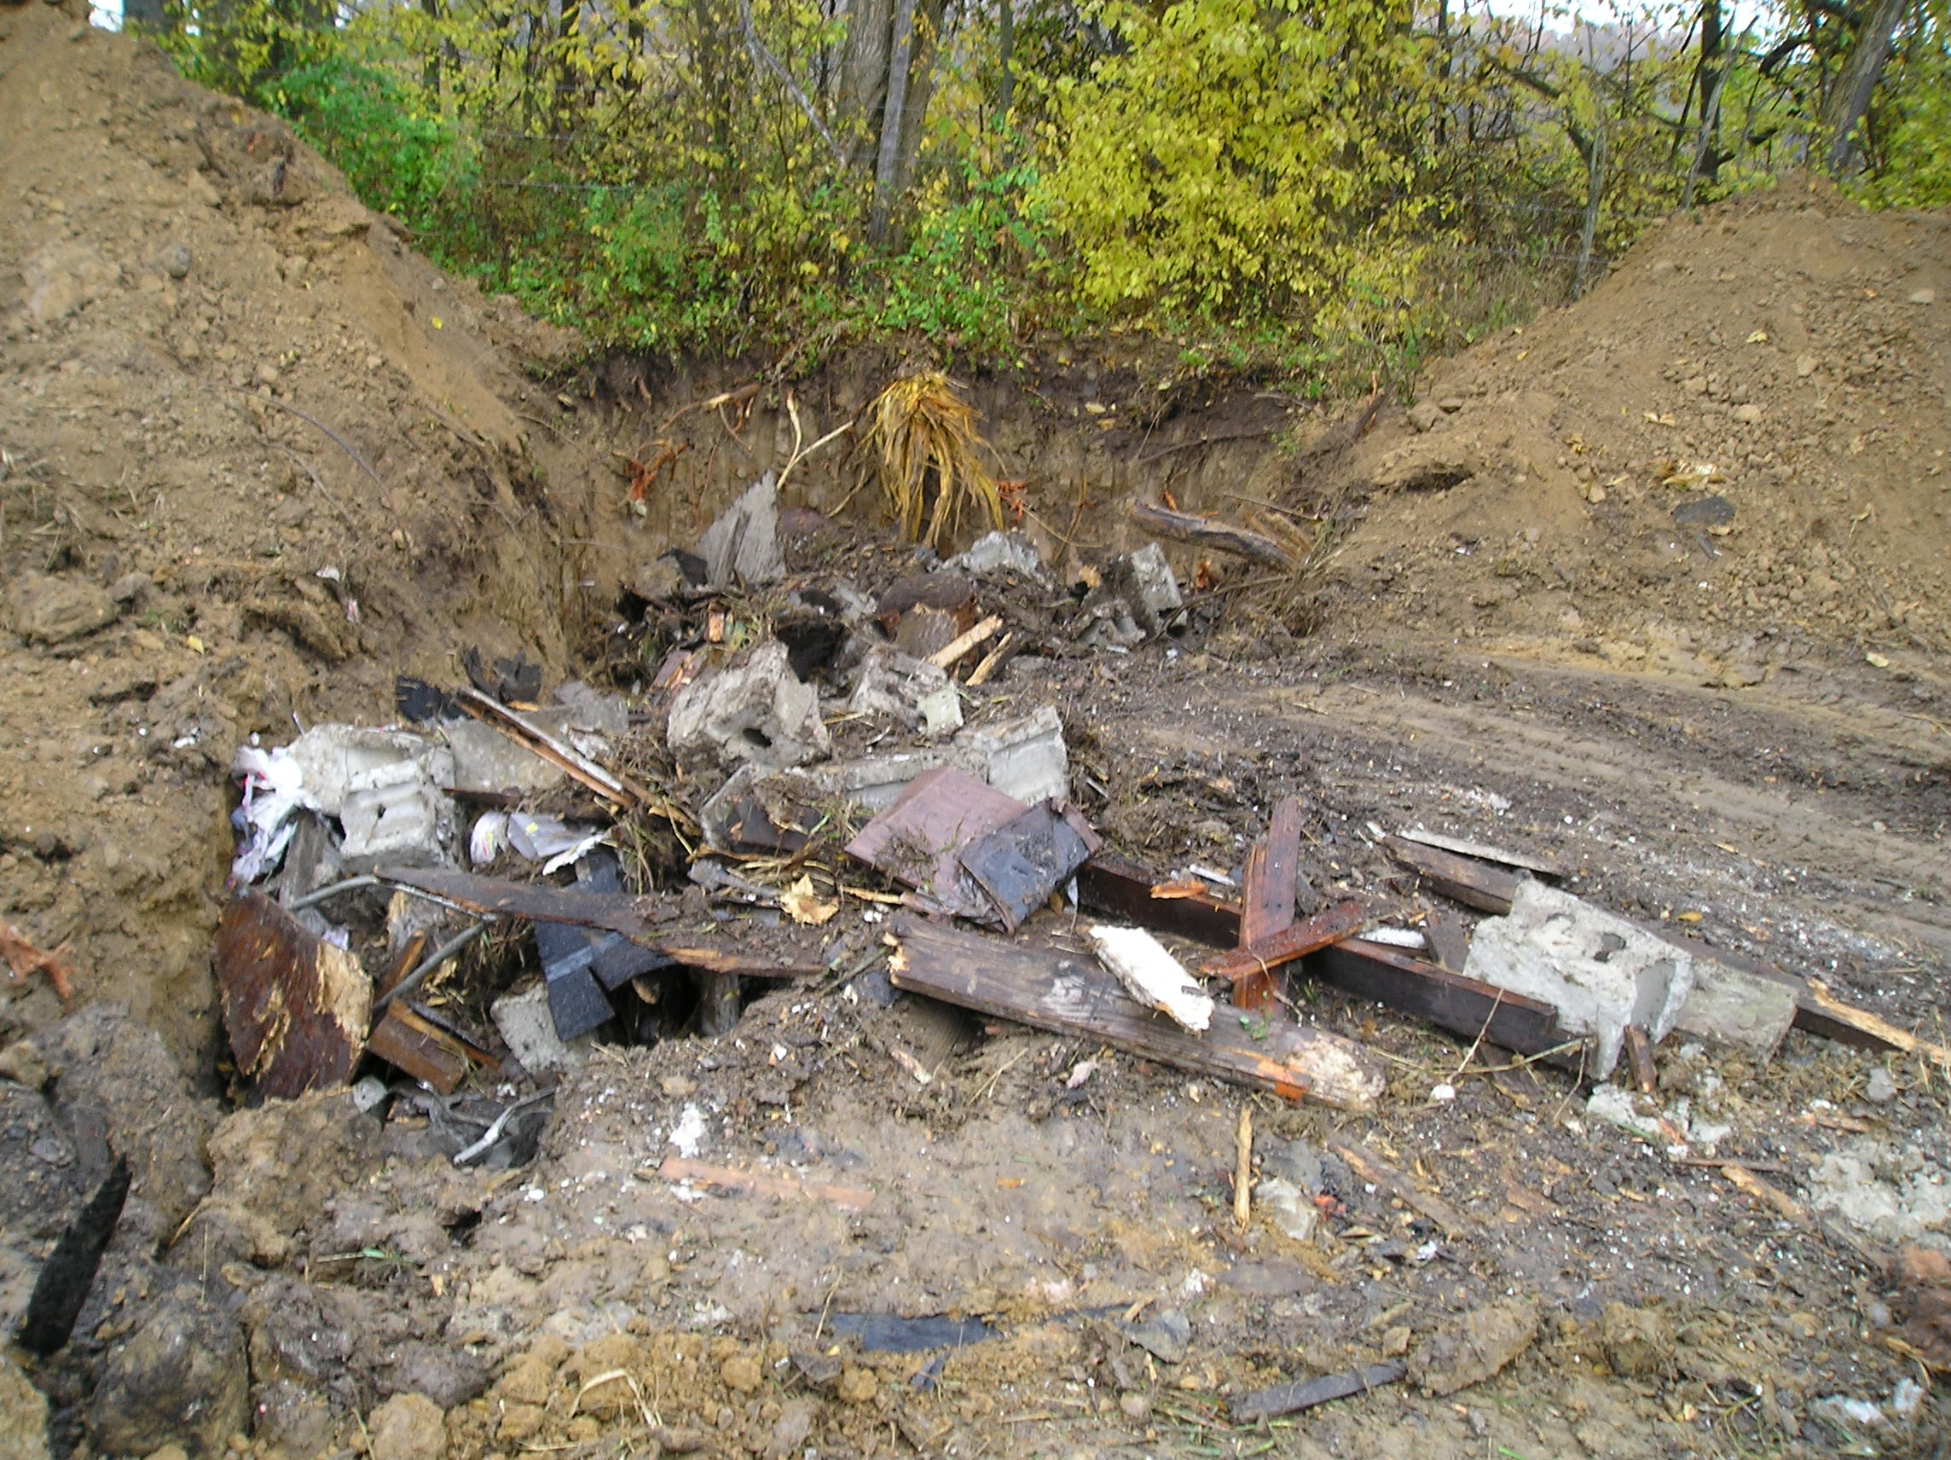

Slide 27
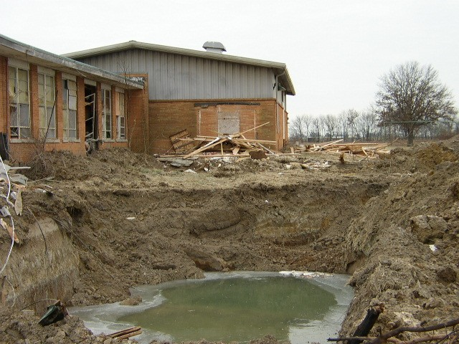

Slide 28
MANAGEMENT OF GENERAL C&D DEBRIS
Management hierarchy
REDUCE
REUSE
RECYCLE
LANDFILL

Slide 29
MANAGEMENT OF GENERAL C&D DEBRIS
Landfill
Transfer Station
C&D Transfer, Storage or Treatment Facility (operated pursuant to 22.38 of the Act)

Slide 30
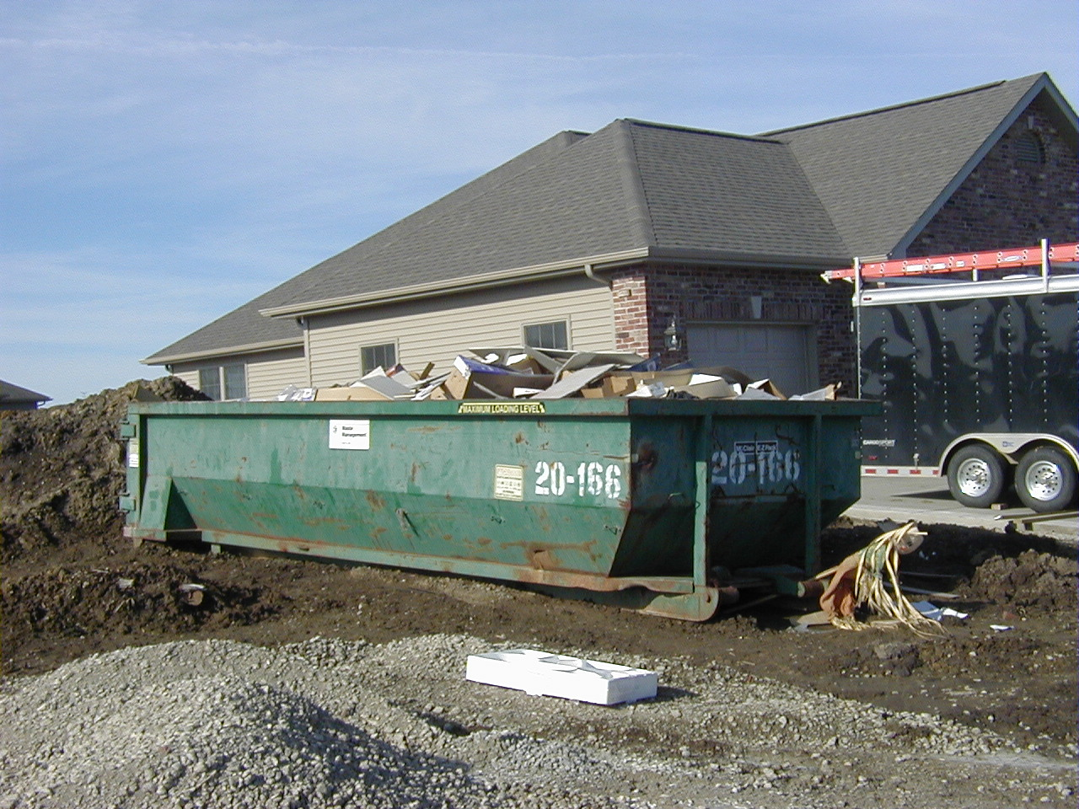

Slide 31
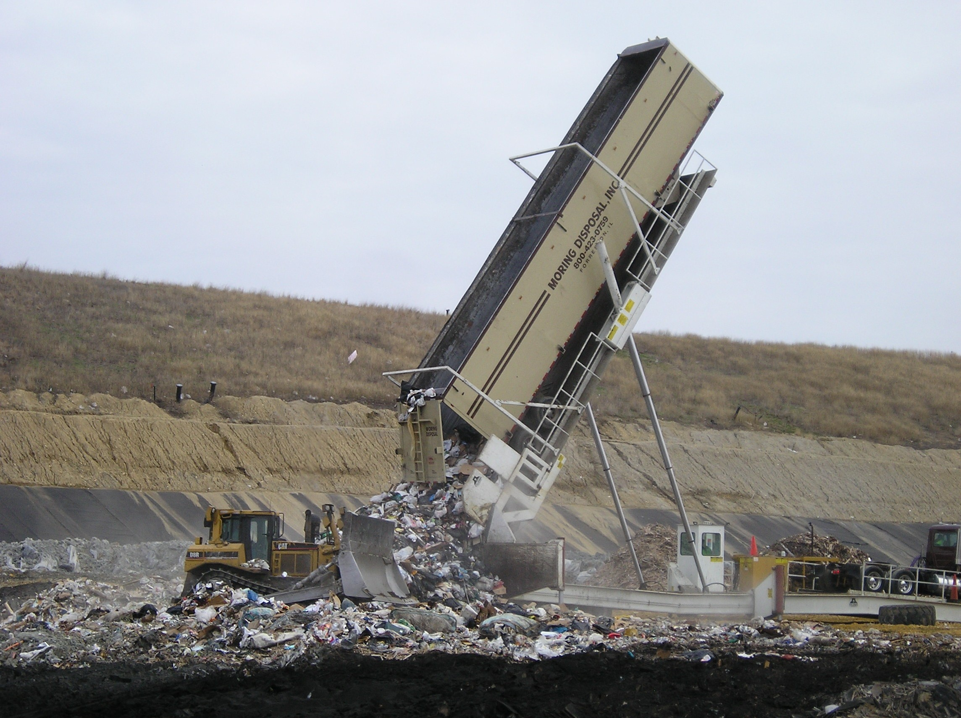

Slide 32
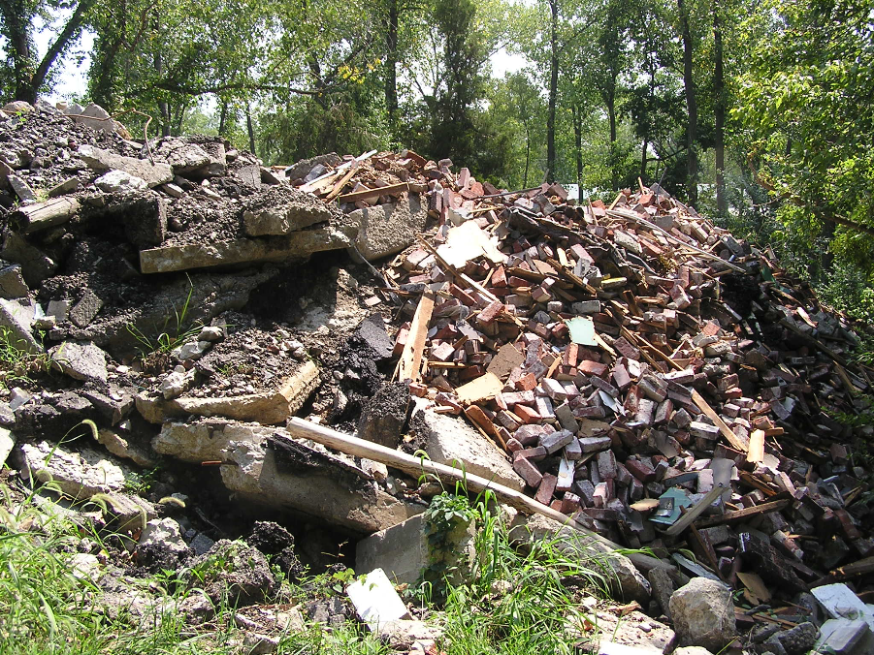

Slide 33
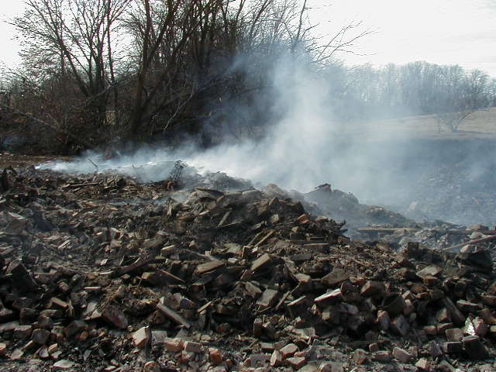

Slide 34
MANAGEMENT OF GENERAL C&D DEBRIS
Transfer, Storage, Treatment facilities for C&D
Section 22.38 of the Act
Notify Illinois EPA 30 days prior to operation
60 sites have Notified
Sort material within 48 hours
Non-recyclables disposed within 72 hours
Limit non-recyclables to 25%
Move off site putrescible or combustibles within 45 days
Move off site non-putrescibles in 6 months

Slide 35
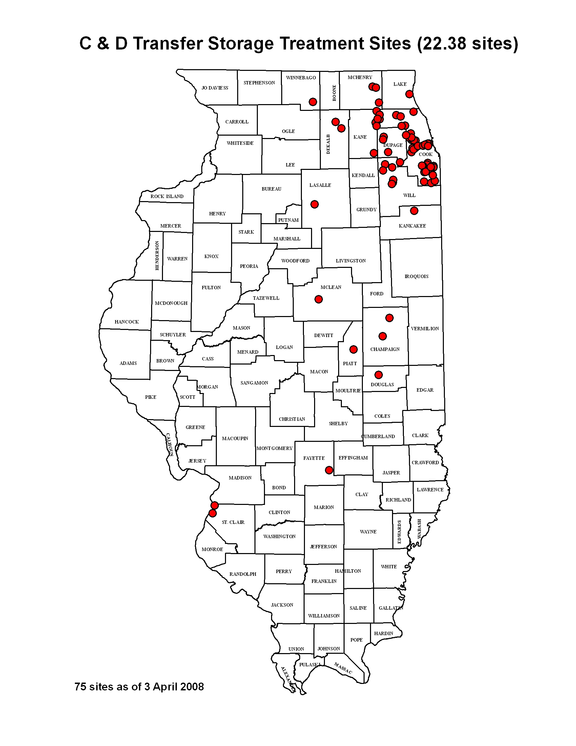

Slide 36
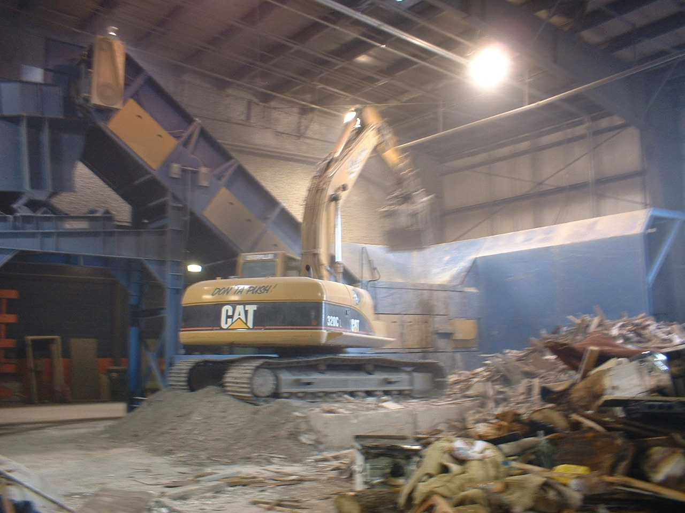

Slide 37
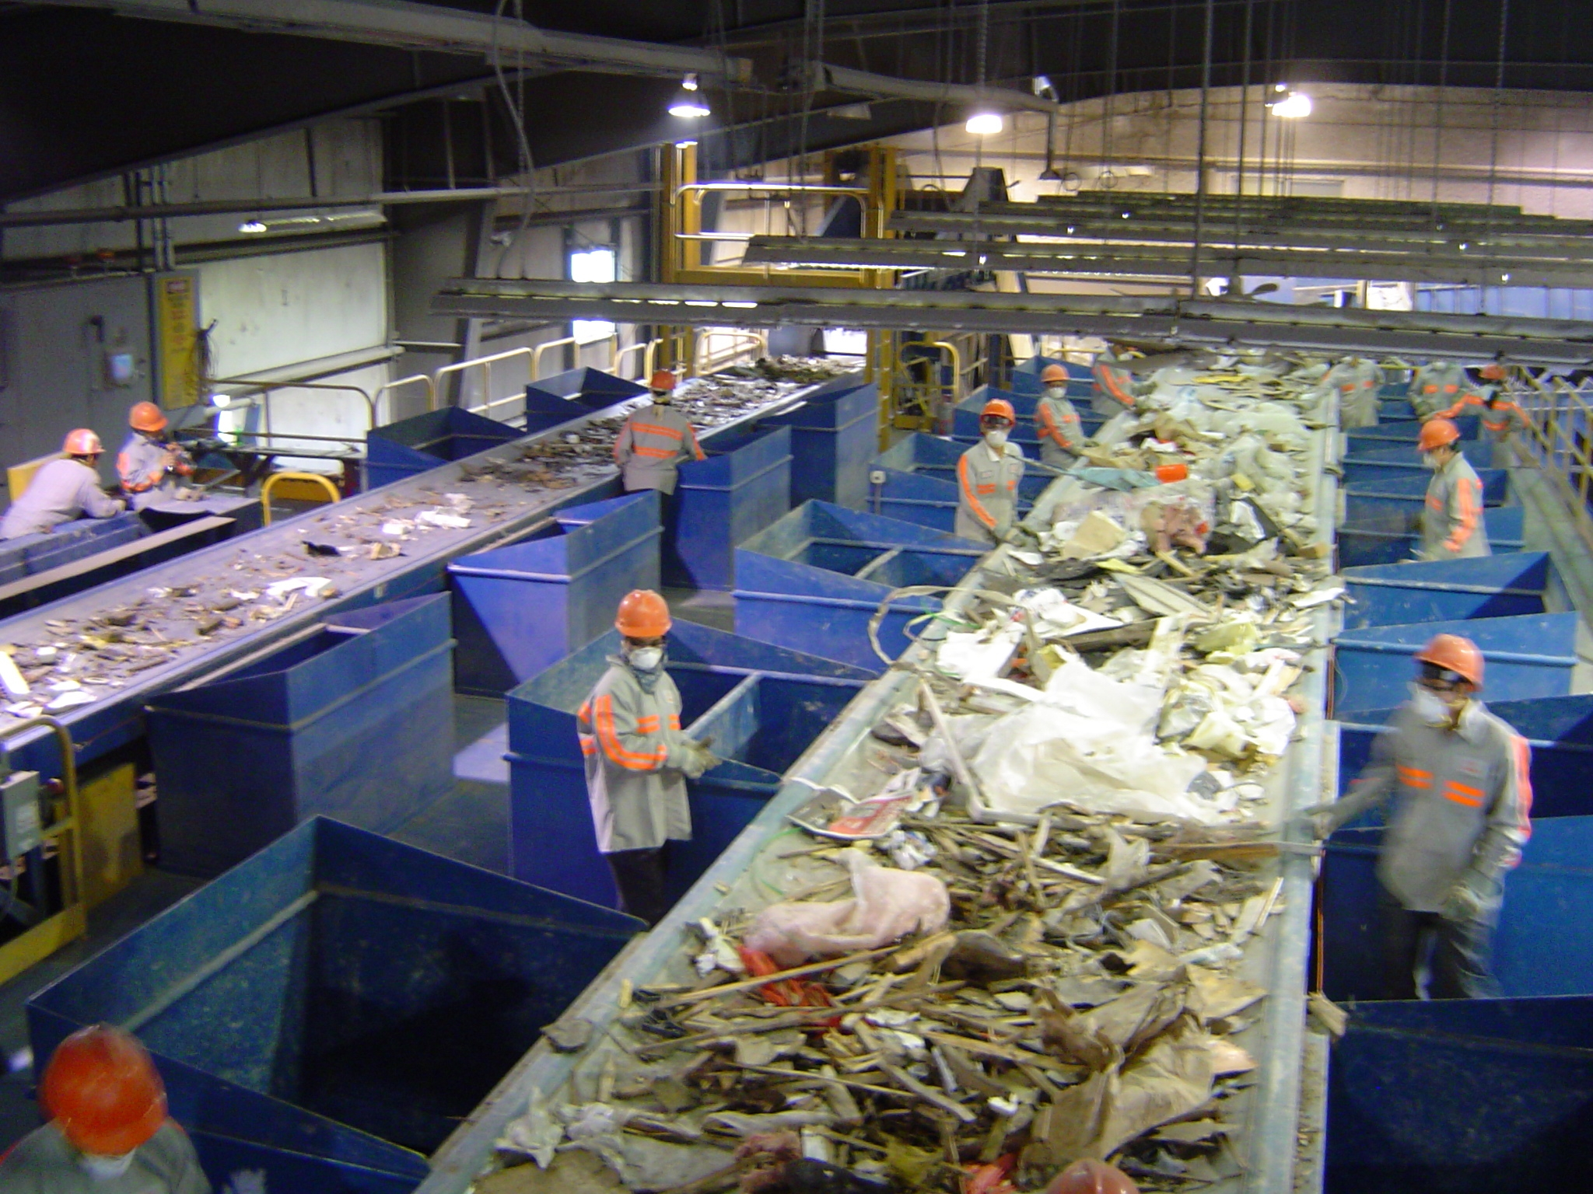

Slide 38
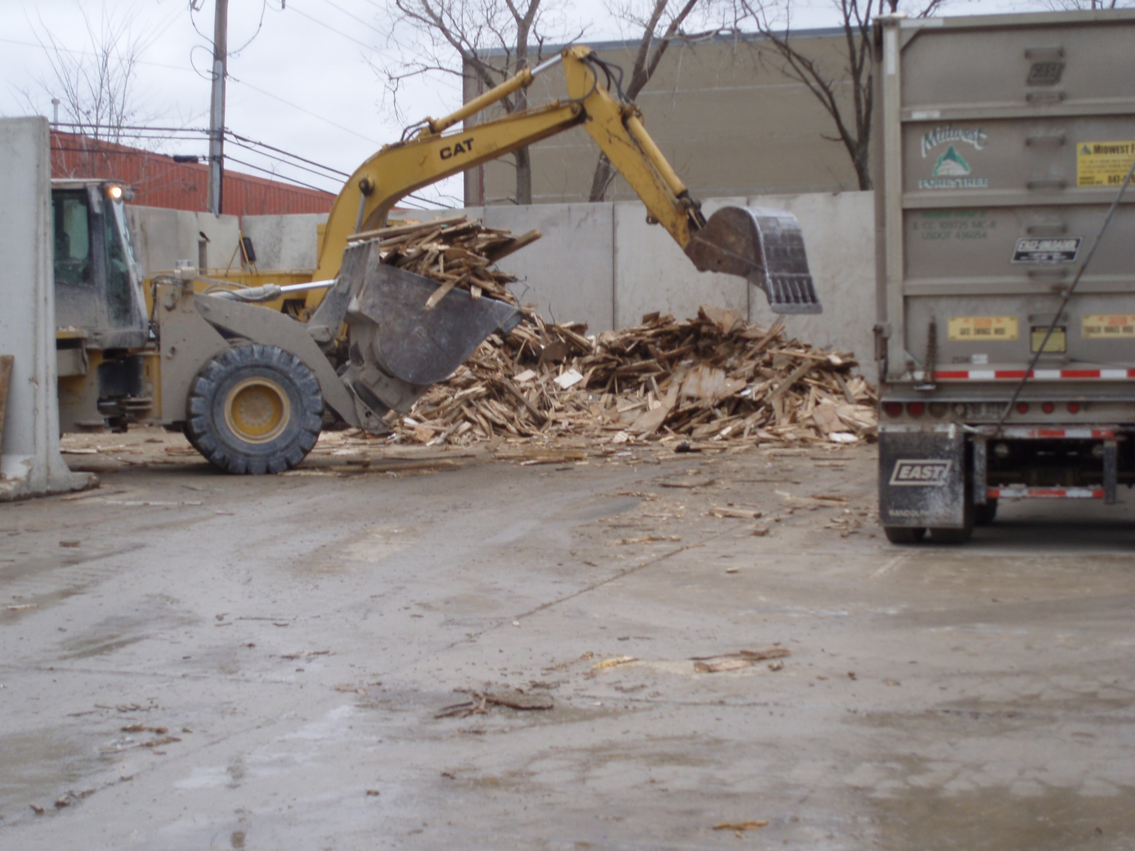

Slide 39
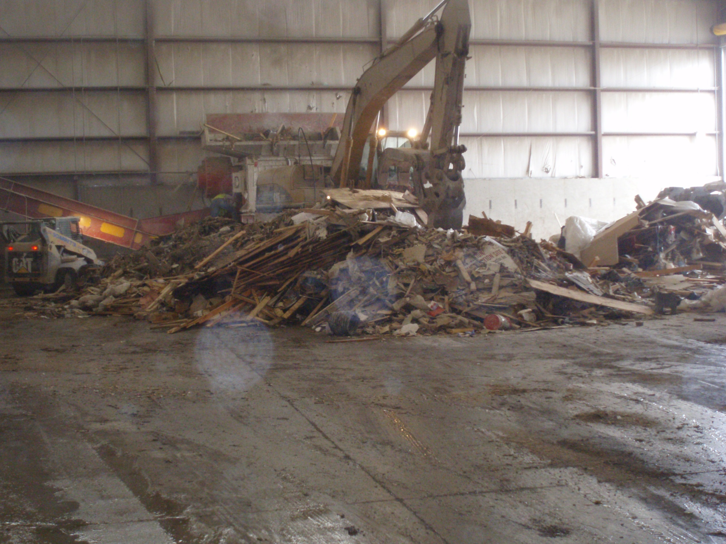

Slide 40
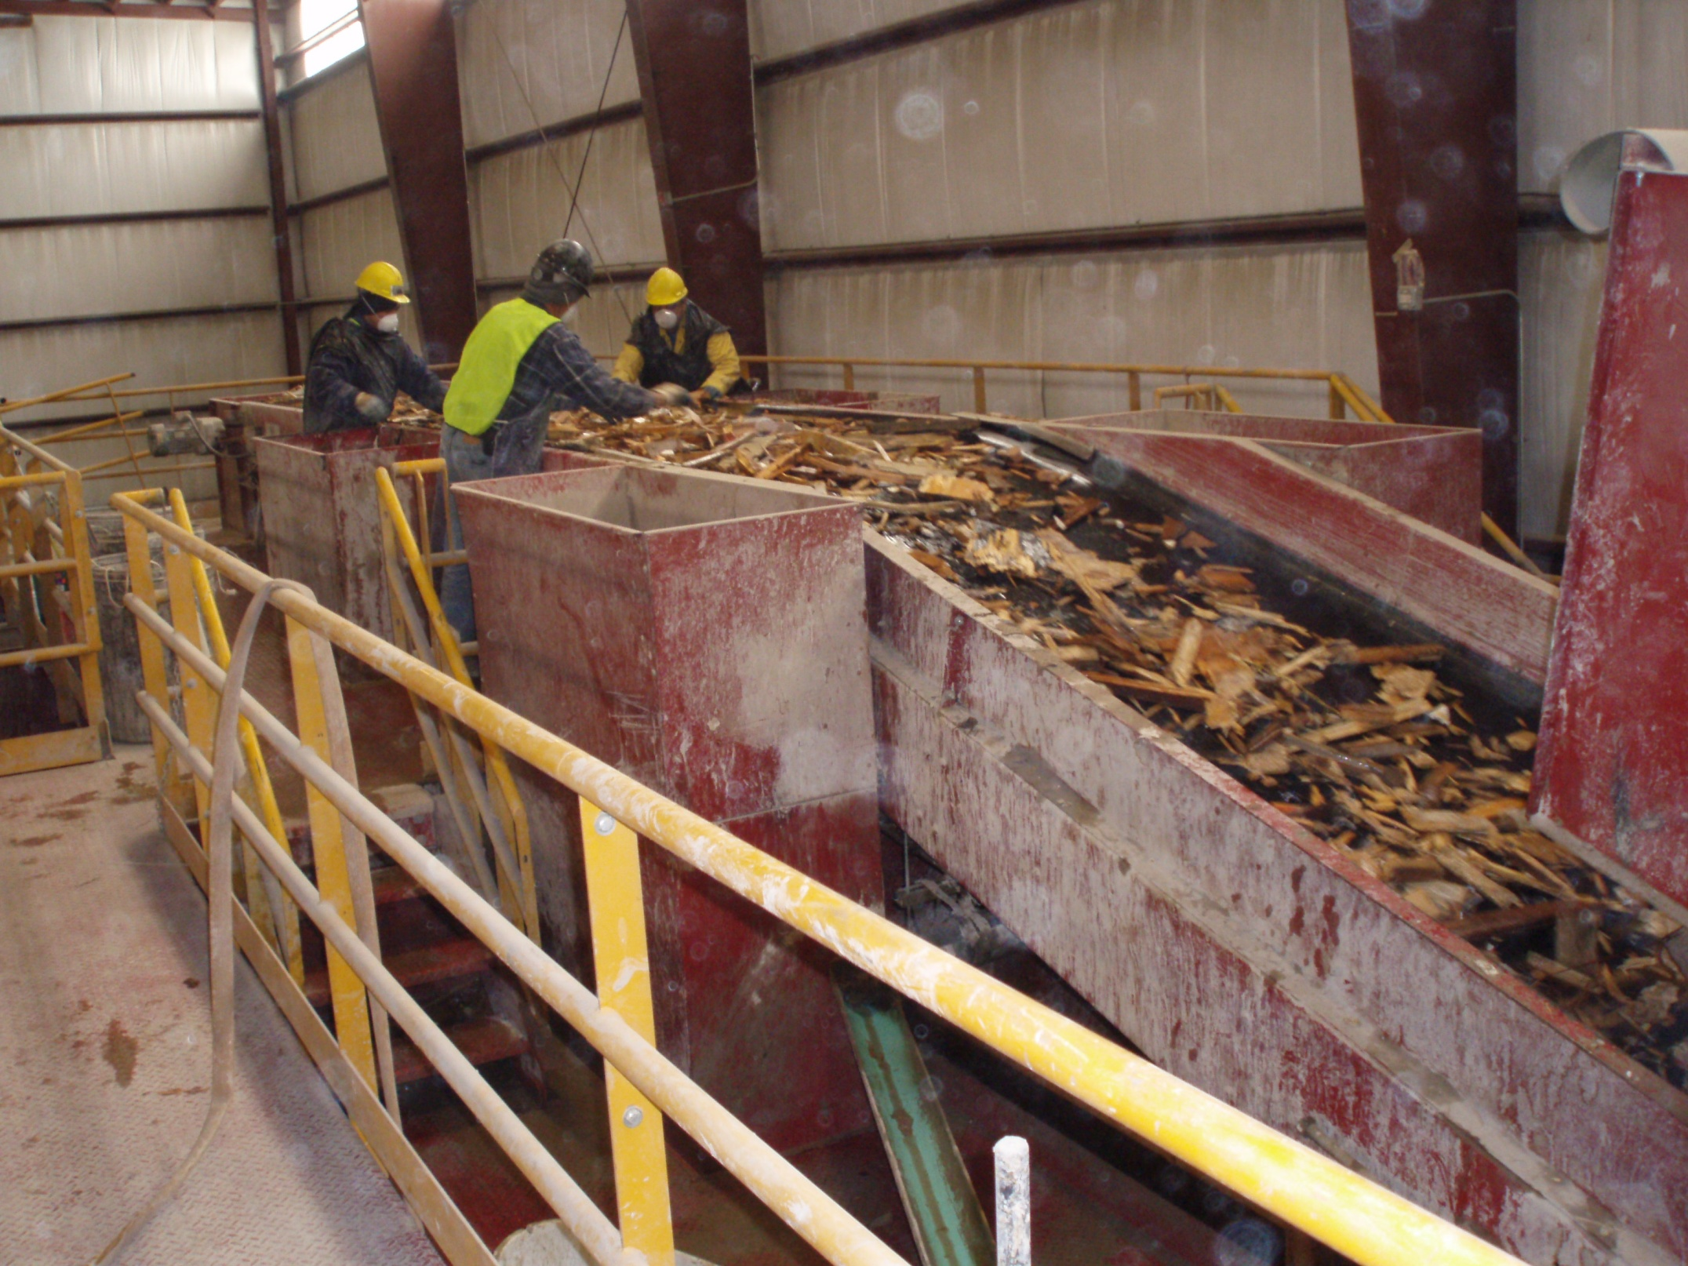

Slide 41
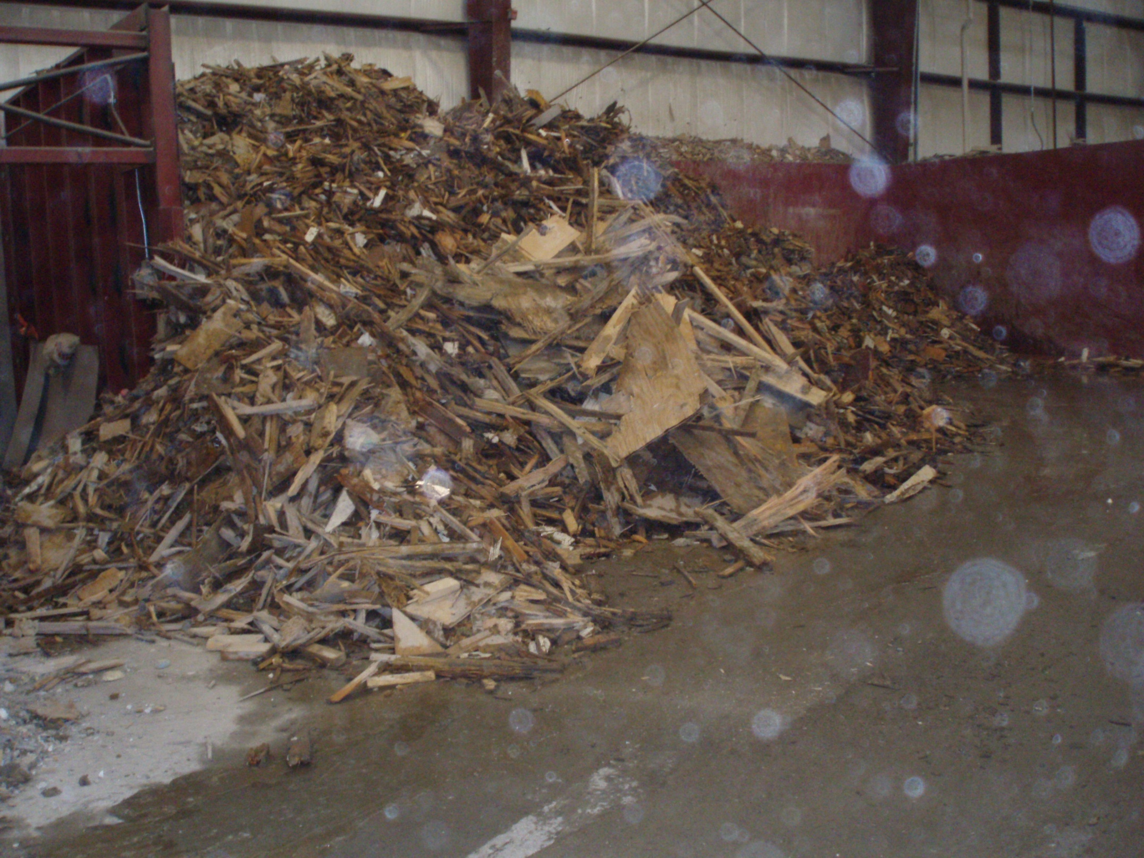

Slide 42
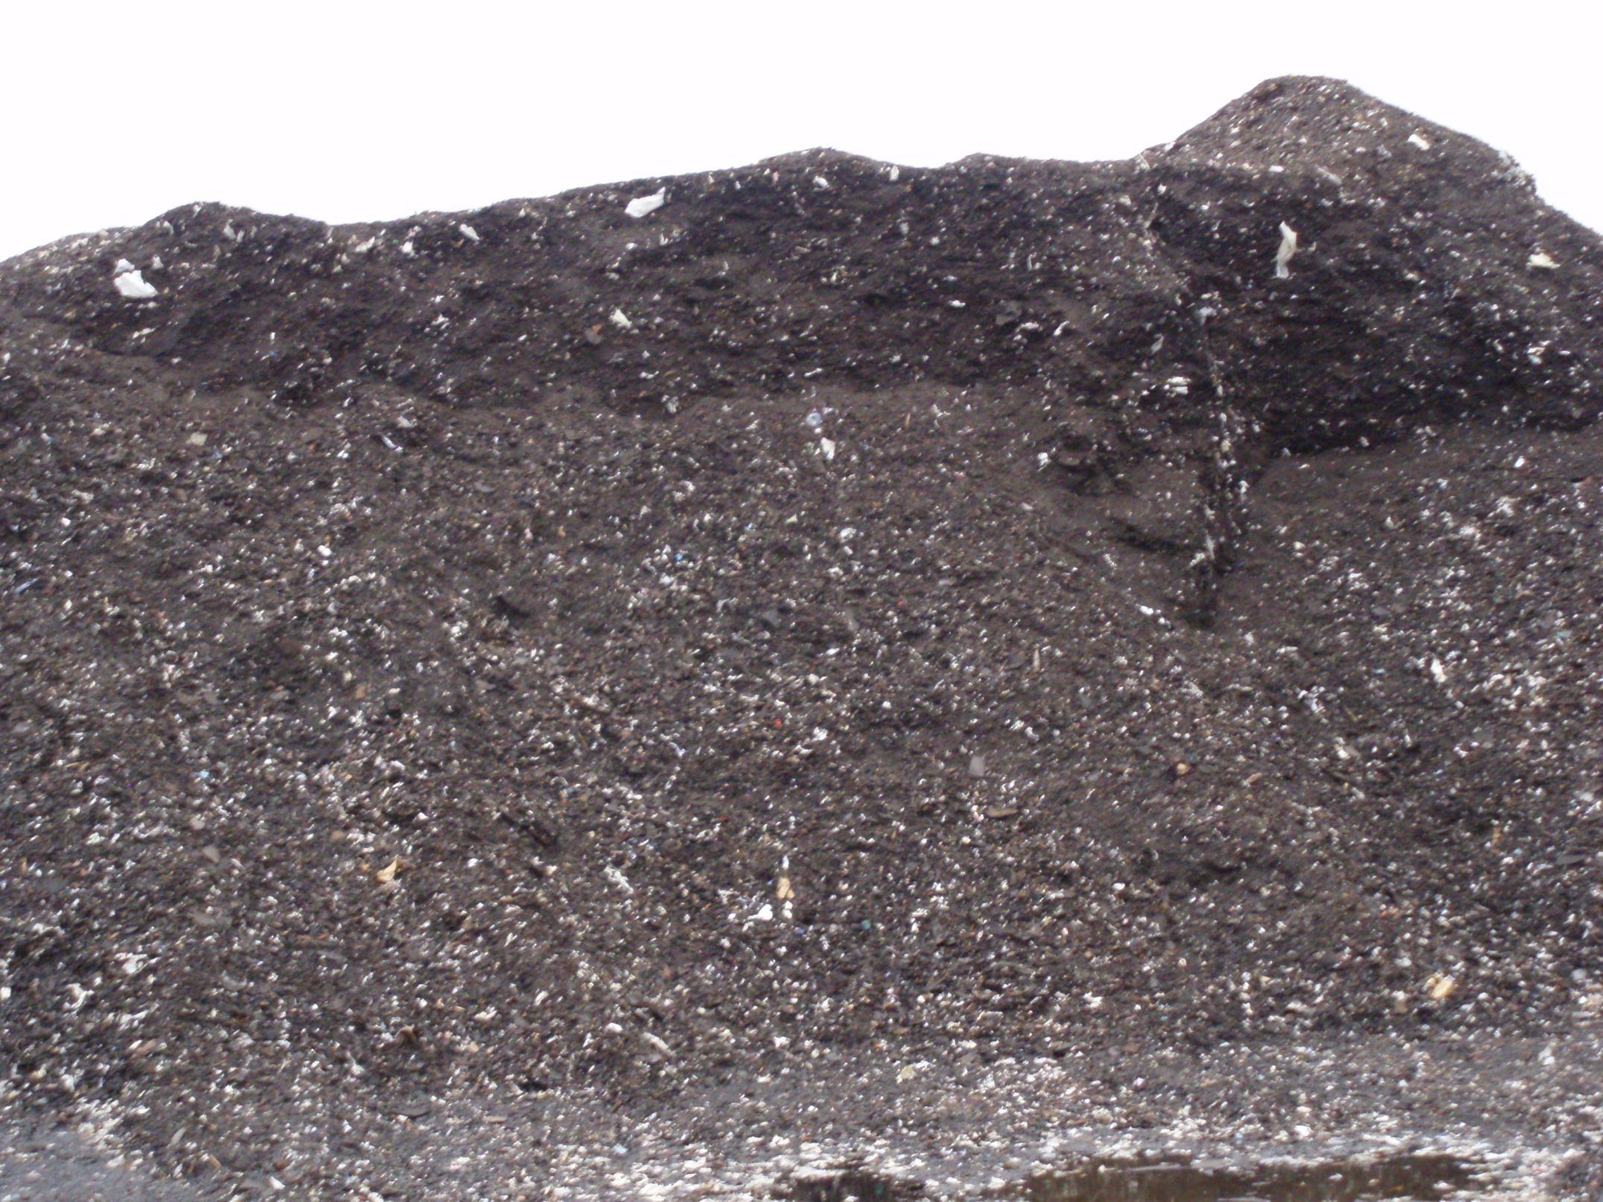

Slide 43
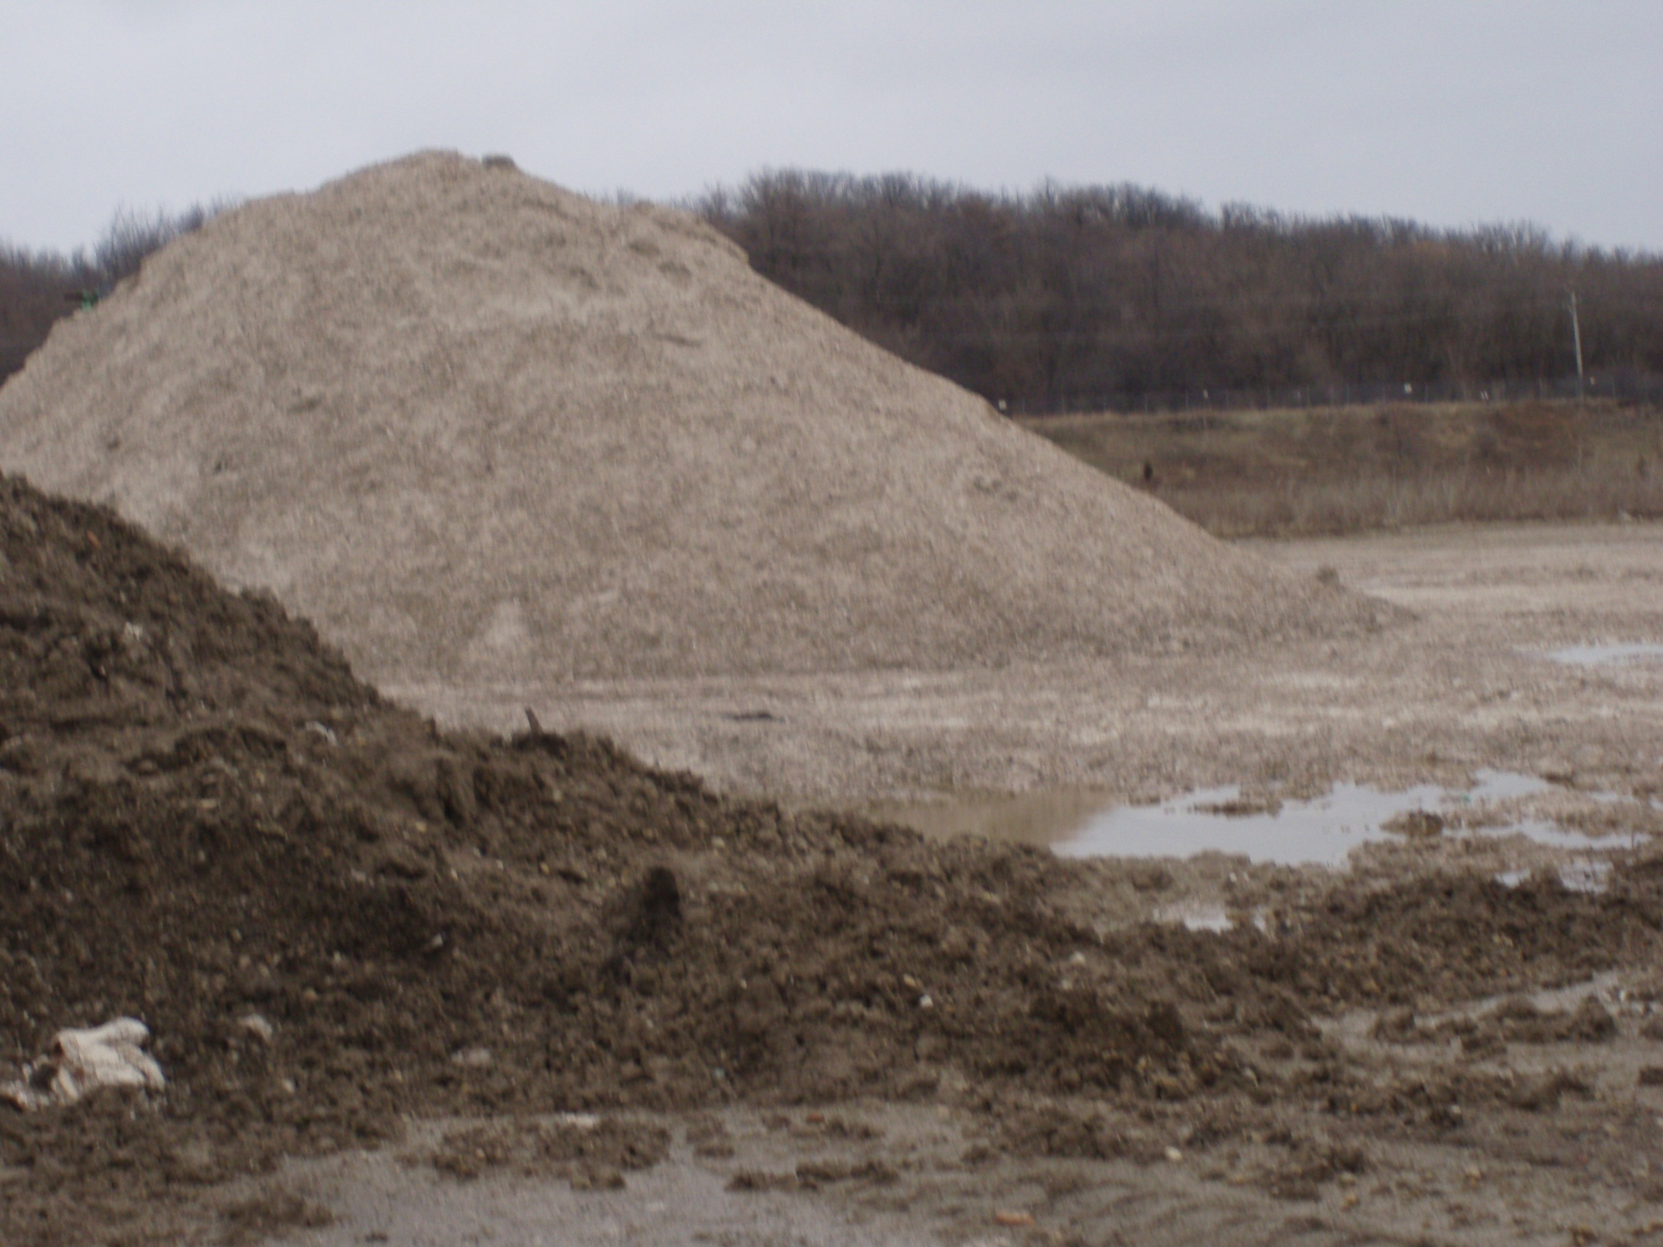

Slide 44
MANAGEMENT OF GENERAL C&D DEBRIS
Recycling Center
Defined at Section 3.375 of the Act
Facility accepts only segregated, non-special, homogeneous loads
i.e. shingles, drywall
For subsequent use in the secondary materials market
The Agency authorizes these facilities
BUD Program (beneficial use determination)

Slide 45
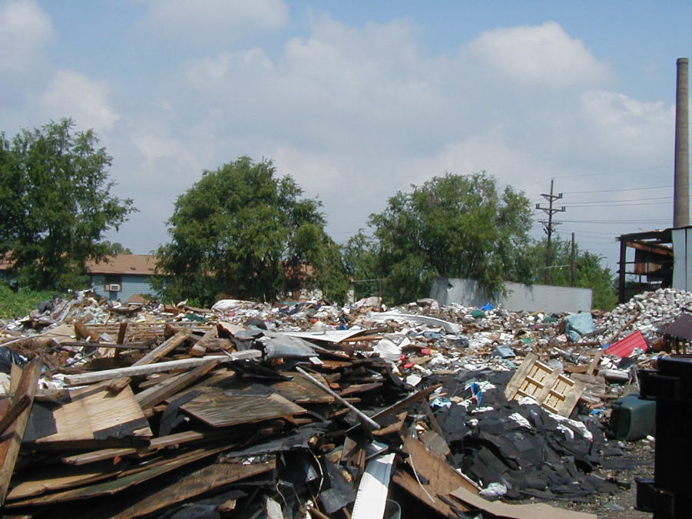

Slide 46
Management and Disposal of Soils and CCDD
Take to a facility permitted/authorized for disposal
“Certification” required to document the material is uncontaminated
Lab testing or generator knowledge is required

Slide 47
Section 22.51
No person shall use CCDD as fill in a quarry, mine or other excavation unless they have a permit from Illinois EPA
The Illinois Pollution Control Board adopted its Part 1100 regulations that established a permit program

Slide 48
CCDD and Uncontaminated Soil Fill Operations
CCDD fill sites currently permitted by Illinois EPA – 68 sites
http://epadata.epa.state.il.us/land/ccdd/
Uncontaminated Soil Fill Operations (USFOs) currently registered with Illinois EPA - 15 sites http://www.epa.state.il.us/land/ccdd/uncontaminated-soil-fill-operations-list.pdf

Slide 49
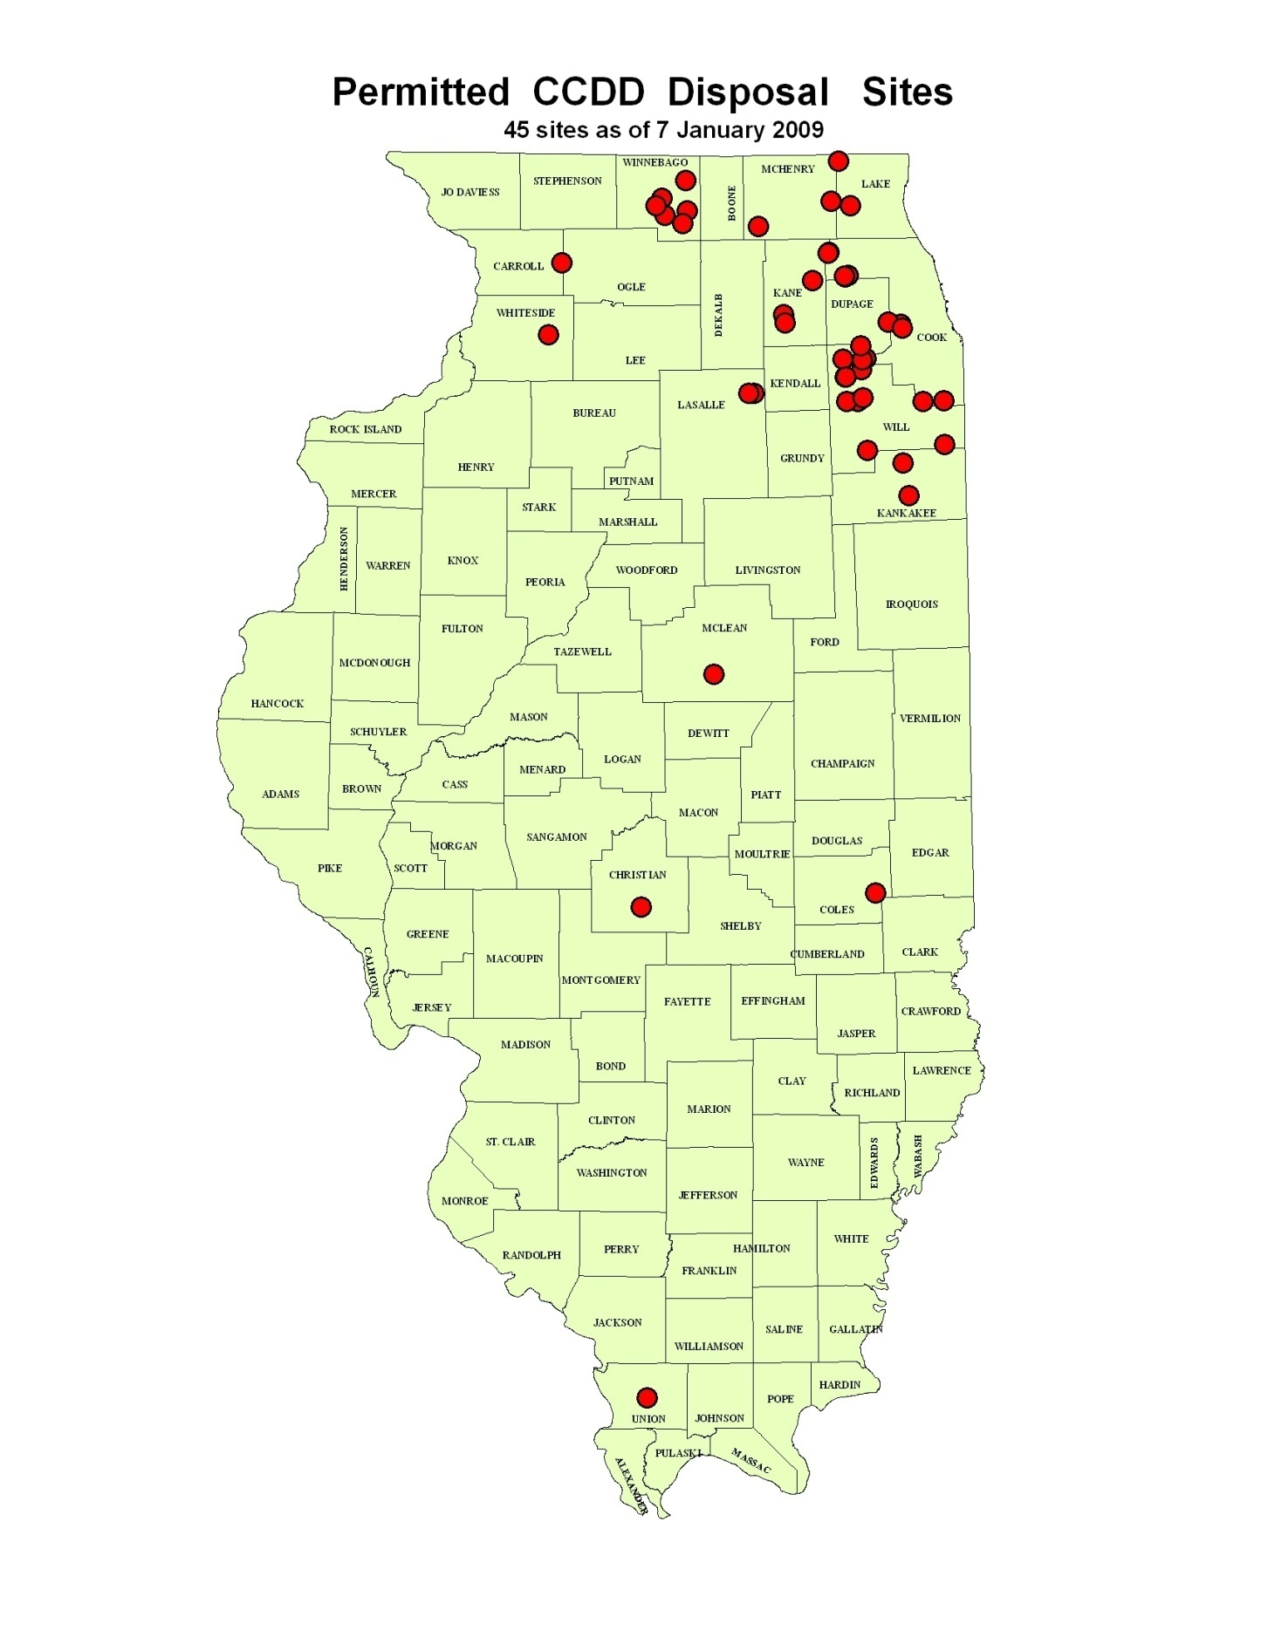

Slide 50
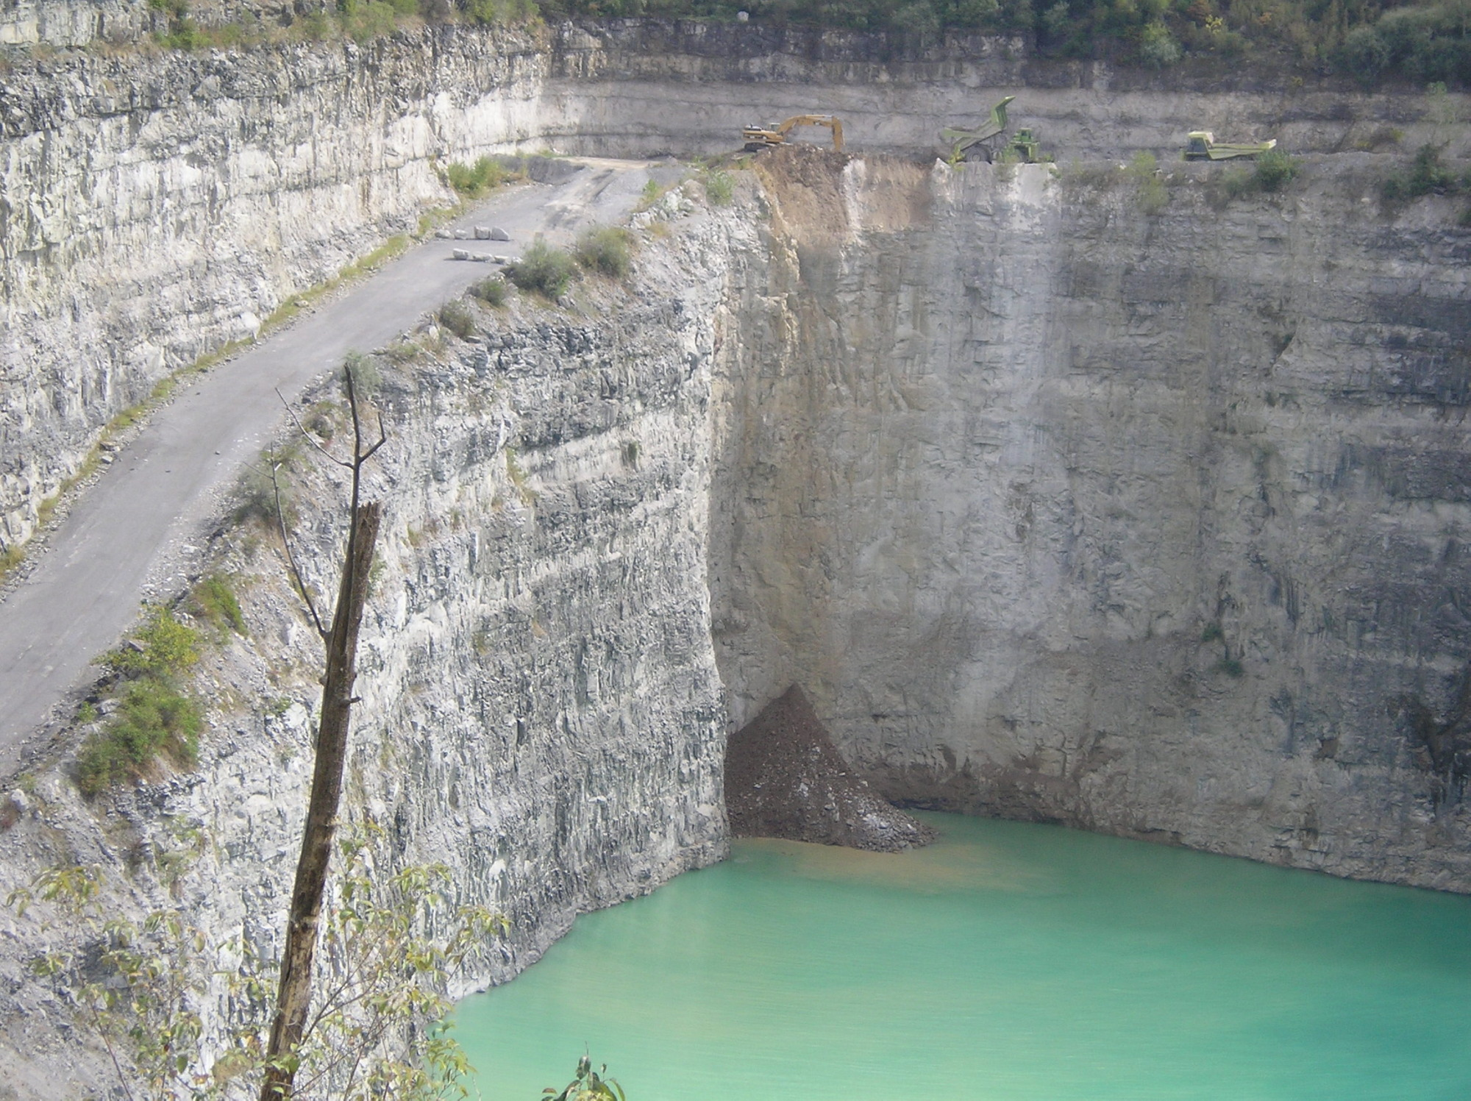

Slide 51
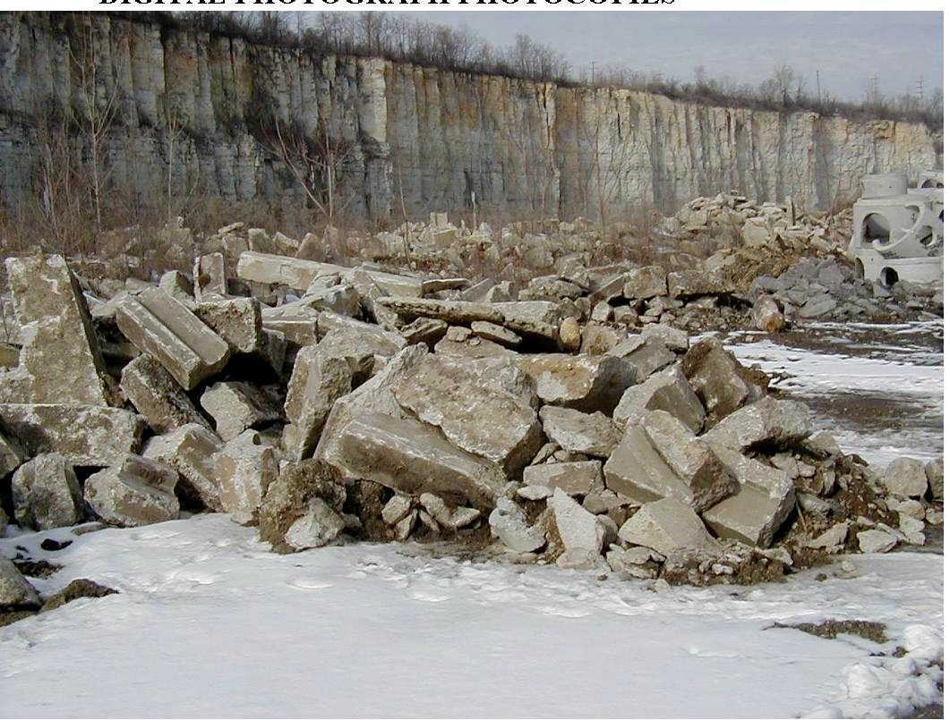

Slide 52
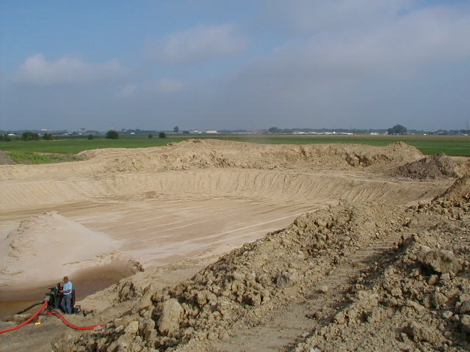

Slide 53
Can I send my soil to a CCDD or Soil Disposal site?
http://www.epa.state.il.us/land/ccdd/new-max-allowable-concentrations-table.pdf
A list of chemicals and the maximum concentration of contaminent

Slide 54
ASBESTOS
Renovations and Demolitions
C&D waste containing asbestos is a non-special solid waste
As long as it is managed in accordance with the NESHAPS regulations

Slide 55
ASBESTOS
Transport of Asbestos Waste
No visible emissions to the outside air during collection, processing, packaging and transport
Must be wetted
Must be bagged or containerized in a leak tight container
Containers must be labeled with OSHA warning labels

Slide 56
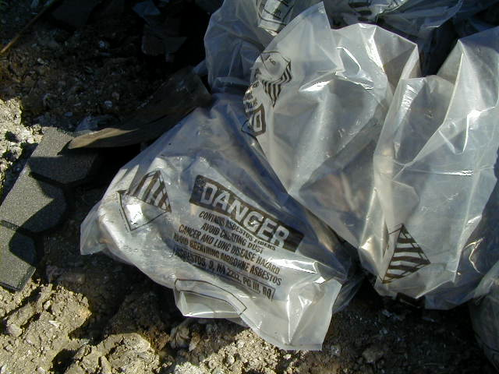

Slide 57
ASBESTOS
C&D waste where asbestos is not removed prior to demolition
Keep wet during loading
Mark vehicle containing asbestos with proper signage
Cover vehicle’s container (i.e., roll-off box)

Slide 58
ASBESTOS
Waste Shipment Records
A Waste Shipment Record must accompany the waste to the landfill
Copies of Waste Shipment Records must be retained by the generator for two (2) years
Waste must be disposed of at a permitted landfill

Slide 59
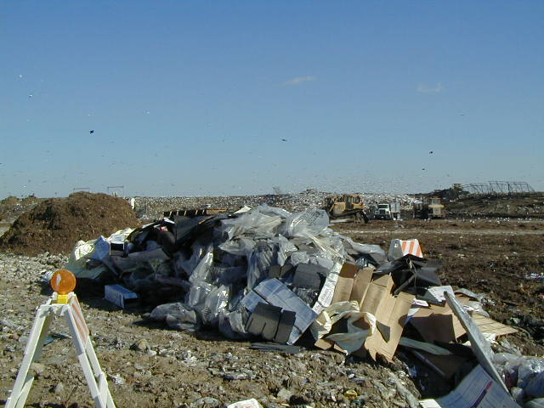

Slide 60
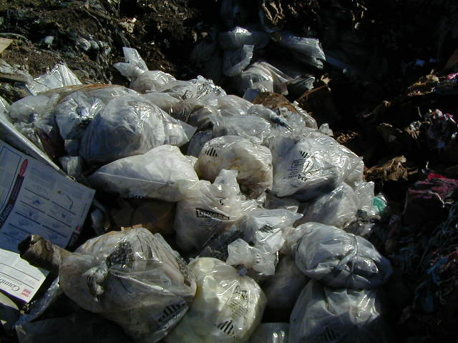

Slide 61
LEAD BASED PAINT
RESIDENTAL
Homeowner and contractor
Removed from or left on the substrate
Exempt from the hazardous waste rules
May be disposed of as general refuse
Must be sent to a permitted landfill

Slide 62
LEAD BASED PAINT
NON-RESIDENTAIL
IF LBP is removed from the substrate to which it was adhered,
THEN the LBP waste is a special waste
It may also be a hazardous waste

Slide 63
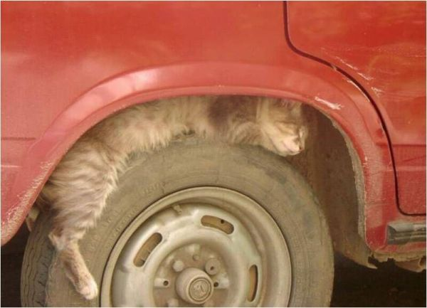
RISKY BEHAVIOR

