Slide 1
Illinois Department of Labor Safety Inspection & Education Division

Slide 2
OSHA Top 10 Most Cited Violations 2012

Slide 3
10) Electrical System Design:

Slide 4
Good Electrical System Design:

Slide 5
Bad Electrical System Design:

Slide 6
9) Machine Guarding

Slide 7
Good Machine Guarding:

Slide 8
Good Machine Guarding:

Slide 9
Bad Machine Guarding:

Slide 10
Bad Machine Guarding:

Slide 11
Bad Machine Guarding:

Slide 12
8) Electrical (Wiring):

Slide 13
Good Electrical Wiring:

Slide 14
Good Electrical Wiring:

Slide 15
Bad Electrical:

Slide 16
Bad Electrical Wiring:

Slide 17
One more:

Slide 18
7) Ladders:

Slide 19
Good Ladder Use:

Slide 20
Good Ladder Use:

Slide 21
Bad ladder Use:

Slide 22
Bad Ladder Use:

Slide 23
Whoops!!

Slide 24
6) Powered Industrial Trucks:

Slide 25
Good Powered Industrial Trucks

Slide 26
All Terrain Powered Industrial Trucks:

Slide 27
Bad Powered Industrial Trucks:

Slide 28
Bad Industrial Powered Trucks:

Slide 29
Bad Powered Industrial Trucks:

Slide 30
5) Lockout/Tagout:

Slide 31
Good Lockout/Tagout:

Slide 32
Good Lockout/Tagout:

Slide 33
Bad Lockout/Tagout

Slide 34
4) Respiratory Protection:

Slide 35
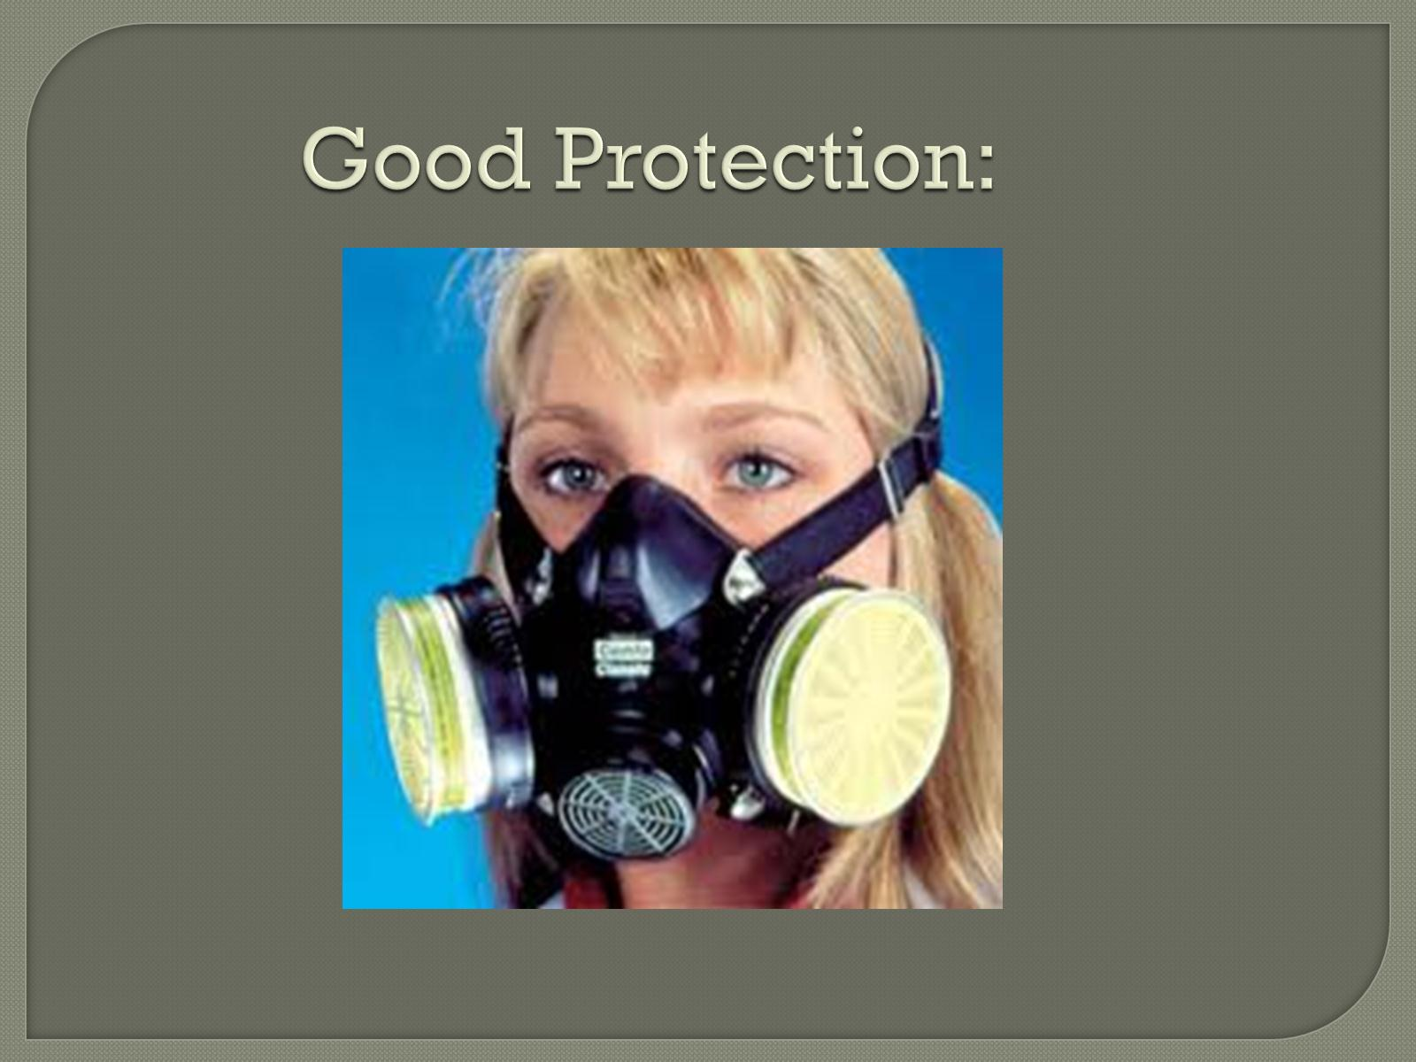
Good Protection:

Slide 36
Bad Protection:

Slide 37
Bad Protection:

Slide 38
What’s wrong with this photo?

Slide 39
3) Scaffolding:

Slide 40
Good Scaffold:

Slide 41
Good Scaffolding:

Slide 42
Bad scaffolding:

Slide 43
Bad Scaffolding:

Slide 44
2)Hazardous Communication:

Slide 45
Good Hazardous Communication:

Slide 46
Good Hazard Communications

Slide 47
Bad Haz Com:

Slide 48
Bad Hazard Communications What is it?

Slide 49
1) Fall Protection

Slide 50
Good Fall Protection:

Slide 51
Bad (No) Fall protection:

Slide 52
Bad (No) Fall Protection:

Slide 55
Consultation Program

Slide 56
Consultation Program

Slide 57
Consultation Benefits:

Slide 58
Safety & Health Management

Slide 59
What Can You Do?

Slide 60
What We Can’t Do!

Slide 61
What’s the Catch?

Slide 62
Questions?

